Slide 1

OPRA Residential Resources
Committee Meeting
February 18, 2026
9:30am – 11am (Residential Waiver)
11:00am – 11:30am (General Updates)
11:30am – 1pm (ICF)
Residential Waiver Chairs ICF Chairs
Susan Berneike Robert Heinzerling
Jamie Steele Kurt Miller

Slide 2
Residential Resources Agenda
Residential Waiver (9:30am – 11:00am)
Trends with assessments / services / changes
Current operational challenges
Provider Search Tool
PDF Resources
DODD Resources / Website
Surveys and Hot Topics
Committee changes for the upcoming year
General Information and Updates (11:00am – 11:30am)
Department updates
Upcoming dates
ICF (11:30am – 1:00pm)
HB 35
Professional Workforce Development Add-on
Year in Review – QCOR / Compliance
Waivers for CPR Requirements
Committee changes for the upcoming year

Slide 3

Trends with assessments / services / changes
Current operational challenges
Provider Search Tool
PDF Resources
DODD Resources / Website
Medication Administration Rules
Surveys and Hot Topics
Committee Changes
Residential
Waiver

Slide 4
General Updates and Information
(11am – 11:30am)
Upcoming Important Dates
DODD Updates
Provider Certification Rule
*** Rule will not open until September 2029; what do we want? ***
“Spotlight” Feature for Future Meetings
Notes:
https://www.usatoday.com/story/news/education/2025/10/13/education-layoffs-special-ed-504-plans-ieps/86671524007/
Nearly the entire Office of Special Education and Rehabilitative Services, including the Office of Special Education Programs, was let go, according to agency employees and their union.

Slide 5
HB 35
Professional Workforce Development Add-on
Year in Review – QCOR / Compliance
Waivers for CPR Requirements
Committee changes for the upcoming year
ICF

Slide 6
SB 35 - Supported Decision Making
Recognizes supported decision-making as a legal option
Designed to promote autonomy
Introduced in Senate Jan. 2025; Cirino and Reynolds sponsors
Senate passed on 10/15/25; Introduced in House 10/21/25
Currently in House committee
Notes:
https://www.usatoday.com/story/news/education/2025/10/13/education-layoffs-special-ed-504-plans-ieps/86671524007/
Nearly the entire Office of Special Education and Rehabilitative Services, including the Office of Special Education Programs, was let go, according to agency employees and their union.

Slide 7
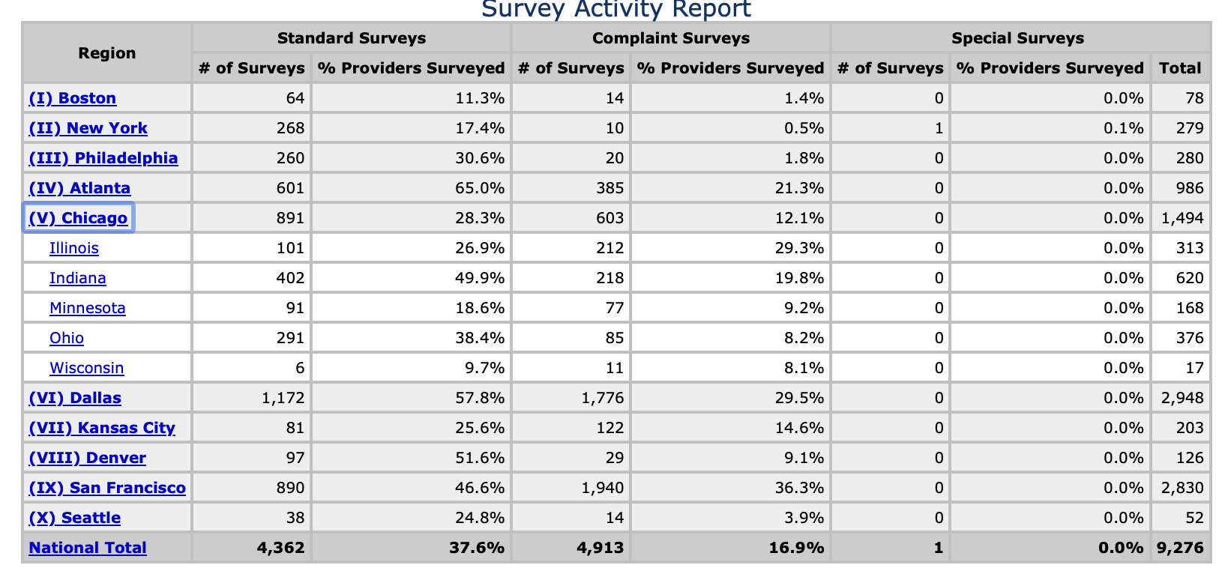
QCOR Data 2025

Slide 8
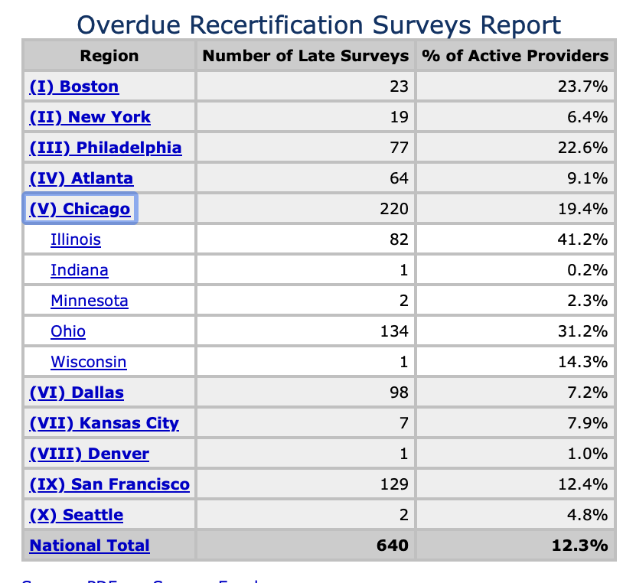
QCOR Data 2025

Slide 9
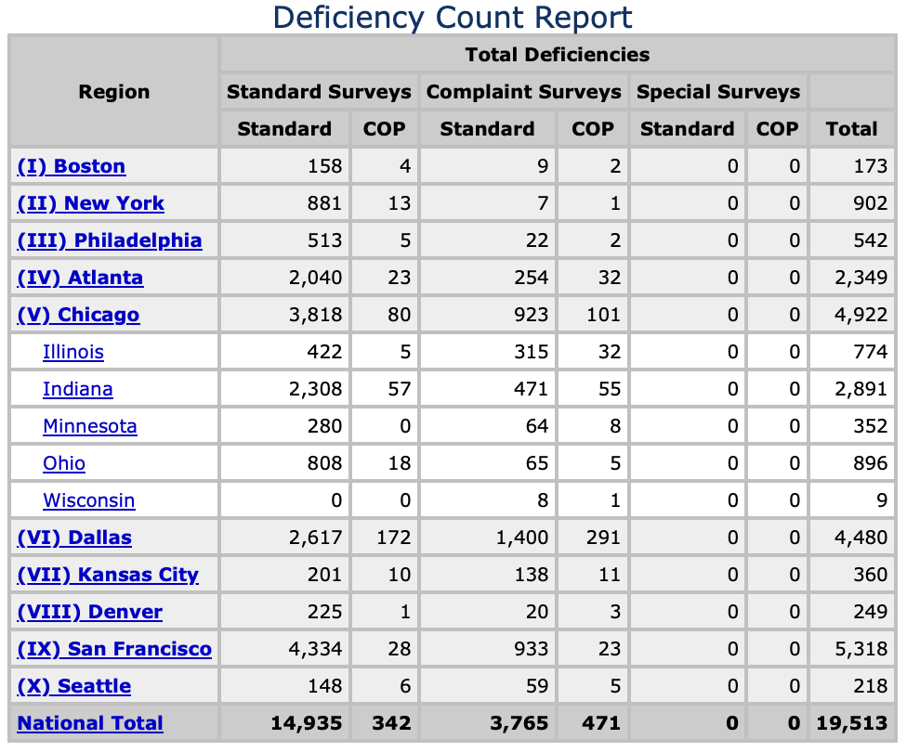
QCOR Data 2025

Slide 10
QIDP Peer Learning
Next session (Session 5) will be on Wednesday, March 18th
Location and topic TBD
Sessions to be held every other month on the 3rd Wednesday of the odd months (Jan, Mar, May, July, Sept, Nov).
Notes:
https://www.usatoday.com/story/news/education/2025/10/13/education-layoffs-special-ed-504-plans-ieps/86671524007/
Nearly the entire Office of Special Education and Rehabilitative Services, including the Office of Special Education Programs, was let go, according to agency employees and their union.

Slide 11
Next Residential Resources Meeting
April 15, 2026
9:30am – 11am (Residential Waiver)
11:00am – 11:30am (General Updates)
11:30am – 1pm (ICF)

