Slide 1

OPRA Residential Resources Committee Meeting October 15, 2025 9:30am – 11am (Residential Waiver) 11:00am – 11:30am (General Updates) 11:30am – 1pm (ICF)
Residential Waiver Chairs ICF Chairs Susan Berneike Robert Heinzerling Jamie Steele Kurt Miller

Slide 2

EVV Discussion and Live Polling
STABLE Accounts Discussion
Settings Reviews
Policy Discussion
Surveys and Hot Topics
Residential
Waiver

Slide 3
EVV Live Polling Discussion
Provider experience
How are you managing EVV?
Administrivia associated with EVV
Identify common “pain points”
Real time feedback
Identification for action
Informs next steps
Shape future trainings
OPRA member shared solutions

Slide 4
Settings Review Tips for Providers
What is a “Settings Review?”
Review to evaluate how HCBS Setting requirement is operationalized.
ODM Requested Information
Correct name; complete address; county location.
Additional Helpful Information
Can last up to 4 hrs; prepare to have staff available.
At least 2 direct care staff will be interviewed on their understanding of the Settings Rule.
Provide current roster of individuals with Medicaid (or mcp) as payor; current care plan of individuals to be interviewed.
Based on HCBS requirements in OAC 5160-44-01.
ODM conducting reviews and will notify providers of upcoming reviews.
Administrator name/contact info.
House Manager (HPC) name and contact info.

Slide 5
What is the Settings Rule?
Toolbox for Compliance Training
OPRA QIDP Learning Series- Sept 2025
Toolbox for Compliance Training
OPRA QIDP Learning Series- Sept 2025
ChatGPT Plain Language Definition: The Settings Rule is about making sure the people we support have choices, independence, and control in their daily lives—just like anyone else. It means people get to choose where they live, who they live with, what they do during their day, and how they spend their time. My job is to support those choices and make sure their home feels like home, not just a workplace.
OR:
It’s the rule that makes sure people have rights, privacy, and choices—so they can live and work as independently as possible.
(Please note that at times ChatGPT utilizes outdated or incorrect information and should be reviewed prior to use).

Slide 6
General Updates and Information (11am – 11:30am)
Ann Weisent, DODD DSP & Provider Supports Manager, Office of Quality & Innovation
Federal Update Government Shutdown Department of Education layoffs
Upcoming Important Dates OPRA Health Care Committee 10/16/25 OPRA Annual Fall Conference 10/22-10/24
Notes:
https://www.usatoday.com/story/news/education/2025/10/13/education-layoffs-special-ed-504-plans-ieps/86671524007/ Nearly the entire Office of Special Education and Rehabilitative Services, including the Office of Special Education Programs, was let go, according to agency employees and their union.

Slide 7
ICF Reimbursement Group Update (Day Services)
Policy Discussion
QIDP Peer Learning Session 2
QCOR Data Review (Jan – October 2025)
Tools for Compliance
Surveys and Hot Topics
ICF

Slide 8
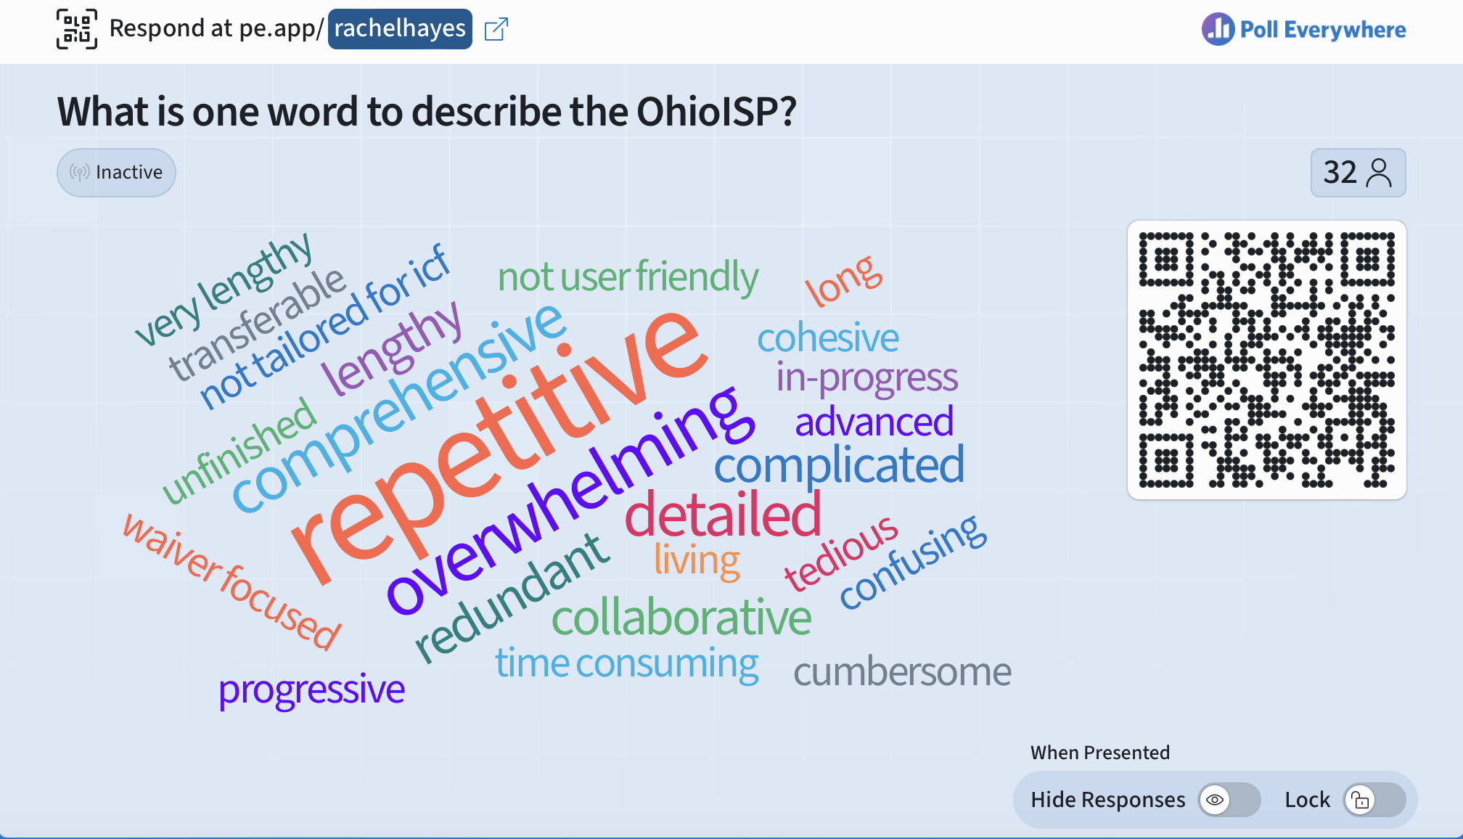

Slide 9
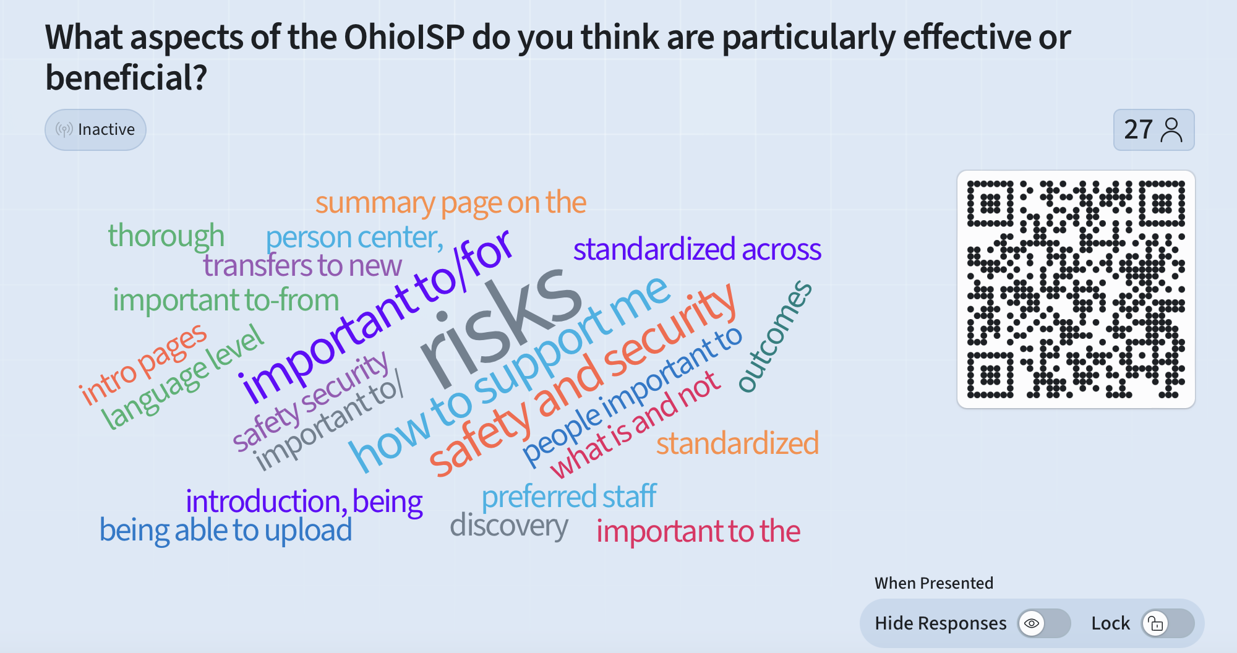

Slide 10
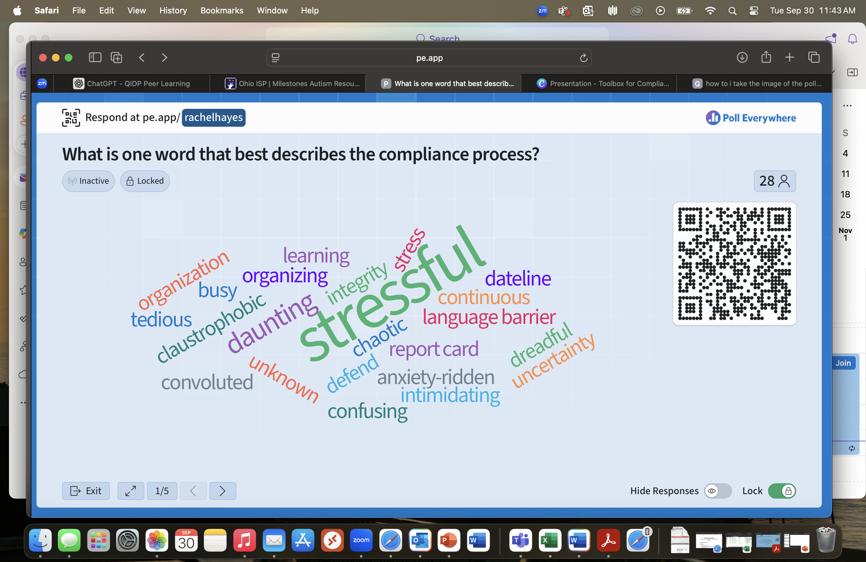

Slide 11
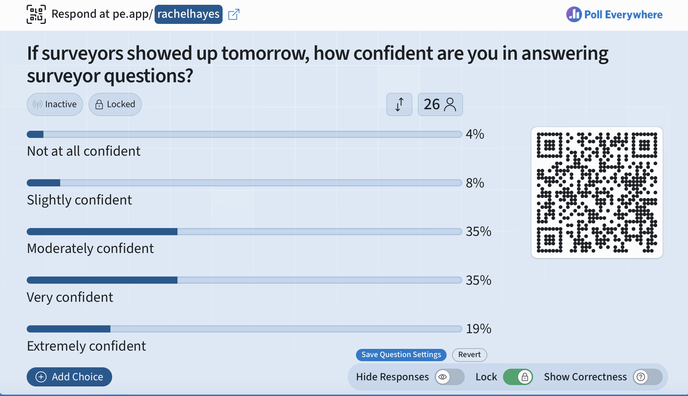
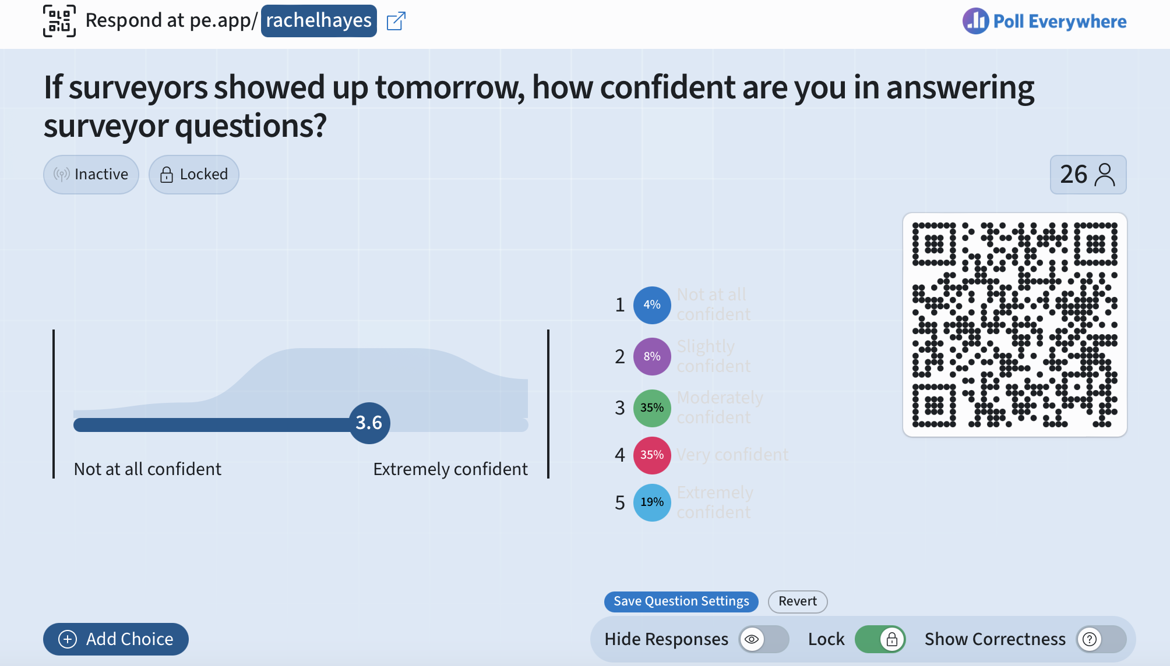

Slide 12
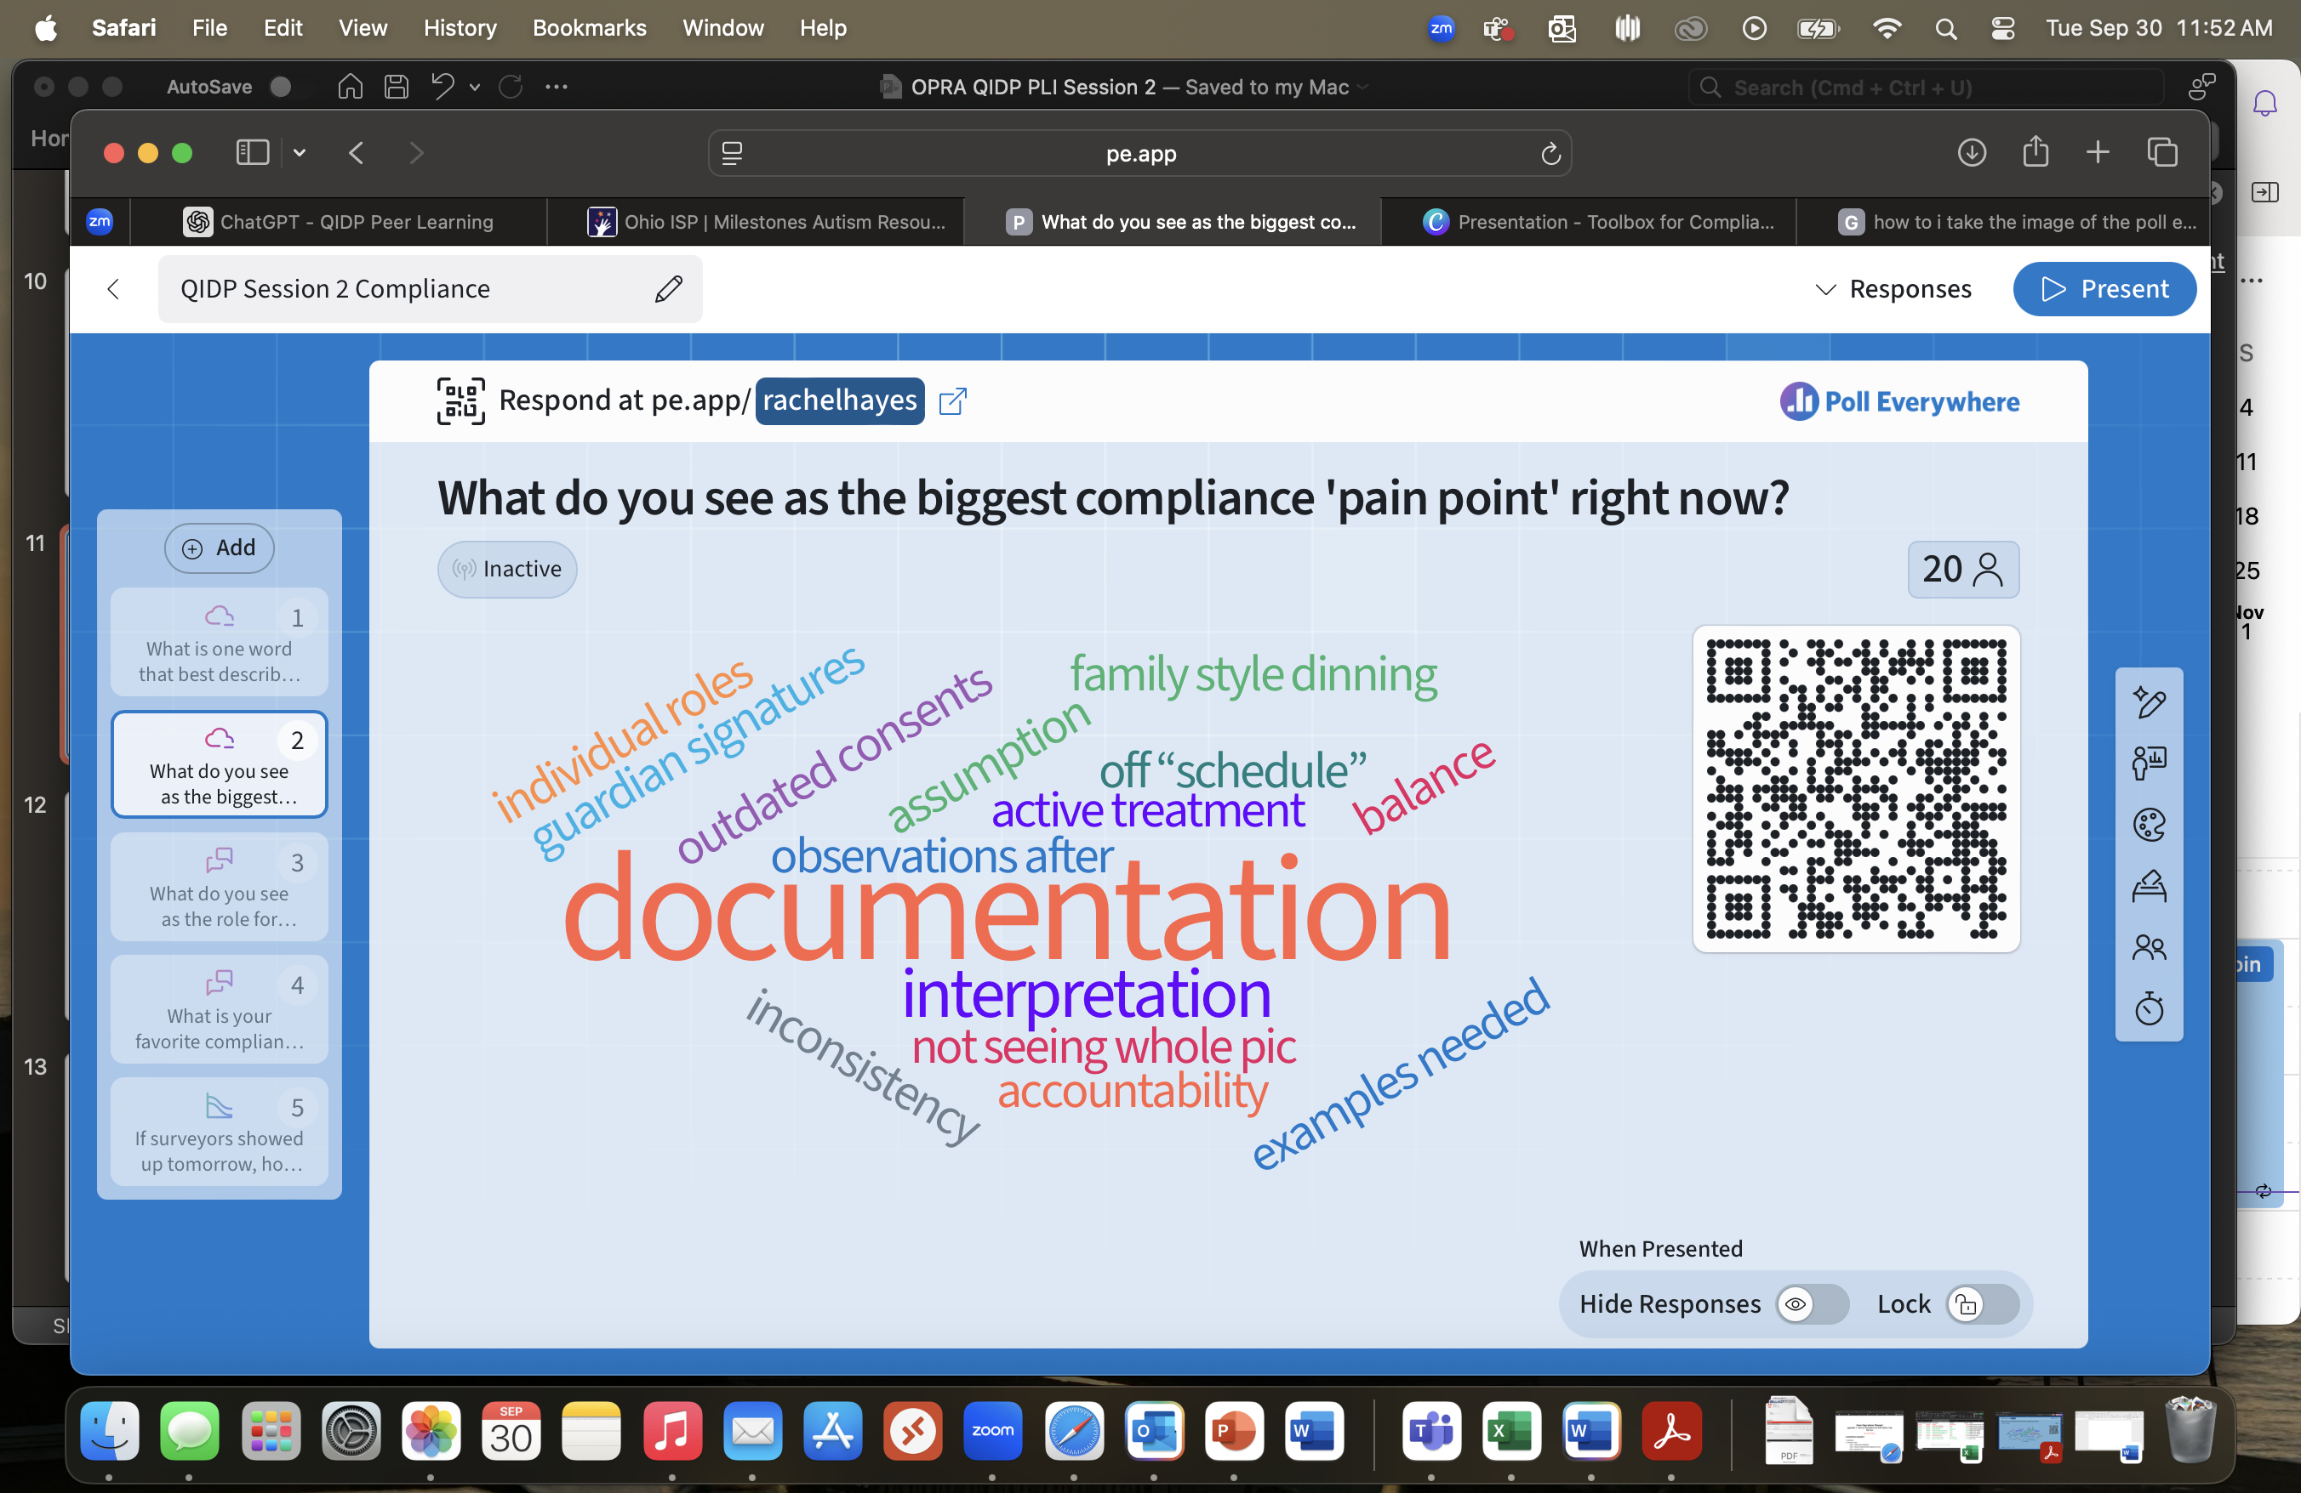

Slide 13
What is your favorite compliance "quick win"?
MUI / UI
Processes
Prevention Plans
General Compliance
Ind. Plan Binders / Floor Books
Specific Compliance Areas
HR
Procedures
Active Treatment
Detailed Schedules
Meal Observations
Med Admin
Cleanliness
Census
Employee Files
Environmental
Client Satisfaction Surveys
HRC

Slide 14
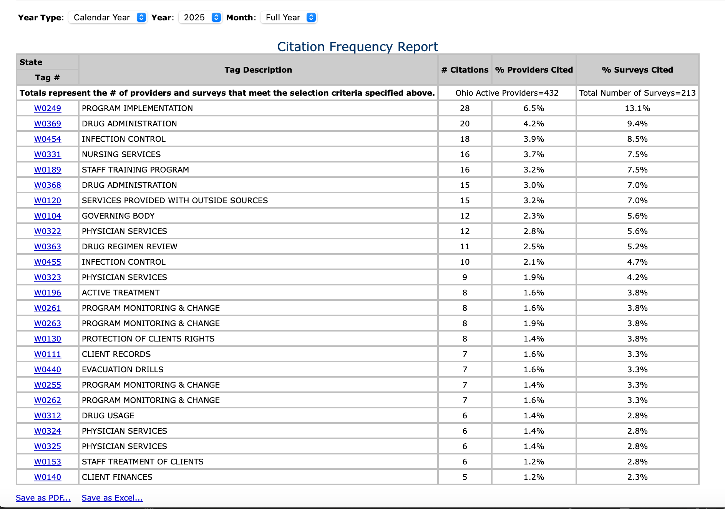
Health Top 25 Citations Jan 2025 - present

Slide 15
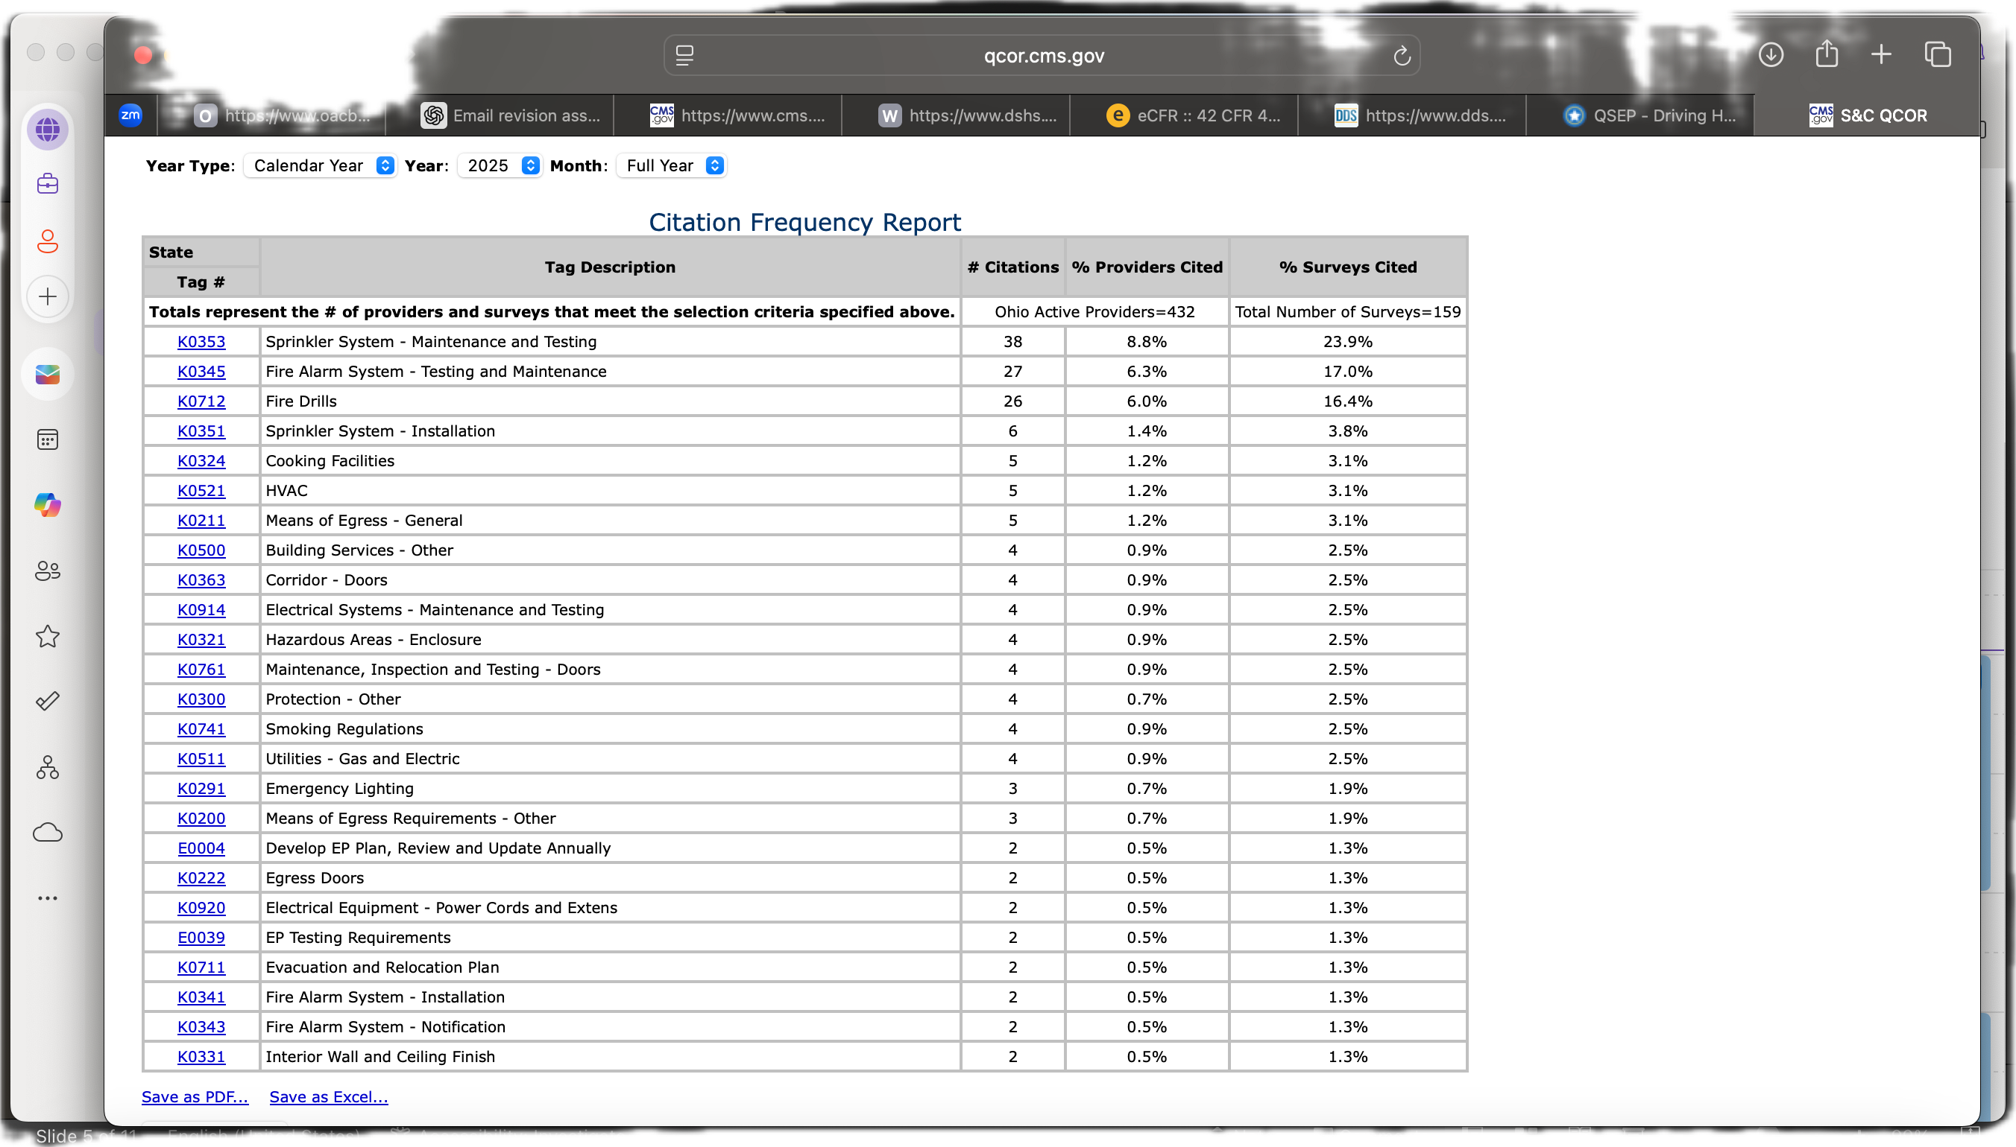
Life Safety Top 25 Citations Jan 2025 - present

Slide 16
Next Residential Resources Meeting December 17, 2025 9:30am – 11am (Residential Waiver) 11:00am – 11:30am (General Updates) 11:30am – 1pm (ICF)

