Slide 1

Residential Resources Committee June 18, 2025
Residential Waiver Chairs Susan Berneike Jamie Steele OPRA Staff Liaison Rachel Hayes ICF Chairs Robert Heinzerling Kurt Miller

Slide 2
OPRA Residential Resources Residential Waiver Agenda (9:30am – 11am)
Budget Overview with Christine
MAIS Update, Discussion, Follow-up
Breakout Rooms
Compliance Tool
Surveys and Hot Topics

Slide 3
OPRA Residential Resources General Information (11:00-11:30)
Lisa Burt, DODD Office of Compliance
MUI Rule Implementation

Slide 4
OPRA Residential Resources Residential Waiver
Medication Administration and MAIS
Medication Administration Training 1/16/25
Training Powerpoint
Webinar Q and A
Reference Grid
MAIS Secretary Profile

Slide 5
OPRA Residential Resources Residential Waiver
Addressing MAIS Concerns
April 22 – Letter to Director Hauck expressing concerns
May 13 – Response from Director
May 28 – Response from OPRA with compromise

Slide 6
OPRA Residential Resources Residential Waiver
Breakout Room Questions
The CMS Access Rule includes significant new requirements for states to ensure Quality in HCBS. From your perspective, how would you, as a provider, define “quality” in the context of HCBS? What does it look like? If you walked into a provider home, how would you know it provides quality services?
How would you define “quality” for the County Board and DODD? What does quality look like in these spaces?

Slide 7
OPRA Residential Resources Residential Waiver
2025 Rules for Review 5123-1-04 Community Capital Assistance Funds 10/1/25 Development of Licensed Residential Facilities
5123-3-10 Liscensed Residential Facilities 11/19/25 Procedures to Waiver Rule Requirements
5123-9-01 HCBS Waiver 11/19/25 Enrollment, Denial of Enrollment, Disenrollment/Reenrollment
5123-9-11 HCBS Waiver 11/19/25 Free Choice of Provider

Slide 8
OPRA Residential Resources Residential Waiver
2025 Rules for Review
5123-9-11 HCBS Waiver 11/19/25
5123-9-14 HCBS Waivers 11/19/25 Vocational Habilitation
5123-9-17 HCBS Waiver 11/19/25 Adult Day Support
5123-9-33 HCBS Waiver 11/19/25 Shared Living
5123-9-39 HCBS Waiver 11/19/25 Nursing Services under IO

Slide 9
OPRA Residential Resources Residential Waiver
GREAT PROVIDER
PLAYBOOK
Coming Soon

Slide 10
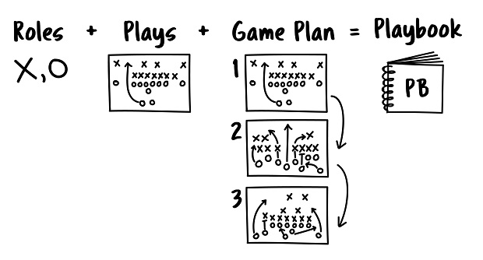
OPRA Residential Resources Residential Waiver
GREAT PROVIDER PLAYBOOK
Practical guides, toolkits, and resources designed for Ohio’s providers to assist in delivering high-quality, person-centered services within Ohio’s DD system.

Slide 11
OPRA Residential Resources Residential Waiver
GPP MUI Rule Example
Roles DSPs Staff County Boards DODD ODH
Play Incident Reporting Prevention Investigation
Game Plan Health/Safety MUI Rule Tools, Kits
Great Provider Playbook

Slide 12
OPRA Residential Resources Residential Waiver
MUI Rule Updates and Trainings Exploring Key Changes to MUI Rule 5123-17-02
MUI Questions and Answers
DODD MyLearning Training

Slide 13
OPRA Residential Resources Residential Waiver
Compliance Resources
Agency Provider Complaince Review Tool
Agency Provider Required Documents List

Slide 14
OPRA Residential Resources Residential Waiver
Next Residential Resources Meeting:
August 20, 2025
9:30am – 11am (Residential Waiver)
11:00am – 11:30am (General Updates)
11:30am – 1pm (ICF)

