Slide 1

Residential Resources Committee
February 19, 2025
Residential Waiver Chairs
Susan Berneike
Jamie Steele
OPRA Staff Liaison
Rachel Hayes
ICF Chairs
Robert Heinzerling
Kurt Miller

Slide 2
OPRA Residential Resources
Residential Waiver Agenda (9:30am – 11am)
Budget Overview
Waiver Modernization Feedback
Assessments and Rates
Priorities Moving Forward
MRC
Fix it or work towards another model?
Waiver Nursing Rule
Remote Supports Update
Peer Learning and Compliance
Surveys and Hot Topics

Slide 3
OPRA Residential Resources
Residential Waiver
DODD Waiver Modernization

Slide 4
OPRA Residential Resources
Residential Waiver
Assessment Simplification
Goal: Streamline Assessments for Acuity-Based Rates
Replace AAI & DDP (and eventually LOC) with a single, unified assessment that leads to acuity-based rates
Progress So Far:
Contracted with Deloitte
Conducted focus groups on assessment tools…looked like it was SIS
Current Work (FY25):
Implementing technology enhancements
Automating transfer of AAI, DDP, LOC data into OISP using “bot”
Next Steps:
Waiver Modernization Workgroup (2/24)
Reevaluate assessment tool
Explore alternative pathways
Define next steps
2 CY to full implementation

Slide 5
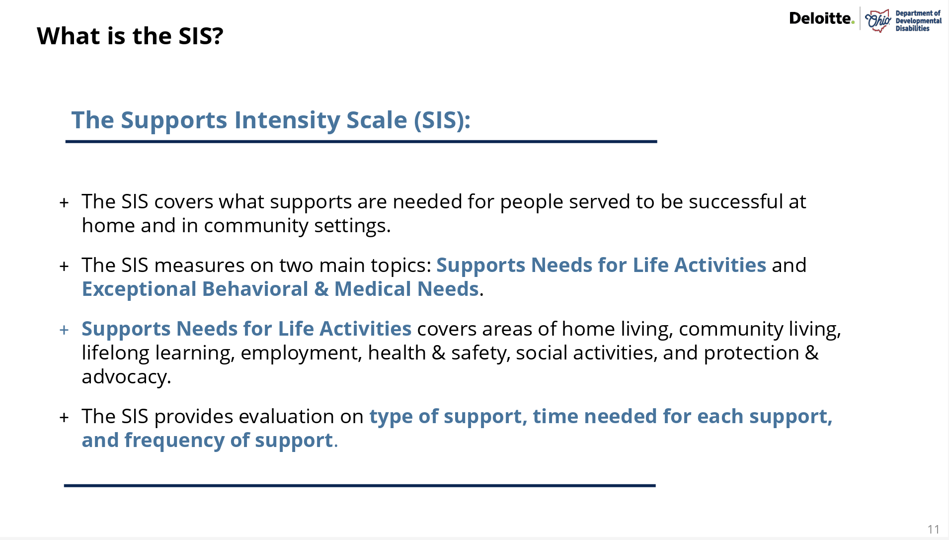

Slide 6
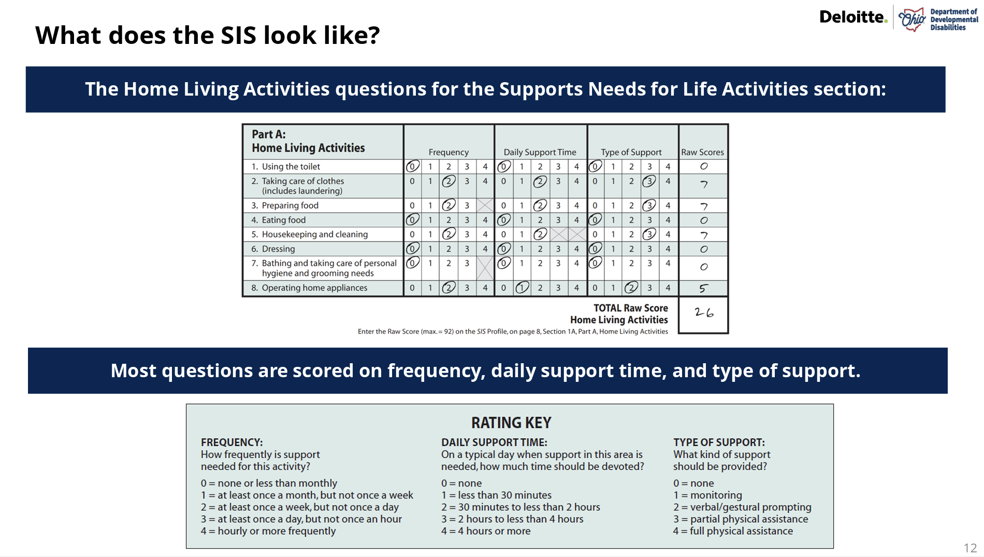

Slide 7
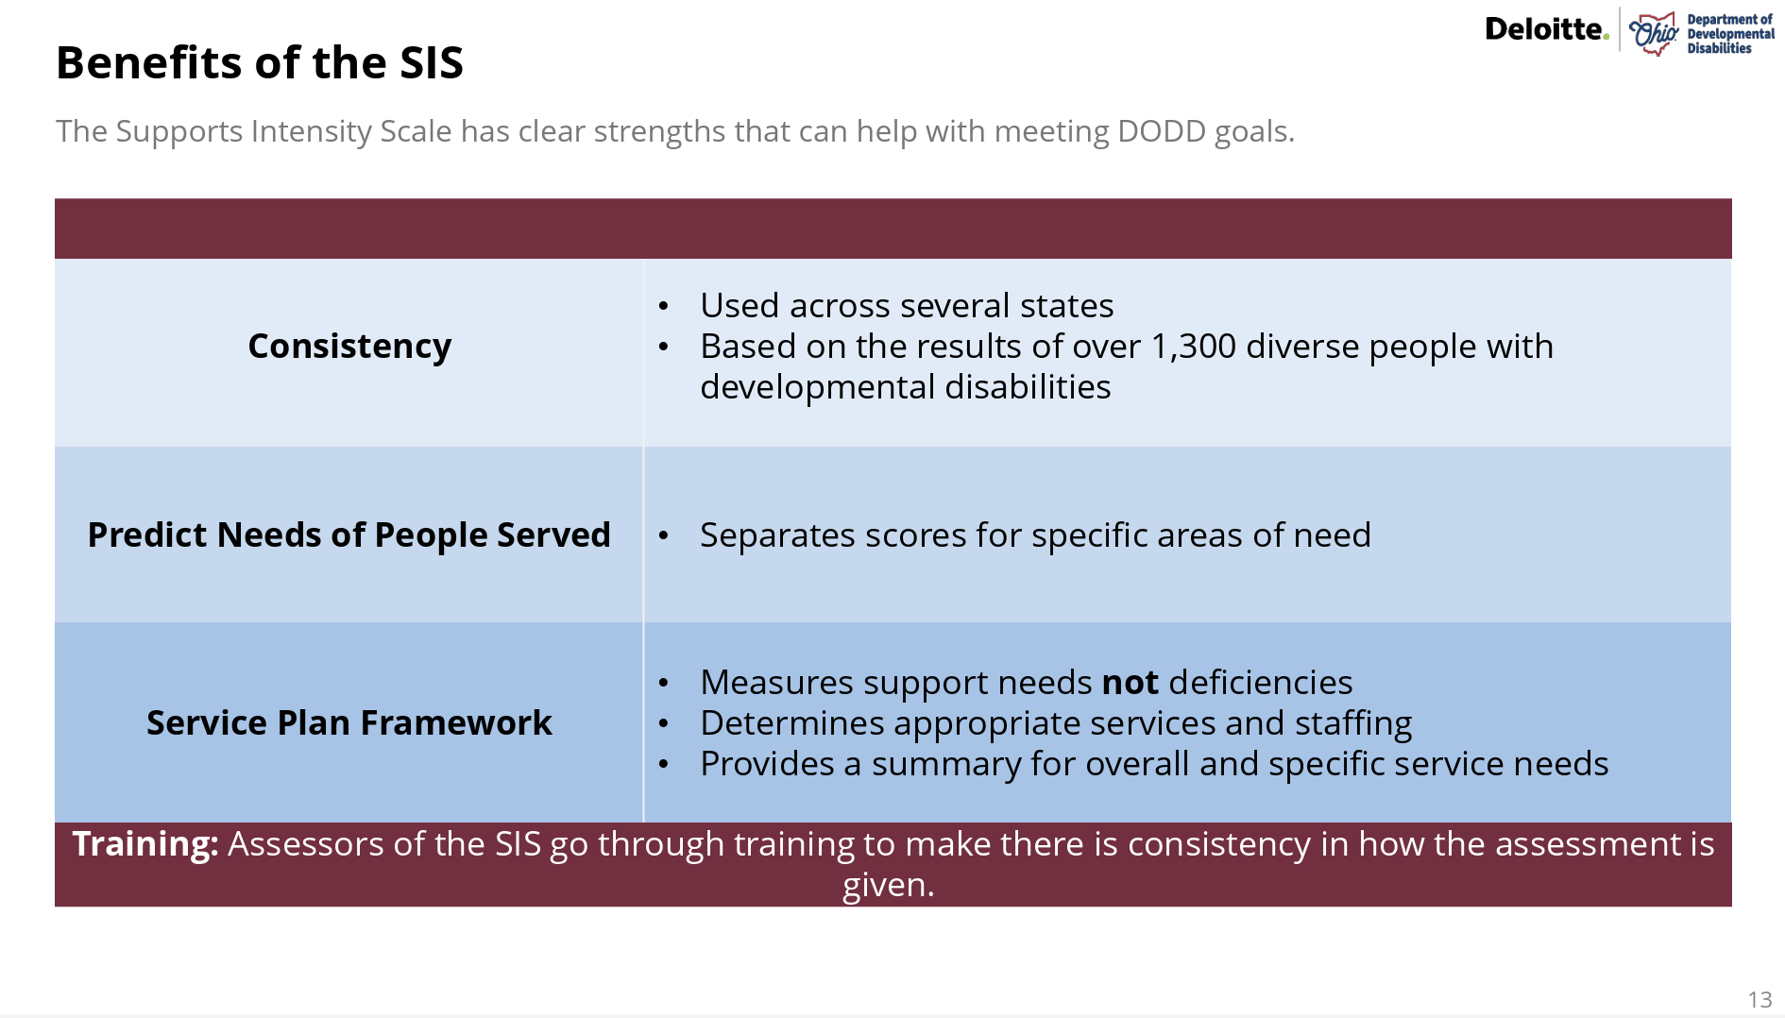

Slide 8
OPRA Residential Resources
Residential Waiver
Challenges with SIS Across States
Training & Administration Issues
  Requires highly vetted and trained assessors (IL)
  Extensive training required, but retention is low (NH)
  Scheduling and assessor shortages create a burden (NH)
  AAIDD controls training and access, limiting flexibility (NM)
Deficit-Based Approach & Scoring Issues
  Families and individuals answer using a strengths-based approach, leading to lower scores (PA)
  Doesn’t adequately capture behavioral or medical needs (RI, PA)
  Often manipulated, leading to dramatic shifts in tier levels (RI)

Slide 9
OPRA Residential Resources
Residential Waiver
Challenges with SIS Across States
Burden on Individuals & Families
  Lengthy process (3-4 hours), difficult for people served to endure (HI)
  Can lead to disagreements about support needs, affecting services received (ME)
  “Horrifically painful” for individuals, leading to withdrawal of proposals (ME)
Lack of Transparency & Data Ownership Issues
  Guardians requested assessment copies but were denied; AAIDD cited trade secrets (ME)
  Limited access to results creates accountability concerns (ME)
Implementation & Systemic Barriers
  Unbundling services to fit SIS into resource allocation models can violate federal maintenance of effort (MOE) requirements (ID)
  States moving away from SIS due to inefficiencies (CO, NM)
  Use of SIS delayed needed waiver changes for two years (IL)
  Poor interrater reliability and assessment bias (HI)

Slide 10
OPRA Residential Resources
Residential Waiver
Billing Simplification
MRC Replacement
DODD is asking providers to choose highest priority:
  Predictability – billing based on schedule
  Consistency – billing exactly what you deliver
  Simplicity – daily/other unit
Do we have an alternative that would address all three?

Slide 11
OPRA Residential Resources
Residential Waiver
Amended Rules (Comment due by 2/28)
5123-9-12 (Assistive Technology)
Adds new component of AT that covers Service Animals.
5123-9-25 (Specialized Medical Equipment)
Clarity around rules (does not provide for vehicle modifications).
5123-9-45 (Participant Directed Goods and Services)
Clarity around rules (does not provide for vehicle modifications).

Slide 12
OPRA Residential Resources
Residential Waiver
New Rules (Comment due by 2/28)
5123-9-08 (Extended Travel)
Establishes a procedure for individuals who receive HCBS and are engaged in extended travel.
5123-9-39 (Waiver Nursing)
Defines Waiver Nursing Services and sets forth provider qualifications, requirements for service delivery and documentation of services, and payment standards for the service. Rescinds and replaces existing rule.
5123-9-44 (Vehicle Modifications)
Defines Vehicle Modifications and sets forth provider qualifications, requirements for service delivery and documentation of services, and payment standards for the service.

Slide 13
OPRA Residential Resources
Residential Waiver
5123-9-39 (Waiver Nursing)
Renames the service from "Waiver Nursing Services" to "Waiver Nursing."
Replaces, updates, and adds definitions.
Revises definition of “plan of care” to align with CMS.
Revise definition of "service documentation" for ease of reader.
Reorders provisions of service.
Updates provider qualifications. Clarifies that Independent Provider may not provide the service to his or her spouse or minor child to align ODM.
Updates the service authorization process.
Requires a provider of the service to utilize EVV.
Specifies that same-day visits must be separated by a lapse of at least two hours.
Addresses billing modification codes in the rule and adds the codes to the appendix.

Slide 14
OPRA Residential Resources
Residential Waiver
2025 Rules for Review
5123-4-02 Service and Support Administration 5/17/25
5123-17-03 Abuser Registry 6/18/25
5123-1-04 Community Capital Assistance Funds 10/1/25
Development of Licensed Residential Facilities
5123-3-10 Liscensed Residential Facilities 11/19/25
Procedures to Waiver Rule Requirements
5123-9-01 HCBS Waiver 11/19/25
Enrollment, Denial of Enrollment,
Disenrollment/Reenrollment
5123-9-11 HCBS Waiver 11/19/25
Free Choice of Provider

Slide 15
OPRA Residential Resources
Residential Waiver
2025 Rules for Review
5123-9-14 HCBS Waivers 11/19/25
Vocational Habilitation
5123-9-17 HCBS Waiver 11/19/25
Adult Day Support
5123-9-33 HCBS Waiver 11/19/25
Shared Living
5123-9-39 HCBS Waiver 11/19/25
Nursing Services under IO

Slide 16
OPRA Residential Resources
Residential Waiver
G. R. I. T.
Great Providers
Respect
Innovation
Teamwork

Slide 17
OPRA Residential Resources
Residential Waiver
Foundations and Fundamentals
Learn and develop an understanding of the foundations and fundamental elements of our system through peer-learning and case study review.
Perfect the fundamentals.
Remove the doubt.
Make good arguments.
Build trust (those served, organization, staff, partners, oversight agencies).
Become the experts.

Slide 18
Experts
OPRA Members
G. R. I. T.
Peer Learning

Slide 19
OPRA Residential Resources
General Updates and Information (11am – 11:30am)
Ann Weisent, DODD Updates
MUI Rule Update
Training and Conference Updates

Slide 20
OPRA Residential Resources
Residential Waiver
Surveys and Hot Topics
Next Residential Resources Committee Meeting
April 16, 2025

