Slide 1
Residential Waiver
Committee
Wednesday, February 21, 2024

Slide 2
AGENDA
DODD Updates
  Ann Weisent, DODD
Office of Compliance
  Angel Morgan, DODD
DNR Discussion
Follow-up Discussion HB 236 (Never Alone Act)
5. Waiver Redesign Update
6. Budget Updates
7. Hot Topics
  Solar Eclipse
  COVID

Slide 3


Slide 4
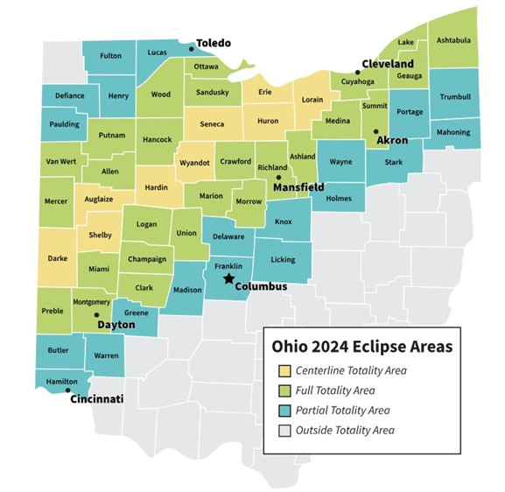

Slide 5
SOLAR ECLIPSE
April 8, 2024
State of Ohio Official Site for Solar Eclipse
Ohio Department of Health
Suppliers of Safe Solar Viewers and Filters
NASA
Websites include list of resources, timelines, maps, tips for preparation.
Tune into local news regarding school/business closings.
Review your Emergency Preparedness Policies.

