Slide 1
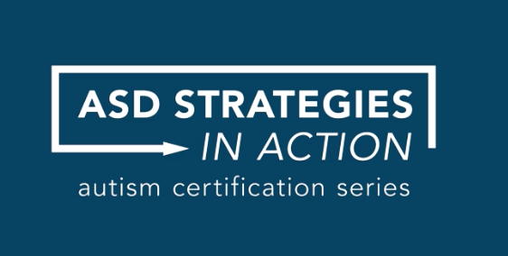

Slide 2
OCALI (Ohio Center for Autism and Low Incidence)
Build capacity by increasing practitioners’ knowledge and applied skills while strengthening and focusing policies, structures, and resources that service individuals, families, and professionals
Notes:
Created by legislation to serve as a central source for parents and professionals to improve supports and services for individuals with autism and low incidence disabilities.
We work to build capacity by increasing practitioners’ knowledge and applied skills while strengthening and focusing policies, structures, and resources that serve individuals, families, and professionals.

Slide 3
What is ASD Strategies in Action?
Online, video-based instruction
Practical, strategy-based information
Demonstrated with real-life examples, filmed in a variety of settings
For anyone involved in the life of an individual with ASD, especially families and direct service providers
Free to Ohioans; out-of-state gets one free course and pays subscription fee for others
Notes:
Today we’re excited to present an innovative new video-based training program called ASD Strategies in Action which has just launched to the public. It’s the result of a collaborative effort across multiple state agencies and the Ohio Center for Autism and Low Incidence. Through a series of multiagency discussions the decision was made to

Slide 4
History of the Autism Certification Center
Primary Goal: To build state-wide capacity to serve individuals with autism spectrum disorder from birth through adulthood
Current Situation: The demand for qualified professionals in autism exceeds the supply
Notes:
Where did it come from? Through a series of multiagency conversations, we identified that the current situation must change. How can we get quality professional development into the hands of those who need it most – frontline workers?

Slide 5
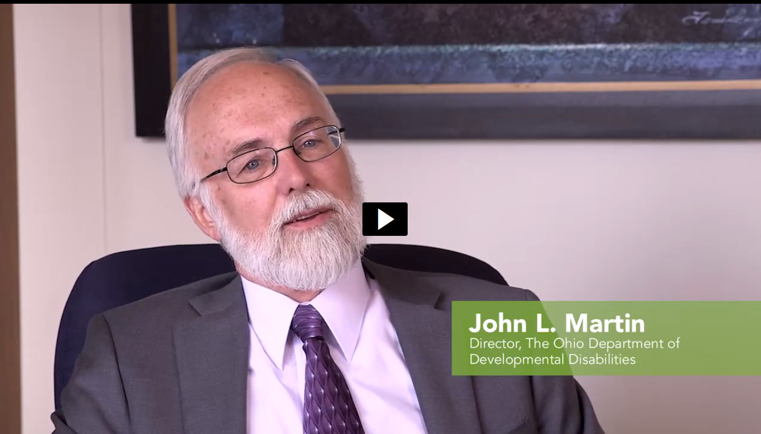

Slide 6
What is ASD Strategies in Action?
30+ hours of video-based instruction
Introductory Course: 1 module – 1 ½ hours
Many Faces of Autism
Characteristics & Simple Strategies
= pre-requisite and stand-alone
3 Strategy-based Courses: 8-9 modules – 10 ½ hrs each
- Toddler/Preschool Age
- School Age
- Transition Age

Slide 7
World Renowned Expert Panelists
Notes:
The program was developed in consultation with a blue-ribbon panel of experts in autism from across the globe – experts who helped ensure the focus on research-based practices from various well-established methodologies.
And it takes these practices and breaks them down into a way that anyone can use them. As one of our community partners described it, these videos are imperfectly real. You’ll see good strategies being used by real people in real homes, real schools, real work places in real time.

Slide 8
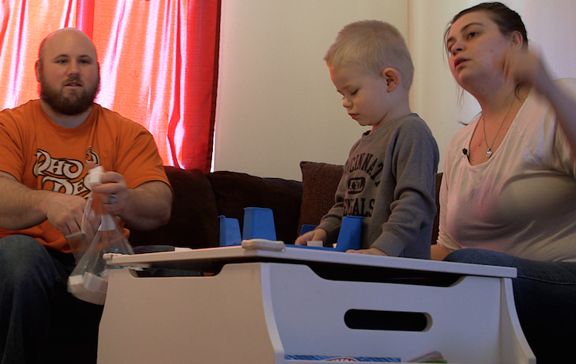
Video Footage from 50+ Partners
Notes:
There can be no video-based modules without good video, right? We worked across our vast network to carefully select filming partners from home, school and work environments. Our filming partners were thoroughly vetted, cultivated, and sometimes coached to ensure that they were modeling the best practices for others to learn from.
We worked closely with our video production partner – Brainstorm Media – to make the most of the video we have with careful editing and the addition of graphics.

Slide 9
What are the Topics?
Essential Elements
Priming
Modifying Tasks
Emotional Regulation
Data Collection
Social Narratives
Reinforcement
Token Economies
Prompting
Joint Attention Strategies
Shared Control Strategies
Notes:
All course have similar modules which are focused on evidence-based strategies. They start off with a module focused on the essential elements of a direct service providers role – presuming competence, developing appropriate relationships, building independence, and demonstrating professionalism. Joint attention and shared control are specific to Toddler and Preschool Age course.

Slide 10
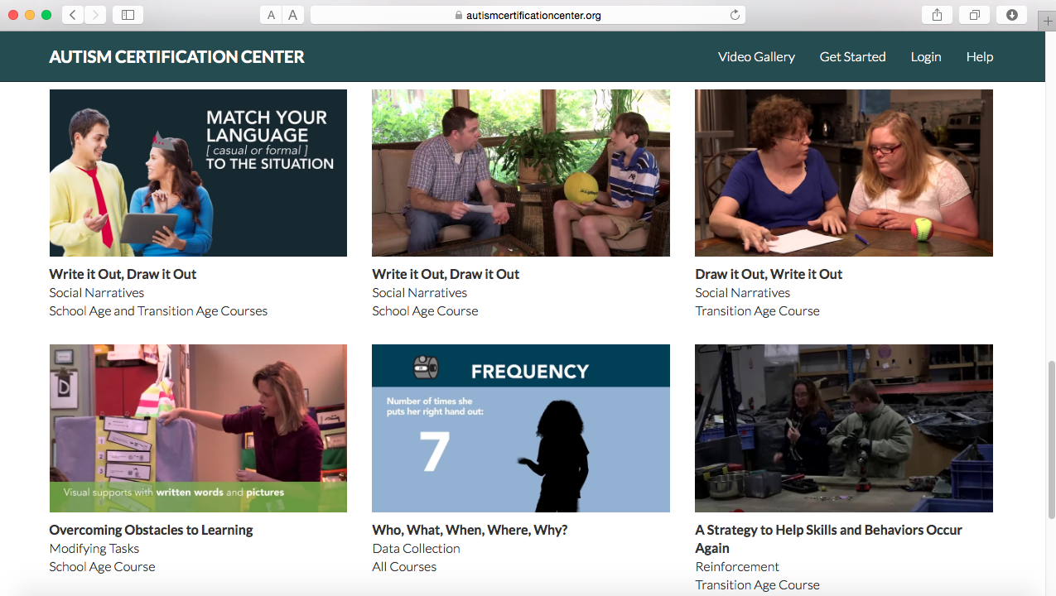
Sample Video Clips
Notes:
Show videos in following order:
Joint attention – every module starts off this way
Emotional regulation – point out interviews with children, young adults and older adults with Asd
Other – choose one or more focused on strategy

Slide 11
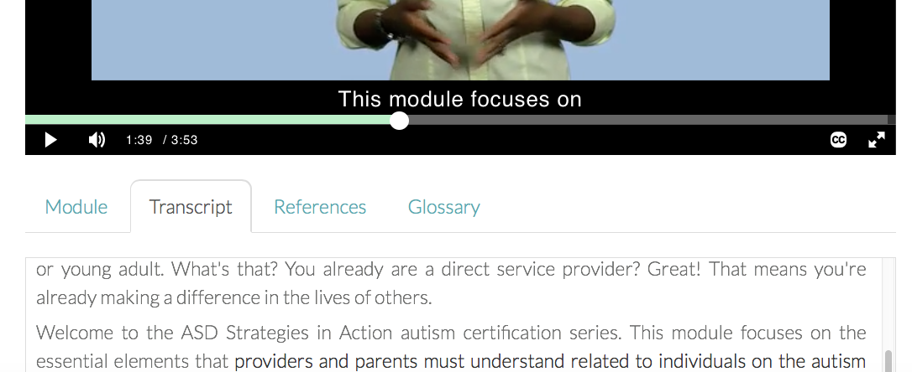
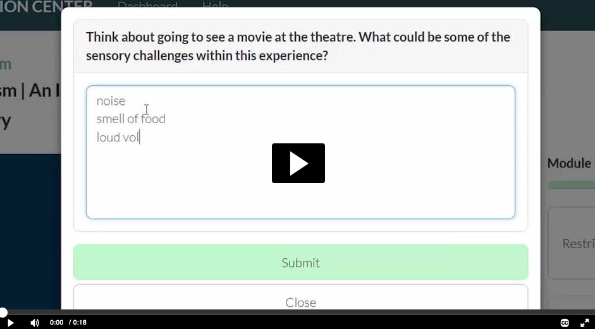
Supports for Online Learners
Notes:
Highlight features like: interactive transcript, closed captioning, reflection and comprehension questions, glossary, and chapter notes.

Slide 12
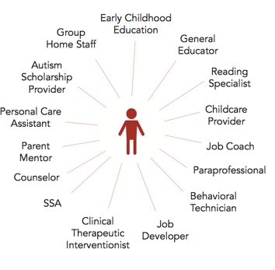
Everyone Benefits
Notes:
As you’ve seen from the sample of clips, these strategies can be learned and implemented by anyone from a person’s support team – parents, teachers, job coaches, in-home aides. And we know that when families and service providers are working from the same understanding about effective practices, the positive impact on an individual is that much greater.
So providers, share this video training program with colleagues at work and with the families you work with.
For families, share it with other family members, with your son or daughter’s providers, and with neighbors and others in your community.
Anyone who interacts with individuals with autism – either now or in the future can benefit from this training program And since we ALL are likely to encounter someone with autism, we all can benefit.

Slide 13
Notes:
There’s an added benefit for professionals who complete the training program. When you finish a course, you will receive a certificate that validates successful completion, which includes reflection questions and module assessments throughout the courses. Also in the process of getting approvals for various CEUs.
Also keep in mind that these strategies work beyond your work with individuals on the autism spectrum. So you will find them valuable across the range of people that you work with.

Slide 14
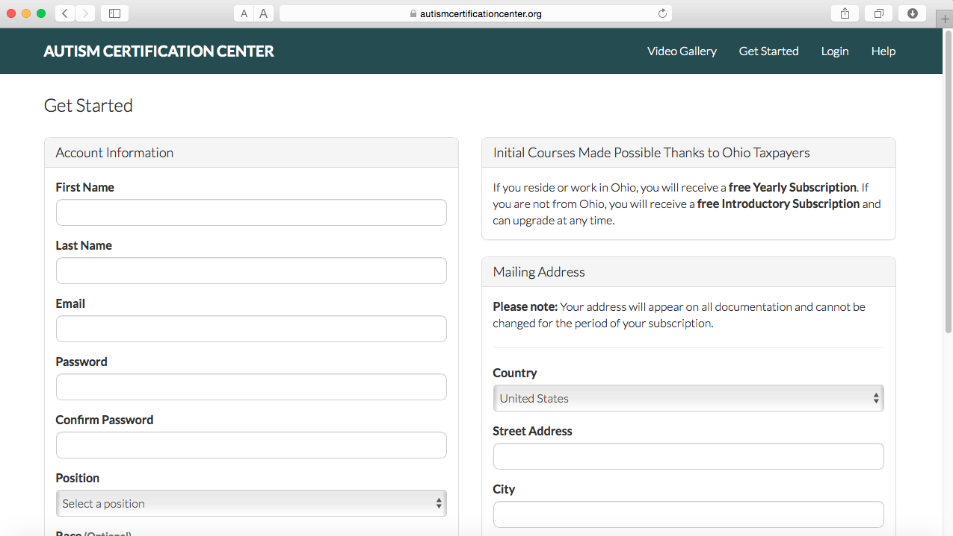
Getting Started
Notes:
Here’s how to access ASD Strategies in Action – go online now at autismcertificationcenter.org and Get Started.
The courses are free to those who live or work within Ohio. For those outside of Ohio, you can access a free Introductory subscription to the Many Faces of Autism course. You can upgrade your subscription at any time. The cost is modest and group-based pricing is available for organizations. Check out the website for more details.

Slide 15
Reaching our Audiences
How might you use ASD Strategies in Action to support the use of evidence-based practices in your organization?

Slide 16
Questions? autismcertificationcenter.org

