Slide 1
Ohio Provider Resource Association
Electronic Visit Verification (EVV)
Julie Evers, Bureau of Long Term Services and Supports
March 20, 2018

Slide 2
What is EVV?
    Electronic Visit Verification (EVV) is a tool for electronically capturing point-of- service information for certain home and community-based services.
        Sandata Technologies is the ODM vendor
        Near real-time processing capability
        GPS-based system with telephony and manual visit entry as alternative data collection methods

Slide 3
Why do we need it?
    Congress established requirements for all states to use an EVV system, in accordance with the 21st Century Cures Act.
      Personal Care Services must use EVV by January 1, 2019
      Home Health Care Services must use EVV by January 1, 2023
      Failure to meet these deadlines results in reduction of Federal Financial Participation for those services

Slide 4
21st Century Cures Act Requirements
“Electronic Visit Verification System” means, with respect to personal care services or home health care services, a system under which visits conducted as part of such services are electronically verified with respect to:
  The type of service performed;
  The individual receiving the service;
  The date of the service;
  The location of service delivery;
  The individual providing the service; and
  The time the service begins and ends.

Slide 5
What are the benefits?
    ODM is adopting an EVV system to promote two key outcomes:
        Promote quality outcomes for individuals (Quality of Care)
          Greater opportunity for enhanced care coordination and data sharing
        Reduce billing errors and improve payment accuracy (Program Integrity)
          Electronically verifies that a caregiver is physically present for a visit

Slide 6
What Services are included in Phase 1?
State Plan Home Health Aide
State Plan Home Health Nursing
State Plan RN Assessment
Private Duty Nursing (PDN)
Ohio Home Care Waiver Nursing
Ohio Home Care Waiver Personal Care Aide
Ohio Home Care Waiver Home Care Attendant

Slide 7
EVV Stakeholders - Collaboration
Individuals
Provider Community
Trading Partners and Billers
Partner Agencies

Slide 8
Getting the Message Out
Sharing the message early to enable a smooth Go Live.
Individuals (Recipients)
  Stakeholder Meetings
  Written Correspondence
  Consumer groups
  Introductory video
Providers
  Stakeholder meetings
  Correspondence
  Access to specifications prior to launch
  Interactive Voice Response (IVR)

Slide 9
How Does EVV Work?

Slide 10
Two System Choices For Agencies -
Same Functionality
Agency Providers have two system choices:
  Use ODM’s system, currently operated by Sandata, free of charge
  Implement their own “Alternate EVV System” that meets ODM’s specifications

Slide 11
How will visit information be collected?
Confidential visit information is collected through the use of a GPS enabled Mobile Device, used to sign in and sign out.
Alternate data collection systems must implement GPS before January 1, 2019
Every EVV System must have two backup methods for collecting data.

Slide 12
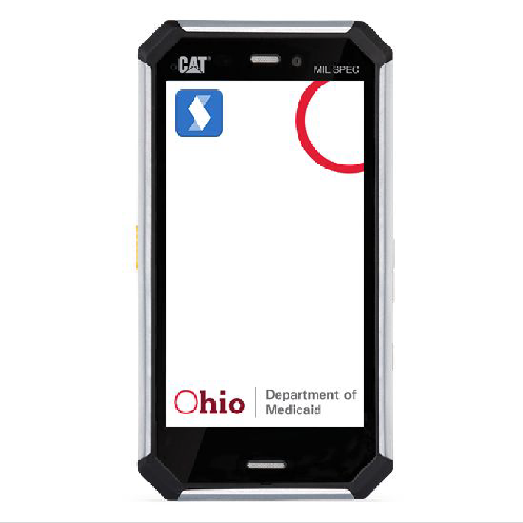
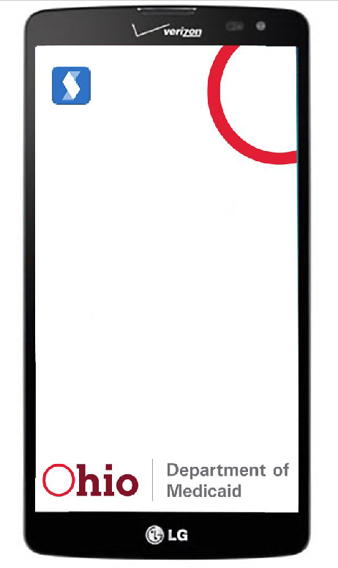
EVV mobile device
EVV devices have been purchased and configured for use with the Sandata system.
Device Specs:
Caterpillar and LG Devices
Android Operating System
Large Screens

Slide 13
Why a Mobile Device?
The mobile device allows capture of visit data wherever services are provided.
Provides flexibility to consumer that a landline or fixed device in the home does not offer
Only needs to go with the individual when the visit will start or end away from home

Slide 14
GPS
Captured only at the start of the visit and the end of the visit
Matches to any address connected to the individual by the provider in the Sandata system
1000 foot geo fence

Slide 15
Cameras and Microphone
Cameras are used for device configuration and disabled before the device is sent to an individual.
Microphone is only active when the record button has been pushed to capture the verification of service delivery

Slide 16
OAC 5160-1-40 (Electronic Visit Verification)
Identifies services subject to EVV
Identifies exceptions to EVV Requirements
  Group Visits
  Anticipated duration of service is 90 days or less (Until July 2018)
  Managed Care
The Department will provide an EVV system to providers
Only claims that match a verified visit will be reimbursed by Medicaid (Beginning July 1, 2018)

Slide 17
OAC 5160-1-40 (Electronic Visit Verification) cont.
Data Collection Requirements
  Individual receiving service
  Direct Care Worker providing service
  Location and Time at start of visit
  Service Provided
  Location and Time at end of visit
  Verification of visit time and service by Individual

Slide 18
OAC 5160-1-40 (Electronic Visit Verification) cont.
Provider requirements
  Current providers must complete required training
  New providers will complete training during provider application process
  Maintain required information with respect to individuals and direct care workers
  Device Requests
  Notification of End of Service
  Failure to meet EVV requirements may lead to termination of provider agreement.

Slide 19
Other Rule Changes Related to EVV
5160-12-04 Home Health and Private Duty Nursing: Visit Policy
5160-12-08 Registered Nurse Assessment and Registered Nurse Consultation Services
5160-45-10 ODM Administered Waiver Programs: Provider Conditions of Participation

Slide 20
Next In Phase 1
Use visit information in claims adjudication process
Eliminate 90 day exception
Offer an application that can be used on a personal mobile device owned by the provider or direct care worker as an alternative to the EVV mobile device
Target implementation date is July 2018

Slide 21
Phase 2
Implementation Target Date in Fall 2018
Includes services in PASSPORT, Level One, Individual Options and SELF waivers
Includes Managed Care (Traditional and MyCare Ohio)
  MCPs have been part of the EVV build from the beginning.
  Managed Care Plans will use fee for service system

Slide 22
Phase 2 Continued
Collaboration with ODA, DODD and Managed Care Plans
One EVV system across Medicaid funded services
Build on the system design in Phase 1
Work includes design, outreach and training

Slide 23
More information to come
ODM has a webpage for EVV, which can be found at http://medicaid.ohio.gov/INITIATIVES/ElectronicVisitVerification.aspx.
ODM continues outreach efforts to our provider community to deliver EVV updates.
ODM has also included an email address on this webpage for any EVV related questions. EVV@Medicaid.ohio.gov.
The webpage will be updated as more information is available, so we encourage you to visit it often.

Slide 24
Questions?
Contact info:
Julie Evers
614-752-3618
Julie.Evers@Medicaid.ohio.gov

