Slide 1
2023 State Biennium Budget

Slide 2
System Reform
Funding

Slide 3
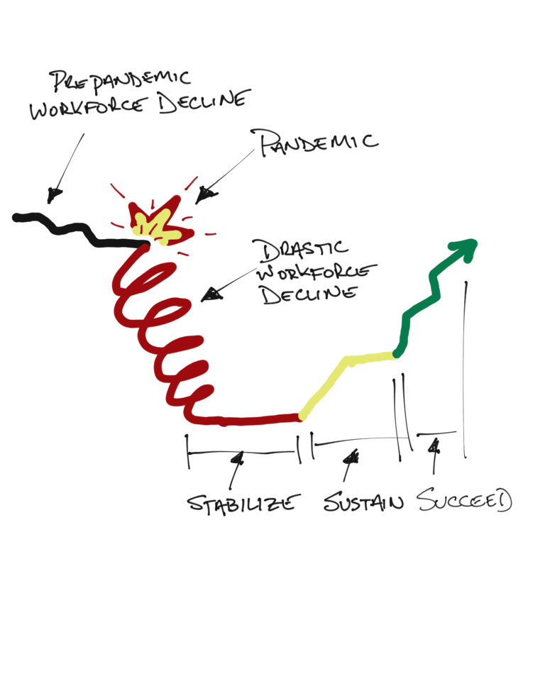
The Stabilization of Our System

Slide 4
Focus on all of the areas
ICF
Residential Waiver
Day/Voc Waiver
NMT

Slide 5
Stabilizing Ohio’s HCBS DD Services
Assessing the impact of the direct care shortage and achieving stability and success for Ohio’s DD System

Slide 6
Background
Ohio's system of services and supports for people with developmental disabilities is at a breaking point.
A need for more funding, resources, and higher wages, paired with pandemic-era stress and rapidly changing demographics have led to an unprecedented workforce shortage that threatens the ability of Ohioans with disabilities to get the care and support they desperately need.
Stabilizing this system of support will require a major investment in service reimbursement, allowing providers to compete, recruit and retain quality Direct Support Professionals.
Pairing that investment with measures that promote long-term sustainability and ensure fiscal accountability will be essential to securing the system of supports that Ohioans with Disabilities and their families need. To that end, we offer the following framework for system stability.

Slide 7
Process for Budget Proposal Development
The analysis and presentation here will contain 3 primary elements;
Service Stability and Impact on People Served.
Operational Stability and Factors Leading to Insolvency
Investment Needed to Stabilize Service Sectors

Slide 8
Assessing Ohio’s HCBS Service Stability
For the past 3 years, our partners at the American Network for Community Options and Resources (ANCOR) have conducted a study of the direct care workforce shortage and its impact on provider capacity and and individual/family’s ability to access needed services. In order to assess Ohio’s Service Stability, we replicated this national study for Ohio’s provider community and found the following;
77% of Homemaker/Personal Care Providers are indicated they are forced to turn away new referrals due to staffing shortages, closely mirroring national indicators.
IMPACT: The limited number of available providers has left individuals with significant or complex support needs traveling long distances outside of their communities—assuming they are able to find a provider at all—thereby heightening their risk of institutionalization or unnecessary hospitalization.”
-Impact Narrative from The State of America’s Direct Support Workforce Crisis 2022. Alexandria, VA: ANCOR, 2022.

Slide 9
Assessing Ohio’s HCBS Service Stability
68% of surveyed H/PC Providers indicate they have had to turn away and/or discontinue to services to those with higher support needs due to staffing shortages.” IMPACT: With programs and services closing at an accelerating rate, the ability of states to maintain an adequate network of community providers, meet the needs of those with higher support needs and meet federal access standards is at grave risk. Reduced availability of services jeopardizes the safety and well-being of the people relying on them, especially those with more complex care needs.
76% of H/PC providers are unable to fulfill all authorized hours/units as a result of staffing shortages.
IMPACT: With the infrastructure of services deteriorating as the dearth of adequate staffing grows, while Ohio may not be experiencing an active ‘waiting list’, people are unable to get the full care and support they need and are waiting or forced to go without all necessary services and supports.
- -Impact Narrative from The State of America’s Direct Support Workforce Crisis 2022. Alexandria, VA: ANCOR, 2022.

Slide 10
Ohio’s Service Stability Continued
“76% of Ohio’s H/PC Providers are Struggling to Achieve Quality Standards due to Staffing Shortages.”
IMPACT: When too few workers apply for jobs, providers are reliant on emergency regulatory flexibilities to maintain minimum staffing requirements. When emergency orders are lifted, providers are left unable to comply with staffing requirements, in turn forcing immediate discharge of people who were once supported and, in the worst cases, complete and permanent agency closures.”
-Impact Narrative from The State of America’s Direct Support Workforce Crisis 2022. Alexandria, VA: ANCOR, 2022.

Slide 11
Ohio’s HCBS Service Stability-Additionally…
50% of provider respondents indicated they were forced to consolidate homes/service sites as a result of the workforce shortage.
72% of provider respondents indicated they have had to utilize foundations, fundraising and alternative revenue streams in order to maintain operations and services.
62% of provider respondents indicated they would be forced to discontinue operations and all services within 5 years without any additional relief.

Slide 12
2022 Operating P/Ls – A Study of 5 Providers
Provider 2
Provider 3
Provider 1
Operating Revenue: $1,266,181
Operating Expense: $1,394,310
Operation Profit/Loss: ($128,129)
Operating Revenue: $783,115.52
Operating Expense: $795,069.80
Operation Profit/Loss: ($39,259.82)
Operating Revenue: 1,441,298
Operating Expense: 1,509,441
Operation Profit/Loss: (68,142)
Provider 4
Provider 5
Operating Revenue: 1,975,091
Operating Expense: 2,090,141
Operation Profit/Loss: (115,049)
Operating Revenue: $3,931K
Operating Expense: $4,435K
Operation Profit/Loss: ($504K)

Slide 13
Operational Stability – Wage Competition
Historically, DSPs and other frontline professionals underpaid profession, especially considering the critical and skilled nature of many of the services they provide.
Rate/reimbursement increases over the past two state biennium budgets helped providers get to a statewide average wage of to approximately $14/hr, but wage inflation of the past several years across many other sectors have made it impossible for providers to compete with other industries.
Medicaid service reimbursement rates set by the state determines the baseline wages providers are able to pay their staff. Providers are unable to raise wages by raising the price of their services and must either cut other operational costs like other employee benefits or use foundations and previous savings to pay competitive wages.
Current staffing shortages also lead to an increase in overtime hours, driving down regular salaries as providers must find a way to pay overtime wages without additional reimbursement.

Slide 14
Operational Stability – Wage Competition
The hourly wage component for Ohio’s H/PC services is $13.76/hr. Any provider paying staff more than this component is doing so at an operational loss and/or using savings or other revenue to supplement wages, an ultimately unsustainable practice.
While service rate add-ons (Medical, Behavioral) can enhance the reimbursement, they are inconsistently applied statewide and require additional administrative resources to implement.
MIT’s living wage calculator indicates that the ‘living wage’ for an adult with 0 children in Ohio is $15.61/hr, and $30.61/hr for an adult with 1 child, and $40.60/hr for an adult with 2 children.
“As of Oct 22, the average annual salary in Ohio is $48,286. Just in case you need a simple salary calculator, that works out to be approximately $23.21 an hour.”- Zip Recruiter Data

Slide 15
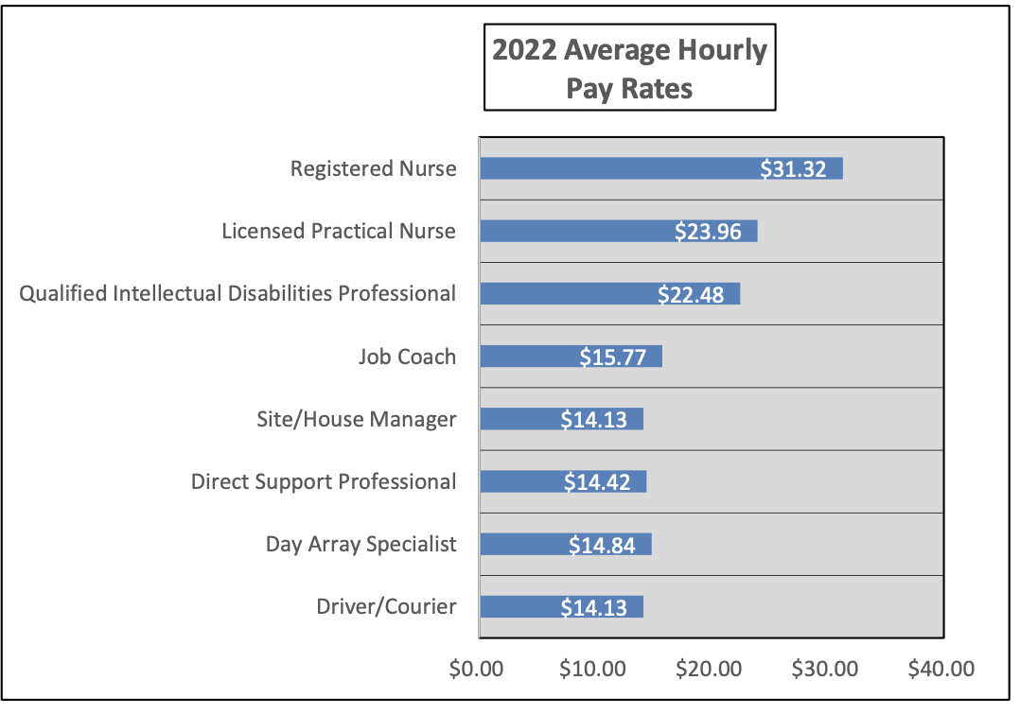
Operational Stability – Wage Competition
According to OPRA’s 2022 Salary and Benefits study, the statewide average DSP wage is $14.42/hr among OPRA members. (This study includes both HCBS and ICF DSP Positions)

Slide 16
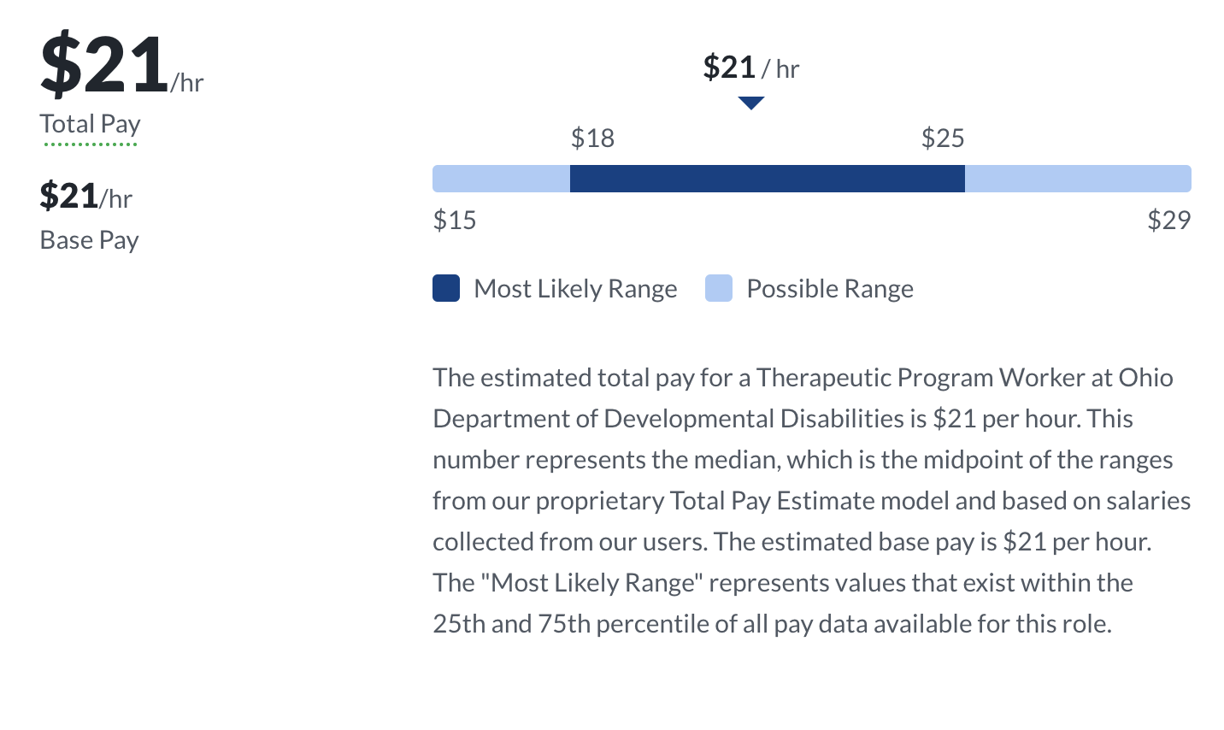
Wage Competition- TPWs and DCs

Slide 17
Wage Competition
Given the average wages of similar occupations, including Therapeutic Program Workers (TPWs) at Ohio’s Developmental Centers, median income levels in Ohio, the level of overtime hours being provided/paid, and the skilled and critical nature of the job, we believe DSPs need to earn an average wage of $18-22/hr in order to be competitive with other sectors. This ‘level playing field’ will allow providers to competitively recruit and retain qualified staff, with the ultimate goal of stabilizing services for Ohioans with disabilities and their families.

Slide 18
Operational Stability– Increased Cost Centers
Health Insurance Premiums average 20% Increase
Gas and Fuel
Activity-related Costs
Groceries and Costs of Living
Liability/property/casualty insurance and Cybersecurity Insurance
Medical Supplies and PPE
Accessible Vehicles have increased in Costs by over 50%
Outsourced Professionals Services (legal, accounting, payroll)
Commercial Loan Interest Rates

Slide 19
Operational Stability – Unfunded Requirements
In addition to the list of costs that have drastically inflated recently, providers are also required to invest time and resource into required activities and operations with few to no mechanisms for reimbursement in the current rate structure. Some of these include;
Overtime, which has skyrocketed for many due to staffing shortages.
Nursing services and Delegated Nursing Coordination
Required Training and On-Boarding costs
PUCO and other agency regulatory requirements
EVV Oversight
Case management and Team/ISP Meetings
PPE and other COVID Protocols
Coordination of Medical Care
Internet and Connection for Adaptive Equipment
Background Checks and Program Oversight
Outcome Tracking System Data Entry

Slide 20
Investment to Stabilize Services
In order to begin stabilizing both this service and operational instability, an historic investment must be made to in Ohio’s HCBS Disability services that will begin to stabilize the services and supports that so many people and families rely on, and setting a path towards sustainability.
This investment will allow providers to pay staff competitive wages and contend with the changed landscape of service provision.
The following investments are what we believe are necessary for quality, accountable services that can compete in the modern market.

Slide 21
Investment to Stabilize HPC & Residential Waiver
Approximately 30,000 Ohioans with I/DD are supported by HCBS Residential services, an area critically impacted by the workforce shortage.
Goals for stabilization:
Achieve a competitive wage for Ohioans support their fellow Ohioans.
Stabilize current workforce and attract new professionals.
Ensure there is capacity to serve all people needing support.
Total GRF Required: $498.2M across SFY24-25 Biennium

Slide 22
Investment to Stabilize Day, Employment & Transportation Services
Day & Employment services support 18,000 Ohioans with I/DD to connect to their communities and find careers, leading to independence and growth.
Goals for Stabilization:
Achieve a competitive wage for Ohioans support their fellow Ohioans
Fully fund an evolving day and employment supports and transportation services
Ease of staffing burden for residential services.
Provide talented staff to provide connective supports.
Total GRF Required:$102.6M across SFY24-25 Biennium

