Slide 1
OPRA Policy Committee
July 2022

Slide 2
The Budget Process

Slide 3
Understanding the State Budget Process
The Budget is essentially one really long bill
Mostly follows the legislative process as other bills
There are a few differences with the Main Operating Budget
Instead of a legislator developing the bill, the initial budget bill language is developed by the Governor and his executive branch
OBM will provide directions to cabinet directors on drafting their budget proposals
The bill language is typically introduced by mid-February but no later than March 15^{th*} and must be passed by July 1st
There are limitations on the main operating budget per Ohio’s Constitution and Ohio law
The bill always starts hearings in the House of Representatives
There is always a conference committee
Notes:
The Governor and the leaders of his departments, commissions, and boards and staff from the Office of Budget and Management will start putting together the Governor’s proposed budget in the summer before the budget must be enacted. So for us, DODD and the Governor’s team will start to develop their request this summer.
The March 15th date is only applicable if the governor is new
The most impactful budget limitations:
balanced budget: the state can not spend more money than it has coming in as revenue
The overall main operating budget can’t grow by a certain percentage each year

Slide 4
Understanding the Budget Process
https://www.legislature.ohio.gov/publications/the-legislative-process
Legislators determine how they want to change the Governor’s budget through committee hearings, direct outreach from constituents, and general caucus priorities
Notes:
We are going to go back through the process and point out some of the differences

Slide 5
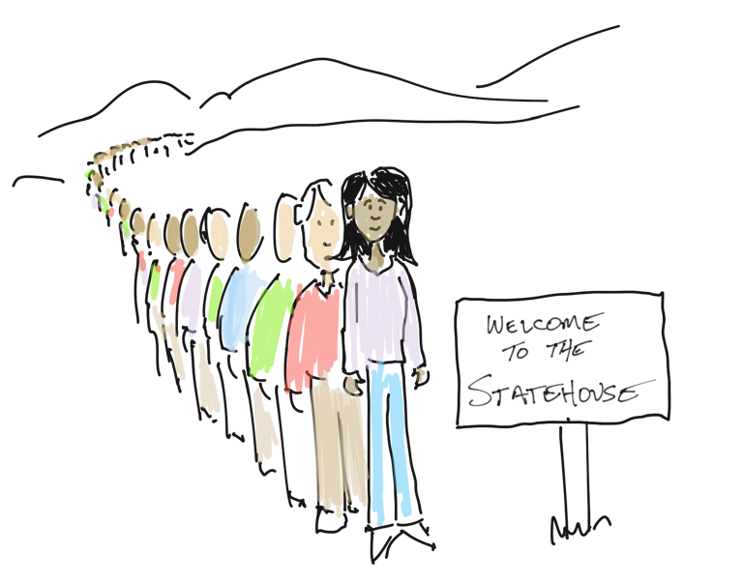

Slide 6
The Budget Ask

Slide 7
Budget Priorities
The Coalition
Historic Asks
Start with the Governor’s proposal
Do we hire outside assistance (message development, marketing, organize partners, etc.)

Slide 8
Today we are…
Providing Information
Asking for your feedback
Organizing a group of OPRA Members to work on a specific issue

Slide 10
3 phases
Phase 1
Stabilize
Phase 2
Sustain
Phase 3
Succeed

Slide 11
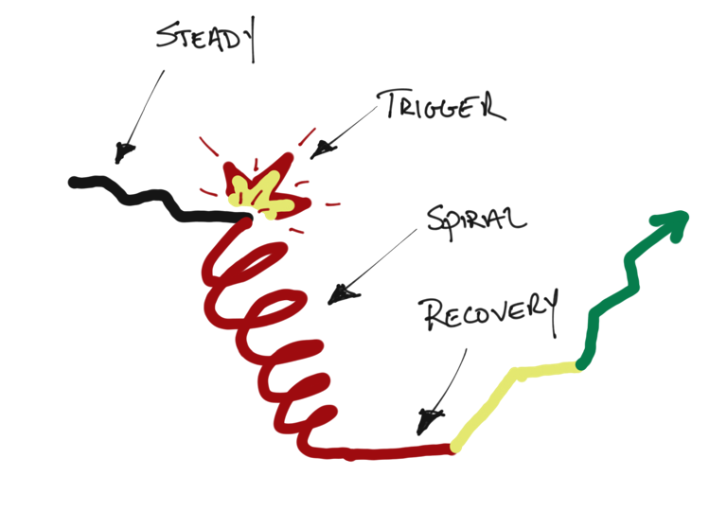

Slide 12
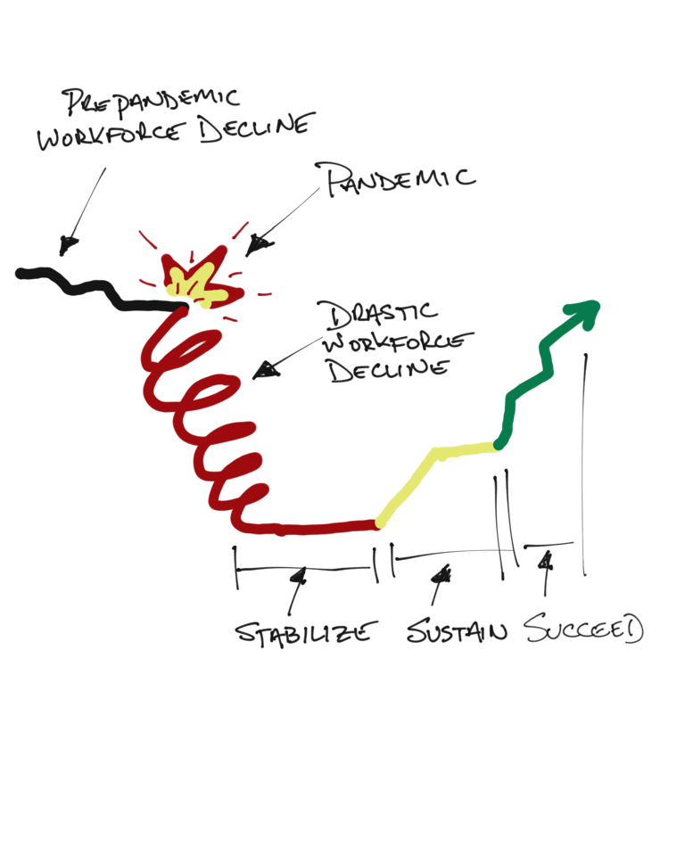

Slide 13
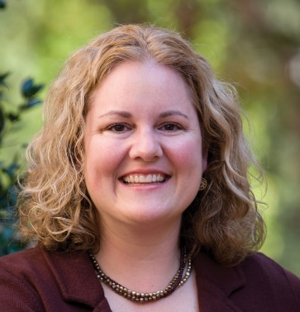
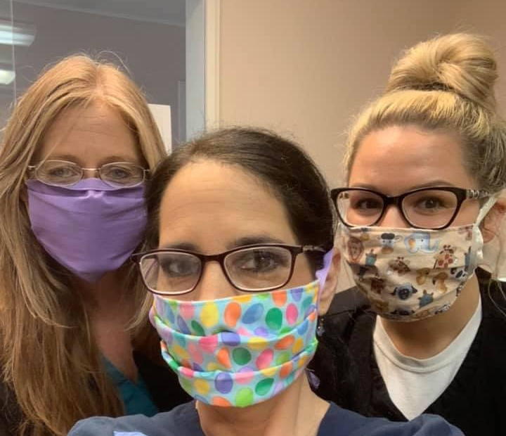
Funding
Capacity
Process Improvement/Efficiency

Slide 14
Possible areas to address:
Percentage Increase
$100s of millions
Staff wages
COLA
Maximize CB Funding
Funding
Capacity
Process Improvement/Efficiency
Possible areas to address:
Must-have proposal for contractor
Stratify HPC
Compliance reform
ICF Modernization
Remote technology
Possible areas to address:
Licensed beds
Setting flexibility
Nursing capacity
Provider certification reform
MSY/add-on reform

Slide 15
Leveling the Playing Field in Our System
ICF
Run the formula
Specialized Services
Day
Rates Supporting the Array
“The blueprint will take care of it.”
Residential Waiver
Increase Pay
Reconcile what should be provided

Slide 16
For Example:
The Nuance of the Ask
ICF
Indirect
Direct
Protected

Slide 17
Reform item #1
Reimbursement and Service Design Reform: As part of the Waiver Reimbursement System Modernization Project, we will be presenting a separate proposal that will include actions and items that must be included in the effort and some things that we believe should not continue in order to simplify and prepare our DD system for long-term sustainability. Part of the proposal will include a variety of issues that complicate the current financial structure of DD waivers including reimbursement structures, acuity factors, prior authorizations, etc. Additionally, the proposal will include some recommendations for redefining services in a way that recognizes the broad range of service needs and thus skill sets required for direct support professionals.

Slide 18
Reform item #2
Individual choice and autonomy: This proposal seeks to promote individual choice, self-direction and autonomy to the greatest extent possible. To that end we propose:
To decrease the over reliance of traditional paid DSPs, the system should fully embrace self-directed services, including participant directed HPC options. Implementation of the new self-directed transportation will provide new options for people with disabilities to get transportation without DSPs providing much needed relief to the system. Participant Directed Goods and Services (DGS) now available to both Level One and SELF waiver enrollees, provides increased access to equipment, goods and services that are available to all citizens and can reduce the reliance on paid staff. Enhanced training on self-direction will be necessary to achieve these objectives.

Slide 19
Reform item #2 (cont.)
Promote additional self-advocacy at the local level to ensure people with disabilities speak up for themselves, are trained on exercising their rights and understand their responsibilities. Utilize OSDA to provide additional support to county boards to strengthen their local processes and regional groups as needed.
DODD will take a leadership role in strengthening and developing Supported Decision-Making as a tool available to consumers across Ohio. Ohio Revised Code Section 5126.043 currently provides for the designation of authorized person to assist with decisions but the statute is not widely understood and/or utilized by consumers. This statute is also not viewed by Probate Courts as an alternative to guardianship. The proposal would be to rescind Ohio Revised Code Section 5126.043 and replace it with a more robust statute which directly recognizes and empowers Supported Decision-Making as an alternative to guardianship.

Slide 20
Reform item #3
Remote Supports Rule: Ohio has shown its dedication to being a Technology First state and we believe this service in the waivers can be modified to promote the use of various technology driven supports. Increased flexibility could lead to increased usage and benefit to those who utilize remote supports.
Redefine the relationship between the residential provider and the technology supports provider. Need to address “free choice of provider” in connection with expectations of both the residential provider and the technology provider.
Reconsider rates for active vs. passive remote supports.
Create rate structure that covers small units of service such as virtual health related supports, verification, or assistance with self-administration of medications or well checks.

Slide 21
Reform item #4
Waiver Nursing & Medication Administration: One of the lessons learned during the pandemic is that there is a desperate need to increase nursing capacity within our DD system. Although waiver nursing was added as a service years ago, utilization is extremely low due to the complex nature of accessing the service. This proposal seeks to make changes in the following areas:

Slide 22
Reform item #4 (cont.)
Short-term: work with DODD to develop a streamlined process to permit county boards to authorize waiver nursing to provide much needed reimbursement with severe nursing shortage in Ohio.
Build on current work with DODD, enhance structure and processes to allow for expanded use for medication dispensers and other technology solutions for health-related needs.
OAC 5123-9-37 needs to be revised to allow county boards and councils of governments to provide nursing services particularly now due to lack of willing and able providers.
Long-term: work with DODD to find a way to allow expanded access to waiver nursing, including adding the service to Level 1 and SELF, and increase flexibility for these services. We believe this is being done in other states and would like to reduce the barriers for DD providers to provide waiver nursing services. In addition, we believe that technology related health care services, such as Station MD, should be covered by Medicaid.

Slide 23
Reform item #5
Develop a workgroup to facilitate discussions with stakeholders to discuss Increased flexibility in development of residential settings that includes parameters in unlicensed and licensed settings.
In particular, specialized services for multisystem youth and adults with significant behavioral challenges are sorely lacking and need bold solutions. Conversations about setting size, while difficult, are necessary to address the sustainability of the system due to the sever workforce shortage.
In addition, flexibility in our current rules may allow for the creation of “intentional integrated communities” or multi-unit living situations which are desired by many people receiving services and their families.

Slide 24
Reform item #6
Provider Compliance & County Board Accreditation: We believe that provider compliance and county board accreditation need revamped to allow for increased partnership when providers or county boards are in good standing.
Compliance should be focused on providers/county boards who are struggling and not those who have demonstrated consistency in their ability to be in significant compliance with rules and regulations. Providers/county boards in good standing should have access to technical assistance and support rather than being subject to ongoing compliance reviews.
County board accreditation: Given the nature of county board services, we recommend a compliance structure that is different than that of providers and more focused on the actions required from the county board.
Create a very limited self-review compliance tool to be utilized for providers who are in good standing and also otherwise accredited.

Slide 25
Reform item #7
Provider Certification Requirement: Limited revisions to the Provider Certification rule would assist with addressing the staffing crisis.
Permanently remove the 18 year old requirement for DSPs.
Permanently remove the high school diploma/GED requirement for DSPs.
Discuss appropriate staff orientation and training requirements for adult learners and make the streamlined onboarding flexibilities authorized through the Appendix K permanent.

Slide 26
Reform item #8
Multi-system Youth/Intensive Behavioral Support ICF Add-on: Unfortunately, the design of this program has not led to the intended outcome of creating additional residential options for children with intensive behavioral support needs. We would like to work with DODD to redesign the program in a way that can meet the variety of needs across the state.

Slide 27
Reform item #9
ICF Modernization: There are several modifications needed for the ICF program to ensure long term sustainability.
While the department and stakeholders spent a lot of effort on creating the current reimbursement structure, there were several concerns that all agreed needed to be addressed in the future.
The acuity scoring for people with high behavioral needs does not accurately reflect the resources needed to serve these individuals, especially if they do not have other medical or adaptive needs in addition to their behavioral needs.

Slide 28
Reform item #9 (cont.)
The group agreed to capture additional information on active treatment costs and then revise the reimbursement to address active treatment. Additionally, since then, DODD is getting ready to implement service and reimbursement changes to day and vocational services funded through the waiver. ICF reimbursement should be in-line with waiver reimbursement to allow ICF residents choice in where they receive their day services.
The cost reporting for ICFs needs reviewed and streamlined to ensure that only necessary data is being requested. A comprehensive review of the ICF cost report hasn’t been completed in over a decade and it is time to complete this and hopefully reduce some of the administrative expense in completing this function.

