Slide 1
OPRA Policy Committee Meeting
9-14-2020

Slide 2
Agenda
Welcome
OPRA AIR Report/Updates
Guiding Principle #1
The Workforce Crisis and Wages
Summary of Information gathered for the guiding principles
R&E Groups
General Discussion
Next Steps

Slide 3
OPRA AIR Update

Slide 8
System Reform: Guiding Principles
Principles that will give us our foundation

Slide 9
React and Enhance Focus Groups

Slide 10
OPRA’s Anchor Statement
Ohio’s providers are focused on supporting the success of the people we support.

Slide 11
Principle #1
We believe the primary focus of our work is the positive and supportive relationship between front-line professionals and the people they support.

Slide 12
Guiding Principle #1
Action Item #1 | Action Item #2 | Action Item #4
Training and Culture Training focused on culture and relationships (orientation and ongoing) Provider control over this process (what do we want from DODD?) ISP (“One Plan”) that sets clear expectations. | Workforce Issues Workforce tool-kit Hiring practices Retention strategies State and local partnerships | MUI Rule Culture and process Define the problem and develop intervention strategy

Slide 13
Discussion: Workforce Crisis
Pool of applicants is shrinking
Long-term employees leaving
Physical and compassion fatigue
Fear of the virus
The pressure of keeping people safe

Slide 14
This is real
“It is not just a pay issue, it is culture, it is system change, and it is changing a system with many historical view points and feelings that are impacted during real conversations. We are not perfect, I will ensure that we try to serve the individuals with the highest care we can and that we are working on improving/changing our model.”

Slide 15
Workforce Toolkit
Recruitment
How do we sell our organization?
Workplace
Culture
Do our employees feel safe and supported?
System
Barriers
What get’s in the way of getting and keeping employees?
Compensation
Are providers appropriately compensated for their services?

Slide 16
The Players and Responsibilities
The Provider (Recruitment, Culture, Compensation, System Barriers)
Your Staff (Recruitment and Culture)
Your Community (Recruitment)
The County Board (Compensation, Barriers)
The State (DODD, ODM) (Compensation, Barriers)
State Government (legislators) (Compensation, Barriers)
Federal Government (Compensation, Barriers)

Slide 17
The Questions
We are going to ask a few questions pertaining to each workforce focus area and ask you to give us your feedback via live polling.

Slide 18
Recruitment
What support do you need to assist in your recruitment efforts? What do you plan on doing over the next several months to recruit new employees?

Slide 19
Notes:
What support do you need to assist in your recruitment efforts?
https://www.polleverywhere.com/free_text_polls/MtShhSELfzqM7khwPe2zy

Slide 20
Culture
What is the biggest challenge in creating a supportive culture?
What support do you need to create a more supportive culture?

Slide 21
Notes:
What support do you need to create a more supportive culture to attract and retain staff?
https://www.polleverywhere.com/free_text_polls/NJuBZcJYxwDBDvFud4N7m

Slide 22
System Barriers
What systematic barriers hinder your ability to hire and keep DSPs?

Slide 23
Notes:
What systematic barriers hinder your ability to hire and keep DSPs?
https://www.polleverywhere.com/free_text_polls/YrLJkvsPpmgmbrvrxs4CT

Slide 24
Compensation:Taking a Fresh Look
Our issues are bigger than wages…It costs more to deliver services (infrastructure, benefits, training, etc.)
Is saying “DSPs need higher wages” going to work or do we say “the service expectations are changing, we need better rates to meet the needs of the people we serve”
We need to set up an approach that does not have us chasing increases every budget cycle

Slide 25
The Future of Day Services

Slide 26
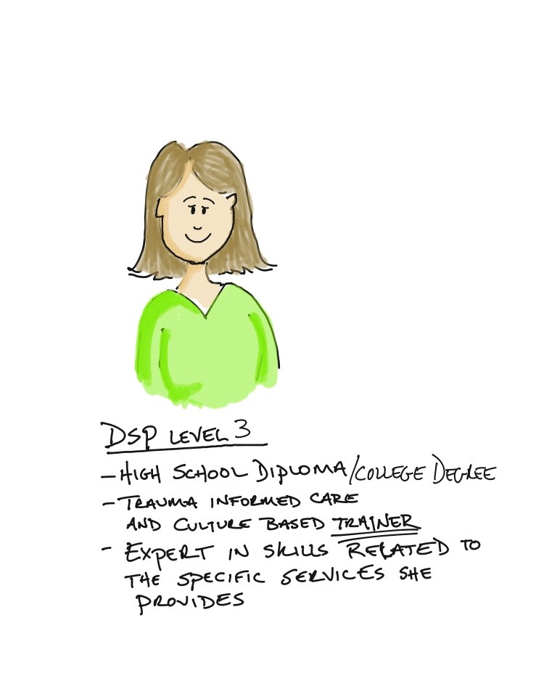
Funding to Support DSPs and Nurses
Nursing

Slide 27
The Future of Day Services

Slide 28
What kind of skill do you need to deliver this service?

Slide 29
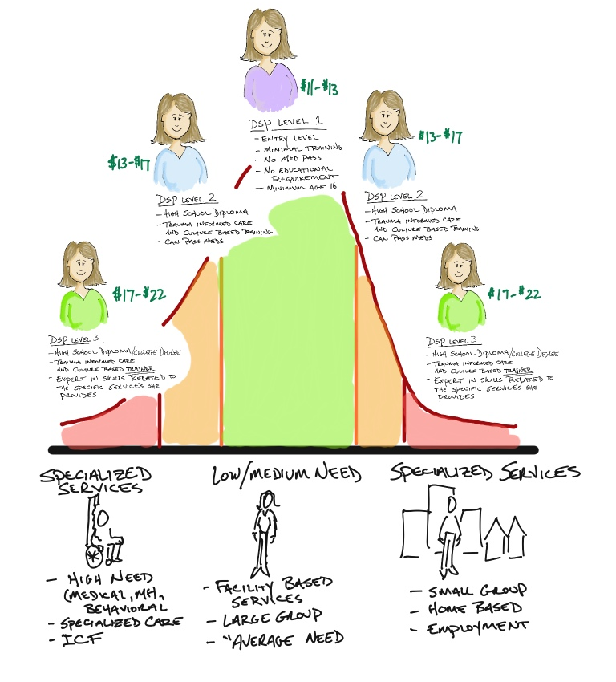
Wages related to Service Type
Nursing
(competitive with
other entities)

Slide 30
A Different Advocacy Approach
Start with Services
Then Rates
Then Wages

Slide 31
Workforce Focus Group
We are looking for a group of members who are interested in being a part of the Workforce Focus Group
Please email Rjacob@opra.org and put Workforce Group in the Subject line

Slide 32
Principle #2
We believe providers should be supported and trusted to support people with developmental disabilities and operate effective and successful organizations.

Slide 33
Action Items
Provider Certification The age and GED challenge DODD prescribed trainings (what does it look like in real life? Are they effective?) | Simplified Billing Eliminate 15 minute units Monthly Billing Outcome based billing | Rule simplification Covid-19 rule relaxation ICF Development rule Consistent nursing rules across all providers. | Provider Quality Quality = Freedom Group of providers to discuss OPRA’s position on Quality

Slide 34
Billing Reform Focus Group
We are looking for a group of members who are interested in being a part of the Billing Reform Focus Group
Please email Rjacob@opra.org and put Billing Reform Group in the Subject line

Slide 35
The Provider Partnership Project: What should the relationship look like?
Recommended practices include:
The establishment of a provider support function/department separate from the SSA department, with provider compliance/quality assurance activities delegated to separate personnel.
A local framework supplemented by COG efforts, when appropriate, that supports continuous collaborative, planning, problem solving, and improvement efforts between Boards and their provider partners.
Hire/appoint/select persons to perform provider support functions that have a specific skill set, which includes: Positive reputation and credibility with a variety of audiences (providers, families, Board staff); The ability to think, plan and operate systemically; Superior communication skills (verbal and written), with an emphasis on achieving clarity, and helping people to focus and prioritize; The ability to engage a variety of stakeholders and manage sometimes difficult and legitimate criticism while actively listening always.

Slide 36
Partnership vs. Compliance Focus Group
We are looking for a group of members who are interested in being a part of the Partnership vs. Compliance Focus Group
Please email Rjacob@opra.org and put Partnership vs. Compliance Group in the Subject line

Slide 37
Partnership vs. Compliance Focus Group
We are looking for a group of members who are interested in being a part of the Provider Quality Focus Group
Please email Rjacob@opra.org and put Provider Quality Group in the Subject line

Slide 38
Recommended practices cont.
Expand Board strategic planning processes to include provider support as a specific category coupled with specific budgetary provisions included in the Board adopted annual operating budget. These efforts are most likely to generate results;
While provider support functions should be separate from the SSA department, SSA functions directly impact service quality delivered by certified providers. Superintendents and other Board leadership must be willing to include their own internal processes in any assessment of effectiveness and efficiency, and engage in regular internal process improvement efforts;
Always have a way to measure the change you want to make before you get started!

Slide 39
Principle #3
We believe providers must be sufficiently compensated to deliver essential services to meet the needs of the people they support in an ever evolving society and system.

Slide 40
Action Items
DSP wages What is the target? 200% of poverty level | Simplified Billing Eliminate 15 minute units Monthly Billing Outcome based billing | Service Rates Day Service spectrum Specialty services Waiver Nursing | Budget No cuts in rates Don’t lose ground during the “recovery”/next budget cycle (2022/23) | Future Funding and the DD System Redistribution of funding (funding the front-line)

Slide 41
Principle #4
We believe all services currently provided across the spectrum of services should be recognized as crucial to each and every person we serve.

Slide 42
Action Items
Appreciation for the Spectrum Public image/education campaign Target relationships with County Boards and DODD | We Step Up State and Federal Advocacy | Local Relationships Joint CB and Provider trainings Local provider consortiums

Slide 43
Discussion: It’s not just about wages…The organization needs to survive?
What have you learned about what services people need and want over the past six months?
What are your biggest concerns about the services you can provide post coronavirus?
Are you currently able to offer the services that people want and be adequately compensated for those services?

Slide 44
OPRA Committee Contributions to the Guiding Principles
Summary from policy committee polling
Summary from Day Array committee

Slide 45
DSP Wage polling feedback
PollEverywhere Questions- On how providers are faring- very mixed- some providers having ok experiences, others are really struggling. On what the ideal DSP wage an hour would be- between $15 and $17 in most areas, $20 in others. We would need to consider how wage compression plays into the need to pay for other employees and how health insurance costs cut into potential increases. A possible argument for reframing the conversation- are we asking the state to support only DSP wages vs supporting organizations.

Slide 46
Covid-19 Impact polling feedback
PollEverywhere Questions on Post-Pandemic World- Concerns are varied. Range from how to help people served transition back to more structured services and not staying home all day, not having enough staff to safely serve people, struggle to switch back to a pre-pandemic regulatory framework- getting everyone up to speed on trainings, what will survey results post-pandemic, worried about being able to grow business or take on people that need services because there are not enough staff. With the state budget looking like it is, we are going to need to relook at the rules and duties we ask all DSPs to do.

Slide 47
Guiding Principles Feedback from Day Array Committee

Slide 48
Principle #1
We believe the primary focus of our work is the positive and supportive relationship between front-line professionals and the people they support.

Slide 49
Need Funding for smaller groups and higher staff education/experience
Need Reimbursed Training Opportunities- especially for resilience, trauma and relationship building.
Over-complicated service plans that don’t actually promote quality outcomes
Need less administrative tasks and burdensome documentation.
Too many changes too quickly

Slide 50
Principle #2
We believe providers should be supported and trusted to support people with developmental disabilities and operate effective and successful organizations.

Slide 51
Shared training between providers, SSAs and others, leading to shared understanding.
Need for more technical assistance from compliance units and less ‘gotcha’.
Too many layers of oversight and supposed ‘help’.
Consistency in education and support from county boards.
Look at decreased compliance burden if nationally certified by other body.
Move to outcome-based documentation can help move compliance culture

Slide 52
Principle #3
We believe providers must be sufficiently compensated to deliver essential services to meet the needs of the people they support in an ever evolving society and system.

Slide 53
Incorporate add-ons into rate to simplify.
Keep ”STEP’ rate for community services
Restructure acuity system to consider current reality including current COVID needs and community needs.
Flexibility to use funding across waivers and funding types.
Economic evaluation of what % of the state wide budget goes to provider agencies vs. bureaucracy.
Simplify and condense billing codes
Regular rate increases based on economic factors

Slide 54
Principle #4
We believe all services currently provided across the spectrum of services should be recognized as crucial to each and every person we serve.

Slide 55
”Day services need to be seen as places where life-long learning and friendships are cultivated. A good day program can give purpose and meaning to a person's life. We've seen that staying at home has a negative impact on mental health.”
“Day Services connected to the community and seen as valued in the community.”
“I think there needs to be a shift in thinking that ADS is more than "adult care"...we are truly like another family to these individuals”.
Need to recognize the importance for everyone to have a personal purpose and that there is great value in being needed and contributing.
“It doesn't help anyone if we are trying to sell each person's inner "snowflake". We need to figure out how to help people be less "special".”

Slide 56
“it is everyone's right to choose where they go. We all enjoy being around "different" people thru our lives.....People with DD have the same "right"..... they can see other people and be apart of other groups..... not just the group of folks they may live with. It is essential for Mental Health and well as social engagement.”
“mental health stability, socialization with friends and building relationships in the community.”
“Outcomes, not supports, really based on discussions with the individuals and their families. Their answers will show they are essential.”
“Reduce "system shame" of providers and individuals who choose a center based model”
The hierarchy of needs (Maslow's) points this out. But the pandemic seems to have caused a system-wide regression to the "caretaker" approach rather than the facilitator/supporter approach that is so much more appropriate for day array services (and all services).

Slide 57
Services should reflect real goals/outcomes and be fluid based on that individual's needs/wants
Publication of current mental health statistics and the impact that isolation can have on all of us.
The system needs to buy into real, concrete outcomes.

Slide 58
General Discussion
Topics you are concerned about
Is there anything we are missing?

