Slide 1
Your Money, Your Goals
An introduction to the Bureau’s tools and resources

Slide 2
DISCLAIMER
This presentation is being made by a Bureau of Consumer Financial Protection representative on behalf of the Bureau. It does not constitute legal interpretation, guidance or advice of the Bureau of Consumer Financial Protection. Any opinions or views stated by the presenter are the presenter’s own and may not represent the Bureau’s views.
This document was used in support of a live discussion. As such, it does not necessarily express the entirety of that discussion nor the relative emphasis of topics therein.

Slide 3
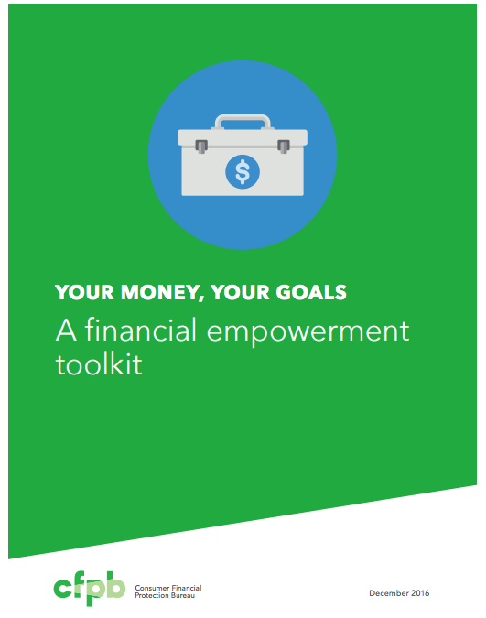
Your Money, Your Goals
Toolkit with financial education modules and tools
Scalable –reached more than 25,000 frontline staff and nearly 980,000 consumers
National perspective, local context – identify financial need and link consumers to local resources
Notes:
Cleared from YMYG trainings (Updated August 2017)

Slide 4
Financial empowerment
What is financial empowerment?
How is it different than financial education, financial literacy, financial capacity, or other commonly used terms?
Skill and confidence to use knowledge
Financial empowerment
Financial literacy
=
Notes:
Training Section 3: Intro Part 1: Introduction to the Bureau and Financial Empowerment
Facilitated Discussion and Presentation (Introduction Part 1, Page 9)
NOTE: Use the animations in this slide to guide the questions and discussion
Transition by reminding participants that an informed consumer is the best defense and that Your Money, Your Goals was developed by Bureau’s Office of Community Affairs.
ASK: What is financial empowerment?
Write their ideas on flip chart paper.
ASK: How is it different from financial education, financial literacy, financial capability, or other commonly used terms?
Ask them how financial empowerment is different from other commonly used terms: financial education, financial literacy, financial capability, financial fitness, financial coaching, and so on.
NOTE: It may be helpful to differentiate strategy terms (financial education, financial coaching, financial counseling) from outcome-based terms (financial literacy, financial capability, financial fitness).
Share definition of financial empowerment using the slide and information from the Introduction Part 1
Financial empowerment includes financial education and financial literacy, but it focuses both on building your skills at managing money and using financial services and on helping to access products that work for you.
When you are financially empowered, you are both informed and skilled. You know where to get help with your financial challenges and can access and choose financial products and services that meet your needs. This sense of empowerment can build confidence that you can effectively use your financial knowledge, skills, and resources to reach your goals.
NOTE: Consider writing this definition on a flip chart and leaving it posted throughout the training.
Share the relationship of financial empowerment to financial education and financial literacy using the slide and information.
Explain that financial education, which is inclusive of other strategies, such as coaching, counseling, technology-based approaches, and so on, leads to financial literacy and that financial literacy plus confidence—the confidence to make decisions and use knowledge, skills, and tools including financial products and services—is financial empowerment.

Slide 5
Financial empowerment and service providers
Trust
Opportunities for providing financial empowerment
Access
=
‘’
Notes:
Training Section 3: Intro Part 1: Introduction to the Bureau and Financial Empowerment
Presentation (Introduction Part 1) (Page 9)
Explain rationale for Your Money, Your Goals using slide and information from Introduction Part 1: Introduction to the toolkit.
Be sure to highlight that:
As a trusted source of information and resources, you are in a good position to provide financial empowerment services to the people you serve. You have access to and the trust of many people that would benefit from financial empowerment services.
Review the intended audience of Your Money, Your Goals using slide and definition in text box in Introduction Part 1.
This toolkit is designed for anyone who works directly with people that have low-income or are economically vulnerable that are served by a wide range of organizations and on a broad range of issues.
Users of this toolkit may have different titles, but you generally come from non-profit, community-based, or private sector organizations or city, county, or tribal government agencies, and are generally responsible for working with people to:
Conduct needs assessments
Develop action plans
Provide resources and referrals needed to implement action plans
Monitor progress and evaluate results
After reviewing intended audience for the toolkit, ask participants: “Given this explanation, are you within the target audience for this toolkit?” Instruct participants to raise their hands if the answer to this question is “yes.”
Facilitate a dialogue with those participants who do not see themselves reflected in this definition using questions such as:
“How is your job fundamentally different from the functions described?”
“How do you feel this kind of toolkit may benefit your work even though you see yourself as outside the target audience for the toolkit?”
NOTE: In all likelihood, participants may not identify as being within the target audience if they have a supervisory role to staff that provide direct service, or they see their job as encompassing more than the broad functions listed here. It is important to help them identify how they are within the target audience for the toolkit.

Slide 6
What’s in the toolkit?
Topics include:
  Goals
  Saving
  Income and spending
  Cash flow budgeting
  Debt
  Financial services
  Consumer protection
Notes:
Don’t read slide.
Rather than focus on equipping case managers to be financial coaches or counselors, we have chosen an approach that will provide training in key financial empowerment concepts and tools case managers can use with their clients to incorporate key topics into their day-to-day interactions with clients.
Building case manager confidence about money management;
And equipping case managers to understand when and how start the conversation.
It includes assessments that, initially, help the case manager become aware of any gaps in their own knowledge and where they’d like to learn more – and to help clients identify their own financial management needs, goals, and information gaps.
Your Money, Your Goals is available for free download in English and Spanish at the Bureau’s website, consumerfinance.gov. Along with the toolkit, you’ll find training materials and an implementation guide.
Cleared: Minnesota conference June 2014:

Slide 7

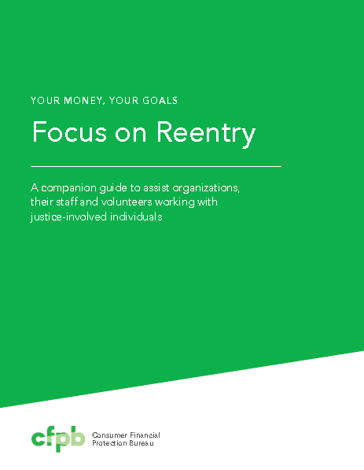

Companion guides to the toolkit
Notes:
Companion guides provide context for having the financial empowerment conversation with special populations. They also have tools and information designed specifically to meet the unique needs of those populations.

Slide 8


Your Money, Your Goals toolkit and training
Gain confidence and knowledge about consumer finance issues
Identify financial challenges and provide actionable tools to the people you serve

Slide 9
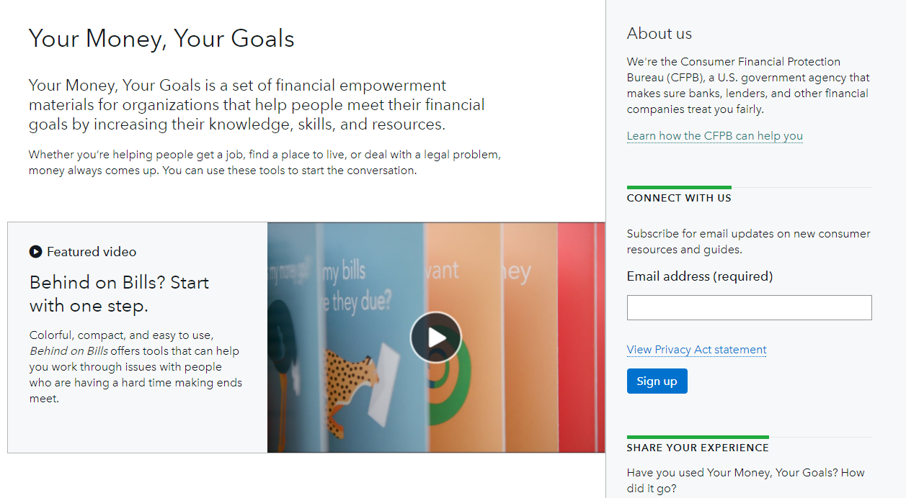
Your Money, Your Goals
Notes:
Review where to find Your Money, Your Goals
http://www.consumerfinance.gov/your-money-your-goals/
Review signing up for the mailing list, which will include updates to Your Money, Your Goals, additional training opportunities, and other important and helpful information from the Bureau.

Slide 10
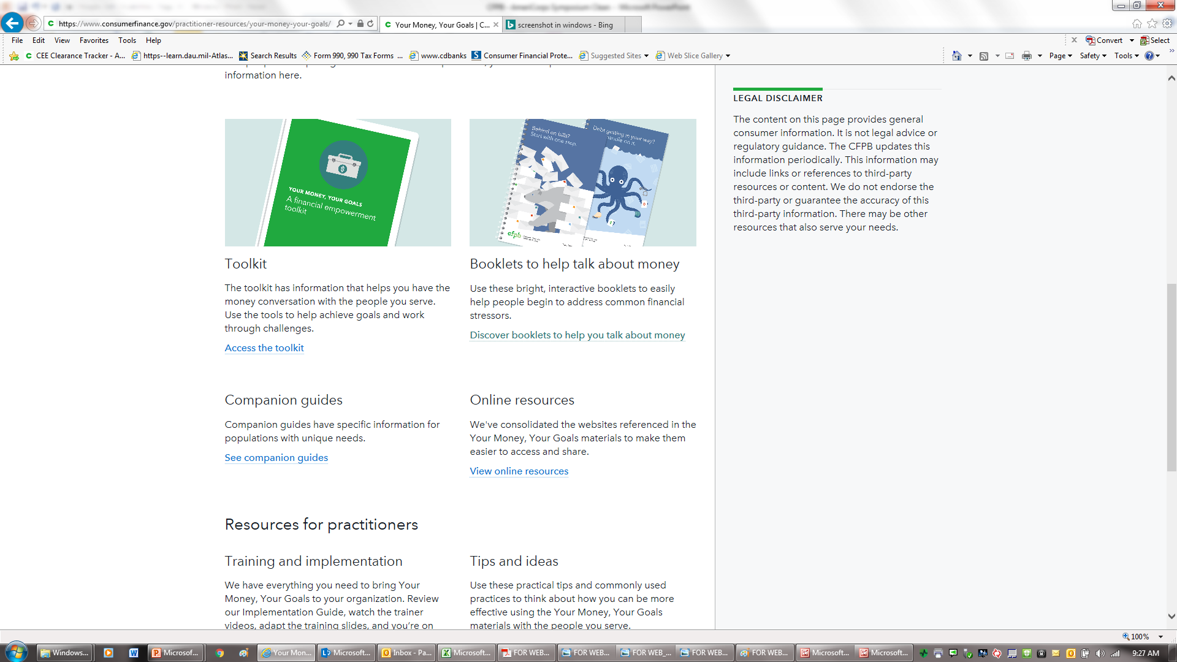
Getting Your Money, Your Goals materials
www.consumerfinance.gov/your-money-your-goals
Notes:
Review each resource or tool on the Your Money, Your Goals landing page using the following:
First you have the toolkit. This document contains all of the narrative information and tools for service providers to use with the people they serve. This is a PDF file that you can download. You can print the whole toolkit or just the sections or individuals tools you need by referring to the table of contents. The toolkit is also available in Spanish.
Under the Training section, you will find all of the material you need to plan and deliver the training. The training guide is a PPT presentation with all of the facilitation instructions in the notes section of the PPT.
Contextualization and customized information and tools for specific populations is provided in shorter companion guides. The one of these guides, Your Money, Your Goals: Focus on Native Communities is shown in this screenshot.
Review the Implementation Guide.
Review the Follow-up Resources
NOTE: If you have access to an Internet connection during the training, it can be useful for participants to see you move through the website to the complaint and show some of the features of this section of the Bureau’s website live.

Slide 11
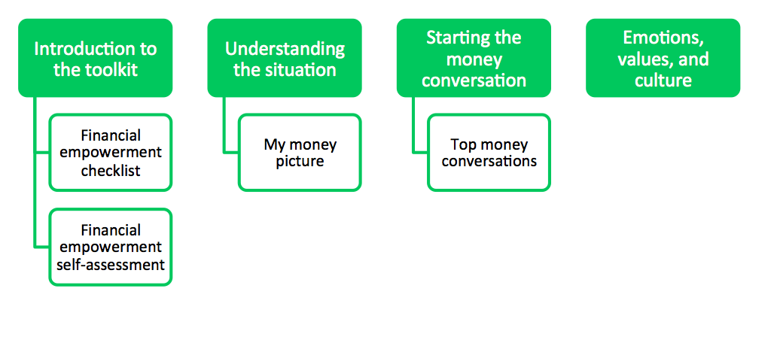
Organization of Your Money, Your Goals
Introductory modules
  Introduction Part 1: Introduction to the toolkit
  Introduction Part 2: Understanding the situation
  Introduction Part 3: Starting the money conversation
  Introduction Part 4: Emotions, values, and culture: What’s behind our money choices?
Notes:
ACTIVITY #2: Focus on Native Communities CONTINUED
Presentation
Show how each section of the toolkit has tools within it. For example, in the Introduction to the toolkit there are two tools: Financial empowerment checklist and financial empowerment self-assessment.
Explain that these tools are not repeated in Focus on Native Communities. You can use these tools as well as the new tools in Focus on Native Communities.

Slide 12
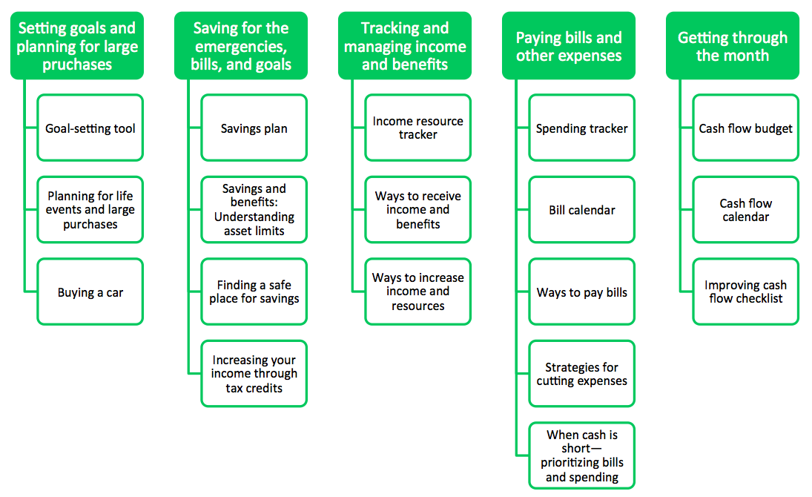
Organization of Your Money, Your Goals
Notes:
ACTIVITY #2: Focus on Native Communities CONTINUED
Presentation
Explain that this shows each content module with the tools are that included in the module.

Slide 13
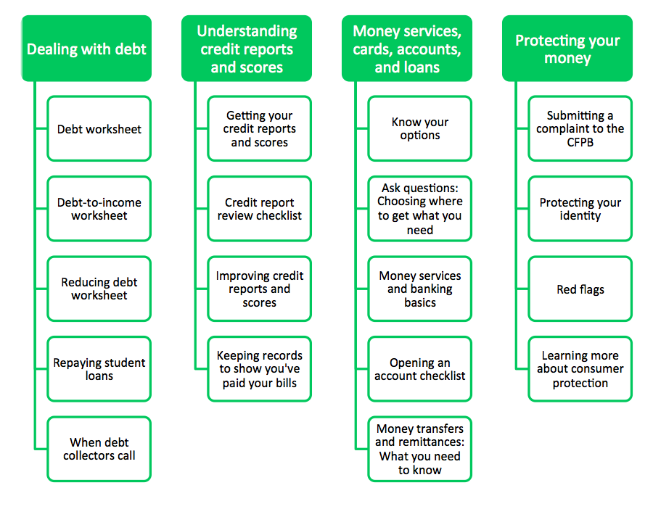
Organization of Your Money, Your Goals
Notes:
ACTIVITY #2: Focus on Native Communities CONTINUED
Presentation
Explain that this shows each content module with the tools are that included in the module.
Explain that dealing with debt is important in Native Communities. The tools associated with debt are NOT in Focus on Native Communities, but they can be easily reference in Your Money, Your Goals. Ideally, both resources are used together.
Explain the key elements of a Toolkit and how the Toolkit is different from a curriculum:
Do not treat the Toolkit like a curriculum—the goal is not to get through all of the materials when working one-on-one with a clients or to cover the material and tools in order.
Provide the right content and tools at the right time.
Use discussions with clients or assessments to figure out where to start.

Slide 14

Behind on bills?
Colorful and engaging
Small and portable
Tools focused on tracking income and expense, budgeting, and cash flow
Order up to 50 copies for free at: https://pueblo.gpo.gov/BureauPubs/BureauPubs.php?PubID=13263

Slide 15
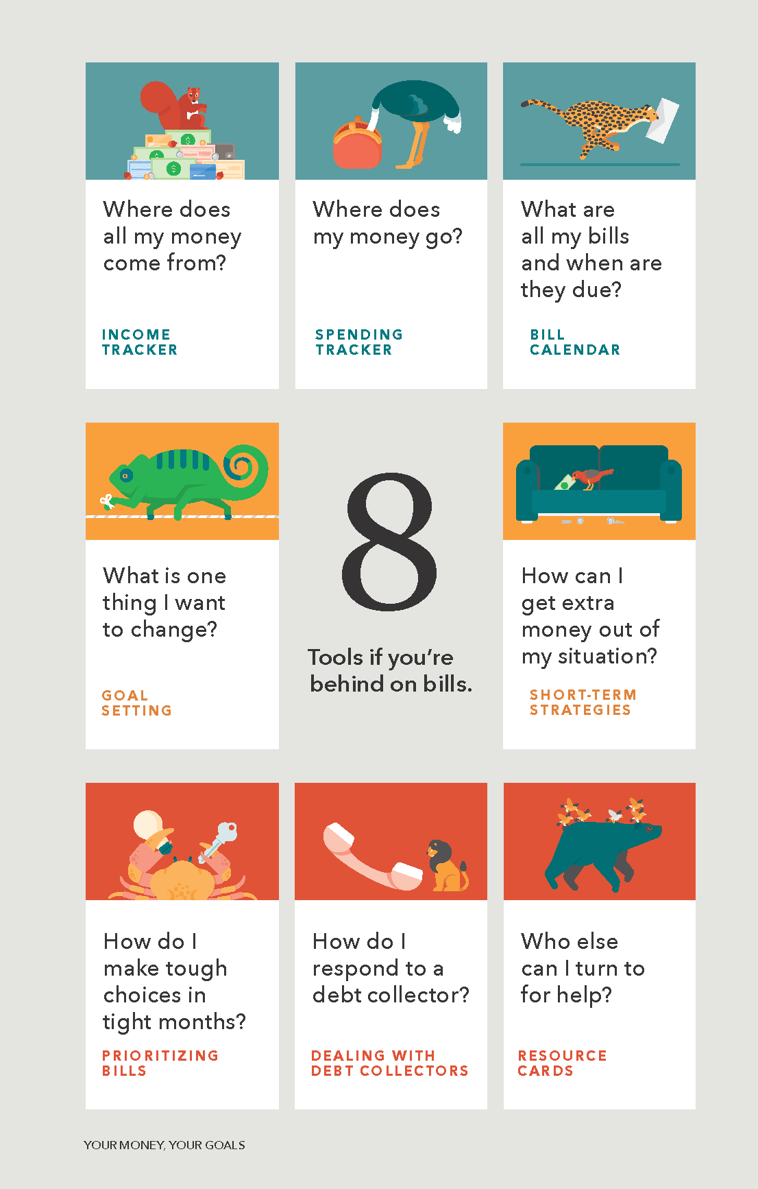
Just the tools
Eight tools if you are behind on bills
Blue-Green – can be used to help people build a clear picture of their income and spending
Yellow – can be used to think about goals and identify ways to increase income and other resources and cut expenses
Red – can be used for immediate challenges and needs

Slide 16

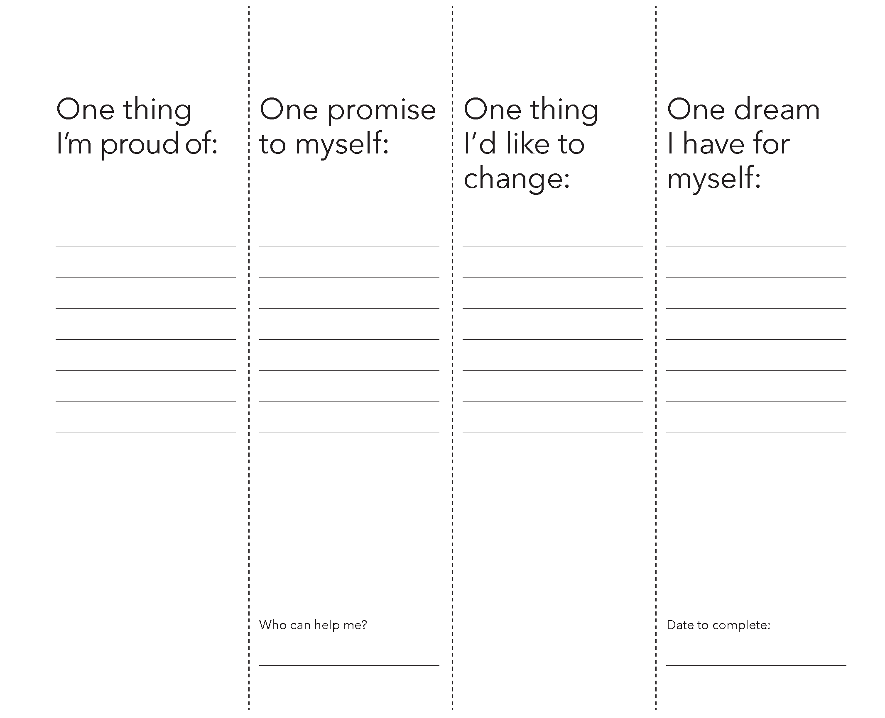
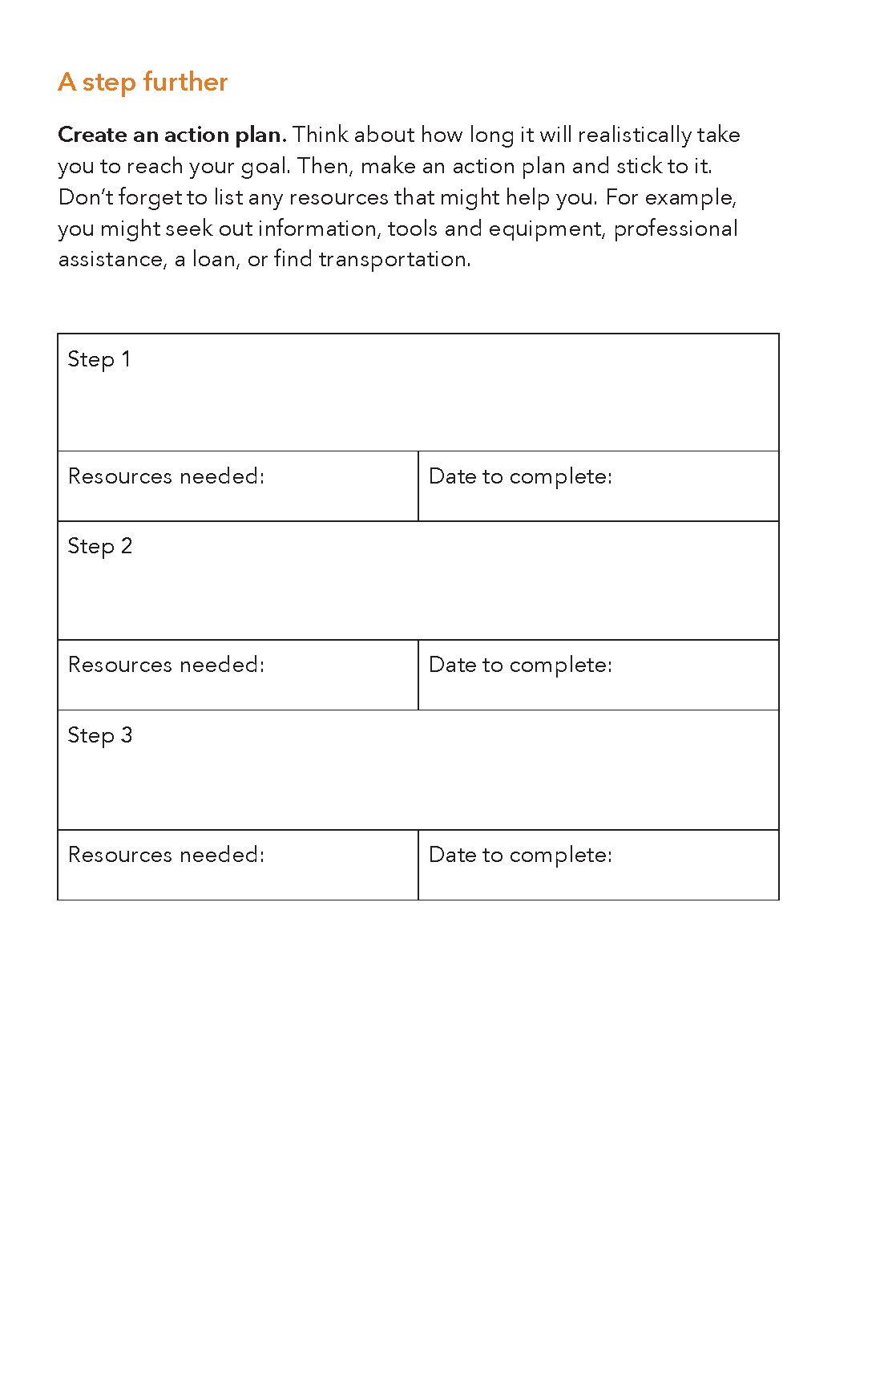
Tool structure
Unfold…
…refold and turn page
Tool description
Worksheet
A step further

Slide 17
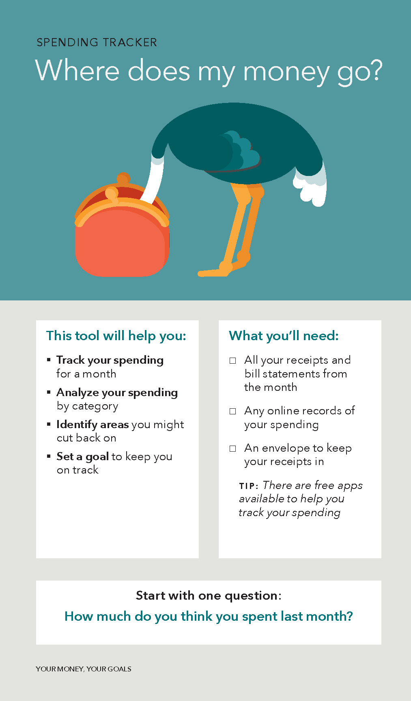
Spending tracker
Track your spending for a month
Analyze your spending by category
Identify areas you might cut back on
Set a goal to keep you on track
Notes:
The Spending tracker can help people build a picture of where their money goes.
You use this tool to help people:
Track their spending for a month
Analyze their spending by category
Identify areas they might cut back on and
Set goals to keep them on track
Open the conversation with the question, “How much do you think you spent last month?” Many people that complete the Spending tracker have “aha” moments not only about the amounts they spend, but also about what they spend it on.
The Spending tracker can be used in a meeting to get an estimate of spending and as “homework” that can help people monitor their spending in “real time.” You can point out that there are also free apps that help people track their spending.
As stated in the “What you’ll need” box, you’ll want to ask the people you serve to collect their receipts and online records of their spending prior to jumping into the worksheet portion of this tool.

Slide 18
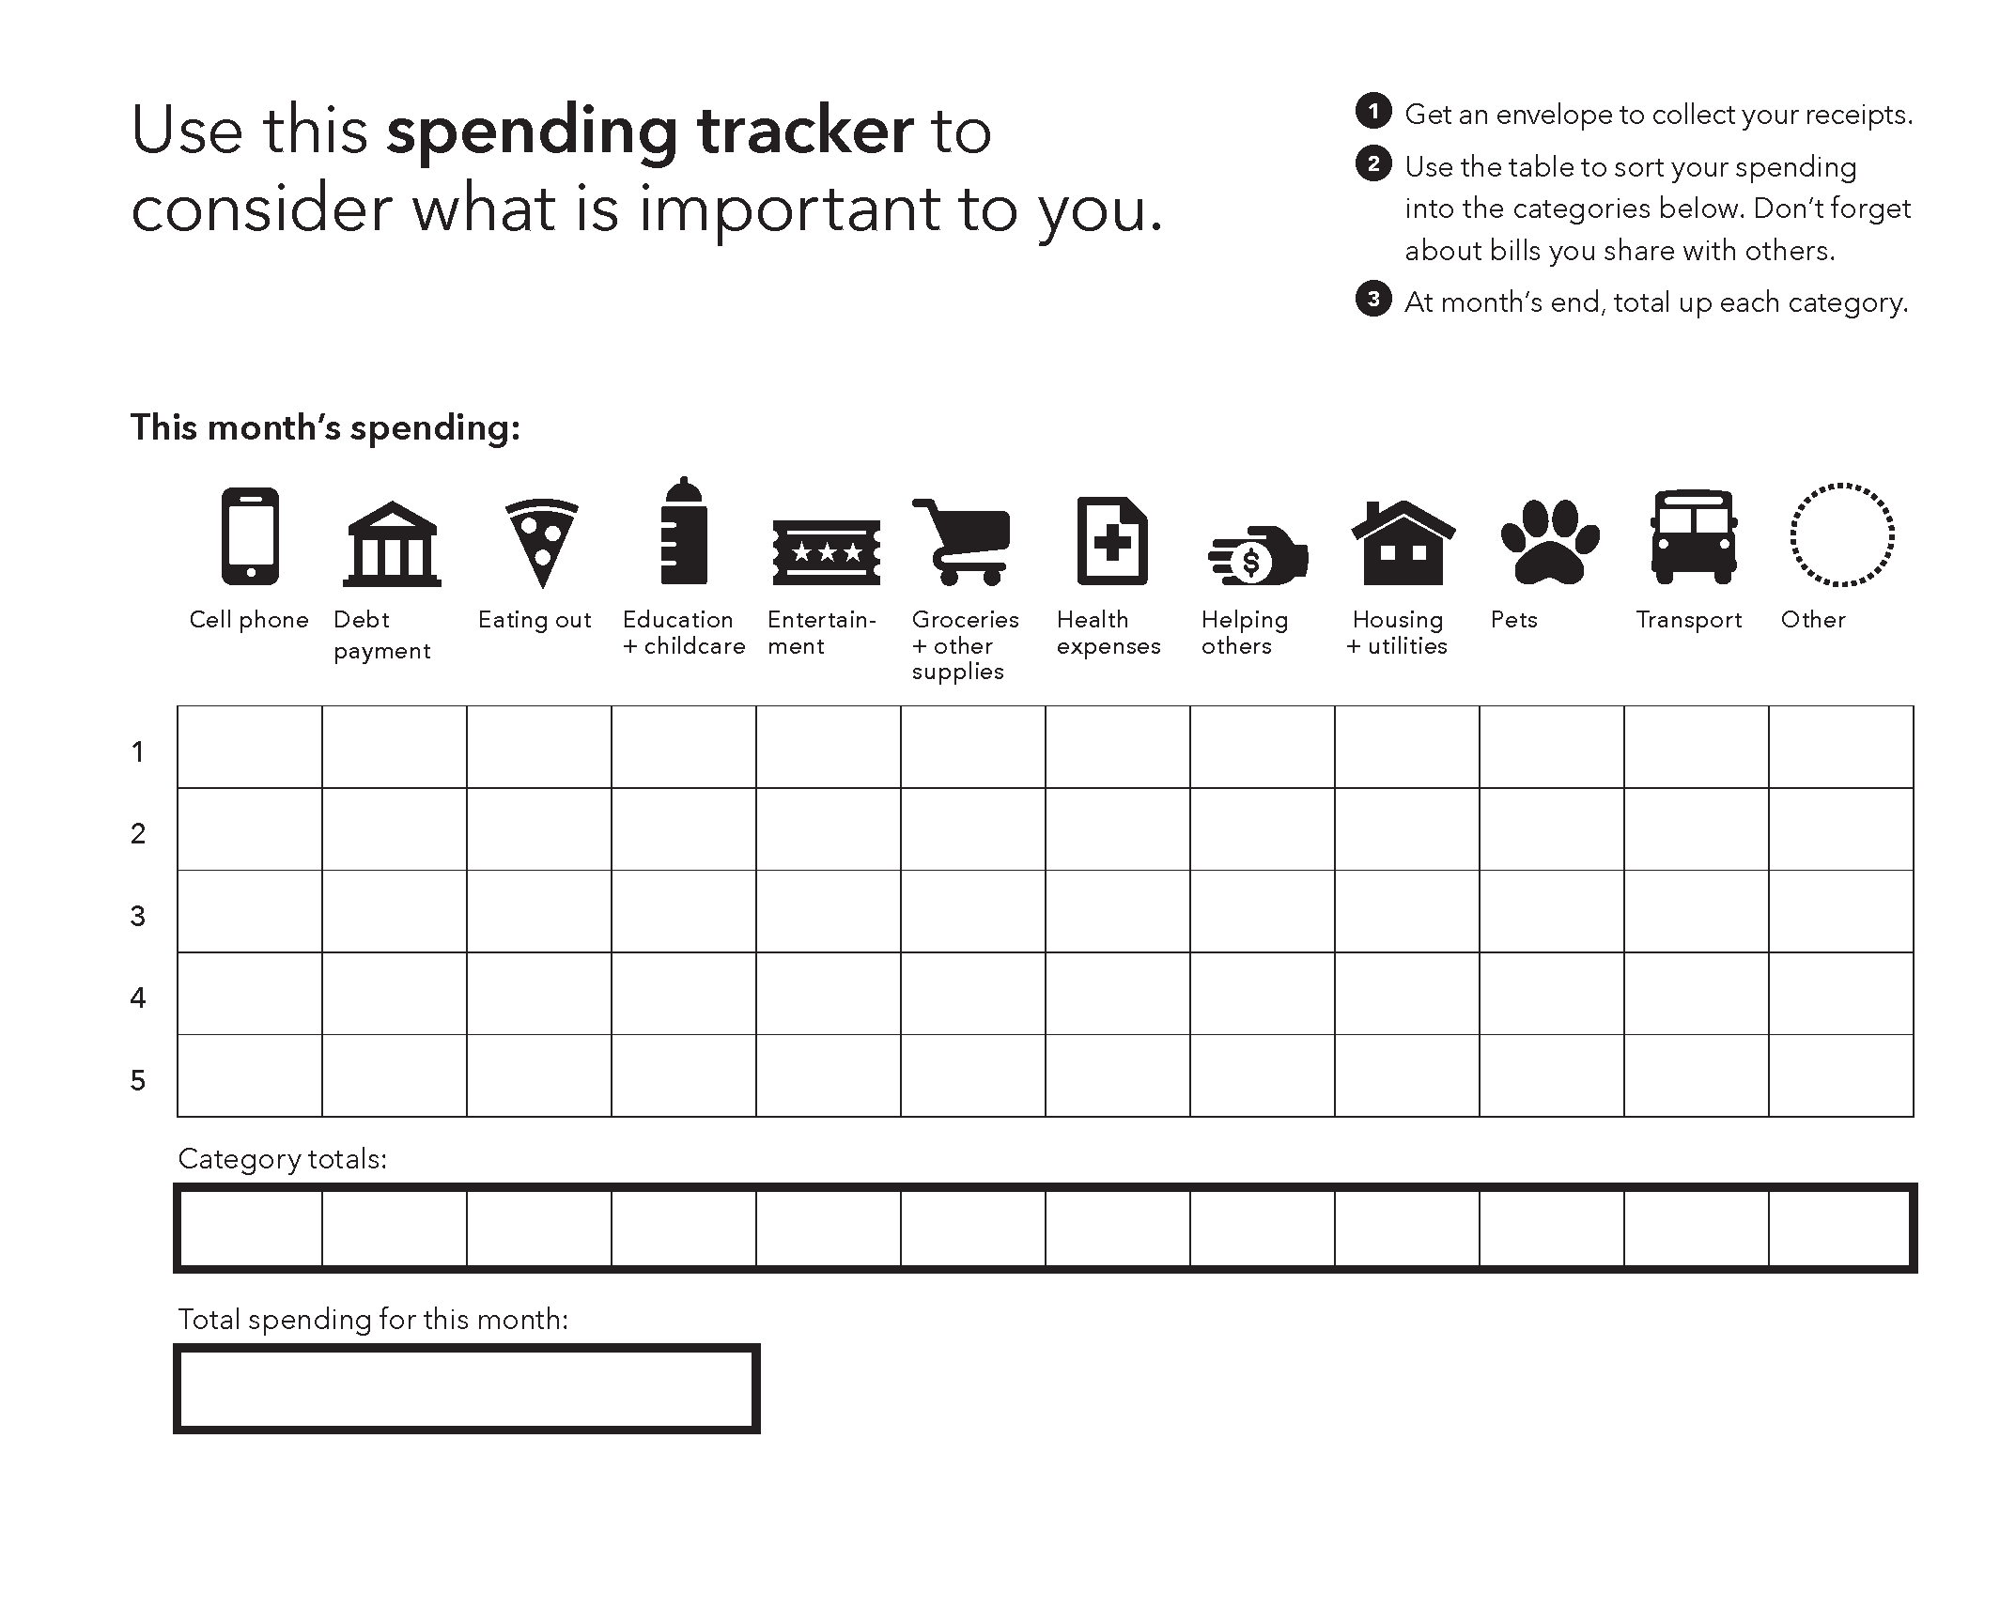
Notes:
The worksheet portion of the Spending tracker provides twelve categories for spending, including an “other” category. Sort the receipts and other documentation of spending into the categories. The rows of the table are the weeks in the month.
Once a person has filled in the week-by-week table, total the costs by category and for total spending during the month. Ask the person what surprises them about the category totals. Does the spending align with their personal priorities?

Slide 19
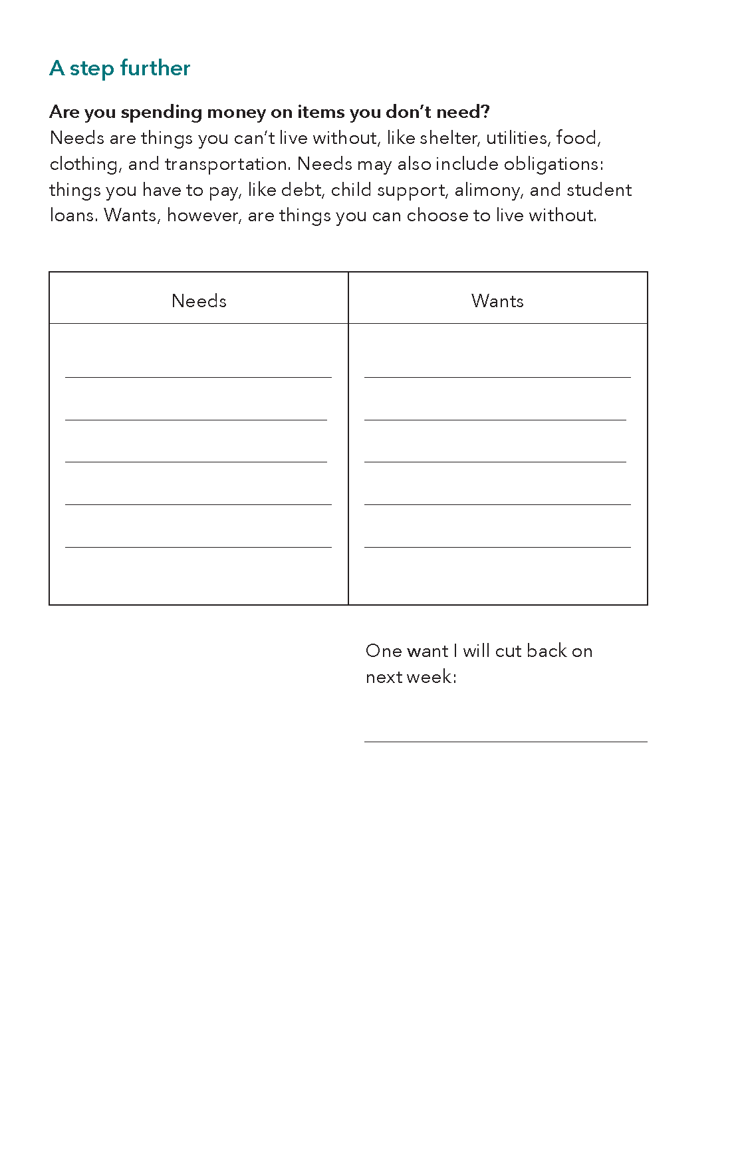
Spending tracker
Notes:
A step further for this tool can help users identify areas where they may want to decrease spending. Classifying expenses as needs and wants is a great way for people to identify where they could cut back.
Practitioners see this tool as a great entry point into a larger budgeting conversation.
Think about the people you work with. What are some specific situations where you would use this tool? Pause this training to jot down those ideas on sticky notes and stick them on this tool.

Slide 20

Debt getting in your way?
Order up to 50 copies for free at: https://pueblo.gpo.gov/BureauPubs/BureauPubs.php?PubID=13324

Slide 21
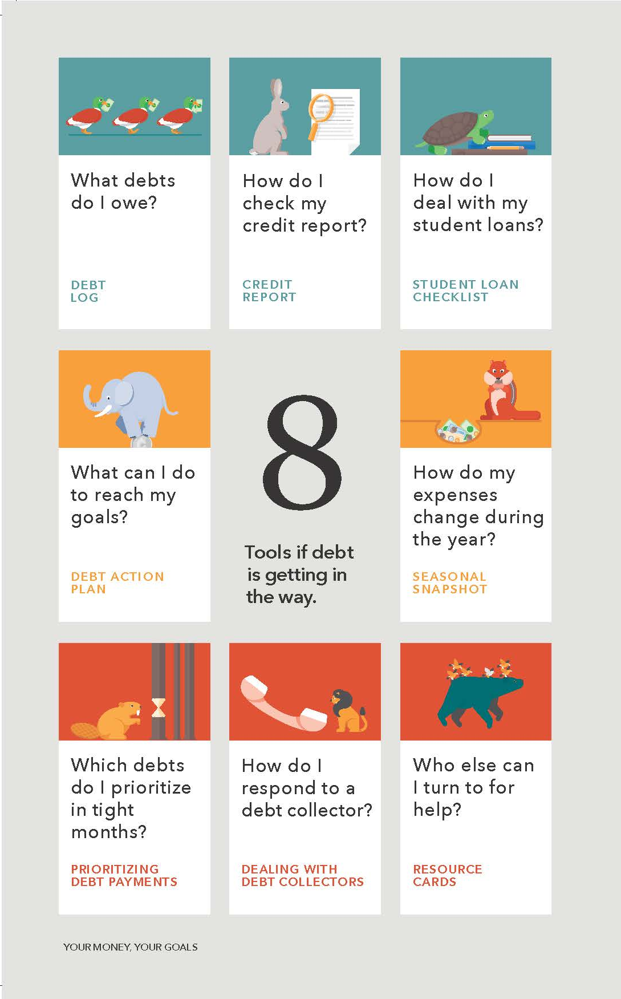
Tools
Track your debts
Check your credit report
Understand student loan repayment options
Set a goal to keep you on track
Think about seasonal and unexpected expenses that can lead to debt
Prioritize payments in tight months
Respond to debt collectors

Slide 22
Your Money, Your Goals Implementation in the Field

Slide 23
2019 Your Money, Your Goals Cohort

Slide 24
Factors for Success

Slide 25

Building Financial Capability, Tools for Planning

Slide 26
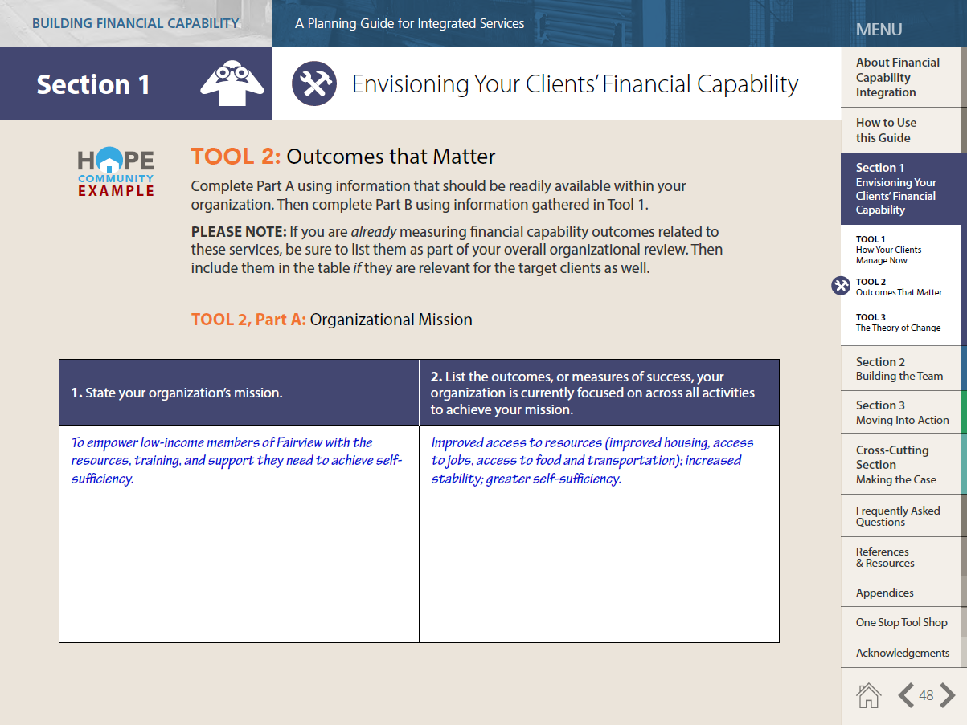
Tool 2: Outcomes that Matter (Starts on page 45)

Slide 27
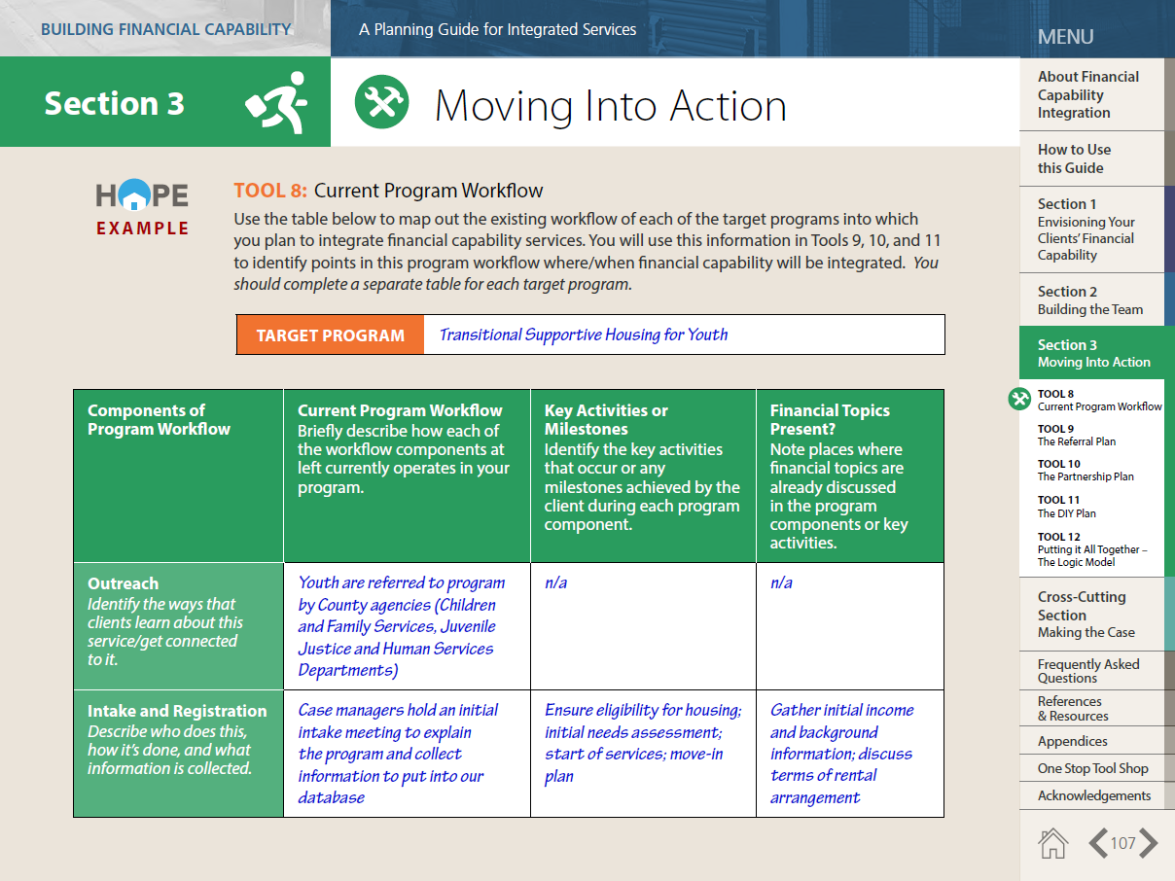
Tool 8: Current Program Workflow (Starts on Page 106)

Slide 28
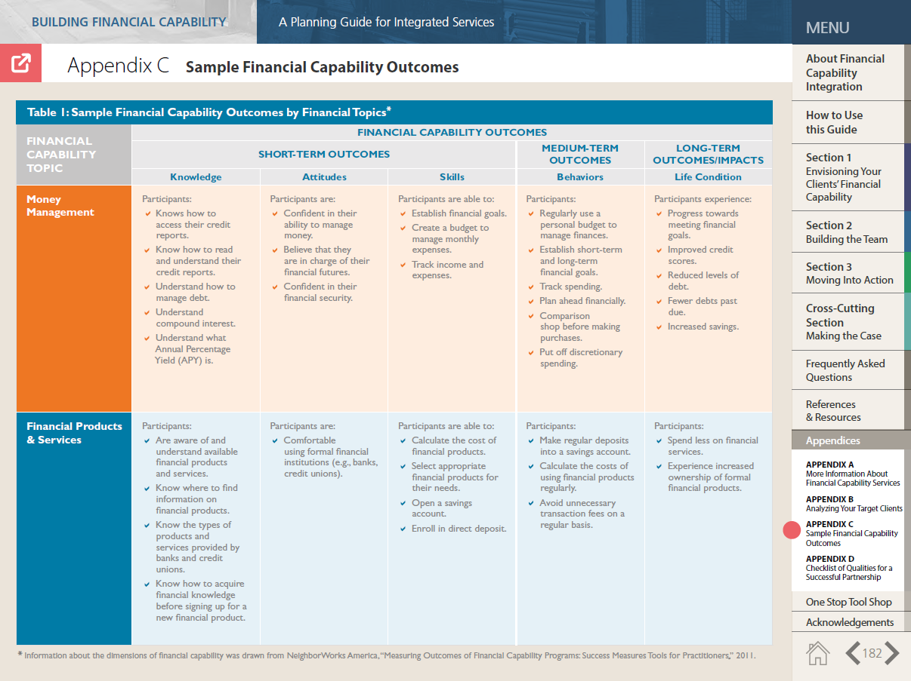
Appendix C: Sample Financial Capability Outcomes (Starts on page 182)

Slide 29
2019 Your Money, Your Goals Cohort Application

Slide 30
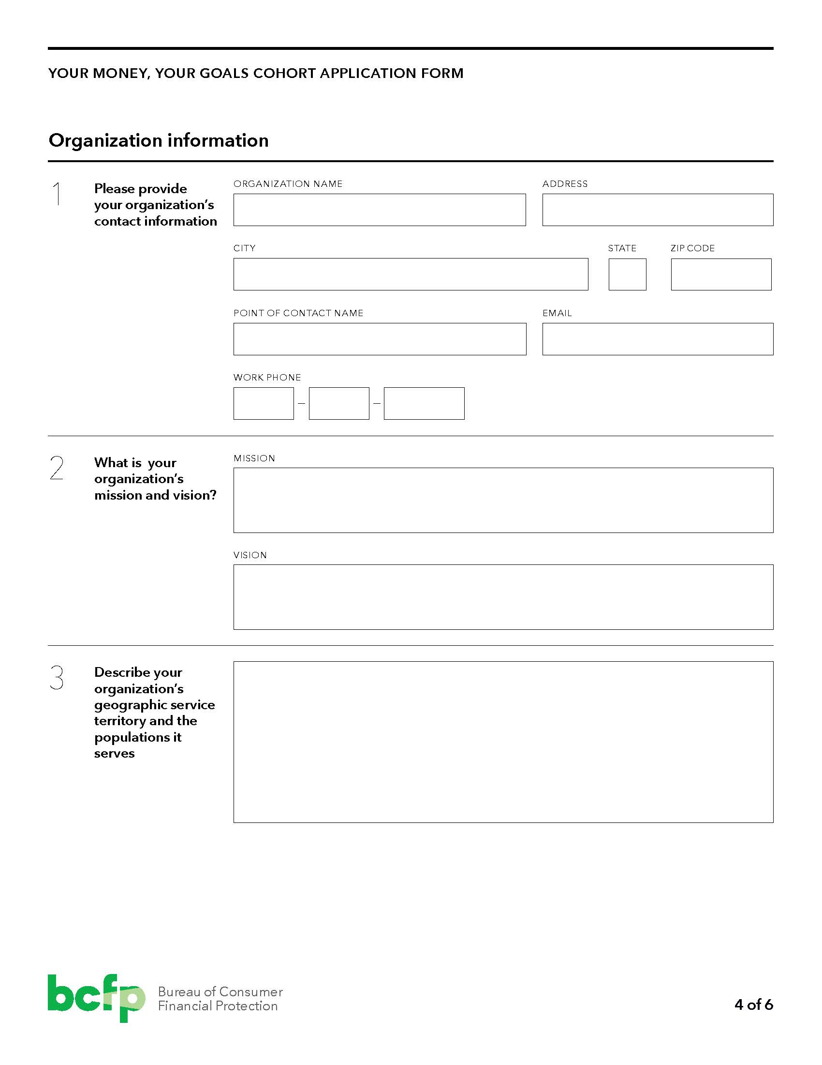
Your Money, Your Goals Application, page 4

Slide 31
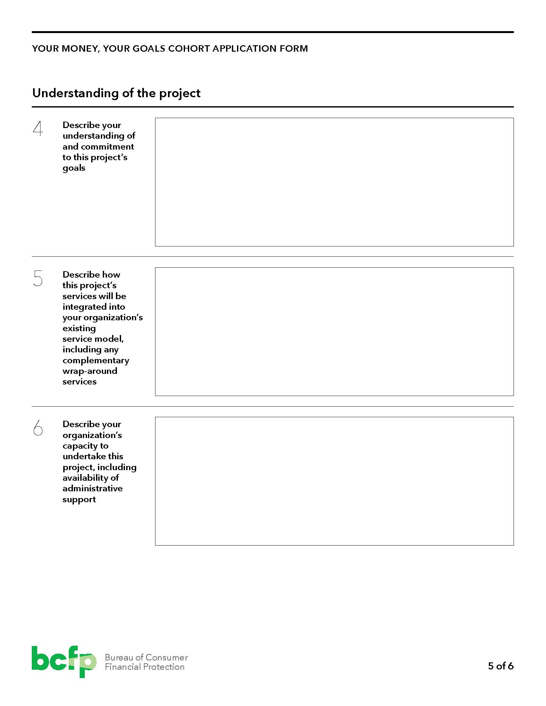
Your Money, Your Goals Application, page 5

Slide 32
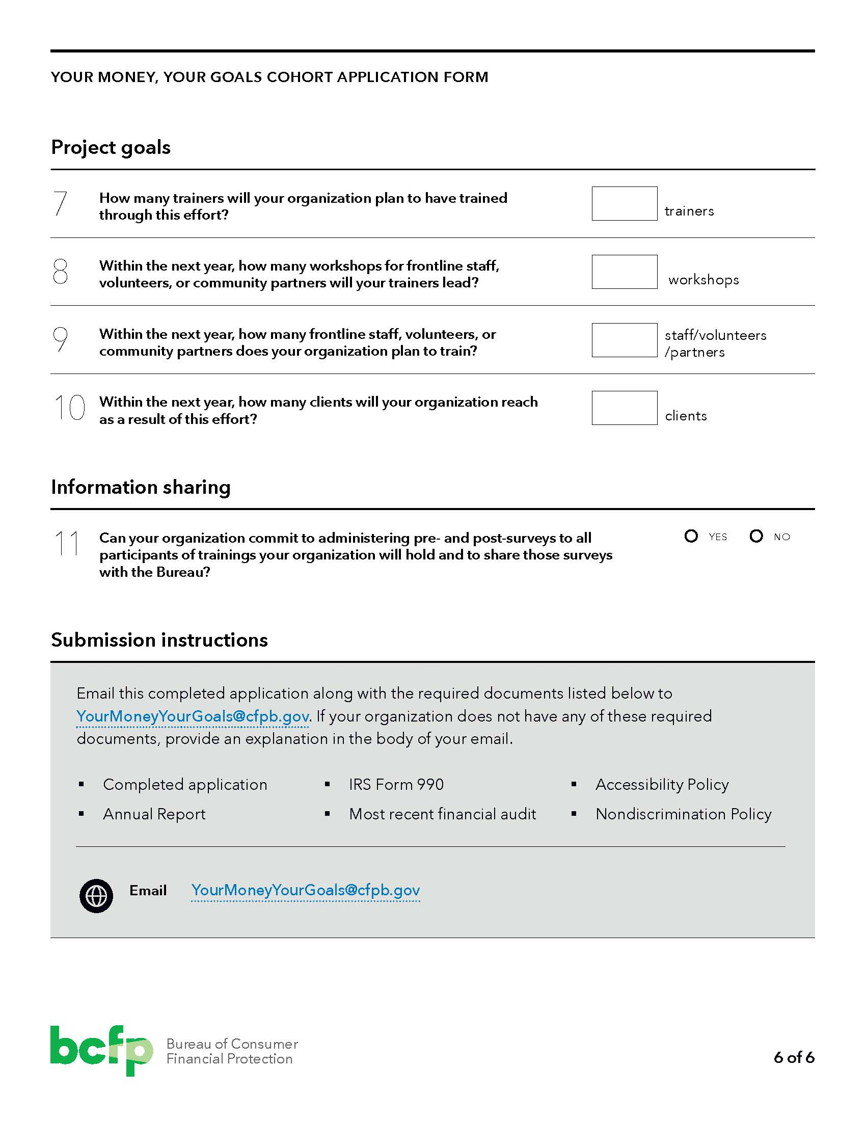
Your Money, Your Goals Application, page 6

Slide 33
Q&A

Slide 34
Thank you!
https://www.consumerfinance.gov/your-money-your-goals/
YourMoneyYourGoals@consumerfinance.gov

