Slide 1
On Site On Call
By the Numbers
Jeff Davis, OPRA

Slide 2
OSOC
Created in 2005 and based on a minimum wage of $5.15 it was assumed that staff could “sleep” all night and agencies could pay staff minimum wage.

Slide 3
OSOC
Minimum Wage
2005 2018 Percentage Increase
$5.15 $8.30 61.1%
DODD Direct Care Wage Component-OSOC Rate
2018 Percentage Increase
$5.15 $6.99 35.7%

Slide 4
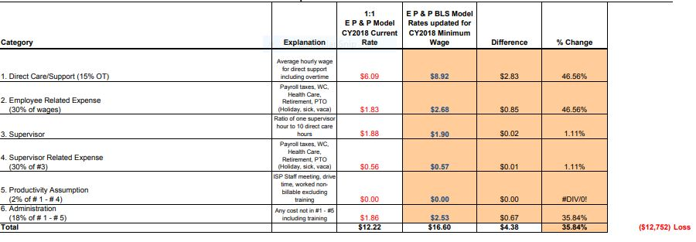
2/19/2018 EPP Rate Model updated to 2018 include Psyciatric 1 to 1 Example 15% OT All Providers
OSOC H/PC Cost Compared To E P & P Calculation of Base

Slide 5
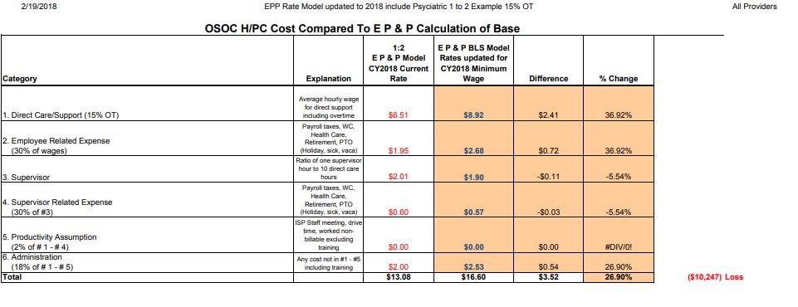

Slide 6
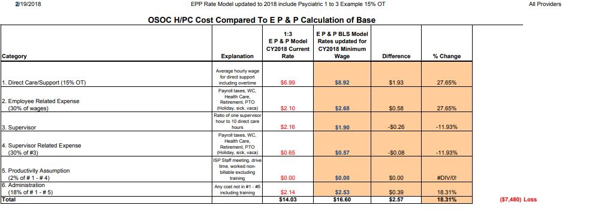

Slide 7
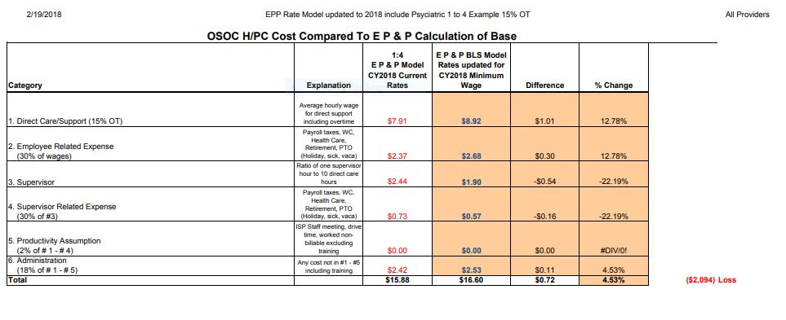

Slide 8
OSOC
When authorizing OSOC we are saying to providers this is what
we are paying you to pay your direct care staff:
Full time staff annual salary - OSOC
$12,667
*1:1= $6.09 per hour x 2080 hours
Compare that to what providers actually pay staff:
$17,264 minimum wage ($8.30)
$23,358 OPRA Wage Survey Average Wage ($11.23)

Slide 9
OSOC
In every conceivable OSOC scenario we are reimbursing providers a direct care wage component LESS then minimum wage and LESS then their actual costs

