Slide 1
EVV and Program Integrity
John Maynard, CPA
Medicaid Program Integrity Director
April 18, 2018

Slide 2
Program Integrity Basics
Fraud
Criminal act (intent) by deception
Goal is theft goes undetected
Waste
Not intentional
Over- or under-utilization
Abuse
Not medically necessary
Fails to meet professionally recognized health care standards
Beneficiary unnecessary costs

Slide 3
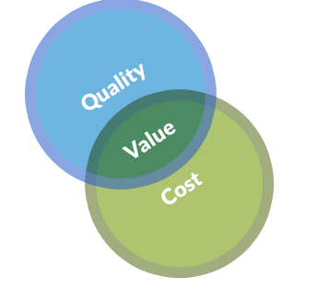
Program Integrity Basics (Ohio Perspective)
Quality of Care and Value
Quality of Care as Fraud & Abuse Indicator

Slide 4
Quality of Care Matters
Nurse sentenced for health care fraud in
patient death case
10 years for manslaughter,
2 counts health care fraud
$134,761 restitution

Slide 5
Quality of Care Matters

Slide 6
Quality of Care Matters

Slide 7
Quality of Care Matters
Eye on Oversight: Home Health Care

Slide 8
Program Integrity by the Numbers

Slide 9
Ohio Works to Fight FWA in the Medicaid Program

Slide 10
Program Integrity Activities for HCBS
Provider Screening & Enrollment
Background Checks
Onsite Visits
Provider Training
Structured Reviews
Annually by PCG
Provider Education
Overpayment Recovery
Claims Processing
Payment Edits

Slide 11
Program Integrity Activities for HCBS
Audits
ODM
AOS
CMS/UPIC
Provider Compliance
Non-Audit Reviews
Provider Education
Policy Reviews and Training
Program Integrity Group (PIG)
Managed Care Program Integrity Group (MCPIG)

Slide 12
Program Integrity Activities for HCBS
Fraud Referral and Investigation
ODM
AGO-MFCU
HHS-OIG
Fraud Indictments and Convictions
#1 Nationally – Convictions
#2 Nationally – Indictments
MFCU estimates 70% convictions HCBS related

Slide 13
Fraud Costs All of Us

Slide 14
Potential Costs of FWA in Medicaid HCBS
Individuals needing services may not actually receive them
Result: Medically necessary services are not received
Result: Poor health outcomes, increased costs due to need for more care such as hospitalization or nursing home services
Individuals may not receive the required quality of care
Result: Health and safety issues may arise, placing individuals at risk for injury or death when the safety net doesn’t work
Result: Poor health outcomes, increased costs
Limited service dollars are wasted and difficult to recover
Result: Access to HCBS limited due to lack of funding to expand
Result: Payment rates are compressed due to the wasted funds
Result: Cost control may limit services or individual eligibility

Slide 15
Potential Costs of FWA in Medicaid HCBS
Phase One Costs for Services Potentially Subject to EVV (FY17)
$407M for Fee-for-Service (FFS)
$330M Agency Providers
$77M Non-Agency Providers
Phase Two Costs for Services Potentially Subject to EVV (FY17)
$2.1B for both FFS and Managed Care
$1.9B Agency Providers
$178M Non-Agency Providers

Slide 16
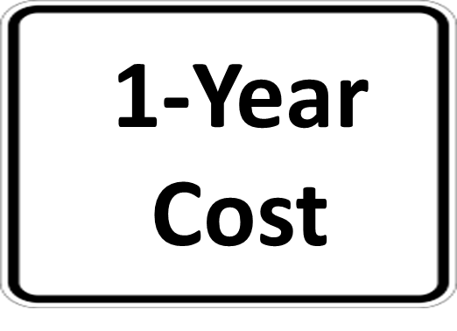
Potential Costs of FWA in Medicaid HCBS
Phase One - $407M
$12M
$40M
Phase Two - $2.1B
$63M
$210M

