Slide 1
DODD Provider Certification Wizard & Provider Search

Slide 2
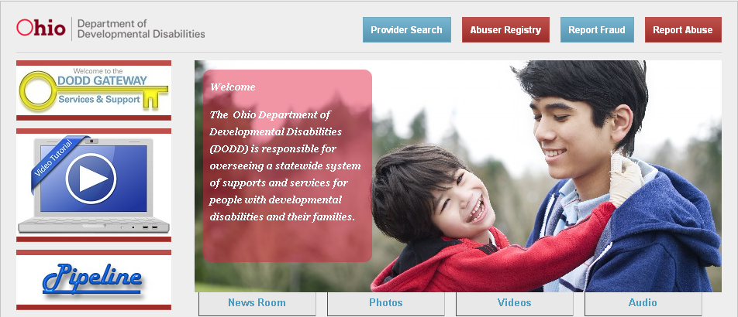
DODD Provider Certification

Slide 3
DODD Provider Certification
October 1, 2009, the Ohio Department of Developmental Disabilities implemented time-limited certification.
To have a more up-to-date record of current providers in the DD system
To revalidate providers every three years to ensure that they continue to meet the standards of certification
To help families and individuals to better find providers who are actively providing and/or are willing to provide services to individuals with developmental disabilities

Slide 4
DODD Provider Certification
PCW
Before a provider can update their certification information, they must log into Provider Certification Wizard and authenticate their contract number to the PCW system. To do this, the provider must start at http://dodd.ohio.gov.

Slide 5
DODD Provider Certification
Once at the DODD home page, select the DODD Gateway.

Slide 6
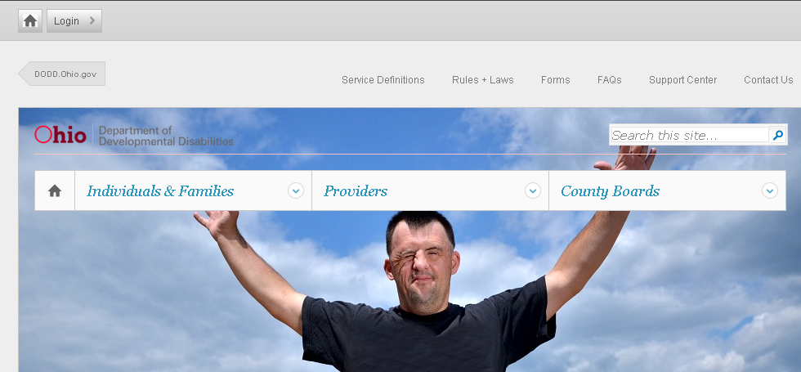
DODD Provider Certification
Providers who already have a security account and logs in regularly to do their billing can go to the login option at the top of the screen and enter their username and password to get started.

Slide 7
DODD Provider Certification
PCW
You will now be taken to the provider portal. As a provider who wishes to use PCW, you will need to select Providers in the middle of the page. You will select certification from the dropdown menu.

Slide 8
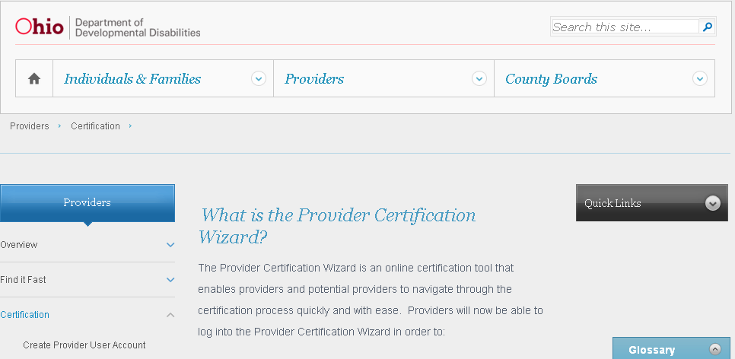
DODD Provider Certification
After selecting Certification from the provider dropdown menu, select that you wish to create a provider user account.

Slide 9
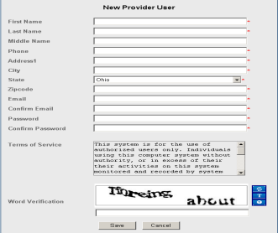
DODD Provider Certification
Creating a User Account
Once the provider selects to Create a
Provider User Account, they will
see the following information
request.
Once you have entered your in-
formation, an email will be sent
to you verifying your user ID.

Slide 10
DODD Provider Certification
Once you have your username and password, go back to the home page and select to Login.

Slide 11
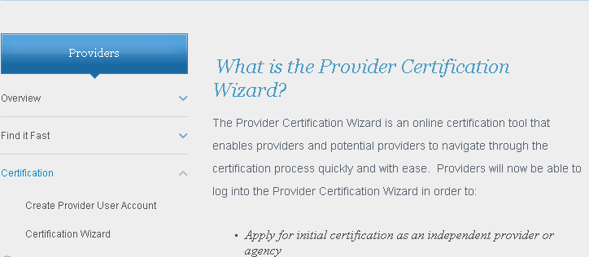
DODD Provider Certification
After you have logged in, you should see your name now at the top of the screen. Return to the provider Section, select Certification from the dropdown menu, and select Certification Wizard.

Slide 12
DODD Provider Certification
Once you select Certification Wizard, you will be asked to identify yourself as a new provider or an existing provider.

Slide 13
DODD Provider Certification
Existing providers will need to enter their contract number and either the last four digits of SSN (independent providers) or the entire Tax ID number (agency providers).
Once you have entered this information and selected View, you will now be able to look at your certification information and make changes to your existing information.

Slide 14
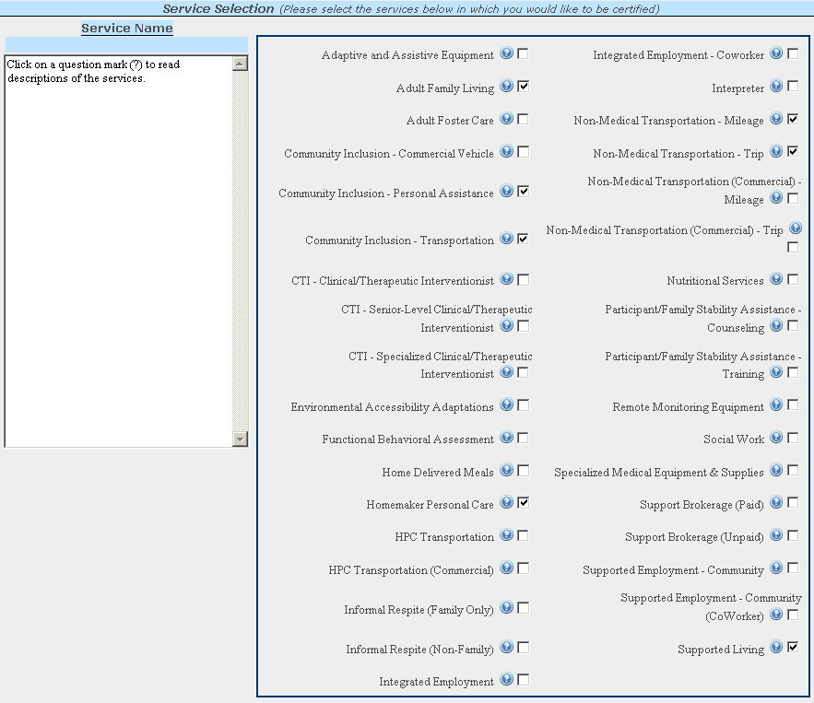
DODD Provider Certification

Slide 15
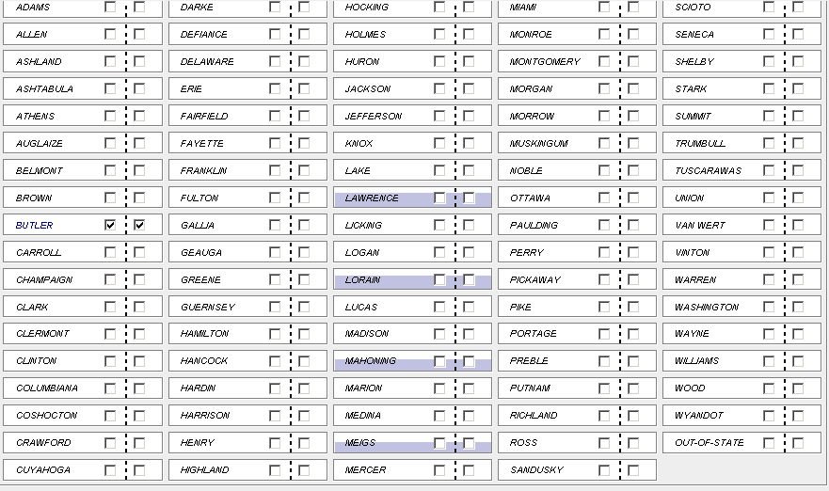
DODD Provider Certification

Slide 16
DODD Provider Certification
Things to be aware of:
There is a fee for certification (there are certain services that for which the fee does not apply) for both initial and renewal.
If you allow your certification to lapse, it can and likely will result in the inability to bill for services. You should not be providing services while expired.
An overview of provider requirements for independent certification can be found at https://doddportal.dodd.ohio.gov/PRV/welcome/becomingaprovider/Pages/Independent-Providers.aspx.
An overview of provider requirements for agency certification can be found at https://doddportal.dodd.ohio.gov/PRV/welcome/becomingaprovider/Pages/Agency-Providers.aspx.

Slide 17
DODD Provider Search
A new provider search tool was launched on October 31, 2011, allowing for some improved features
Providers can update information in the Provider Certification Wizard (PCW) that feeds every 24 hours to the provider search. This includes demographic changes, as well as a number of additional features that are new to PCW.

Slide 18
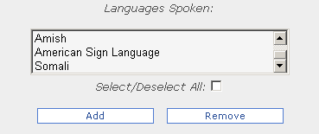
DODD Provider Search
Languages spoken
This includes a list of different languages that can help families who may be looking for a specific language (i.e. sign language)

Slide 19
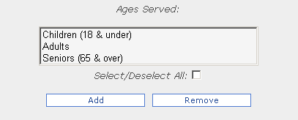
DODD Provider Search
Ages served
For families looking for a provider who has worked with individuals in a particular age group, the provider can indicate this experience.

Slide 20
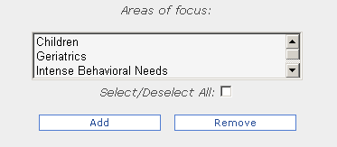
DODD Provider Search
Areas of Focus
This category allows providers to indicate if they have experience focusing with a specific group of individuals with developmental disabilities.

Slide 21
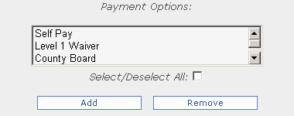
DODD Provider Search
Payment Options
This allows the provider to indicate if they are willing to provide services to individuals on the IO, Level One, and SELF waivers, and if they accept additional forms of payment for services.

Slide 22
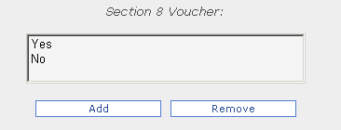
DODD Provider Search
Section 8 Vouchers
If you are a provider who accepts section 8 vouchers for housing, you can indicate this by selecting this option.

Slide 23
DODD Provider Search
Agency with Choice
If the provider is certified as a SELF Waiver provider, they may indicate if they elect to be an agency with choice, meaning that they are willing to hire the provider that the individual elects to provide the services. The provider may also indicate that they are willing to hire family members.

Slide 24
DODD Provider Search
Providers have the ability to update their demographic information; any required documentation would be indicated within the application depending on the information that is being changed (i.e. name, tax ID, address, email, etc.)

Slide 25
DODD Provider Search
Providers can also update the counties that they wish to be listed as looking for new business through PCW; this indicates to the families that these providers are actively wishing to provide services to individuals and wish to be contacted.

Slide 26
DODD Provider Search
Providers can also provide information about their business that includes
Websites
Pictures
Service Descriptions
These areas are pre-approved by DODD staff before being added to the provider search.

Slide 27
DODD Provider Search
Provider Search can be accessed from multiple areas of the website at http://dodd.ohio.gov and in the provider portal.
Information that is updated through PCW will update in the provider search within 24 hours.
Providers who have allowed their certification to expire will no longer be viewable in the provider search.

Slide 28
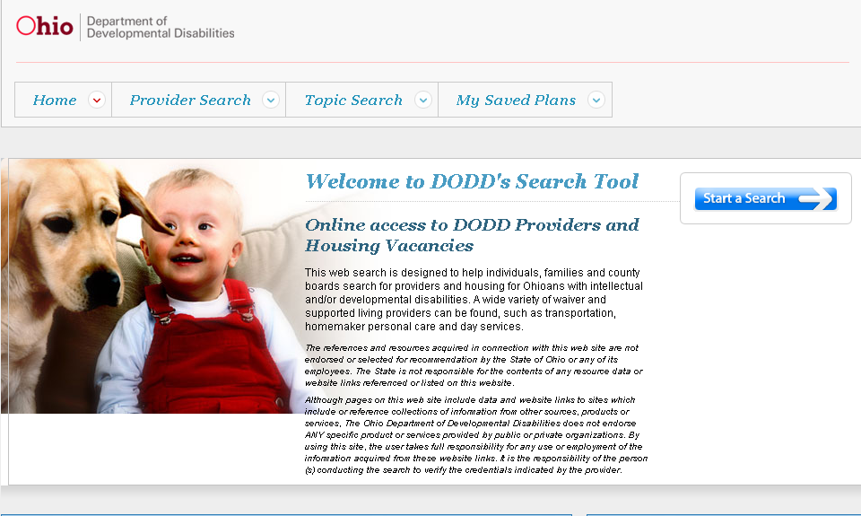
DODD Provider Search
Once you have selected to go to Provider Search, you will be taken to the following page.

Slide 29
DODD Provider Search
Select to Start a Search

Slide 30
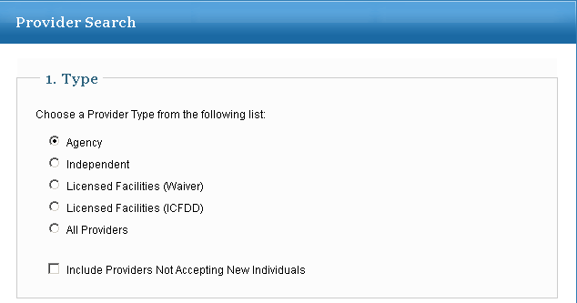
DODD Provider Search
There are several different options for the search. The first option is to search by provider type.
Note that if you select the box Include Providers Not Accepting New Individuals, it will show all providers; this includes the providers who do not wish to be called to provide services to individuals.

Slide 31
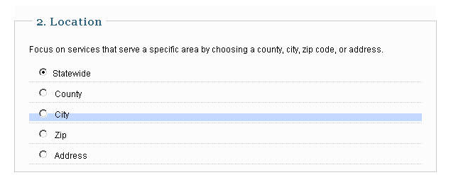
DODD Provider Search
You can also search by location. There are a number of different types of locations that can be searched.
Notes:
There is also an optional Name Search if you know the name of the provider.

Slide 32
DODD Provider Search
You can also search by a specific service.
There is also an optional Name search, if you know the name of the provider.
Notes:
There is also an optional Name Search if you know the name of the provider.

Slide 33
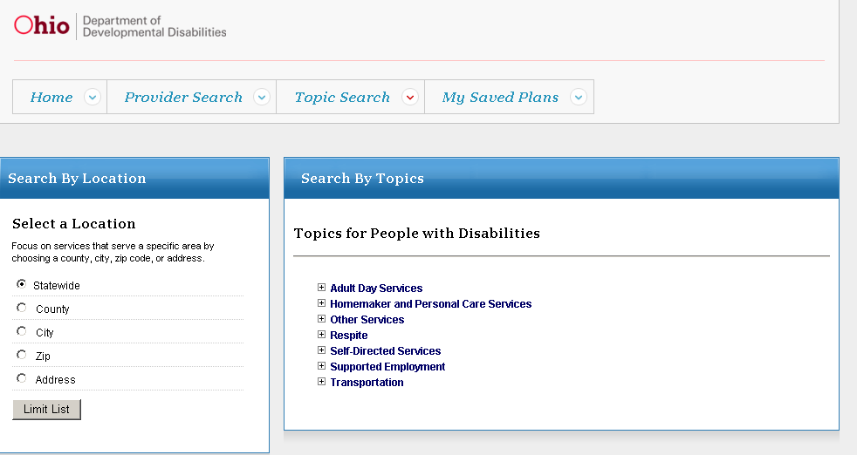
DODD Provider Search
You are able to search by Topics from the main page of the provider search website.

Slide 34
DODD Provider Search
Once you have entered your search criteria, the results will display.

Slide 35
DODD Provider Search
To see a list of all services that a provider is certified to provide, there is a small icon next to the name of the provider that will expand the information about the services this provider is certified to provide.

Slide 36
DODD Provider Search
By selecting the service of the agency under the search, you can see a complete page of information regarding that provider.

Slide 37
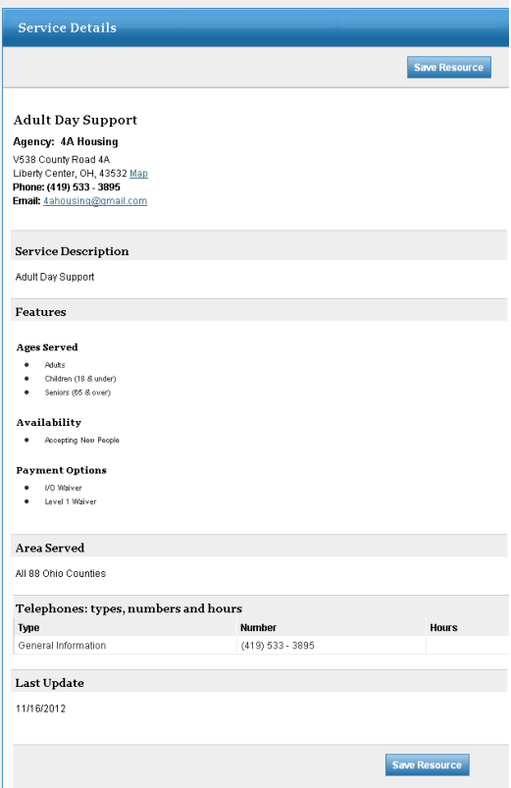

Slide 38
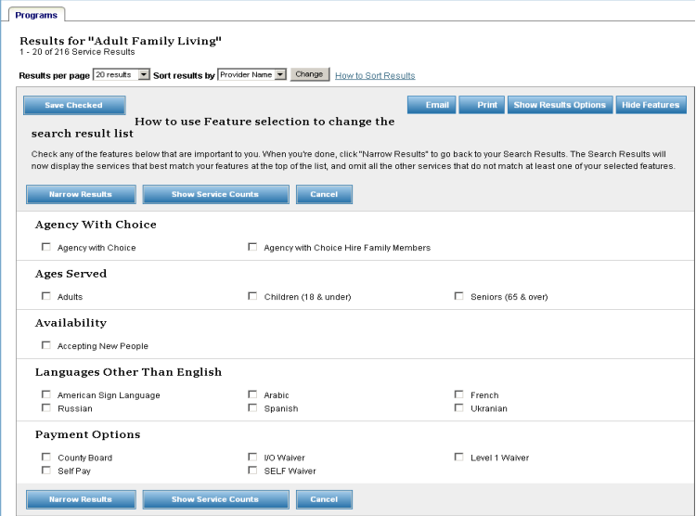
DODD Provider Search
If you want to narrow your search, you could select to Show Features.

Slide 39
DODD Provider Search
If there are additional features listed, you can select the feature and narrow your results to include only providers who have indicated these features.

Slide 40
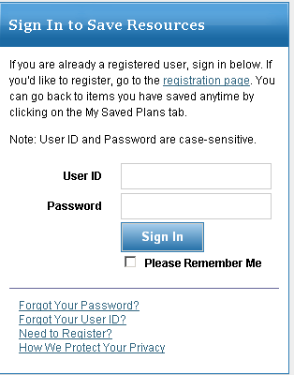
DODD Provider Search
Saving your search
On the Home page of the provider search, you can create an account that will allow you to save your searches when logged into the system.
The login that you create does not
carry over from the login from PCW;
you will need to create a separate account.

Slide 41
DODD Provider Search
Saving your search
Once you have logged into your account, you are able to save your searches.

Slide 42
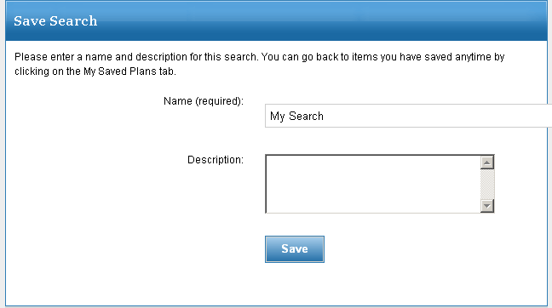
DODD Provider Search
Saving your search
Once you have logged into your account, you are able to save your searches.
You will be able to save with a name of the search and also a description.
This will automatically update when the data changes in the provider search.

Slide 43
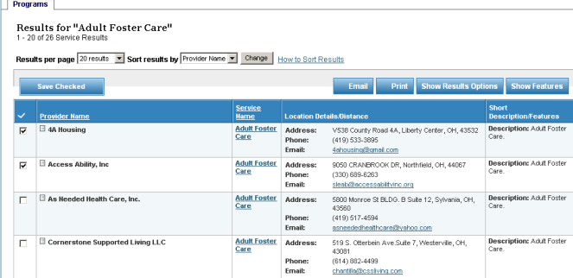
DODD Provider Search
Saving a Plan
You can also save a specific plan of different providers. By checking the provider you wish to save to a plan, and then selecting Save Checked, you can have a variety of providers for varying services in one place. This is useful if you wish to keep track of specific providers for a particular individual.

Slide 44
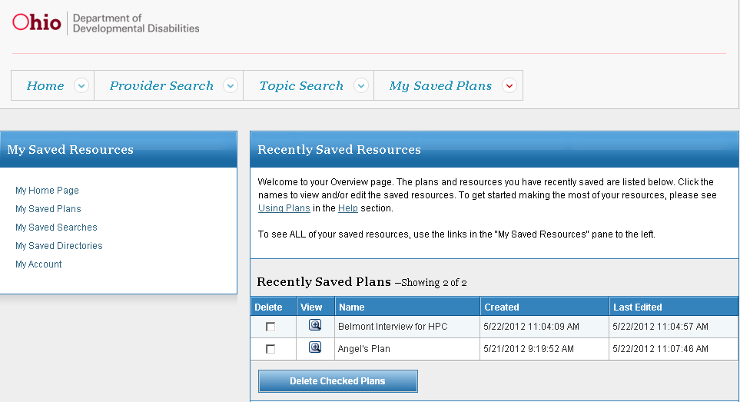
DODD Provider Search
You can look at all of your saved searches and saved plans in one place by looking under My Saved Plans.

Slide 45
DODD Provider Search
Questions?
Contact DODD Support Center at
1-800-617-6733, Option 3

