Slide 1
Overview for Ohio Provider Resource Association
March 3, 2017

Slide 2
Importance of Quality Early Care, Learning & Afterschool Programs
Essential part of today’s economy
Investment in quality child care equals:
Kindergarten readiness
Increased 3rd grade reading proficiency
Higher graduation rates
Reduced need for intervention
Less involvement with the juvenile justice system
Develops a strong workforce
Notes:
Quality Early Care, Learning and Afterschool programs are an essential part of today’s economy:
Allows parents to work more effectively knowing that their children are in settings that are safe, healthy, and promote learning.
Provides young children with the preparation they need to enter school ready to succeed.
Supply employers with the next generation of workers who will be ready to tackle the jobs of the future.
Investment in quality child care equals:
Kindergarten readiness
Increased 3rd grade reading proficiency
Higher graduation rates
Reduced need for intervention
Less involvement with the juvenile justice system
Builds a ready workforce

Slide 3
Profile
Incorporated in 1989
Proven public-private partnership
Governed by a board of directors
CCR&Rs serve as regional hubs providing professional development and technical assistance
Notes:
The Ohio Child Care Resource & Referral Association is a nonprofit agency that serves as a member association for the state’s child care resource and referral agencies (CCR&Rs).
Currently governed by a board of directors comprised of eight regional Child Care Resource & Referral (CCR&R) agencies and five community at-large members
CCR&Rs serve as regional hubs providing professional development and technical assistance to child care, early learning, and afterschool local programs

Slide 4
Profile
Members
4C for Children (SDA 6 & 8)
Action for Children (SDA 9)
Child Care Connection (SDA 4)
Child Care Resource Center (SDA 2)
COAD Child Care Resource Network (SDA 5, 10, 11)
Starting Point (SDA 3)
YWCA Child Care Resource and Referral of Northwest Ohio (SDA 1, 7, 12)

Slide 5
Core Services
Services for Professionals
Services for Programs
Services for Families
Notes:
OCCRRA works closely with federal and state government officials on policy and funding improvements to create excellent programs and knowledgeable professionals to support healthy, happy, productive future citizens
OCCRRA’s Core Services focus on professionals, programs, and families of children receiving early care, learning, and afterschool services

Slide 6
Services for Professionals
Credentialing
Administrator, Early Childhood Mental Health & Help Me Grow
Ohio Professional Registry
Professional Profiles
Instructor Approvals
Training Approvals
Workforce Development
T.E.A.C.H. Early Childhood Ohio

Slide 7
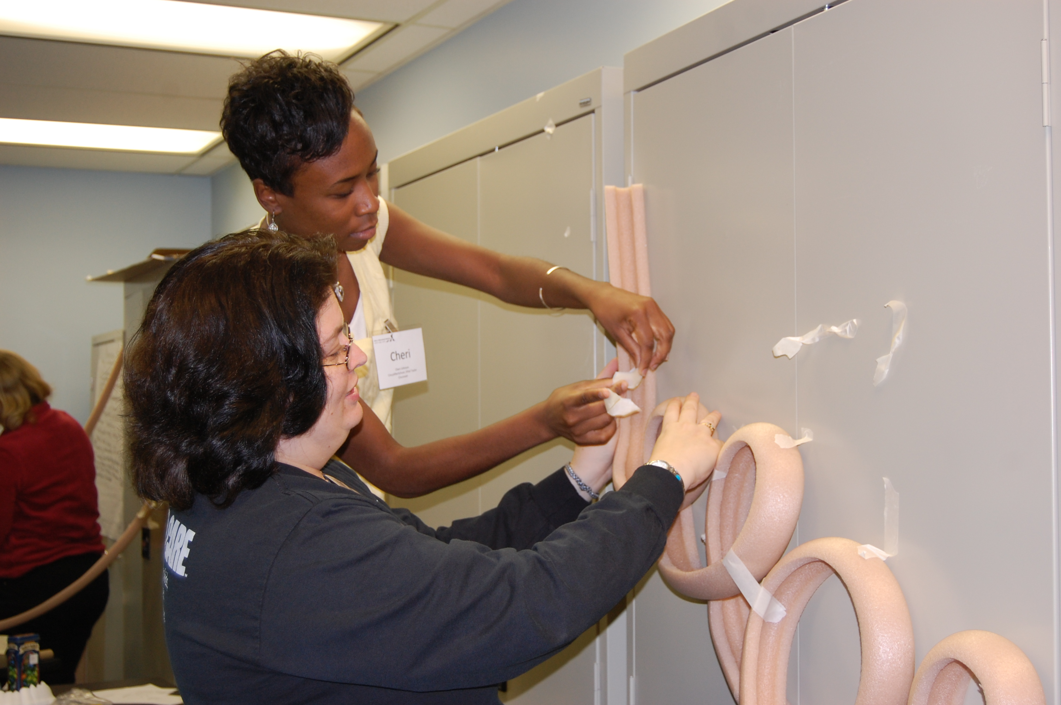
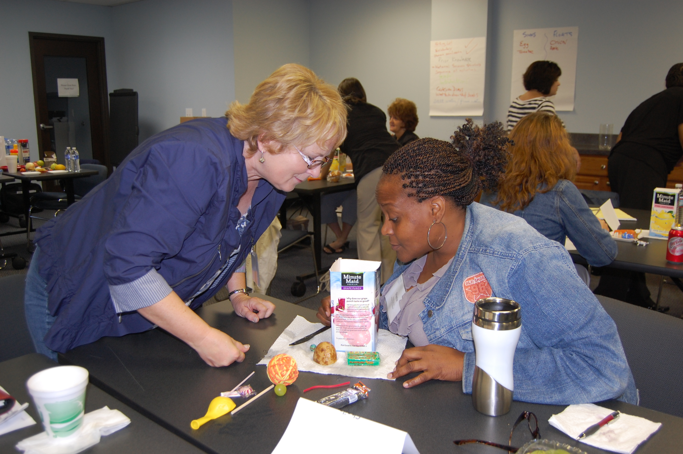
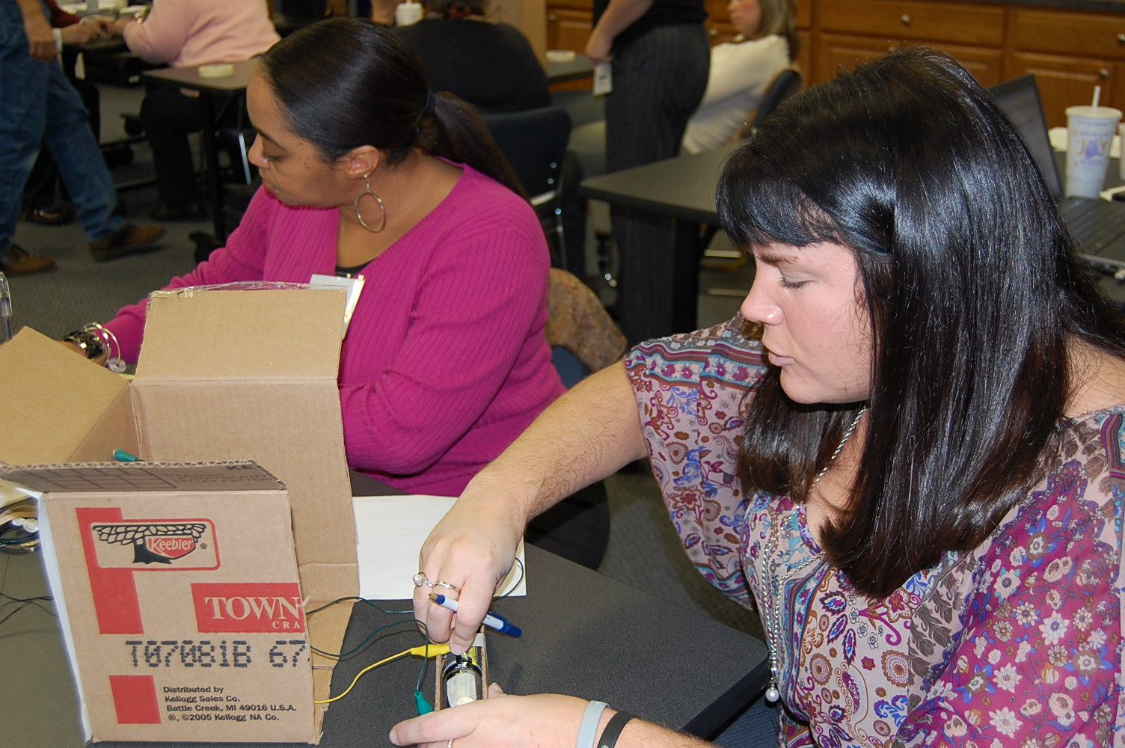
Services for Program
OCCRRA and our members provide training, tools, technical assistance and staff specialists for:
Infant/Toddler Initiatives
Preschool Initiatives
Afterschool Initiatives
Step Up to Quality
Ohio Healthy Programs
Notes:
Infant/Toddler, Preschool, and Afterschool Initiatives - OCCRRA develops trainings and tools, supported by current research and best practices, for professionals in programs serving children and youth.
Ohio is part of a multi-state initiative funded by the National Science Foundation to provide training and technical assistance on offering hands-on, inquiry-based STEM (science, technology, engineering and mathematics) learning experiences to children and youth in afterschool programs. Afterschool programs are an ideal setting to provide rich STEM experiences that help to spark interest and expand the skills of our future workforce.
Step Up to Quality (SUTQ) is Ohio’s quality rating and improvement system for licensed child care programs. Currently these programs voluntarily meet and maintain standards that go beyond minimum licensing requirements. The standards are based on national research linked to improved child outcomes and school readiness. OCCRRA and the CCR&R network in partnership with the Ohio Department of Job and Family Services are the professional development and technical assistance delivery system providing consumer education.
OCCRRA was awarded funding under the Wellness & Obesity Prevention Grant from the Ohio Department of Health. Child care program staff and directors attend a series of training sessions on promoting healthy practices and policies in child care programs and complete additional requirements. Programs receive materials to use with children and parents. Once complete, programs may apply online through the Registry for designation as a Healthy Program, and submit documentation of their program policies.

Slide 8
Services for Families
OCCRRA connects families with their CCR&Rs for:
Child care locations, licensing standards, costs and policies
Step Up to Quality programs rated among Ohio’s best
Tips on parenting and child development
Help determining quality care
Information on financial assistance to pay for care
Notes:
As a parent, choosing a high quality early care, learning and afterschool program is a critical to the success of your child. Our network of child care resource and referral agencies make this challenging process easier. Your CCR&Rs will assist you in asking pertinent questions to determine if a desired program has planned programming, experienced staff, and program policies necessary for your child to learn, thrive, and grow.

Slide 9
Questions?
Todd Barnhouse, CEO
Ohio Child Care Resource & Referral Association
2760 Airport Drive, Suite 160
Columbus, Ohio 43219
614.310.1364 T
614.396.5960 F
tbarnhouse@occrra.org
www.occrra.org

