Slide 1

OPRA Policy Committee
Tuesday, February 21, 2017
10:00-2:00

Slide 2
Welcome:
Neil Castelow
Parent Advocate
http://myvoice4mychoice.org/

Slide 3
OPRA-OACBDD
Priority Issues

Slide 4
OPRA-OACBDD Priority Issues
County Boards:
OPRA/Providers:
1. IDS- Expedite a data exchange process with Gatekeeper to ensure data integrity at the state level and reduce inefficiencies at the local level. Reevaluate IDS and make recommendations for improvements as needed.
2. Waiver enrollment- Evaluate steps in the process and consider any possible ways to streamline enrollment processes.
3. Waiver ODDP and Prior Authorization. Review current DODD policies related to application of ODDP funding ranges, and prior authorization processes.
1. MUI/UI Rule and Process- Comprehensively review the current Major Unusual Incident/Unusual Incident rule and process to identify efficiencies in reporting and investigations while maintaining system integrity. Use the MUI/UI process to identify gaps in service delivery and communication and coordination of care. Identify unintended negative consequences of rule and process implementation and take steps to mitigate.
2. Provider Certification- Analyze the provider certification rule, process and IT System in their entirety to ensure the upmost effectiveness and efficiency in application for all stakeholders. Establish safeguards to prevent the unintended consequence of lapses in provider’s certification.
3. Timeliness of Waiver Authorization and Payment. Create strategies and/or processes to ensure the timely county DD board authorization and payment for waiver services.

Slide 5
MUI/UI
Handouts:
Common Goal of MUI/UI
MUI Concerns by Category

Slide 6
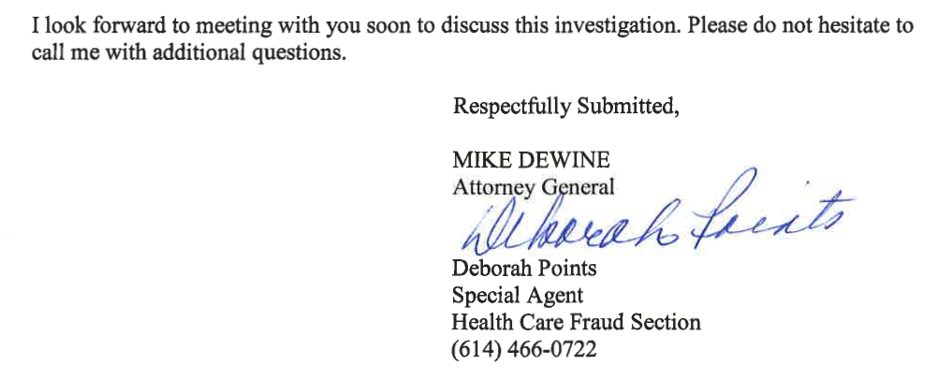
MUI/UI

