Slide 1
EVV Townhall 5/8/25

Slide 2
Agenda
Review of EVV
Poll Questions
Open Discussion

Slide 3
Review of EVV
Electronic Visit Verification (EVV) was mandated in Medicaid personal care services and home health care services in the 21st Century Cures Act
The 21st Century Cures Act is a federal law passed in 2016
The Ohio Department of Medicaid has been working towards implementation since the federal law was passed

Slide 4
Review of EVV
When ODM created the EVV program, the plan was to eventually use EVV units to validate billing but did not set a date for when claims denials would begin
Until denials were turned on, ODM can and does use EVV in their audits and fraud investigations
ODM announced last year that they would begin claims denials over a series of phases through 2026
DODD service are set to begin denials in October 2025

Slide 5
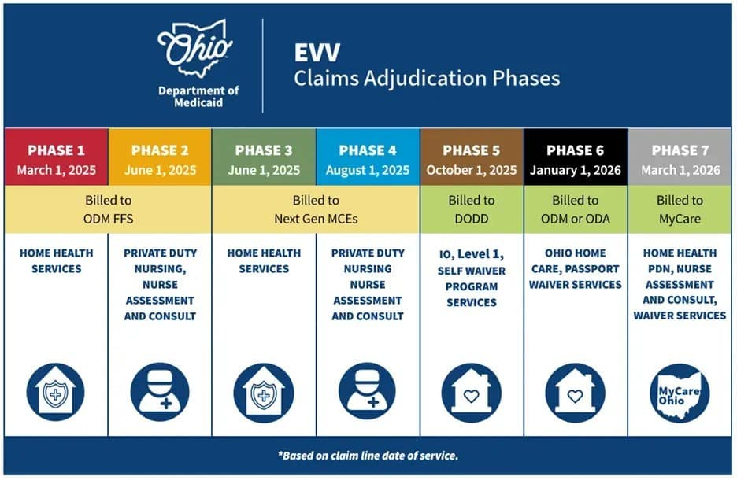
Review of EVV
Claims denial turn-on phases

Slide 6
Review of EVV
What DODD services are required to use EVV?
https://dam.assets.ohio.gov/image/upload/medicaid.ohio.gov/Providers/EVV/Providers/ODM_EVV_Covered_Programs_and_Services.pdf
I/O waivers | Level 1 waivers | SELF waiver
HPC billed in 15-minute units (AMW, AMX, AMY, AMZ, APC, APV, AQC, AQV, AQW, AQX, AQY, AQZ) | HPC billed in 15-minute units (FMW, FMX, FMY, FMZ, FPC, FPV, FQC, FQV, FQW, FQX, FQY, FQZ) | Participant-directed HPC (ARR)
Participant-directed HPC (ADC and ADV) | Participant-directed HPC (FDC, and FDV)
Waiver Nursing (T1002 (RN), T1003 (LPN))
Waiver Nursing Delegation (G0493 (RN Consultation), G0493 with U9 modifier (RN Assessment))
Residential Respite in 15-minute units (ARR)

Slide 7
Review of EVV
What DODD services are not subject to EVV?
HPC billed using the monthly rate calculator/daily billing unit
Shared living
On-site/on-call
Services provided by live-in caregivers
Requires approval by ODM via this form-
https://dam.assets.ohio.gov/image/upload/medicaid.ohio.gov/Providers/EVV/Providers/EVV_One-Pager_Live-In_Care_Exemption_4.2.25.pdf

Slide 8
Review of EVV
Once denials are turned on, when will claims be denied?
For a claim for an EVV required service to be paid starting in October, the number of EVV units must be equal to or greater than the number of units of service billed
Examples-
Number of EVV units in the EVV aggregator | Number of service units billed | Will ODM deny or pay this claim?
14 | 13 | ODM will PAY this claim
14 | 14 | ODM will PAY this claim
13 | 14 | ODM will DENY this claim

Slide 9
Review of EVV
There is currently a provision in the budget that would prohibit ODM from using EVV in the claims denial process
ODM could still use EVV in audits and fraud investigations
If the provision survives the budget-making process, Governor DeWine will almost certainly veto the provision

Slide 10
Why are we here?
ODM and DODD are convening a small group of stakeholders in the very near future to discuss issues specific to the DODD services
DODD wants to develop new tools and resources for DODD providers
We (OPRA) wants to know what do you all need as we move toward denials turning on?

Slide 11
Poll Questions

Slide 12
Open Discussion
What other concerns do you have?
Do you have any suggestions for solutions?
Other ideas for improving the EVV experience?

Slide 13
Thank you!
If you think of any other ideas, please send them my way
Christine Touvelle- ctouvelle@opra.org
ODM’s EVV website- https://medicaid.ohio.gov/resources-for-providers/special-programs-and-initiatives/electronic-visit-verification

