Slide 1
Ohio Automated Registry Check System (ARCS) and Rapback Expansion
Initial Training
October 2014

Slide 2
AUTOMATED REGISTRY CHECK SYSTEM (ARCS) TRAINING

Slide 3
ARCS Features
User accounts and system access validated through mapping to providers’ MITS profile to ensure security
For new applicants, accesses information from six registries simultaneously, eliminating the need to enter information into each registry systems.
For applicants with no significant findings, generates form needed to order a fingerprint check.
After an applicant becomes an employee, notifies employers of any new registry findings that surface.

Slide 4
Six Required Registries
Excluded Parties List System (U.S. General Services Administration)
List of Excluded Individuals and Entities (U.S. Office of Inspector General)
Abuser Registry Verification (DODD)
Sex Offender and Child Victim Database (AGO)
ODRC Inmates Database (ODRC)
Nurse Aide Registry (ODH)

Slide 5
Eligibility for ARCS
In order to assure privacy and security of employee data, only providers with an active MITS account will be eligible to participate.
Provider identifying information from MITS will be used to generate ARCS registration information.
Providers must update their information in MITS in order to receive an ARCS welcome e-mail with an ARCS user id and instructions to create a password in ARCS.

Slide 6
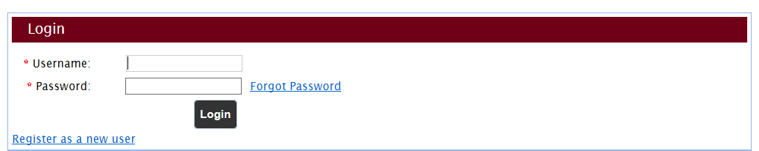
ARCS Registration as a New User
Only providers with an active MITS account will be eligible to participate.
Provider identifying information from MITS will be used to generate ARCS registration information.
Providers must update their information in MITS in order to receive an ARCS welcome e-mail with user id for ARCS.

Slide 7
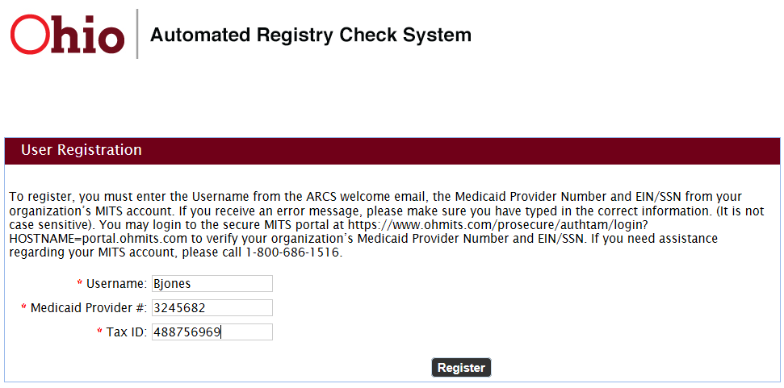
ARCS Registration as a New User
After clicking on “Register as a new user”, this screen appears.
Type in the username you were emailed,
along with your Provider Medicaid ID and the EIN/Tax ID.

Slide 8
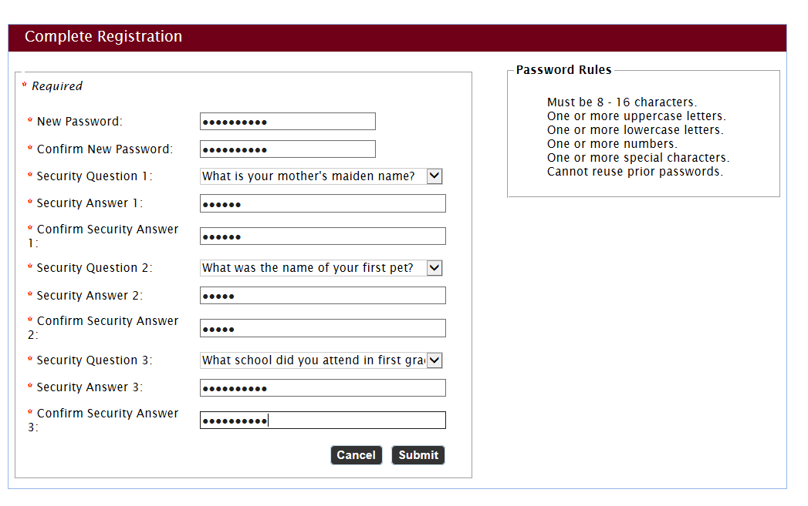
ARCS Registration as a New User
After clicking on Register, you will be prompted to
set your password and security questions.

Slide 9
ARCS Registration as a New User
Finally, you will be asked to read and accept the End User License Agreement at this point, and every time you log into the system.

Slide 10
Adding a Provider User
The new provider admin account has the ability to create both provider users and more provider admin accounts but ONLY for their assigned providers. To create a new provider user account go to Admin > User Accounts and click Add New User.
Fill out the required information. Provider users are ONLY able to create more provider users, so you will not be able to select anything other than Provider on the User Type dropdown.
To complete the new account setup, you must assign a provider. To assign a provider, click Assign Providers. Because we are logged in as ASmith, who only has access to the provider Ohio Hospice Care, it will be the only one that will appear with your search on the Assign Providers page. Click Save once you have assigned the provider, and click Save again on the User Account page to complete to new user set up.

Slide 11
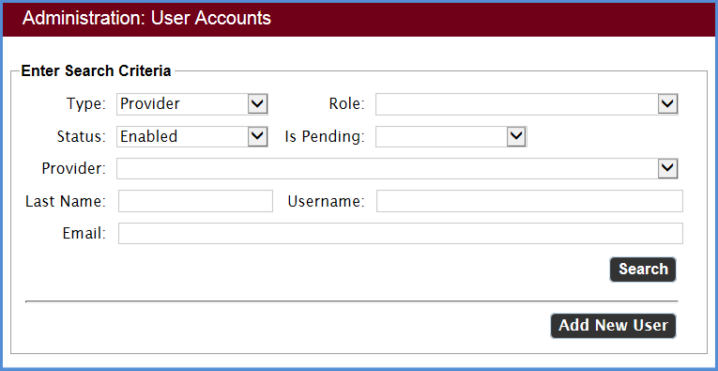
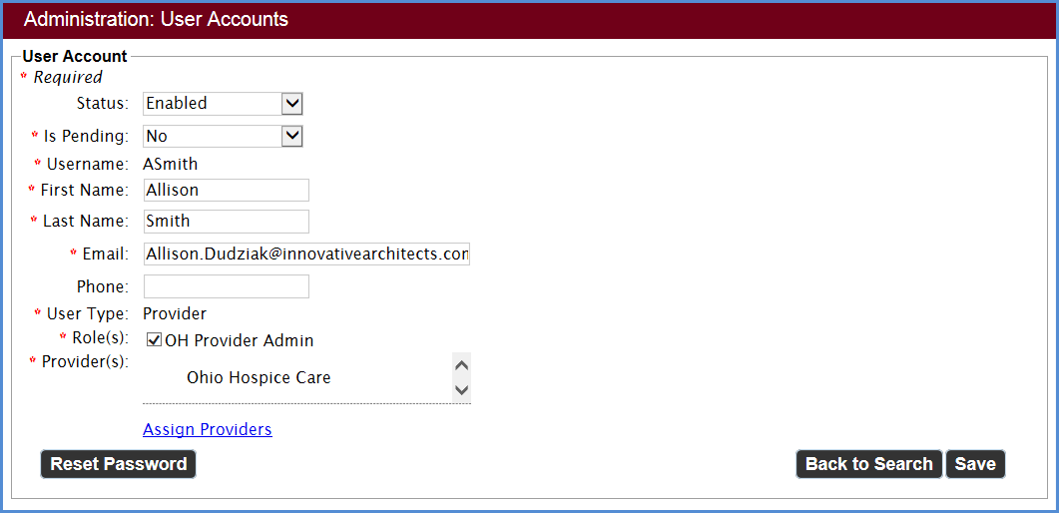
Editing/Disabling a Provider User
Provider administrators can edit and disable a user from the Admin: User Accounts screen.
Go to Admin > User Accounts.
Once you have filled in the relevant fields, click Search.
When the search results appear you have the option to either edit or disable a user. Disabling a user means that the user will no longer be able to log into ARCS. You will be able to edit the user’s status back to enabled if you need to.
To disable a user, select Disable under the actions column, on the far right of the User Search Result.
To edit a user, select Edit under the actions column, on the far right of the User Search Result. You will be taken to the User Accounts page, where you will be able to edit the user’s information, change their status, and assign new providers.
You must click Save to save the changes.

Slide 12
Resetting a Forgotten Password
It is easy to reset a forgotten password from ARCS without needing to contact an administrator or help desk.
From the login screen, click Forgot Password.
Enter your username then click Next.
Once you have clicked Next you will be asked to enter the answer for your chosen security question. Correctly answer the question, then click Email New Password.
A green banner will appear on the login screen to let you know that your password has been reset and a new one has been emailed to you.
NOTE: When using the computer generated password for the first time after you request a new password, you will be prompted to set up your password as if you are a new user.

Slide 13
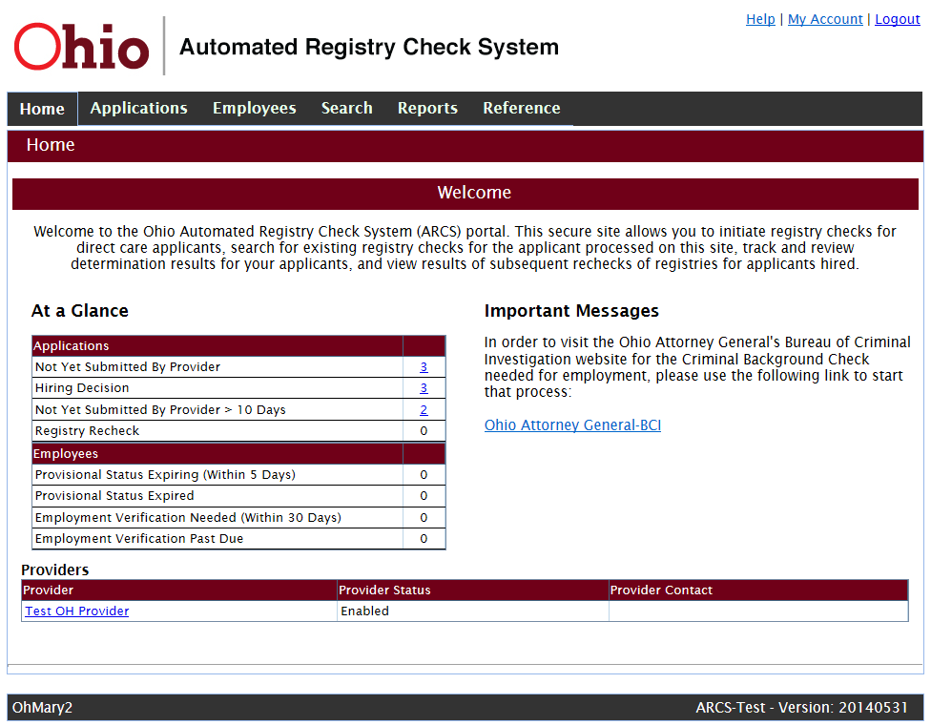
Home Page
“At a Glance” provides quick access to pending tasks.

Slide 14
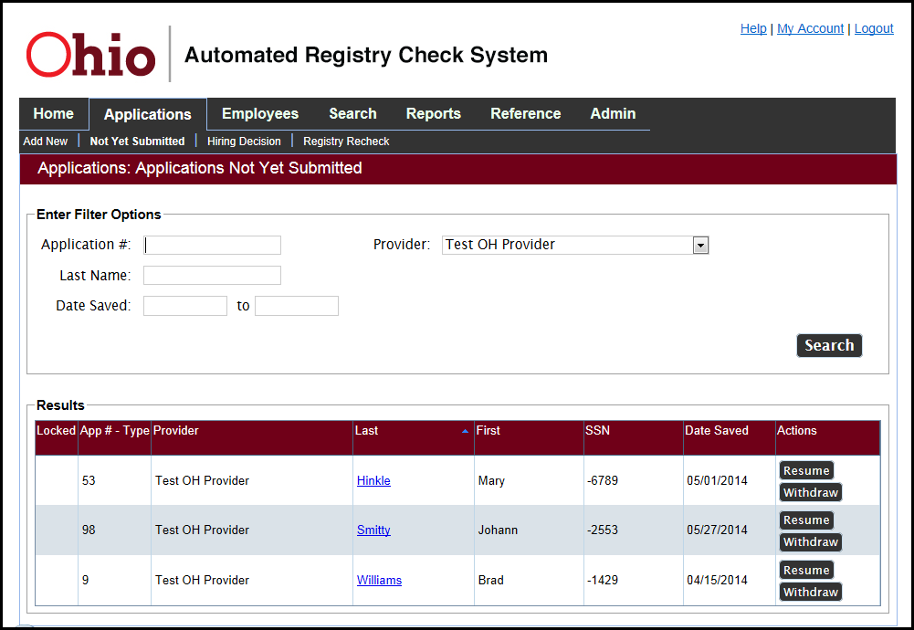
The Not Yet Submitted List
The last names are hyperlinked. Click to view the Person Summary page. From the Not Yet Submitted list, you can resume the application or withdraw it.

Slide 15
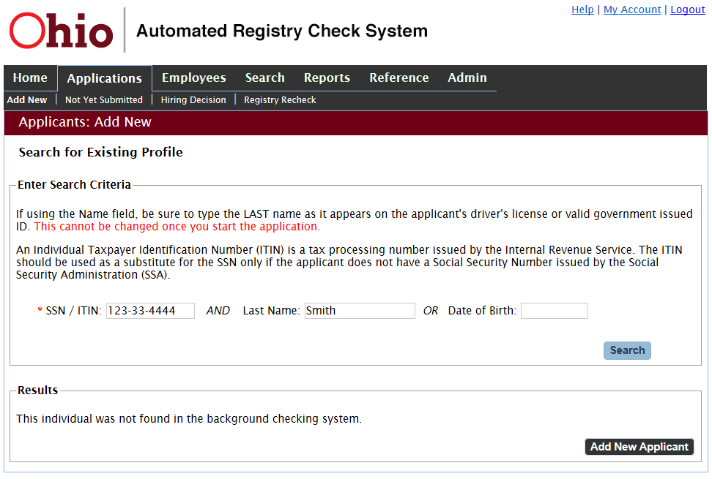
Adding a New Applicant
Since the applicant was not found in the system, click the Add New Applicant button to start an application for the individual.

Slide 16
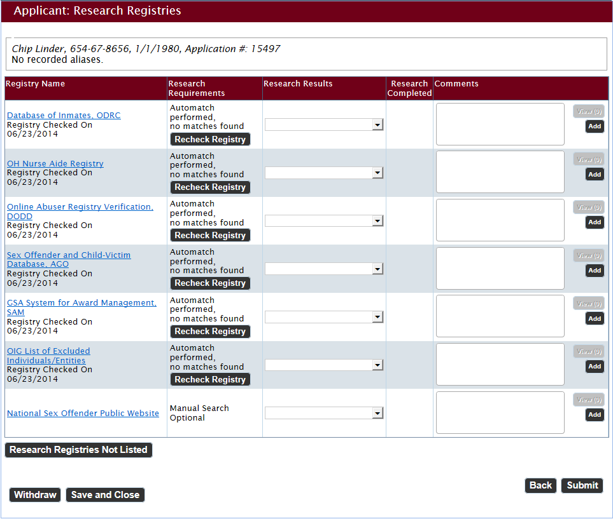
Research Registries
There are six registries that are required to be checked for an applicant who is an Ohio resident and who has not resided or worked in other States in the last 5 years.
The National Sex Offender Public Website is available as an optional search.

Slide 17
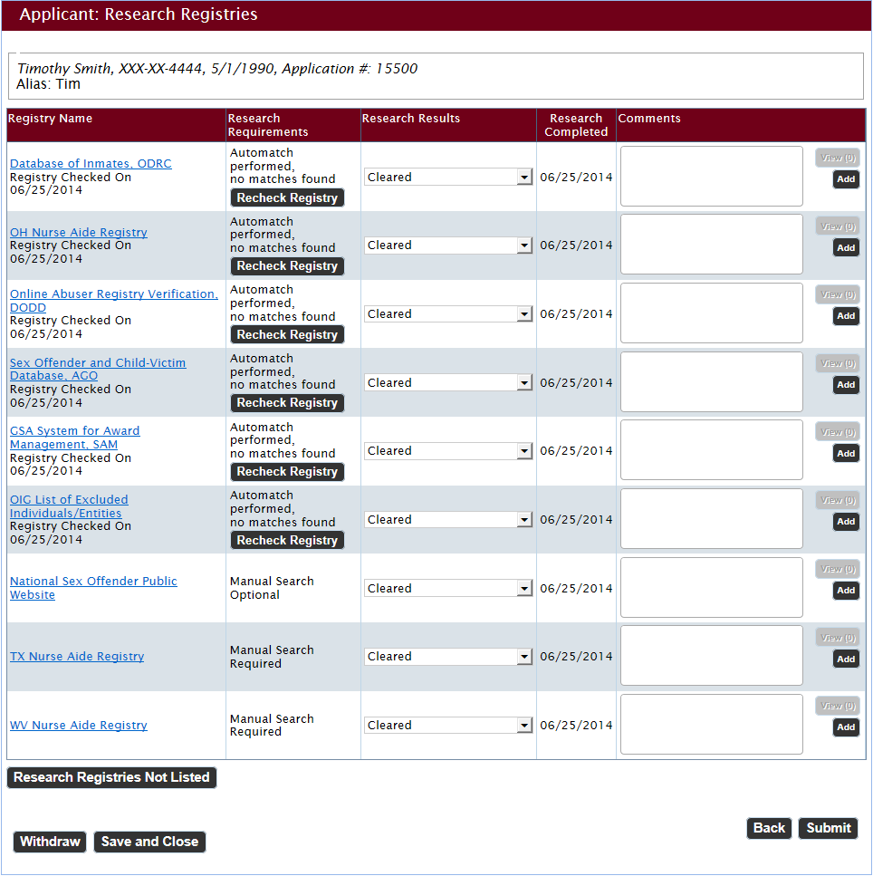
Research Registries: Continued
When all required registries are marked Cleared, click the Submit button.

Slide 18
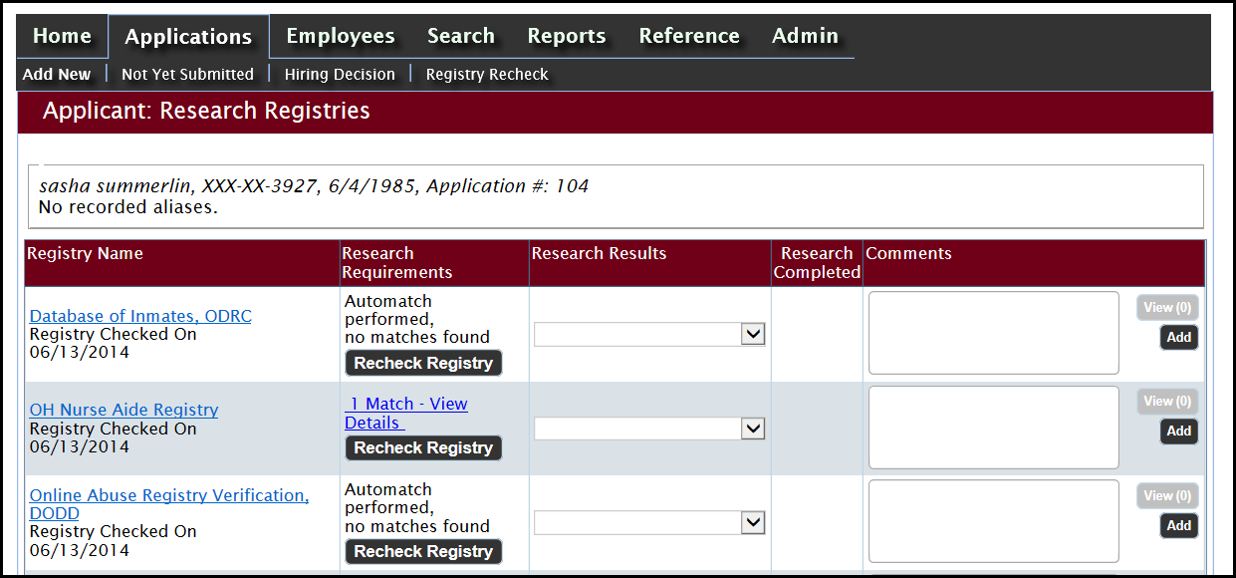
Validating Registry Results
This screen shows a match in the Ohio Nurse Aide Registry.
Providers should view details and validate every match by manually searching the registry site on the left.

Slide 19
Clearing Registries
When all required registries are marked Cleared, click the Submit button.

Slide 20
Applicant Confirmation
A clear registry review generates the above Application Submitted Confirmation page. You can access two forms from this page: the Final Registry Results form and the Background Check Fingerprint Request.

Slide 21
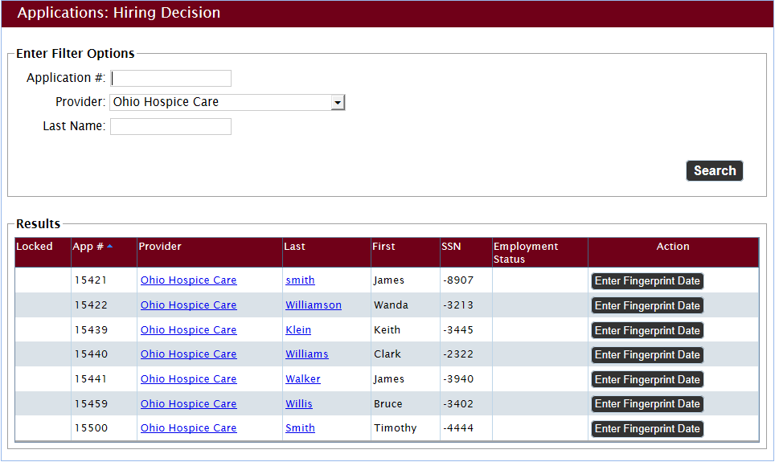
Hiring Decision
The applicant can be provisionally hired after fingerprints are taken. Record the date the fingerprints were taken by clicking on the Enter Fingerprint Date button.

Slide 22
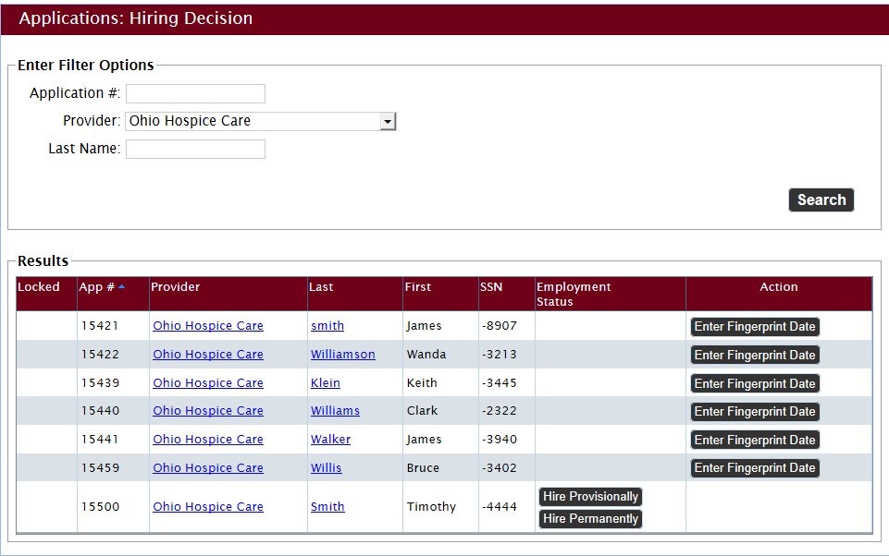
Provisional Hire
Once the fingerprint date is entered and saved, the Enter Fingerprint Date button is removed from the Hiring Decision record and two hire buttons are added. If criminal history results have not yet been received, you can hire the applicant provisionally. Click on the Hire Provisionally button.

Slide 23
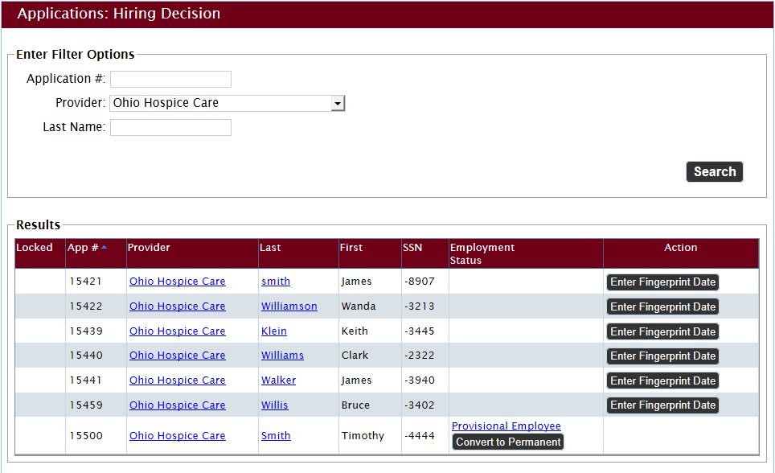
Provisional Hire: Continued
Our applicant is now listed as a Provisional Employee in the Employment Status column of the Hiring Decision page.

Slide 24
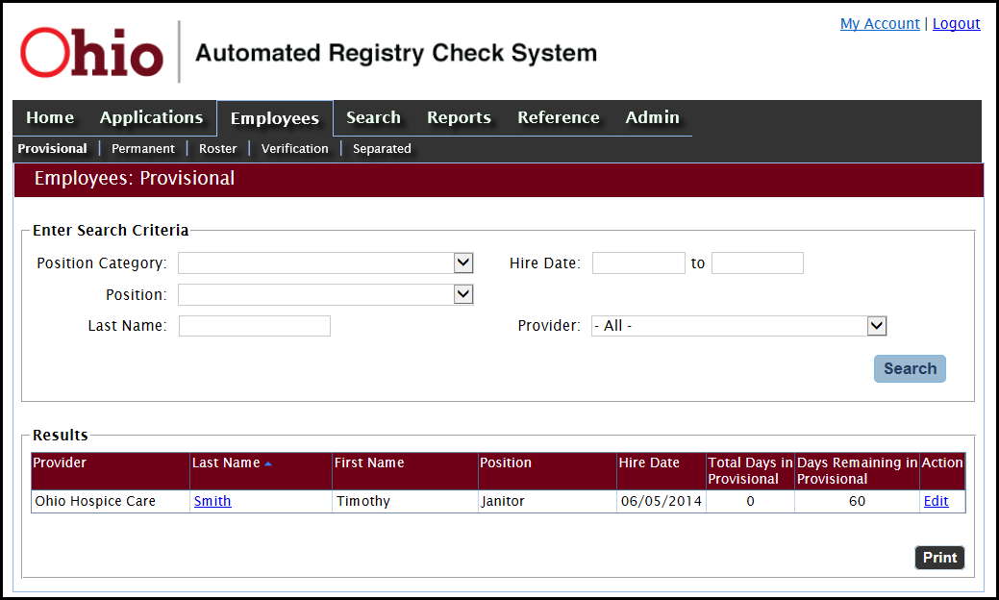
Tracking Provisional Employees
The applicant will also be listed on your Provisional Employee list. Click on Employees > Provisional on the navigation bar to see the provisional employees page. Then click the Search button to see your list of provisional employees.

Slide 25
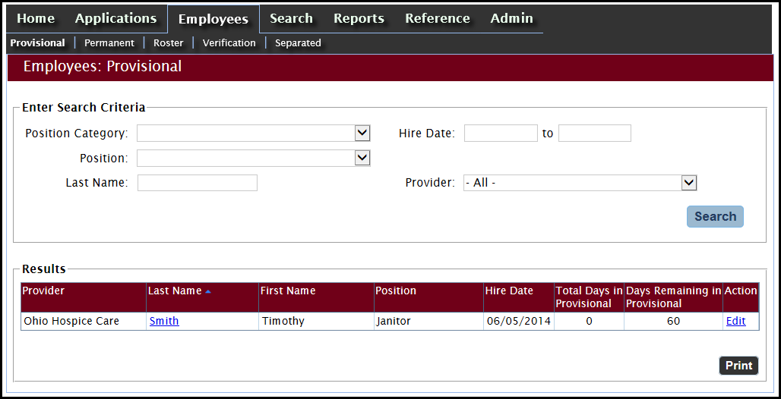
Tracking Provisional Employees: Continued
Applicants can work provisionally for 60 days. The provisional employees page keeps track of the number of days an applicant has been employed provisionally. To hire a provisional employee permanently, click the Edit button.

Slide 26
Converting to Permanent Status
Alternatively, you can convert an employee from provisional to permanent status on the Hiring Decision page. Click the Convert to Permanent button.
On any applicant list, the applicant’s last name is hyperlinked. Click the last name to view the applicant’s Person Summary.

Slide 27
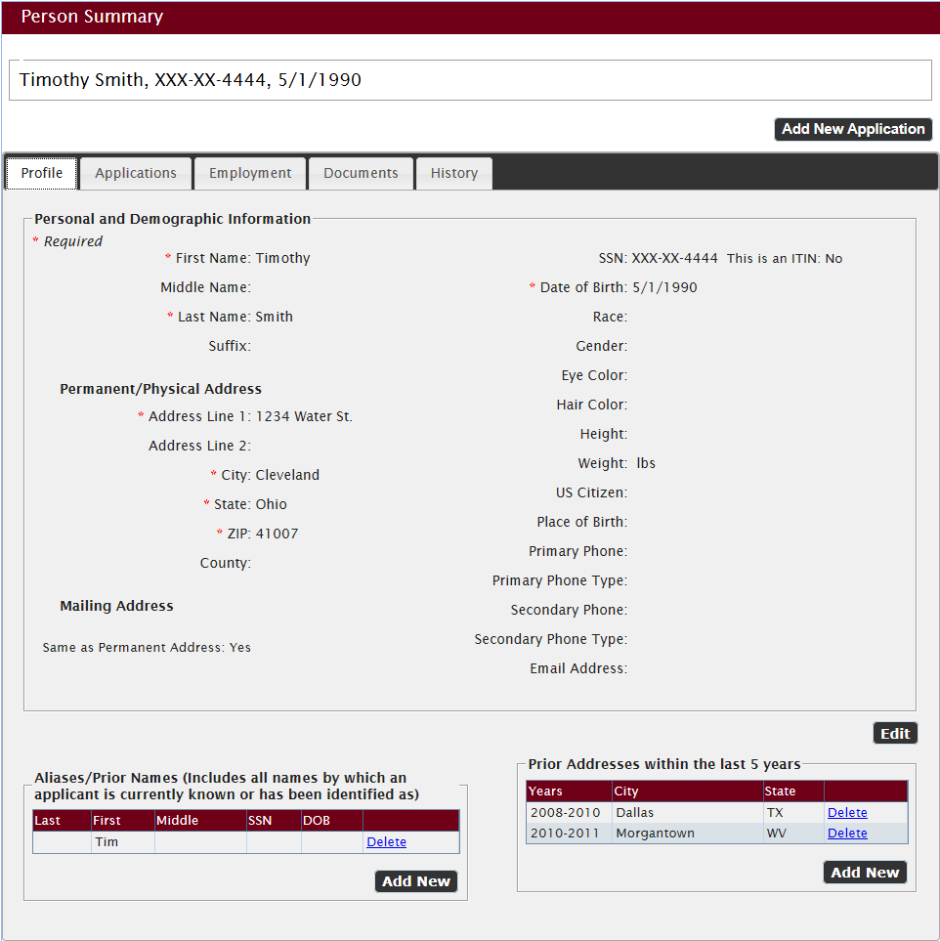
Person Summary
The Person Summary page has five tabs. This is the Profile tab.

Slide 28
Person Summary: Documents
The Document tab of the Person Summary page stores the documents for this applicant that have been generated by the system or uploaded by you. Click on the hyperlinked document names to open the documents as PDF files.

Slide 29
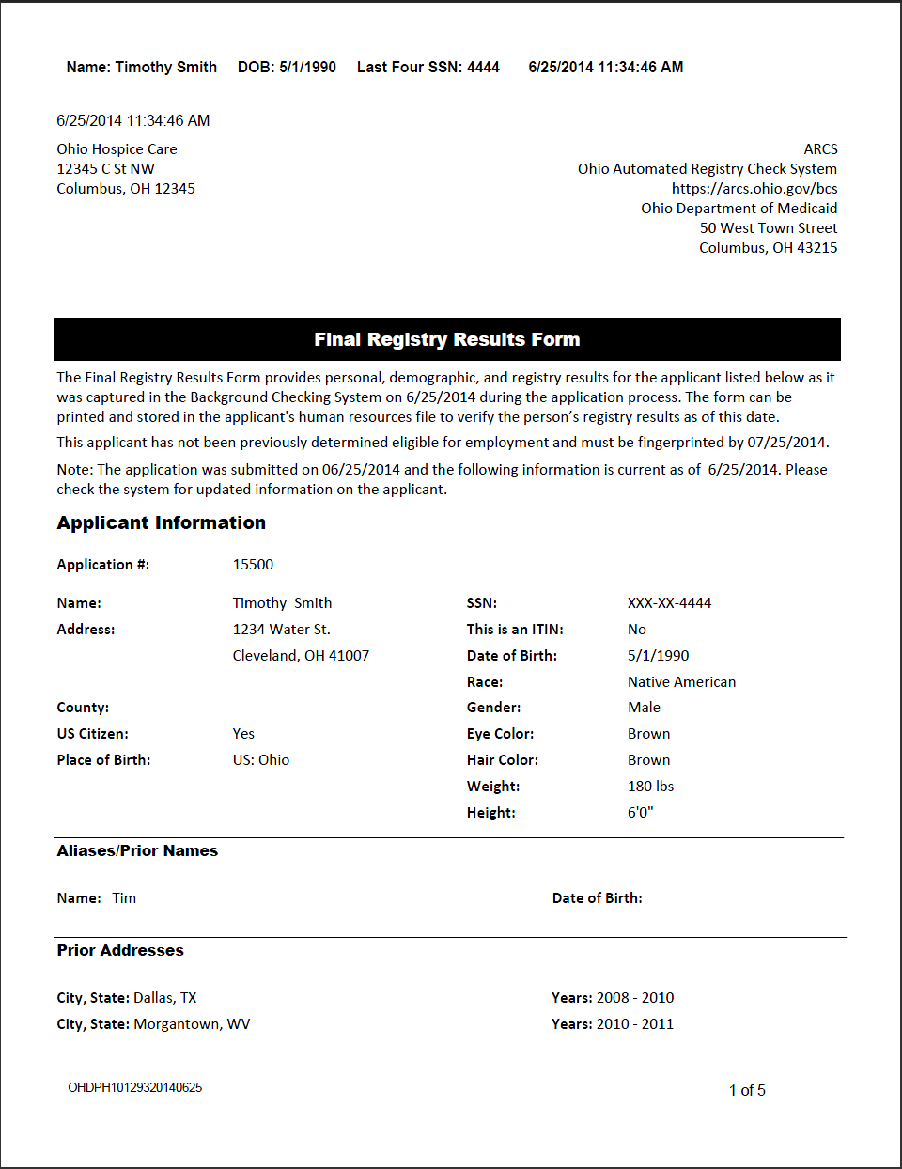
Final Registry Results Form
The system generates the completed form. This is page 1 of a multi-page report. This page identifies the provider and lists the applicant profile information.

Slide 30
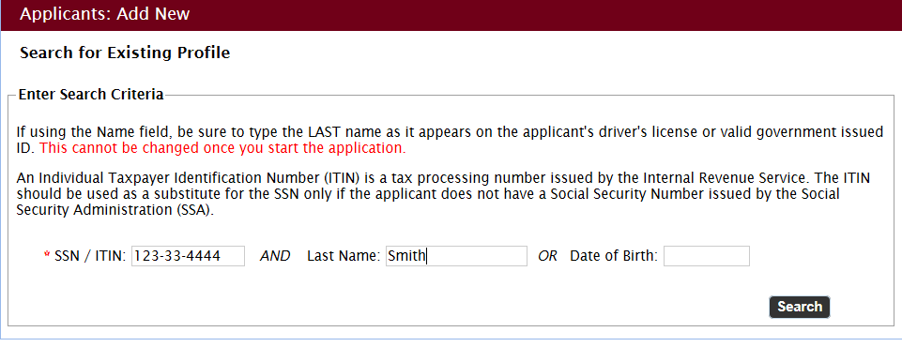
Searching for an Existing Profile
If a second provider were to search for our applicant in the system, they would start by entering our applicant’s SSN and Last name on the Search for Existing Profile page and clicking search.

Slide 31
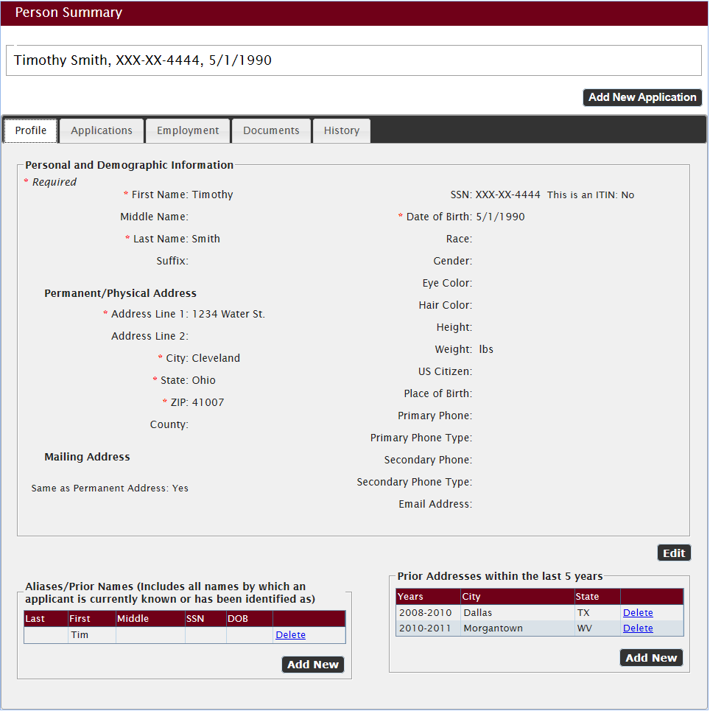
Person Summary: Profile
The search returns the Person Summary page for an applicant who is already in the system.
To edit the Profile information, click the Edit button.

Slide 32
Editing the Profile
You can edit the profile information with the exception of the last name, SSN, and date of birth.
After making any necessary changes, click the Save button.

Slide 33
New Applications
To begin a new application for an applicant already in the system, click the Add New Application button on the Person Summary page.
You’ll be taken to the Verify Identity screen and you’ll follow the application process from there.

Slide 34
ARCS QUESTIONS

