Slide 1
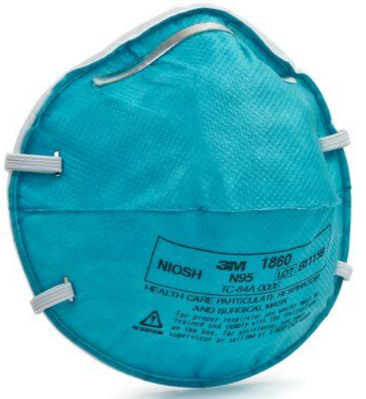
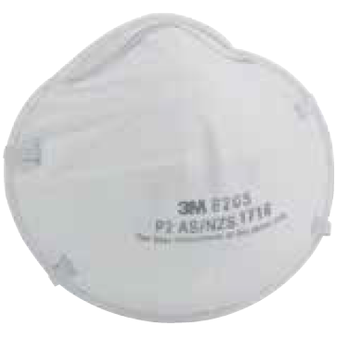
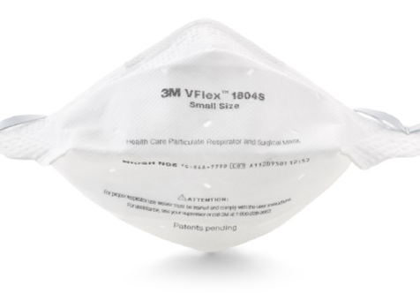
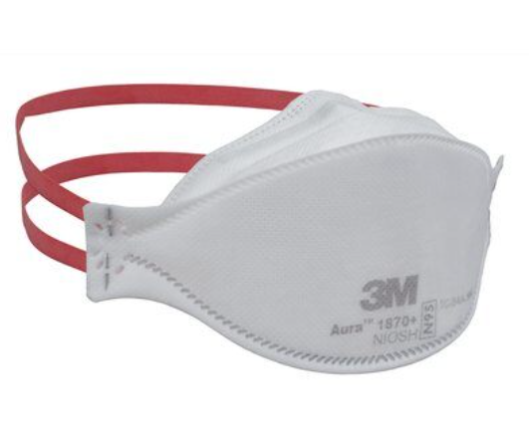
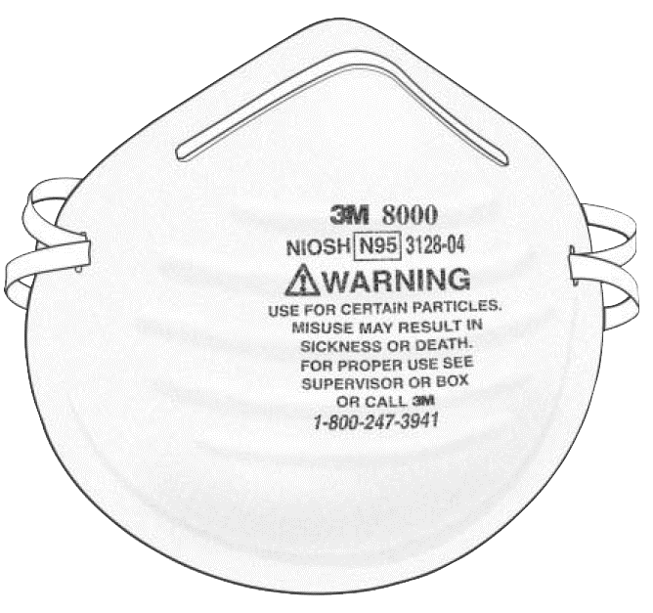
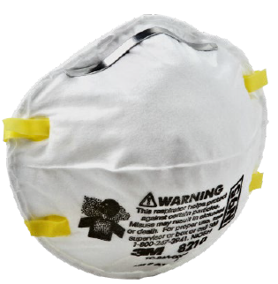
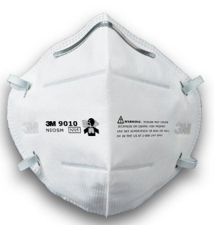
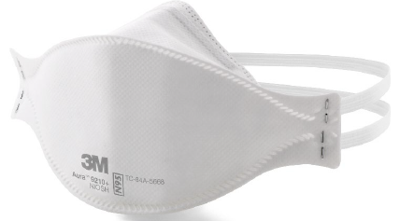
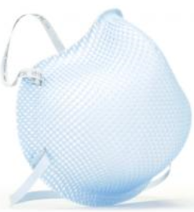
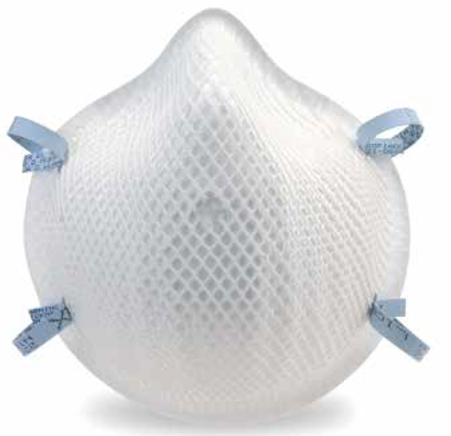
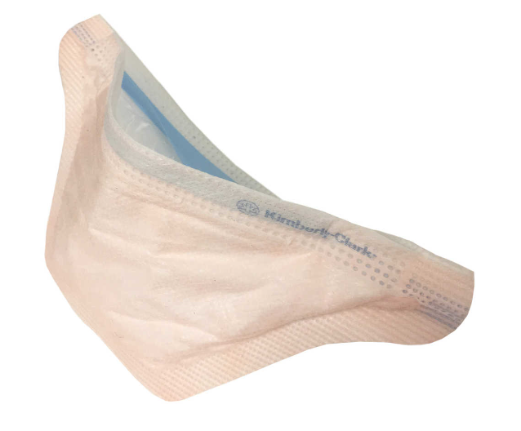
N95 Masks Treatable by Battelle CCDSTM
3MTM VFLEX 1804
3MTM 1860(S)
3MTM Aura 1870+
3MTM 8205
3MTM 8000
3MTM 8210
3MTM 9010
3MTM Aura 9210+
Gerson 1730
Gerson 2140C
Moldex 1500 Series
Moldex 2200
Kimberly-Clark 46727

Slide 2
Contain Cellulose – Do Not Treat
ProTech NON27501
Check for Cellulose Acetate in undefined masks by placing filter, shell, and coverweb (not straps or nose foam) in Butyric Acid.
Polypropylene and Polyester have satisfactory chemical resistance to it, but Cellulose Acetate (CA) does not so degradation should be evident if the mask contains CA.

