Slide 1

Introduction to GHS

Slide 2

Hazard Communication Revision Global Harmonized System
GHS

Slide 3
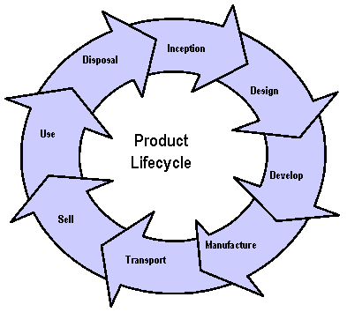
Chemical Lifecycle
Disposal or Abandonment Phase
Development
Phase and R&D
Customer or End User Phase
Manufacture and Distribution Phase

Slide 4

What is GHS
The Globally Harmonized System (GHS) is an international approach to hazard communication
Many International countries and organizations helped develop the system
United Nations' document on Globally Harmonized System of Classification and Labeling of Chemicals (purple book)

Slide 5
Who Is affected by GHS?
Over 40 million workers (USA)
Over 5 million workplaces (USA)
OSHA estimates that the standard will prevent 43 fatalities and 585 injuries and illnesses annually
The primary benefit of the GHS is to increase the quality and consistency of information provided to workers, employers and chemical users by adopting a standardized approach to hazard classification, labels and safety data.

Slide 6
Hazard Communication Revision
GHS was finalized in the federal register on 3/26/12
Effective in 60 days, May 26, 2012
Executive Order # 13563 signed by the President
OSHA is modifying its Hazard Communication Standard (HCS) to conform to the United Nations' Globally Harmonized System of Classification and Labelling of Chemicals (GHS).

Slide 7
New Hazard Communication Program
Modification to the Hazard Communication Standard
Revised criteria for the classification of chemical hazards
Standardized labels - signal words, pictograms, hazard and precautionary statements
Specified format for Safety Data Sheets

Slide 8
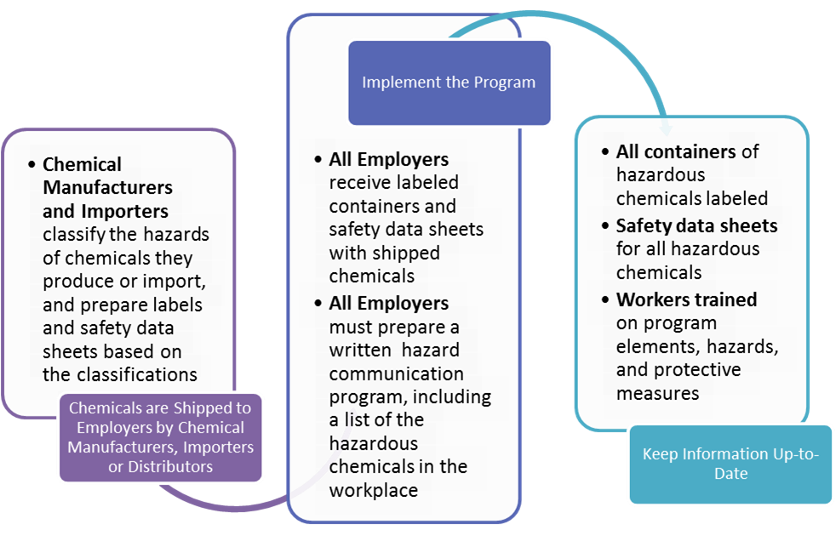
How Hazard Communication Works

Slide 9
Three Major Changes
Hazard classification: The definitions of hazard have been changed to provide specific criteria for classification of health and physical hazards, as well as classification of mixtures. These specific criteria will help to ensure that evaluations of hazardous effects are consistent across manufacturers, and that labels and safety data sheets are more accurate as a result.
Labels: Chemical manufacturers and importers will be required to provide a label that includes a harmonized signal word, pictogram, and hazard statement for each hazard class and category. Precautionary statements must also be provided.
Safety Data Sheets: Will now have a specified 16-section format.

Slide 10
Critical Dates
GHS will have a phase in period over 4 years
Compliance:
Employers would be required to maintain either the existing or revised Hazard Communication program during the phase in period
Chemical Manufacturer’s, Importers and Distributors - June 2015 – phase1 – 12/2015 phase 2
Employers – end users

Slide 11
Critical Dates (Employers)
Employers Must :
Train employees on the new label elements and
safety data sheet (SDS) format 12/1/2013
Update alternative workplace labeling and
hazard communication program as necessary
and provide additional employee training for
newly identified physical or health hazards 6/1/2016

Slide 12

Chemical Labels New Format
How will labels change under the revised Hazard Communication Standard?
Labels will cover physical, health and environmental hazards
Pictograms-
Signal Words -
Hazard Statement -
Precautionary Statement -

Slide 13


Pictograms
There are nine pictograms used in the new GH system (8 are mandatory)
Pictogram must have a Red border with a symbol inside

Slide 14
Signal Word
single word used to indicate the relative level of hazard severity
Danger – More severe hazard
Warning - Less severe hazards.

Slide 15
Hazard Statement
Statement associated with the hazard class or degree of hazard
hazard class and category that describes the nature of the hazard(s) of a chemical, including, where appropriate, the degree of hazard.

Slide 16
Precautionary Statement
a phrase that describes recommended measures to be taken to minimize or prevent adverse effects resulting from exposure to a hazardous chemical, or improper storage or handling of a hazardous chemical

Slide 17
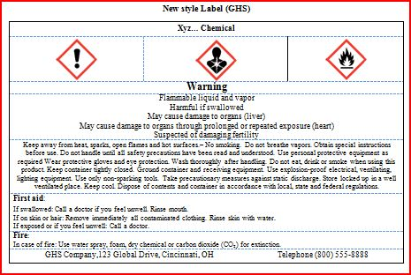
Sample of a new label under the GHS program
Pictograms
Signal Word
Hazard Statement
Precautionary Statement

Slide 18









Health Hazard | Flame | Exclamation Mark
• Carcinogen • Mutagenicity • Reproductive Toxicity • Respiratory Sensitizer • Target Organ Toxicity • Aspiration Toxicity | • Flammables • Pyrophorics • Self-Heating • Emits Flammable Gas • Self-Reactives • Organic Peroxides | • Irritant (skin and eye) • Skin Sensitizer • Acute Toxicity (harmful) • Narcotic Effects • Respiratory Tract Irritant • Hazardous to Ozone Layer (Non Mandatory)
Gas Cylinder | Corrosion | Exploding Bomb
• Gases under Pressure | • Skin Corrosion/ burns • Eye Damage • Corrosive to Metals | • Explosives • Self-Reactives • Organic Peroxides
Flame over Circle | Environment (Non Mandatory) | Skull and Crossbones
• Oxidizers | • Aquatic Toxicity | • Acute Toxicity (fatal or toxic)
Notes:
These are the nine pictograms used in the GHS system Note Physical , Health and Environment

Slide 19
Sample Label
Product Identifier
CODE ______________________________
Product Name ___________________
Supplier Identification
Company Name_________________
Street Address ______________________
City _________________ State ______
Postal Code __________ Country ______
Emergency Phone Number ___________
Precautionary Statements
Keep container tightly closed. Store in cool, well ventilated place that is locked.
Keep away from heat/sparks/open flame. No smoking.
Only use non-sparking tools.
Use explosion-proof electrical equipment.
Take precautionary measure against static discharge.
Ground and bond container and receiving equipment.
Do not breathe vapors.
Wear Protective gloves.
Do not eat, drink or smoke when using this product.
Wash hands thoroughly after handling.
Dispoae of in accordance with local, regional, national, international regulations as specified.
In Case of Fire: use dry chemical (BC) or Carbon dioxide (CO₂) fire extinguisher to extinguish.
First Aid
If exposed call Poison Center.
If on skin (on hair): Take off immediately any contaminated clothing. Rinse skin with water.
Hazard Pictograms
Signal Word
Danger
Hazard Statement
Highly flammable liquid and vapor.
May cause liver and kidney damage.
Supplemental Information
Directions for use
______________________________
______________________________
______________________________
Fill weight: _____________ Lot Number ______
Gross weight: __________ Fill Date: ______
Expiration Date: ___________

Slide 20
Within the new GHS program Chemical Manufacturer must develop a format for information on chemicals
Safety Data Sheets will replace MSDS
SDS – Standardized format for information
16 section format
Sections 12-15 are not required by OSHA (USA)

Slide 21
Standardized Format SDS
Section 1. Identification
Section 2. Hazard(s) identification
Section 3. Composition/information on ingredients
Section 4. First-Aid measures
Section 5. Fire-fighting measures
Section 6. Accidental release measures
Section 7. Handling and storage
Section 8. Exposure controls/personal protection
Section 9. Physical and chemical properties
Section 10. Stability and reactivity
Section 11. Toxicological information
Section 12. Ecological information
Section 13. Disposal considerations
Section 14. Transport information
Section 15. Regulatory information
Section 16. Other information, including date of preparation or last revision

Slide 22
Hazard Communication Safety Data Sheets
The Hazard Communication Standard (HCS) requires chemical manufacturers, distributors, or importers to provide Safety Data Sheets (SDSs) (formerly known as Material Safety Data Sheets or MSDSs) to communicate the hazards of hazardous chemical products. As of June 1, 2015, the HCS will require new SDSs to be in a uniform format, and include the section numbers, the headings, and associated information under the headings below:
Section 1, Identification includes product identifier; manufacturer or distributor name, address, phone number; emergency phone number; recommended use; restrictions on use.
Section 2, Hazard(s) identification includes all hazards regarding the chemical; required label elements.
Section 3, Composition/information on ingredients includes information on chemical ingredients; trade secret claims.
Section 4, First-aid measures includes important symptoms/ effects, acute, delayed; required treatment.
Section 5, Fire-fighting measures lists suitable extinguishing techniques, equipment; chemical hazards from fire.
Section 6, Accidental release measures lists emergency procedures; protective equipment; proper methods of containment and cleanup.
Section 7, Handling and storage lists precautions for safe handling and storage, including incompatibilities.
Section 8, Exposure controls/personal protection lists OSHA's Permissible Exposure Limits (PELs); Threshold Limit Values (TLVs); appropriate engineering controls; personal protective equipment (PPE).

Slide 23
Hazard Communication Safety Data Sheets
Continued…
Section 8, Exposure controls/personal protection lists OSHA's Permissible Exposure Limits (PELs); Threshold Limit Values (TLVs); appropriate engineering controls; personal protective equipment (PPE).
Section 9, Physical and chemical properties lists the chemical's characteristics.
Section 10, Stability and reactivity lists chemical stability and possibility of hazardous reactions.
Section 11, Toxicological information includes routes of exposure; related symptoms, acute and chronic effects; numerical measures of toxicity.
Section 12, Ecological information*
Section 13, Disposal considerations*
Section 14, Transport information*
Section 15, Regulatory information*
Section 16, Other information, includes the date of preparation or last revision.
*Note: Since other Agencies regulate this information, OSHA will not be enforcing Sections 12 through 15(29 CFR 1910.1200(g)(2)).
Employers must ensure that SDSs are readily accessible to employees.
See Appendix D of 1910.1200 for a detailed description of SDS contents.
For more information: www.osha.gov
(800) 321-OSHA (6742)

Slide 24
Mixture Classification
Generally use test data for the mixture, when available
⬇
Use bridging principles, if applicable
(defined in purple book) classifying untested mixtures but there is sufficient data on the components and/or similar tested mixtures
Dilution, Batching ,Concentration , Substantially Similar , Aerosols
⬇
For health and environmental hazards, estimate hazards based on the known ingredient information

Slide 25
In the revised Hazard Communication Standard (HCS), OSHA has added below under the definition of "hazardous chemical“
Pyrophoric Gases
include the signal word "danger" and the hazard statement
"catches fire spontaneously if exposed to air".
Simple Asphxiants
simple asphyxiants which include the signal word "warning" and
the hazard statement "may displace oxygen and cause rapid
suffocation".
Combustible Dust
include the signal word "warning" and the hazard statement
"May form combustible dust concentrations in the air".

Slide 27
Hazard Classification
  Example: Flammable liquids GHS
    Category 1: Extremely flammable liquid and vapour
    Category 2: Highly flammable liquid and vapour
    Category 3: Flammable liquid and vapour
    Category 4: Combustible liquid
    Comparison of Existing classification
    HMIS NFPA 704
    4- Severe 4- Extreme
    3- Serious 3- High
    2- Moderate 2- Moderate
    1- Slight 1- Slight

Slide 28
Hazard Classification continued
Employers can still use the HMIS or NFPA 704 systems within GHS
However classification categories must conform with the GHS program
1- Most Dangerous or Hazardous
4- Least Dangerous or Hazardous
Employers must train their employees by 12/2013

Slide 29
Other Agencies
Department of Transportation (DOT) Currently in alignment with GHS – HM-181 DOT has already modified their requirements for classification and labeling to make it consistent with international UN transport requirements and the GHS
United States Environmental Protection Agency Pesticides – added signal word “Caution”
Consumer Products Safety Commission

Slide 30
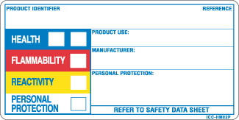
Next Step Strategies
Employers should begin to re evaluate their current chemical inventories
Decide how you are going to label your secondary chemical containers
HMIS
NFPA
Other
Label implementation date is June 2015

Slide 31
Next Step Strategies continued
Begin to gather chemical manufacturer data such as telephone and contact information
SDS will be sent to employers from the manufacturer data base
If you don’t receive them you can use the data collected to contact the manufacturer
June 1, 2016 employer program requirements

Slide 32
Guidance & Outreach
Press Release: US Department of Labor's OSHA publishes final rule to update the Hazard Communication Standard (HCS)
Guidance
  OSHA Briefs
  Fact Sheet
  Quick Cards

Slide 33
Questions ?
Thank you for your attention

