Slide 1
Health Care Reform Analyzer
Small Employer Case Study #1
(Confidential)
© 2012 Wells Fargo Insurance Services
No Reprints Without Permission

Slide 2
Common Small Employer Situations
Case Study | Characteristics | Representative Industries
1 | Medium potential migration, low income demographics skewing, high-low dual plan structure | General
2 | High potential migration, low income demographics skewing, medium richness of plan structure | Retail, hospitality, restaurant, agriculture/fishing (currently using a carve-out strategy)
3 | Low potential migration, low income demographics skewing, low richness of plan structure | Retail, hospitality, restaurant, agriculture/fishing
4 | Low potential migration, high income demographics skewing, high richness of plan structure | Hi-Tech, professional firms
5 | Low potential migration, medium income demographics skewing, high richness of plan structure | Tax-exempt governmental entities, some non-profit organizations
6 | Low potential migration, low income demographics skewing, high richness of plan structure | Some non-profits
7 | High potential migration, low income demographics skewing, high richness of plan structure | Some non-profits (currently using a carve-out strategy)
© 2012 Wells Fargo Insurance Services
No Reprints Without Permission

Slide 3
Fundamental paradigm shift
Three primary ways to obtain health insurance coverage in the U.S.
Employer-provided group plans
Individual health policies
Governmental programs (e.g., Medicaid, Medicare, TRICARE, etc.)
In 2014, ACA changes ground rules with respect to eligibility and the cost of accessing these coverage options
Thus, employees will potentially migrate into or out of employer-provided group plans
Critical for employers to understand the drivers and financial implications that these migration patterns will have on their ability to maintain their relative competitiveness for its labor force at an affordable cost
Group Plans
Government Programs
Individual Policies
© 2012 Wells Fargo Insurance Services
No Reprints Without Permission

Slide 4
Fundamental paradigm shift
Employer-provided health care delivery system will be restructured in 2014 primarily due to following ACA provisions:
Employer Drivers: Two different variations of employer “play or pay” mandates
Employee Drivers: Individual mandate / Plans moving to the mean / Auto enrollment (for employers with 200 or more full-time employees)
New Potential Options: Subsidized state exchange coverage / Medicaid eligibility expansion
A new degree of collaboration needed between HR, finance, and senior management to ensure development of appropriate response to the complexities and financial impact of ACA for a given organization
In light of the new federal standards affecting employer-provided health coverage, what is the best way to allocate compensation dollars and manage your employee benefit program?
Employers will need to assess multiple potential strategies across a broad continuum
© 2012 Wells Fargo Insurance Services
No Reprints Without Permission

Slide 5
Current Situation (What the Data Reveals)
Case Study #1 has approximately 200 employees working 30+ hours per week.
There are currently 144 employees that are participating in the 2 plans offered, 48 that are waiving coverage and 8 who are currently ineligible for medical coverage.
Current Cost
(Not tax adjusted)
Total
$1,234,703
Plan | Grandfathered? | Self-insured? | Enrollment | Estimated Actuarial Value | % Enrolled
PPO | No | Yes | 59 | 96% | 41%
HDHP | No | Yes | 85 | 68% | 59%
ER Total
$842,317
EE Total
$392,385
a
© 2012 Wells Fargo Insurance Services
No Reprints Without Permission

Slide 6
Actuarial value plan sampling
Sample Plan #1 | Platinum Plan (90% AV)
Deductible | $250
Coins. | 0%
OOP Max | $0
PCP Co-pay | $30
Rx | $15/$30/$55
Sample Plan #2 | Gold Plan (80% AV)
Deductible | $500
Coins. | 20%
OOP Max | $1,000
PCP Co-pay | $25
Rx | $15/$35/$60
Sample Plan #3 | Silver Plan (70% AV)
Deductible | $1,000
Coins. | 20%
OOP Max | $2,000
PCP Co-pay | $40
Rx | $20/$35/$60
Sample Plan #4 | Bronze Plan (60% AV)
Deductible | $250
Coins. | 35%
OOP Max | $5,000
PCP Co-pay | $20
Rx | $15/50%/50% after $250 Rx Ded (for Tiers 2 and 3)
Actuarial value is a measure that indicates percentage of covered medical expenditures that a plan will pay in the aggregate with respect to a standardized population
A way to measure the relative “richness” of a health plan by focusing solely on the cost-sharing provisions in the plan design
The allocation of the premium cost of coverage between employer and employee is not taken into account
Table above shows some sample plan designs that correspond to various proposed actuarial value standards
However, by using these cost-sharing levers, there are many different ways to design a plan with a given actuarial value
© 2012 Wells Fargo Insurance Services
No Reprints Without Permission

Slide 7
Employer “play or play” mandates
All Employees
≥ 30hrs Week
“Minimum Essential Coverage” (MEC) and 60% Cost Sharing Value
“Acceptable”
Health Coverage
“Affordable”
Employee Contributions
“Fair”
Employee Access
<9.5% of Household Income
< 400% Federal Poverty Line
“Individual”
Tax Credits
© 2012 Wells Fargo Insurance Services
No Reprints Without Permission

Slide 8
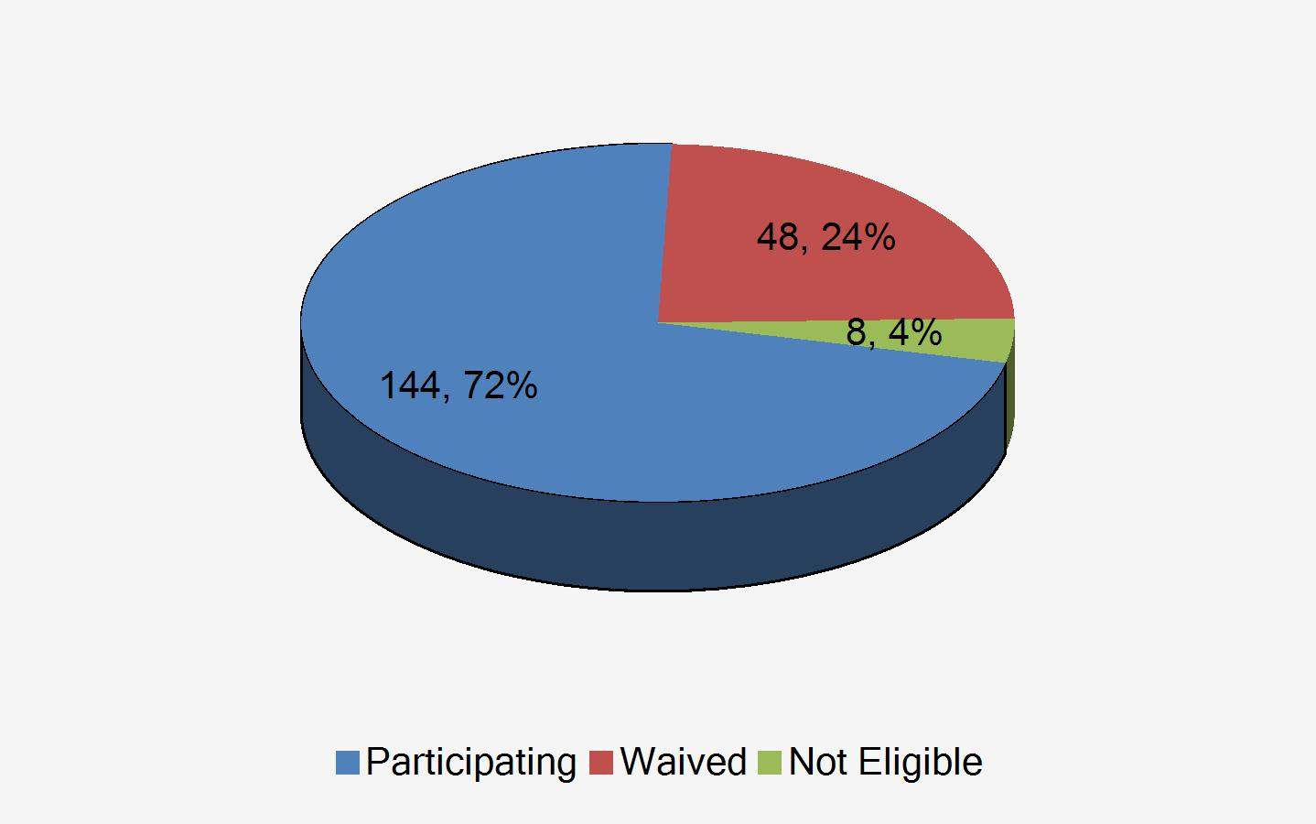
“Fair” Employee Access
Key Considerations:
In 2014, Employers with greater than 50 Full Time Equivalents must offer Minimum Essential Coverage (MEC) to all employees who work an average of 30 or more hours per week (HCR Eligible) within a given month or pay a penalty in the amount of the total number of full time equivalents x $2,000 per year (monthly).
Implications:
HCR restricts an employer’s ability to offer different benefits to different populations without paying significant penalties
Compass Heading:
It is likely that some percentage of currently waived or ineligible full time employees will enroll in employer sponsored coverage due to individual mandates and differences among employers narrowing (starting in 2014).
Once the designated percentage of the Medicaid eligible population has been moved to Medicaid, the assumed uptake percentage for waived population is set at 35%, and set at 70% for ineligible population.
“Fair” Access Index
HCRParticipation
© 2012 Wells Fargo Insurance Services
No Reprints Without Permission

Slide 9
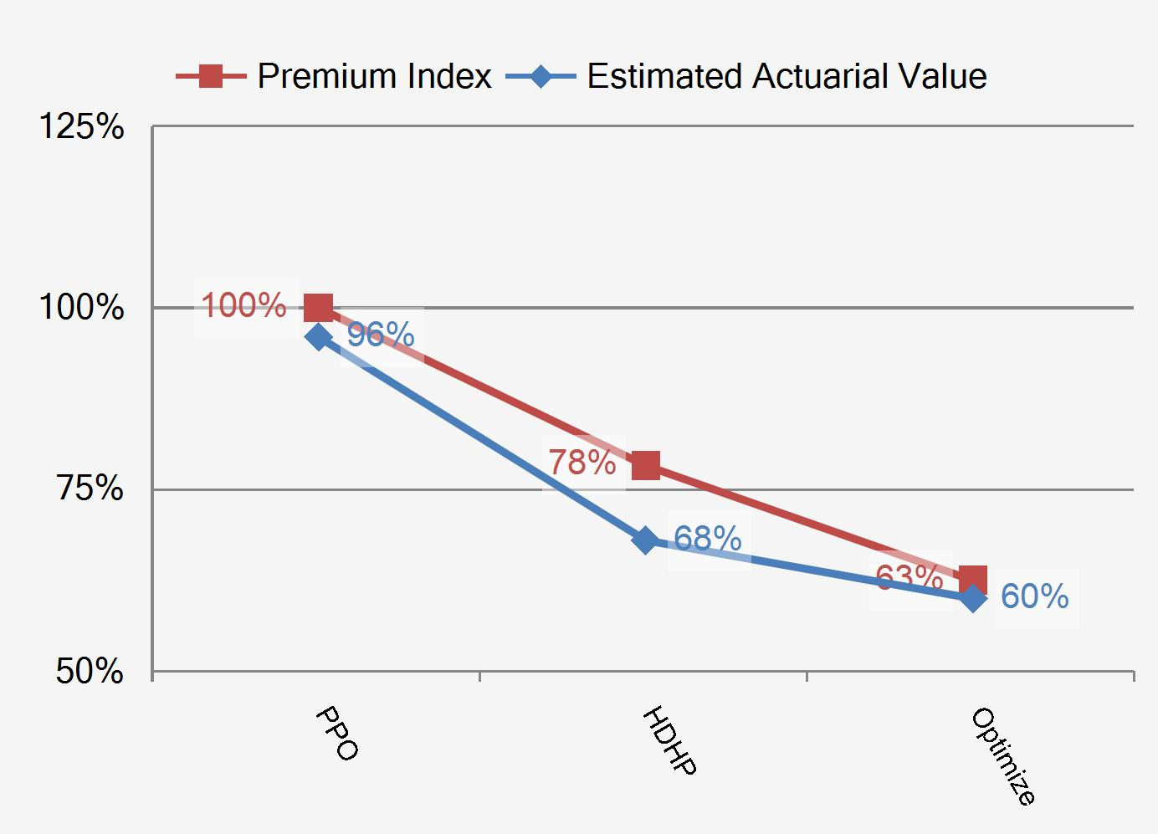
“Acceptable” Health Coverage
Key Considerations:
HCR will increase mandated coverages and establish limits on cost sharing for employees. Minimum Essential Coverage (MEC) must be provided to avoid penalties. Standards for Medical Loss Ratio (MLR) will be established for fully-insured plans.
In order to be considered “Acceptable Coverage”, an employer sponsored plan must pay (on average) 60% of the costs of benefits provided. This is referred to as a plan’s actuarial value.
Employers should consider the value of any plan’s offered to optimize cost and risk. When evaluating “pay or play scenarios” employers should consider the value of the plans offered in the scenario and use this information to adjust the forecasted costs accordingly.
Compass Heading
The PPO plan is estimated to have an actuarial value of 96%.The estimated equivalent premium for an "Acceptable Plan" using the new benchmark of 60% AV would be approximately 62.5% of today’s costs (before including the cost of compliance with healthcare reform’s other provisions).
The HDHP plan is estimated to have an actuarial value of 68%.
Health Coverage Comparison
PlanComparison
© 2012 Wells Fargo Insurance Services
No Reprints Without Permission

Slide 10
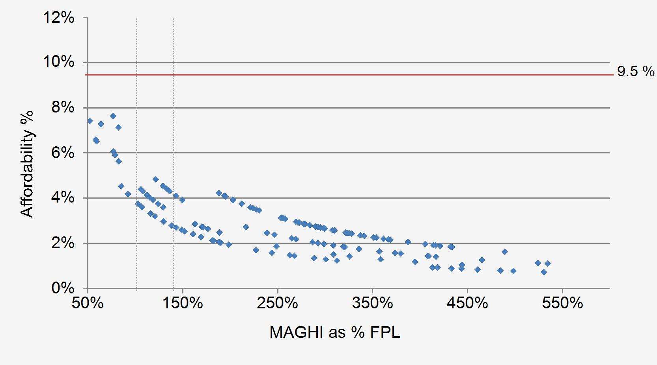
Employee Affordability
Key Considerations:
Employees will have access to subsidies in the Public Health Insurance Exchange (PHIE) even if their employer offers MEC if their required contribution for that plan exceeds 9.5% of their modified adjusted gross household income (MAGHI).
Implications:
If employees enroll in the PHIE (and receive a subsidy), a “Large” employer will pay a penalty of $3,000 per employee up to a max of $2,000 times all employees.
Compass Heading:
This slide shows where employees currently are in relation to the 9.5% affordability scale.
Note that “affordability” is measured based on the current plan with at least a 60% AV with the lowest employee contribution rate for single coverage, and coverage tiers are used as a proxy for family size (since FPL increases per family size)
Currently waived and ineligible employees reflect an assumed coverage tier based upon national averages.
Current Plan “Affordability”
EEAffordability
© 2012 Wells Fargo Insurance Services
No Reprints Without Permission

Slide 11
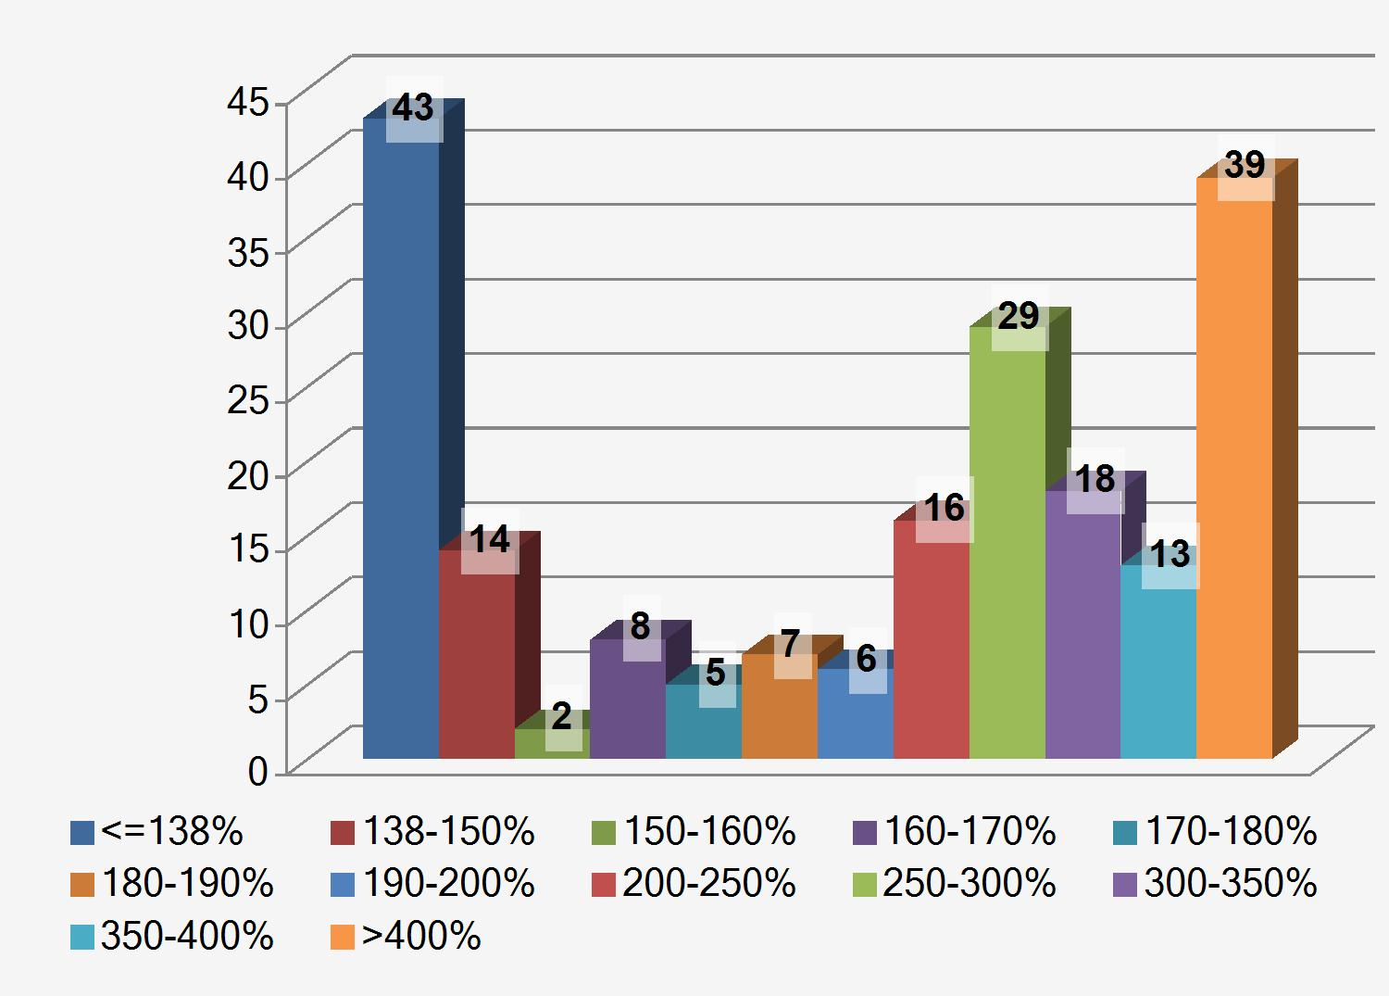
Employee Modified Adjusted Gross Household Income Distribution
Key Considerations:
Employees >138% and <400% of the FPL will have access to varying levels of subsidies .
Employees <138% of the FPL will be eligible for Medicaid .
Implications:
If an employee receives a subsidy, a “Large” employer will pay a penalty of $3,000 per employee up to a max of $2,000 times all employees.
There is no penalty for the employer if the employee is eligible for Medicaid.
Compass Heading:
This slide shows where employees’ anticipated AGHI currently fall in relation to the FPL.
AGHI Distribution by FPL
EEAffordability
© 2012 Wells Fargo Insurance Services
No Reprints Without Permission

Slide 12
2012 Federal Poverty Level guidelines (all states, except for Alaska and Hawaii)
Family Size | 100%* | 138% | 400%
1 | 11,170 | 15,415 | 44,680
2 | 15,130 | 20,879 | 60,520
3 | 19,090 | 26,344 | 76,360
4 | 23,050 | 31,809 | 92,200
5 | 27,010 | 37,274 | 108,040
6 | 30,970 | 42,739 | 123,880
7 | 34,930 | 48,203 | 139,720
8* | 38,890 | 53,668 | 155,560
* For family units of more than 8 members, add $3,950 per additional person
PHIC2
© 2012 Wells Fargo Insurance Services
No Reprints Without Permission

Slide 13
Public insurance exchanges
General overview
Basically federally supervised, but state-operated, marketplaces where health insurance policies meeting specific eligibility and benefits requirements will be available for individuals and certain small employers, starting in 2014
Each state must establish at least one exchange (federal government will operate one if a state chooses not to establish its own)
5 different actuarial value coverage tiers will be available
Coverage subject to modified community rating (guaranteed issue with no individual medical underwriting)
Rates can vary only based on (1) individual or family coverage; (2) geographic area; (3) tobacco use (but only within 1.5:1 ratio band); and (4) age (but only within 3:1 ratio band for adults)
Cost of unsubsidized individual coverage will increase significantly in most states
© 2012 Wells Fargo Insurance Services
No Reprints Without Permission

Slide 14
Public Health Insurance Exchanges
Key Considerations:
In the exchange, some individuals will be able to access Premium Credits and Out of Pocket Subsidies that will reduce their overall cost of healthcare
Implications:
Employers need to consider how employees access government subsidies as a part of their overall strategy for offering benefits.
Compass Heading:
Many employees will be able to access coverage that is better than the current group plan if they are eligible for individual tax credits and cost sharing subsidies.
Tax Credit Guidelines
Federal Poverty Level | Max Premium as % of AGHI | Estimated Plan Actuarial Value
<100% | 0% | 100%
100% - 138% | 2% | 100%
139% - 150% | 3.0% - 4.0% | 94%
151% – 200% | 4.0% - 6.3% | 87%
201% – 250% | 6.3% - 8.05% | 73%
251% - 300% | 8.05% - 9.5% | 70%
301% - 400% | 9.5% | 70%
>400% | unlimited | 60%
PHIC2
© 2012 Wells Fargo Insurance Services
No Reprints Without Permission

Slide 15
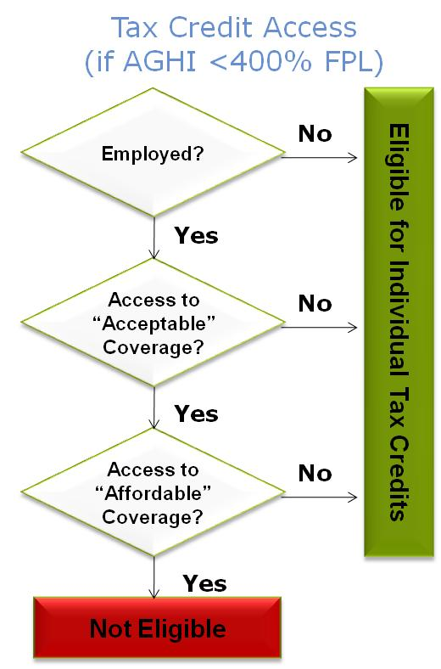
Individual Tax Credit/Cost Sharing Subsidy Eligibility
Key Considerations:
Individual access to the Exchange will be based upon a combination of factors.
Employed individuals who have access to affordable coverage that meets minimum requirements will not be able to receive subsidies on the Exchange regardless of their income level.
Implications:
Should an employer offer a plan that meets MEC, low employee contributions may preclude employees from accessing subsidies on the Exchange.
Compass Heading:
What the employer offers, and how they price it, has everything to do with whether or not employees will be able to access the tax credits and cost sharing subsidies through the exchange.
PHIC
© 2012 Wells Fargo Insurance Services
No Reprints Without Permission

Slide 16
Subsidy Eligible Employee Example
Key Considerations:
Premium Credits will have the effect of capping an individual’s expenditure on health insurance.
Subsidies will have the effect of decreasing the out-of-pocket expenditures for employees (and their families).
Implications:
Employees (if they are eligible for subsidies) will need to evaluate their coverage options in terms of their projected use of healthcare.
Compass Heading:
In the example to the right, the employee receives 2% less of their average health expenditures covered for $7,102 less premium per year.
Employee Profile
Age | 45
Salary | $33,207
Current Coverage Level | Family
Projected Coverage Level | Family
Est. AGHI | $33,207
% Est. AGHI to FPL | 138.47%
Employee View | Gross Premium | Net Premium | Est. AV
Group (as of 2014) | $10,150 | $8,111 | 96%
Exchange | $11,068 | $1,009 | 94%
Comparison | $918 | ($7,102) | -2%
SubsidyEligibleEE
© 2012 Wells Fargo Insurance Services
No Reprints Without Permission

Slide 17
Non-Subsidy Eligible Employee Example
Key Considerations:
Employees not eligible for Premium Credits or Subsidies will be forced to buy relatively expensive Exchange coverage with after tax dollars.
Implications:
Many higher wage earners will be far better off on employer-sponsored coverage.
Compass Heading:
In the example to the right, the employee receives 26% less of their average health expenditures covered for $9,534 more per year.
Employee Profile
Age | 54
Salary | $52,912
Current Coverage Level | Employee and Spouse
Projected Coverage Level | Employee and Spouse
Est. AGHI | $84,130
% Est. AGHI to FPL | 534.46%
Employee View | Gross Premium | Net Premium | Est. AV
Group (as of 2014) | $6,159 | $4,715 | 96%
Exchange | $14,250 | $14,250 | 70%
Comparison | $8,091 | $9,534 | (26)%
SubsidyIneligibleEE
© 2012 Wells Fargo Insurance Services
No Reprints Without Permission

Slide 18
The Bottom Line
Current Strategies
(Tax Adjusted)
Options
(Tax Adjusted)
Current Cost
(Tax adjusted)
2014
No HCR
2014
Maintain
2014
Terminate
2014
Minimize
2014
Optimize
Employer Perspective
ER Total
$484,061
ER Total
$629,311
ER Total
$611,271
ER Total
$685,362
ER Total
($29,333)
ER Total
$342,469
Employer Perspective
($18,040)
$74,091
($640,604)
($268,801)
Employee Perspective
EE Total
$307,973
EE Total
$399,733
EE Total
$416,285
EE Total
$348,643
EE Total
$827,888
EE Total
$410,589
Employee Perspective
$16,552
($67,642)
$411,602
($5,696)
Compared to 2014 Maintain
Optimized plan set at 60% AV
Operating in state that elects to expand Medicaid and 100% of Medicaid eligible population opt out of employer group plan
BottomLine
© 2012 Wells Fargo Insurance Services
No Reprints Without Permission

Slide 19
Impact Analysis – No HCR (As of 12/31/2013)
Employer Perspective
Group
Premium
$1,095,013
Premium
Tax Impact
($427,055)
FICA
Tax Impact
($38,646)
Penalty
$0
Lost Comp
$0
ER Total
$629,311
Employee Perspective
Group
Premium
$510,100
Premium
Tax Impact
($71,720)
FICA
Tax Impact
($38,646)
Exchange
Gross
$0
Subsidies
$0
Lost Comp
$0
EE Total
$399,733
Key Considerations
Salaries trended to 103%
Group premiums trended to 130%
Of the 200 employees who work at least 30 hours per week and 144 currently on the group plan
AnalysisTemplate
© 2012 Wells Fargo Insurance Services
No Reprints Without Permission

Slide 20
Impact Analysis - Maintain Plan (Projected to 2014)
Employer Perspective
Group
Premium
$1,063,522
Premium
Tax Impact
($414,773)
FICA
Tax Impact
($37,477)
Penalty
$0
Lost Comp
$0
ER Total
$611,271
($18,040)
Employee Perspective
Group
Premium
$500,824
Premium
Tax Impact
($73,525)
FICA
Tax Impact
($37,477)
Exchange
Gross
$410,985
Subsidies
($384,520)
Lost Comp
$0
EE Total
$416,285
$16,552
Key Considerations
Salaries trended to 103%
Group premiums trended to 130%
Of the 200 employees who work at least 30 hours per week and 144 currently on the group plan; 138 (-6) projected to elect group plan, 43 go to Medicaid, 5 go to Medicare, 14 opt out of coverage
AnalysisTemplate
© 2012 Wells Fargo Insurance Services
No Reprints Without Permission

Slide 21
Impact Analysis - Terminate Plan (Projected to 2014)
Employer Perspective
Group
Premium
$0
Premium
Tax Impact
($197,119)
FICA
Tax Impact
$37,047
Penalty
$340,000
Lost Comp
$505,435
ER Total
$685,362
$74,091
Employee Perspective
Group
Premium
$0
Premium
Tax Impact
$83,915
FICA
Tax Impact
$37,047
Exchange
Gross
$1,736,767
Subsidies
($1,003,651)
Lost Comp
($505,435)
EE Total
$348,643
($67,642)
Key Considerations
Salaries trended to 103%
Group premiums trended to 130%
Excise tax penalty based on all 200 full-time employees (less the first 30) regardless of whether they obtain other coverage
“Lost Comp” is the aggregate compensation value lost for all employees adversely impacted by termination of group coverage, calculated as the difference between current cost and future cost of exchange coverage.
AnalysisTemplate
© 2012 Wells Fargo Insurance Services
No Reprints Without Permission

Slide 22
Impact Analysis - Minimize Plan (Projected to 2014)
Employer Perspective
Group
Premium
$62,795
Premium
Tax Impact
($24,490)
FICA
Tax Impact
($67,638)
Penalty
$0
Lost Comp
$0
ER Total
($29,333)
($640,604)
Employee Perspective
Group
Premium
$907,411
Premium
Tax Impact
($135,967)
FICA
Tax Impact
($67,638)
Exchange
Gross
$508,603
Subsidies
($384,520)
Lost Comp
$0
EE Total
$827,888
$411,602
Key Considerations
Salaries trended to 103%
Group premiums trended to 130%
Of the 200 employees who work at least 30 hours per week and 144 currently on the group plan; 124 (-20) projected to elect group, 43 go to Medicaid, 7 go to Medicare, 12 go to an individual exchange plan, 14 opt out of coverage
AnalysisTemplate
© 2012 Wells Fargo Insurance Services
No Reprints Without Permission

Slide 23
Impact Analysis - Optimize Plan (Projected to 2014)
Employer Perspective
Group
Premium
$558,453
Premium
Tax Impact
($217,796)
FICA
Tax Impact
($34,186)
Penalty
$36,000
Lost Comp
$0
ER Total
$342,469
($268,801)
Employee Perspective
Group
Premium
$456,781
Premium
Tax Impact
($68,445)
FICA
Tax Impact
($34,186)
Exchange
Gross
$526,481
Subsidies
($470,041)
Lost Comp
$0
EE Total
$410,589
($5,696)
Key Considerations
Salaries trended to 103%
Group premiums trended to 130%
Of the 200 employees who work at least 30 hours per week and 144 currently on the group plan; 124 (-20) projected to elect group plan, 43 go to Medicaid, 7 go to Medicare, 12 go to an individual exchange plan, 14 opt out of coverage
AnalysisTemplate
© 2012 Wells Fargo Insurance Services
No Reprints Without Permission

Slide 24
The Bottom Line (Additional Scenario)
Current Strategies
(Tax Adjusted)
Options
(Tax Adjusted)
Current Cost
(Tax adjusted)
2014
No HCR
2014
Maintain
2014
Terminate
2014
Minimize
2014
Optimize
Employer Perspective
ER Total
$485,097
ER Total
$630,618
ER Total
$718,986
ER Total
$695,261
ER Total
($13,902)
ER Total
$400,318
Employer Perspective
$88,367
($23,725)
($732,888)
($318,668)
Employee Perspective
EE Total
$309,009
EE Total
$401,040
EE Total
$501,650
EE Total
$422,484
EE Total
$938,305
EE Total
$426,680
Employee Perspective
$100,609
($79,165)
$436,655
($74,969)
Compared to 2014 Maintain
Optimized plan set at 60% AV
Operating in state that does NOT elect to expand Medicaid and 100% of Medicaid eligible population opt out of employer group plan
BottomLine
© 2012 Wells Fargo Insurance Services
No Reprints Without Permission

Slide 25
Impact Analysis – No HCR (As of 12/31/2013)
Employer Perspective
Group
Premium
$1,095,013
Premium
Tax Impact
($427,055)
FICA
Tax Impact
($37,339)
Penalty
$0
Lost Comp
$0
ER Total
$630,618
Employee Perspective
Group
Premium
$510,100
Premium
Tax Impact
($71,720)
FICA
Tax Impact
($37,339)
Exchange
Gross
$0
Subsidies
$0
Lost Comp
$0
EE Total
$401,040
Key Considerations
Salaries trended to 103%
Group premiums trended to 130%
Of the 200 employees who work at least 30 hours per week and 144 currently on the group plan
AnalysisTemplate
© 2012 Wells Fargo Insurance Services
No Reprints Without Permission

Slide 26
Impact Analysis - Maintain Plan (Projected to 2014)
Employer Perspective
Group
Premium
$1,247,239
Premium
Tax Impact
($486,423)
FICA
Tax Impact
($41,829)
Penalty
$0
Lost Comp
$0
ER Total
$718,986
$88,367
Employee Perspective
Group
Premium
$618,688
Premium
Tax Impact
($86,632)
FICA
Tax Impact
($41,829)
Exchange
Gross
$11,423
Subsidies
$0
Lost Comp
$0
EE Total
$501,650
$100,609
Key Considerations
Salaries trended to 103%
Group premiums trended to 130%
Of the 200 employees who work at least 30 hours per week and 144 currently on the group plan; 160 (+16) projected to elect group plan, 5 go to Medicare, 35 opt out of coverage
AnalysisTemplate
© 2012 Wells Fargo Insurance Services
No Reprints Without Permission

Slide 27
Impact Analysis - Terminate Plan (Projected to 2014)
Employer Perspective
Group
Premium
$0
Premium
Tax Impact
($205,748)
FICA
Tax Impact
$33,448
Penalty
$340,000
Lost Comp
$527,561
ER Total
$695,261
($23,725)
Employee Perspective
Group
Premium
$0
Premium
Tax Impact
$84,856
FICA
Tax Impact
$33,448
Exchange
Gross
$1,736,767
Subsidies
($905,027)
Lost Comp
($527,561)
EE Total
$422,484
($79,165)
Key Considerations
Salaries trended to 103%
Group premiums trended to 130%
Excise tax penalty based on all 200 full-time employees (less the first 30) regardless of whether they obtain other coverage
“Lost Comp” is the aggregate compensation value lost for all employees adversely impacted by termination of group coverage, calculated as the difference between current cost and future cost of exchange coverage.
AnalysisTemplate
© 2012 Wells Fargo Insurance Services
No Reprints Without Permission

Slide 28
Impact Analysis - Minimize Plan (Projected to 2014)
Employer Perspective
Group
Premium
$78,882
Premium
Tax Impact
($30,763)
FICA
Tax Impact
($62,020)
Penalty
$0
Lost Comp
$0
ER Total
($13,902)
($732,888)
Employee Perspective
Group
Premium
$925,610
Premium
Tax Impact
($137,002)
FICA
Tax Impact
($62,020)
Exchange
Gross
$211,717
Subsidies
$0
Lost Comp
$0
EE Total
$938,305
$436,655
Key Considerations
Salaries trended to 103%
Group premiums trended to 130%
Of the 200 employees who work at least 30 hours per week and 144 currently on the group plan; 130 (-14) projected to elect group plan, 7 go to Medicare, 28 go to an individual exchange plan, 35 opt out of coverage
AnalysisTemplate
© 2012 Wells Fargo Insurance Services
No Reprints Without Permission

Slide 29
Impact Analysis - Optimize Plan (Projected to 2014)
(
Employer Perspective
Group
Premium
$592,388
Premium
Tax Impact
($231,031)
FICA
Tax Impact
($33,038)
Penalty
$72,000
Lost Comp
$0
ER Total
$400,318
($318,668)
Employee Perspective
Group
Premium
$487,067
Premium
Tax Impact
($71,835)
FICA
Tax Impact
($33,038)
Exchange
Gross
$201,744
Subsidies
($157,256)
Lost Comp
$0
EE Total
$426,680
($74,969)
Key Considerations
Salaries trended to 103%
Group premiums trended to 130%
Of the 200 employees who work at least 30 hours per week and 144 currently on the group plan; 132 (-12) projected to elect group plan, 7 go to Medicare, 24 go to an individual exchange plan, 37 opt out of coverage
AnalysisTemplate
© 2012 Wells Fargo Insurance Services
No Reprints Without Permission

Slide 30
Strategic Action Plans
The output of CHROME Compass is a multi-year plan designed to “optimize” your position in terms of the points of the compass.
Leading employers are making incremental changes to their allocation of compensation dollars to avoid radical changes.
There are only two “open enrollment” opportunities between now and 2014.
“Acceptable”
Health Coverage
“Fair”
Employee Access
“Affordable”
Employee Contributions
© 2012 Wells Fargo Insurance Services
No Reprints Without Permission

Slide 31
Action plan – “Fair” employee access
Strategies | WFIS Sample 1 - General | Considerations | Actions Required
Waiting periods designed to balance risk, recruiting, and compliance objectives | Current wait period is 1st of the month following 90 days | HCR will limit waiting period to 90 calendar days in 2014 | Consider adjusting wait period to 90 calendar days to comply with the mandate
Medical plan eligibility limited by average number of hours | Current eligibility is 30 hours | HCR will mandate eligibility for all employees at or above 30 hour weekly average | No action required
Active employee eligibility management integrated with vendors | Current practice unknown | 3-5% of carrier eligibility is incorrect in manual environment | Many of today’s eligibility management systems will not be sufficient to handle the compliance reporting needed in 2014. Consider conducting a system audit
Include special provisions concerning coverage for spouses with other coverage available | Not currently implemented | 13% of all employers have this type of provision with 3-5% planning to add in 2012 | Consider implementing a spousal surcharge to avoid adverse selection if spouse has access to other group coverage
ActionPlanFair
© 2012 Wells Fargo Insurance Services
No Reprints Without Permission

Slide 32
Action plan – “Acceptable” health coverage
Strategies | WFIS Sample 1 - General | Considerations | Actions Required
Gradually adjust actuarial value of the plan closer to 60% by 2014 | Current plans range in actuarial value from 68% - 96% | Having plans above exchange standards may contribute to adverse selection | Consider reducing plan choice. Determine plan design “destinations” and customize plan to achieve these objectives
Explore discount medical card options for improved access to primary care physicians | Not yet offered | Health Care Reform will bring about a shortage of primary care physicians | Consider new programs for telemedicine and additional benefits in “non insurance” form
Offer “excepted” benefits as a way to enhance overall compensation value given decrease in emphasis on major medical plan. Integrate excepted benefits into employee communication and enrollment strategy | Currently offers employer paid life and AD&D to Executives | Voluntary benefits will play a major role in enhancing the adjusted group plan actuarial values as they are not subject to the provisions of health care reform | Consider adding voluntary benefits that are subsidized with employer savings to enhance the adjusted actuarial value of the group medical plan. Perform product value analysis based upon employee segments and enhance offerings in stages which mirror adjustments to major medical plan. Review integration of excepted benefits into current enrollment platform. Evaluate CHROME Navigator
Offer wellness incentives as a way to enhance overall compensation value for employees | None currently offered | Wellness incentives have been proven to increase employee productivity and lower overall cost | Consider offering reduced premiums for reaching wellness goals or implementing smoker/nonsmoker rates
ActionPlan
© 2012 Wells Fargo Insurance Services
No Reprints Without Permission

Slide 33
What is the real effect of lowering plan actuarial value and adding Excepted Benefits?
Major Medical Plan
What if the employee gets cancer?
Total out-of-pocket cost for employee on the 60% plan
is a savings of $10,521 vs. $8,576 on the 83% plan.
What if the employee has a major accident?
Total out-of-pocket cost for employee on the 60%
plan is $6,025 vs. $8,226 on the 83% plan.
What if the employee has an ongoing condition that requires a few prescriptions and goes to the doctor a few times a year?
Total out-of-pocket cost for employee on the 60%
plan is $7,309 vs. $7,697 on the 83% plan.
What if the employee is in good health and just uses preventative services?
Total out-of-pocket cost for employee on the 60%
plan is $3,897 vs. $4,906 on the 83% plan.
60% Actuarial Value Plan
-Or-
83% Actuarial Value Plan
+
Excepted Benefits
+
Accident
+
Critical Illness
Telemedicine
=
=
Annual Premium: $3,897
Annual Premium: $4,906
All plan scenarios were based on a 35 year old male smoker. 0% employer contributions are assumed. Excepted benefits assume the full premium is paid by the employee on an after-tax basis.

Slide 34
Action plan – “Affordable” contributions
Strategies | WFIS Sample 1 - General | Considerations | Actions Required
Gradually adjust employee contributions to optimize exchange eligibility | Current single coverage employee contributions are “affordable” for all employees | Most leading edge employers will increase single coverage premiums to allow optimum exchange access | Consider gradually increasing employee contributions and reallocating compensation in the form of excepted benefits for certain classes
ActionPlan
© 2012 Wells Fargo Insurance Services
No Reprints Without Permission

Slide 35
Appendix
ActionPlan
© 2012 Wells Fargo Insurance Services
No Reprints Without Permission

Slide 36
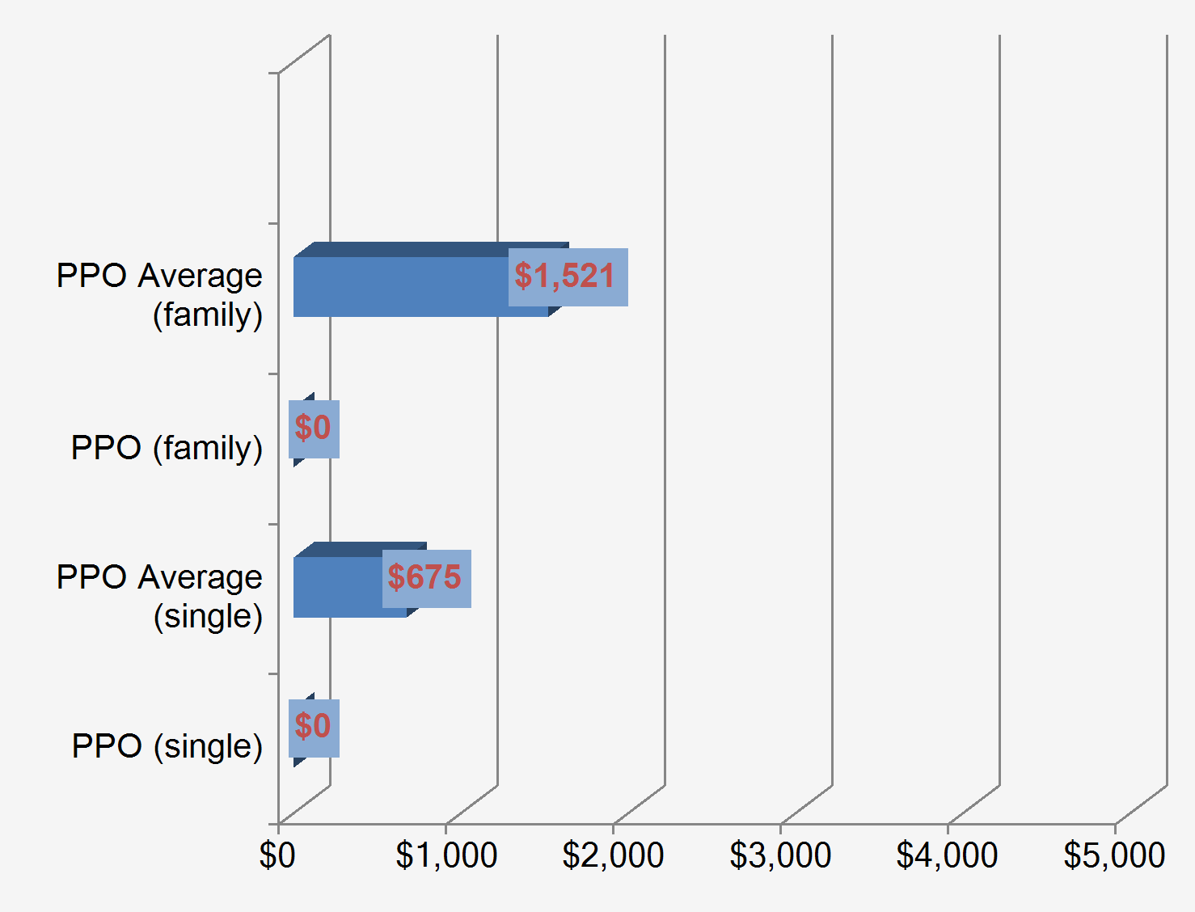
Current Plan Design - PPO
Plan Highlights
Anthem
Deductible
$0.00 Single/$0.00 Family Deductible
Out of Pocket Maximum
$2,500.00 Single/$5,000.00 Family OOP
Copays/Coinsurance
20% coinsurance
$20.00 Routine Office Visit
$35.00 Specialist Visit
$10.00 Tier 1 Prescription
$20.00 Tier 2 Prescription
$35.00 Tier 3 Prescription
Deductible Benchmarking
* Kaiser Family Foundation, 2011
a
© 2012 Wells Fargo Insurance Services
No Reprints Without Permission

Slide 37
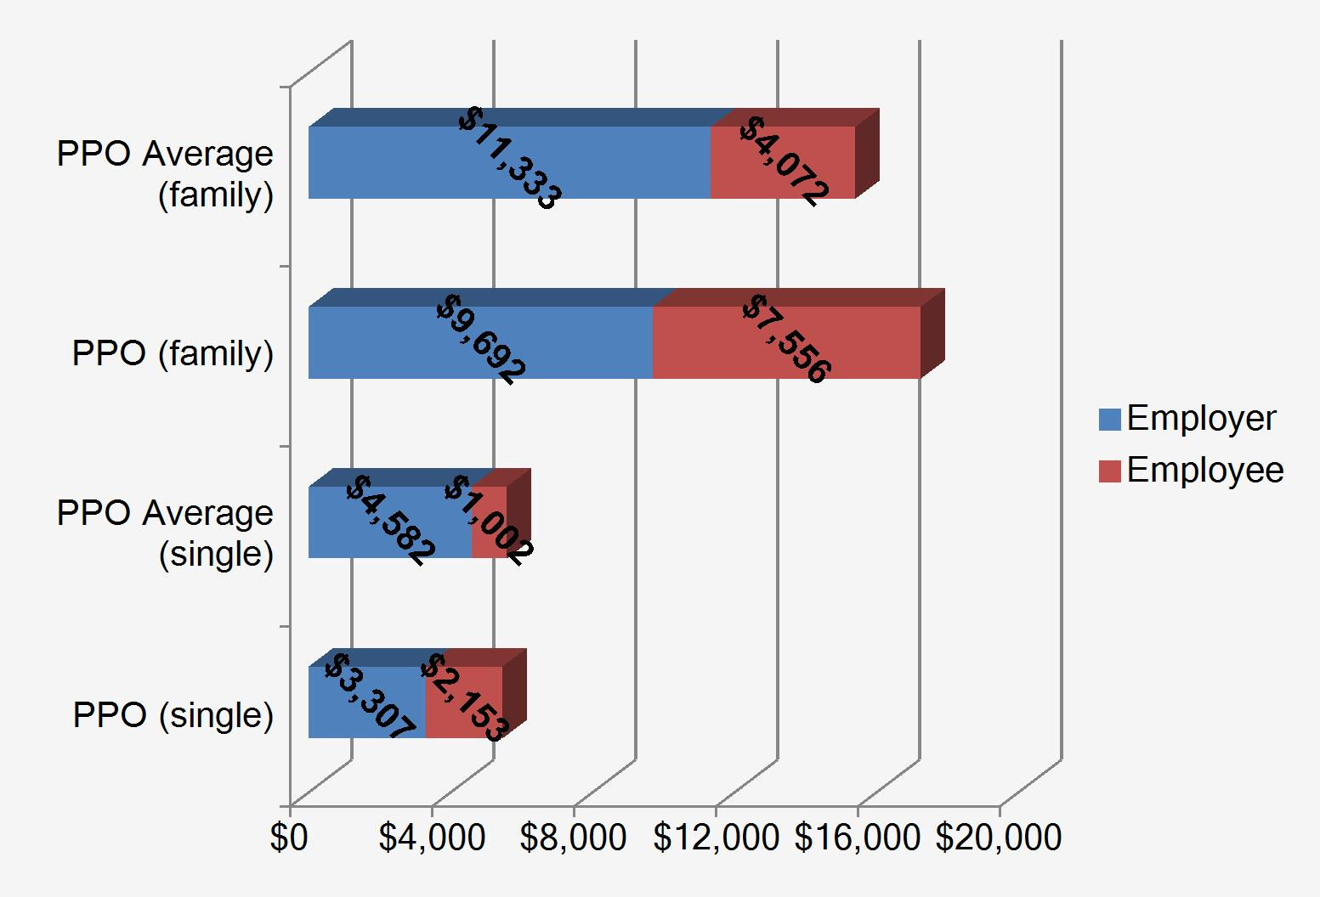
Current Cost and Contribution Structure - PPO
Key Considerations
Employees Covered
59 (40.97% of covered employees)
Total Cost
Single = 97.78% of Benchmark
Family = 111.96% of Benchmark
Employee Contributions
Single = 214.89% of Benchmark
Family = 185.56% of Benchmark
Cost and Contribution Benchmarking
* Kaiser Family Foundation, 2011
CostStructure
© 2012 Wells Fargo Insurance Services
No Reprints Without Permission

Slide 38
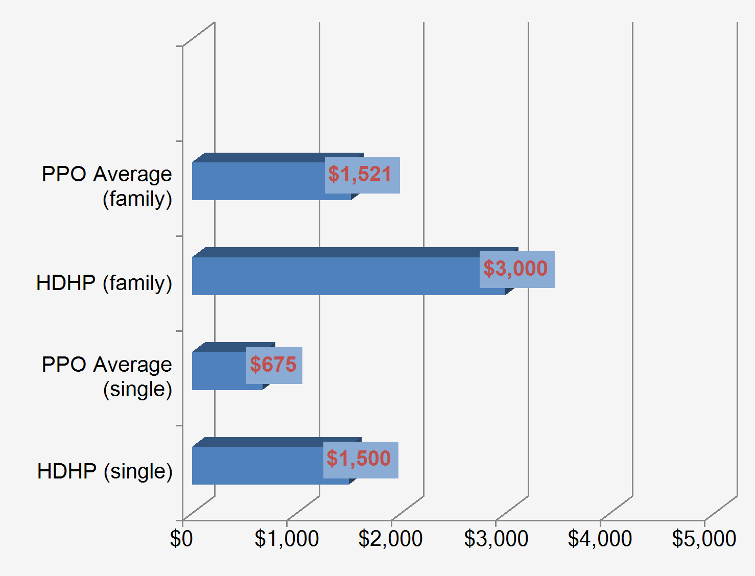
Current Plan Design - HDHP
Plan Highlights
Anthem
Deductible
$1,500.00 Single/$3,000.00 Family Deductible
Out of Pocket Maximum
$5,000.00 Single/$10,000.00 Family OOP
Copays/Coinsurance
20% coinsurance
$30.00 Routine Office Visit
$60.00 Specialist Visit
$10.00 Tier 1 Prescription
$30.00 Tier 2 Prescription
$50.00 Tier 3 Prescription
Deductible Benchmarking
* Kaiser Family Foundation, 2011
a
© 2012 Wells Fargo Insurance Services
No Reprints Without Permission

Slide 39
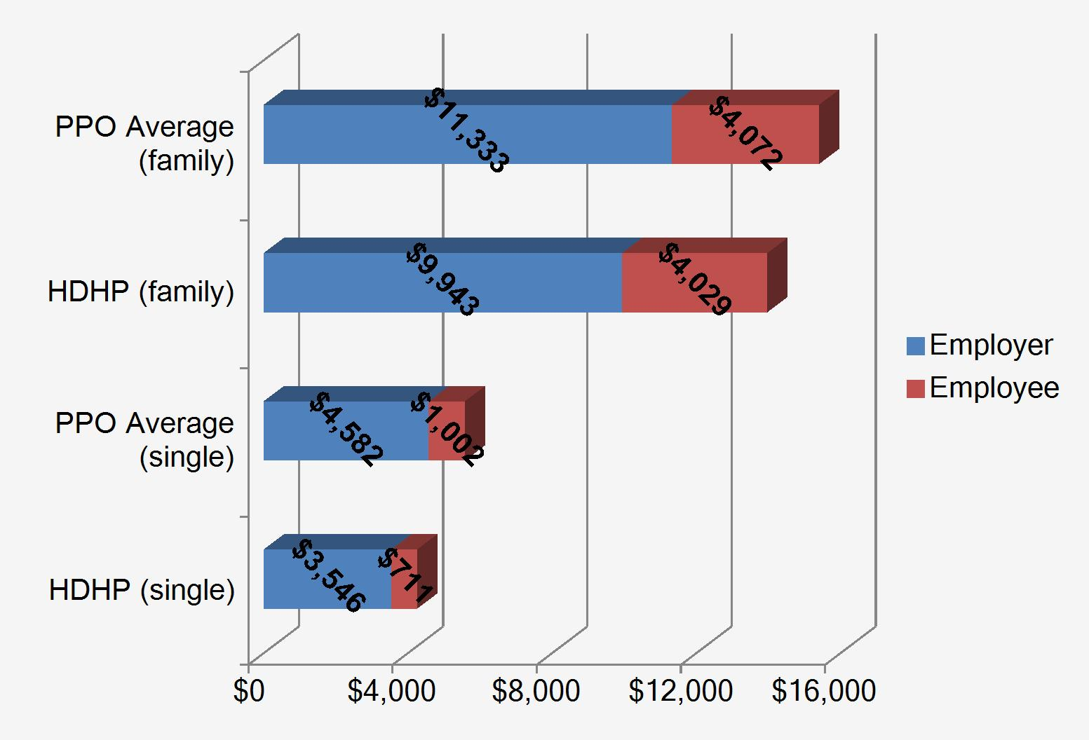
Current Cost and Contribution Structure - HDHP
Key Considerations
Employees Covered
85 (59.03% of covered employees)
Total Cost
Single = 76.22% of Benchmark
Family = 90.7% of Benchmark
Employee Contributions
Single = 70.92% of Benchmark
Family = 98.94% of Benchmark
Cost and Contribution Benchmarking
* Kaiser Family Foundation, 2011
CostStructure
© 2012 Wells Fargo Insurance Services
No Reprints Without Permission

Slide 40
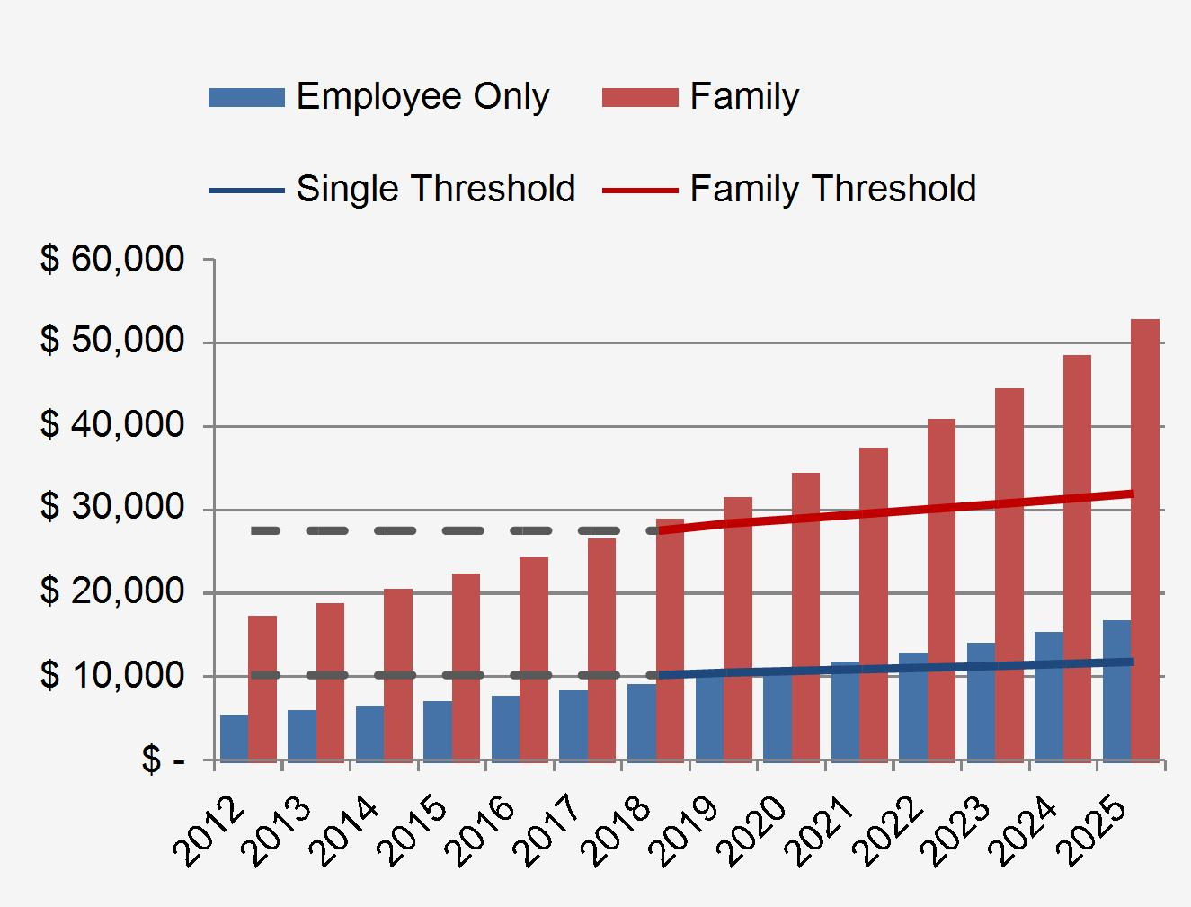
Cadillac Plan Excise Tax - Anthem PPO
Key Considerations:
Starting in 2018, a 40% excise tax will be levied on the total premium cost of employer-provided health coverage that exceeds certain thresholds (i.e., $10,200 for single and $27,500 for non-single coverage, subject to a special one-time adjustment in 2018, non-medical COLA adjustments thereafter, and special rules for certain employees including those subject to collective bargaining agreements).
Total premium cost includes employee and employer contributions for most types of group health plan coverage, with exclusions for stand-alone dental and vision coverage, long-term care, and certain types of excepted benefits (but not employer-paid hospital indemnity and critical illness type coverage).
Implications:
Since post-2018 thresholds are not tied to medical inflation, almost all employers will eventually become subject to the excise tax which will raise the cost of providing coverage.
Employers will need to monitor their plan costs and consider plan containment strategies to mitigate the impact of future excise taxes.
Compass Heading:
If current plan design is maintained, it is anticipated that in 2018 single coverage will be less than thresholds by $1,043 and family coverage will exceed thresholds by $1,426.
Cadillac Plan Threshold
EEAffordability
© 2012 Wells Fargo Insurance Services
No Reprints Without Permission

Slide 41
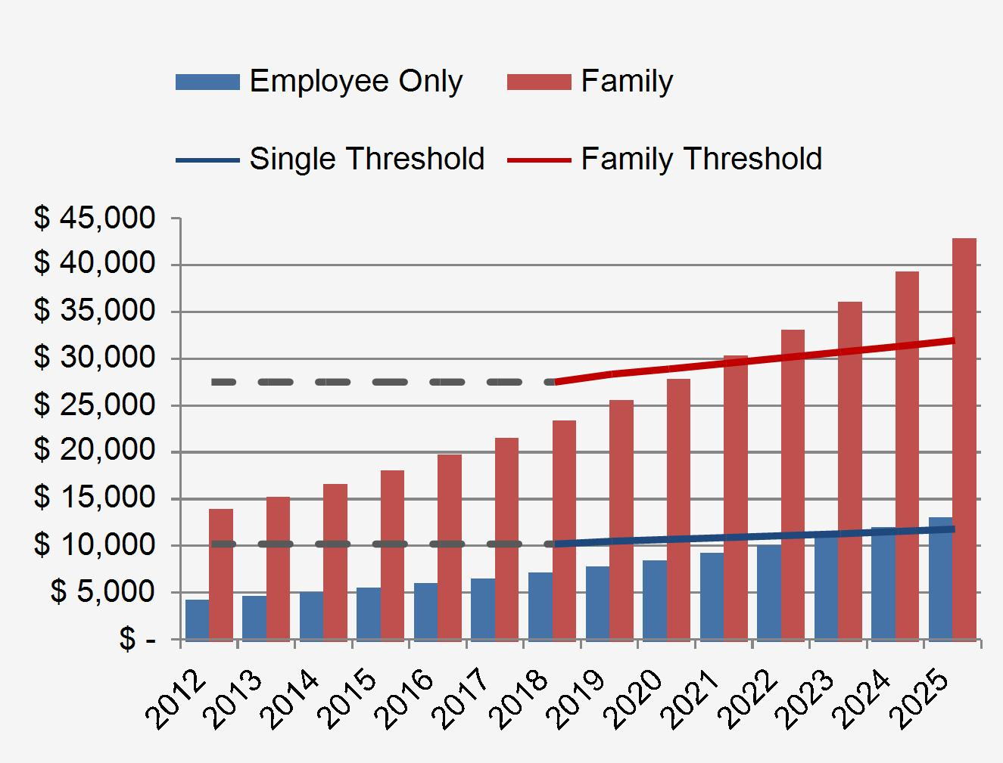
Cadillac Plan Excise Tax - Anthem HDHP
Key Considerations:
Starting in 2018, a 40% excise tax will be levied on the total premium cost of employer-provided health coverage that exceeds certain thresholds (i.e., $10,200 for single and $27,500 for non-single coverage, subject to a special one-time adjustment in 2018, non-medical COLA adjustments thereafter, and special rules for certain employees including those subject to collective bargaining agreements).
Total premium cost includes employee and employer contributions for most types of group health plan coverage, with exclusions for stand-alone dental and vision coverage, long-term care, and certain types of excepted benefits (but not employer-paid hospital indemnity and critical illness type coverage).
Implications:
Since post-2018 thresholds are not tied to medical inflation, almost all employers will eventually become subject to the excise tax which will raise the cost of providing coverage.
Employers will need to monitor their plan costs and consider plan containment strategies to mitigate the impact of future excise taxes.
Compass Heading:
If current plan design is maintained, it is anticipated that in 2018 single coverage will be less than thresholds by $3,061 and family coverage will be less than thresholds by $4,068.
Cadillac Plan Threshold
EEAffordability
© 2012 Wells Fargo Insurance Services
No Reprints Without Permission

Slide 42
Questions
The material is provided for informational purposes only based on our understanding of applicable guidance in effect at the time of publication, and should not be construed as ERISA, tax, or legal advice. Customers and other interested parties must consult and rely solely upon their own independent advisors regarding their particular situation and the concepts presented here. Although care has been taken in preparing and presenting this material accurately (based on the laws and regulations, and judicial and administrative interpretations thereof, as of the date set forth above), Wells Fargo Insurance Services USA, Inc. disclaims any express or implied warranty as to the accuracy of any material contained herein and any liability with respect to it, and any responsibility to update this material for subsequent developments.
To comply with IRS regulations, we are required to notify you that any advice contained in this material that concerns federal tax issues was not intended or written to be used, and cannot be used, for the purpose of (i) avoiding tax-related penalties under the Internal Revenue Code, or (ii) promoting, marketing, or recommending to another party any matters addressed herein.
© 2012 Wells Fargo Insurance Services. All rights reserved

