Slide 2
Immigration in 2025:
The Changing Landscape

Slide 3
Agenda
Immigration Basics
Impact of Executive Orders and Policy Changes
ICE Enforcement Activities
Preparing for I-9 Audits

Slide 4
Immigration Basics

Slide 5
Agencies with Immigration Functions
Department of Homeland Security (DHS) – three parts:
U.S. Citizenship and Immigration Services (USCIS) – benefits
U.S. Customs and Border Protection (CBP) – security
U.S. Immigration and Customs Enforcement (ICE) – the “cops”
Department of Labor (DOL) –
focus is on protecting U.S. workers
LCA; PWD; PERMs
Department of State (DOS) –
focus on overseas representation of U.S. government
Embassies and Consulates abroad; visa issuance

Slide 6
Immigrant vs. Nonimmigrant Visas
Nonimmigrant visa (NIV) –
temporary stay for limited duration and for limited purposes.
Each category has its own requirements and its own limitations regarding visa availability, permissible activities, and duration of stay.
Immigrant visa (IV) –
permanent stay for unlimited period and virtually unlimited purposes – the “Green Card”

Slide 7
What is a “VISA”?
A VISA is a travel document that permits a foreign national to travel to the United States.
Only needs to be valid when entering the United States.
Validity period of the visa does not govern authorized period of stay.
STATUS is the classification you are given upon admission
Each classification (or category) has different eligibility requirements, benefits, and responsibilities.
Status expiration dates are provided upon admission (on the I-94)

Slide 8
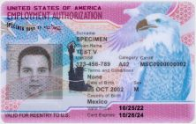
Important Documents
Visa Stamp
EAD

Slide 9
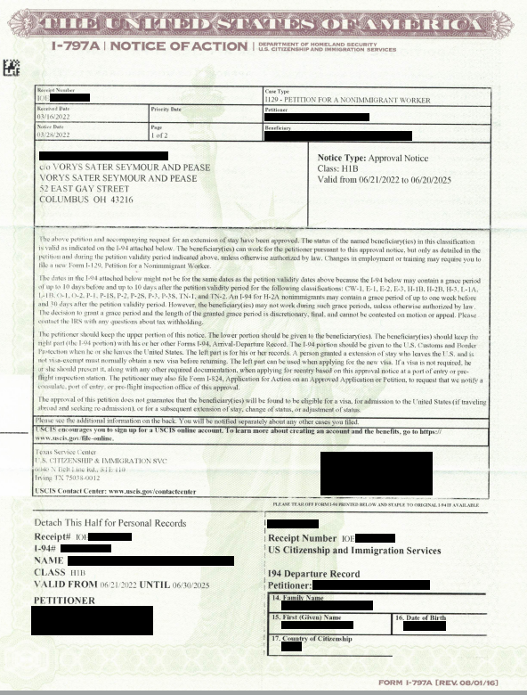
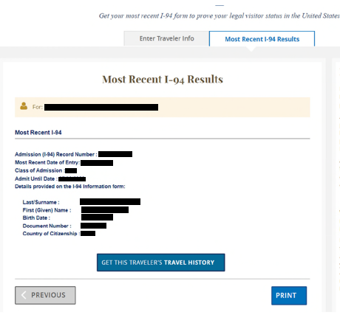
Important Documents (cont.)
USCIS Approval Notice
Form I-94

Slide 10
Immigration Executive Orders and Policy Changes

Slide 11
Executive Orders
Executive Order 14159 – “Protecting the American People Against Invasion”
Revokes Biden era immigration policies and strengthens enforcement measures
Calls for:
the end of certain humanitarian protections
immigration-related sanctions against “recalcitrant” countries
denial of federal funding to “sanctuary” jurisdictions

Slide 12
Executive Orders (cont.)
Underlies directives to terminate protections and employment authorization for certain TPS and humanitarian parole recipients
Anticipated to impact employers in a variety of industries that have legally employed these individuals
Could also result in suspension of visa issuance and other immigration benefits to nationals of countries that do not accept deported individuals

Slide 13
Executive Orders (cont.)
Executive Order 14165 – “Securing Our Borders”
Reinstates certain border enforcement policies from the first Trump administration.
Includes call for termination of the CHNV (Cuban, Haitian, Nicaraguan, and Venezuelan) humanitarian parole program.
Again, anticipated to impact employers in industries that have legally employed these individuals.

Slide 14
Executive Orders (cont.)
Executive Order 14161 – “Protecting the United States from Foreign Terrorists and Other National Security and Public Safety Threats”
Instructs “maximum degree” of vetting and screening of all noncitizens who are entering the U.S. or are already within the U.S.
Anticipated scrutiny and delays in routine visa processing for sponsored workers and business visitors
May underly country-specific travel bans, which may prevent hiring foreign talent and hinder international travel of noncitizen employees/business visitors from certain countries

Slide 15
Executive Orders (cont.)
“America First Trade Policy” (90 FR 8471)
Directs assessments of trade agreements and practices/policies of trade partners with respect to impacts on the U.S. economy and U.S. workers.
Includes explicit call for assessment of USMCA (U.S.-Mexico-Canada Agreement), which is the basis for TN visas.
Signals potential restrictions on certain treaty-based visa categories (such as TN, E, and H-1B1) and processes that facilitate business immigration in B-1 and L-1 visa categories under the USMCA.

Slide 16
Executive Orders (cont.)
Executive Order 14150 – “America First Policy Directive to the Secretary of State”
Directs the Secretary of State to issue guidance that bring the Department of State policies in line with “America First” policy
Similar to the “Buy American, Hire American” directive under the first Trump administration
Likely to result in increased scrutiny of employment-based visa applicants, more barriers to U.S. employers who wish to hire foreign talent, and processing delays for workers applying for visas at U.S. consular posts

Slide 17
Temporary Protected Status (TPS)
Temporary relief given to eligible nationals of designated countries
Eligible for employment authorization
Currently 17 countries have active TPS designations
Designation periods are specified by U.S. Department of Homeland Security (DHS) and renewed every 18 months

Slide 18
Temporary Protected Status (TPS) (cont.)
Administration has taken action to end TPS designations for Venezuela and Haiti – and just this week Afghanistan also.
Actions purport to shorten already issued designations and accompanying employment authorization (A12 or C19)
Creates practical challenges for employers and government agencies in identifying proper expiration dates and planning for potential staffing needs
Employers also need to navigate nondiscrimination obligations based on national origin

Slide 19
Temporary Protected Status (cont.)
Court challenges have made it hard to keep track. As of 5/12/25 –
Venezuela: Termination of TPS designation was to take effect April 7, 2025; temporarily postponed by court order
Venezuelan TPS employees with EAD expirations of 9/10/2025, 4/2/2025, 3/10/2024, and 9/9/2022 are automatically extended through 4/2/2026.
Haiti: TPS designation shortened to August 3, 2025; legal challenge remains pending
Afghanistan: TPS designation terminates July 14, 2025. EADs with earlier expirations are automatically extended, but must be reverified past that date. Litigation is expected.
Situation is fluid; employers should maintain awareness and always consult immigration counsel before taking employment action

Slide 20
One of several special programs established by the prior administration under the “humanitarian parole” authority of the Immigration and Nationality Act
Categorical program grants temporary legal permission to remain in the U.S. and provides employment authorization
DHS published Federal Register Notice to terminate the CHNV program on March 25, 2025 – ending all grants and employment authorization no later than April 24, 2025.
Would have impacted over 530,000 paroled beneficiaries.

Slide 21
Current status (as of 5/12/25):
Clarified that the blanket termination notice only applies to CHNV program – not other humanitarian parole programs for the indicated countries
Federal judge in lawsuit challenging the Order issued stay to the extent it revokes individual grants of parole without case-by-case review
No new or renewal applications are being accepted
EADs (category C11) remain valid – for now – until the stated expiration dates

Slide 22
Words of caution –
Not all C11 EADs held by individuals from the four countries are issued based on the CHNV program – raises practical challenges of identifying affected EADs in the event of early termination
DHS is still issuing terminations of individual grants of humanitarian parole; employers should continue to accept facially valid EADs unless they are aware of official termination of the person’s individual parole EAD

Slide 23
Individuals who need to apply for visas could face processing delays – impact on business-related travel
Possibility of sudden travel bans based on nationality, visa type, or other category
Active use of visa revocations
Presently focused on student protesters and nonimmigrants with any criminal issues
Can reapply abroad but high risk that visa will not be reissued

Slide 24
Worksite Enforcement
Increase in enforcement activities is expected
Types of enforcement activities
ICE Enforcement (worksite “raids”)
Form I-9 and E-Verify audits
Audits of employment-based visa sponsorship programs (e.g., H-1B, L-1, and R-1 visa programs)

Slide 25
ICE Enforcement Activities

Slide 26
What is ICE?
Immigration and Customs Enforcement, an agency of DHS
The “immigration police” – functions include:
Investigative and interior enforcement (“border” areas are manned by CBP)
Enforcement and removal operations
Form I-9 (Employment Eligibility Verification) audits
Homeland Security investigations (immigration crime, human rights violations, smuggling of narcotics, etc.)

Slide 27
ICE Enforcement and Removal Operations (“ERO”)
ERO Agents have the authority to:
Conduct enforcement activities, including worksite “raids”
Take certain individuals into custody for civil immigration deportation (“removal”) proceedings
Enforcement activities at worksites may or may not target an individual, but non-targeted individuals may be taken into custody as a result

Slide 28
Enforcement and Removal Operations (cont.)
Executive Orders 14159 and 14165 directed agencies to strengthen enforcement measures; this led to –
Rescission of long-standing policy prohibiting enforcement at or near “sensitive locations” (e.g., schools, places of worship, courthouses, and healthcare facilities, )
Moves terminating programs that provided temporary employment authorization and legal permission to remain in the U.S. (e.g., TPS, humanitarian parole), which in turn expand possible targets for enforcement

Slide 29
When ICE Visits
Alert immigration counsel immediately
ICE can access public areas of the premises
Determine scope of ICE’s authority to access private areas and/or items –
Is there a judicial warrant or subpoena and for what?
Be careful about providing consent to access non-public areas and information
Ensure Employer Representatives act in accordance with policy/protocol

Slide 30
When ICE Visits (cont.)
Employer Representatives should respectfully follow ICE agents during their visit and make a record of their activities without interfering
Firmly object when agents exceed scope of authority, but do not obstruct their activities; create a record
Employer Representatives may make employees aware of their rights, but do not advise or represent employees, and do not aid or abet

Slide 31
Preparing for ICE Enforcement Activities
Designate one or more Employer Representatives to interact with agents
Train initial points of contact with the public (e.g., receptionists, security guards) on response when ICE arrives
Train Employer Representatives to know the difference between judicial warrants/subpoenas and administrative warrants/subpoenas

Slide 32
Preparing for an ICE Raid (cont.)
Understand actions that ICE agents are allowed to take on public versus private parts of the premises and under what circumstances
Establish protocol to apply during and after the raid and train relevant personnel
Train Employer Representatives and other key personnel of their rights and rights of employees and third parties (guests, customers, etc.) on premises

Slide 33
Preparing for an ICE Raid (cont.)
Ensure Employer Representatives are aware of state/local law and internal policies impacting response to ICE visit
Know Your Rights materials for employees are available online from the American Immigration Lawyers Association (“AILA”) as well as various immigrant rights and community organizations
Make sure employee emergency contact information is up to date
Contact immigration counsel if you feel a need to create protocols that are not currently in place

Slide 34
After an ICE Raid
Employer Representatives should collect all records of ICE activities, including an inventory of items that were seized
Fully debrief internally and contact immigration counsel
If any employees are taken into custody, ensure families are contacted and any money owed is paid

Slide 35
Preparing for I-9 Audits

Slide 36
Background
The Immigration Reform and Control Act (“IRCA”) requires all U.S. employers to verify (1) employment eligibility and (2) identity of all associates hired to work in the United States.
This is accomplished by properly completing a Form I-9 for each associate hired after IRCA was enacted (1986).
This applies to all employers, regardless of size, and all associates, regardless of citizenship or national origin.

Slide 37
Employer’s I-9 Obligations: Completion
Ensure Section 1 is fully and correctly completed by the associate no later than the first day of employment
Complete Section 2 within three (3) business days of first day of employment
Inspect documents to verify both IDENTITY and EMPLOYMENT AUTHORIZATION
Reverify any temporary employment authorization no later than expiration date (Supplement B)

Slide 38
Employer’s I-9 Obligations: Inspecting Documents
Employer must physically inspect the documents and determine if they reasonably appear to be genuine and to relate to the employee who presents them
Remote verification option is available, but only for employers enrolled in E-Verify at the applicable hiring site at the time of verification

Slide 39
Employer’s I-9 Obligations: Retention
Employers must maintain I-9 forms for:
three years after the date of hire
OR
one year after the date the associate is terminated –
whichever is later.

Slide 40
I-9 Retention (cont.)
Store I-9 forms in location that can be readily accessed from the physical worksite in the event of an audit.
Do not store I-9 forms with personnel files; central storage is advisable for control purposes.
Electronic storage is permissible if it meets specific conditions

Slide 41
Copying Documents
Must have consistent policy (copy all or copy none) at each hiring site.
E-Verify requires copying of specific “photo-matching” documents at enrolled sites, even when no other documents are retained.
State laws may require copying and retention of documents (e.g., Florida).

Slide 42
I-9 Penalties
Both civil and criminal penalties can result from paperwork violations, employment of unauthorized workers, or unlawful discriminatory practices.
The civil fines assessed can add up quickly, and non-compliance can be costly for the company.
Fines for substantive/uncorrected technical violations currently range from $288 to $2,861 per violation.
Fines for knowingly hiring or employing unauthorized workers currently range from $716 to $28,619 per violation.

Slide 43
I-9 Best Practices
Strong protocols and training materials for I-9 completion and storage are in place
Thorough and regular training of onsite personnel representatives responsible for I-9 completion
Protocol for identifying expiring employment authorization and performing timely reverification
Periodic internal audits of I-9 forms and protocols
Regular review of I-9 protocols and audit outcomes by immigration counsel

Slide 44
QUESTIONS?

Slide 45
Bob Harris
614.464.8373 raharris@vorys.com

