Slide 1
Health Plan Compliance:
Stay on Track to Meet
ACA Reporting Requirements
Lisa M. Simioni
Area assistant vice president,
compliance counsel

Slide 2
Agenda
The Challenges of Reporting: Data Compilation and “How To” Steps
The Context for Reporting: Who, Why, What, Where, and When
Untangling the Tangle of Different Forms for Different Purposes
A Look at the Forms – Overview
Examples
Questions

Slide 3
The challenges of Reporting:
Data Compilation and “how to” steps

Slide 4
WHAT’s Hard About Reporting? DATA!
Being sure you’ve got all the data needed
Figuring out where any existing data is now
Touching each FT employee and determining for each month
  Whether an offer of affordable minimum value coverage has been made;
  Whether he/she and spouses/dependents are covered
Reviewing all coverage data, and determining for each month which other employees and non-employees are covered or have received offers

Slide 5
WHAT Data is Needed?
Employer Information
*Address, EIN
* Contact
* # FTs
* Total # Ees
* Con. Grp
Employee or Other Individual Information
* Names
* Addresses
* SSNs
* FT status
* Coverage
* Delivery info
Offer Information
* 95/70% FT
* Min Value
* Affordability
* Cost**
* Spouses
* Dependents
* Non-FT Ees
* Non - Ees
Transitional Relief Information
* Claiming
* Qualify
* 50–99 FTEs
* 80 freebies
** Cost of employee share of lowest cost monthly premium for self-only minimum value coverage

Slide 6
HOW TO: Steps
Figure out what data you need
Define which people you need to analyze for each month
Determine where this data currently is
Assign responsibility amongst data sources
Determine if you will hire a vendor* for this function or handle internally
Coordinate data sources for data flow to reporter (HIPAA BAA needed?)
Compile data
Analyze data
Complete forms
Send to individuals
Send to IRS
Maintain data, and keep good records of data and forms
* But, according to regulations, you will have ultimate liability

Slide 7
The context for reporting: who, why, what, where, and when

Slide 8
Reporting and Penalties: WHY?
IRS Reconciles All Information Reported
From Employer via Forms 1094 and 1095
From Insurer via Forms 1094 and 1095
From Employee via Income Tax Return
IRS

Slide 9
Reporting and Penalties: WHY?
IRS Assesses Penalty/Employer Responds
From Employer: Documented Proofs
IRS
Steps:
Information to the IRS
IRS reconciles
IRS notice to Employer (e.g., employee received subsidy)
Employer responds with documentation (e.g., employee was not entitled to an offer of coverage)
IRS agrees with Employer’s proof OR assesses penalty via notice and demand letter
Employer pays

Slide 10
WHAT is Enforced by Reporting?
Individual Mandate Section 6055
Individuals must have MEC
Report shows who has coverage (including non-employees like spouses, dependents, COBRA, retirees)
Employer Mandate Section 6056
ALEs must make offers of affordable, minimum value coverage to 95% of FT employees
Report shows which FT employees received appropriate offers
Premium Tax Credit Section 36B
Individuals must not have received an offer of affordable minimum value coverage and must meet certain income thresholds
Report shows which person is entitled, based on information the employer has, to a premium tax credit

Slide 11
WHO is Reported? WHY?
FT Employees
Individual Mandate
Covered Employees, including PT
Individual Mandate
Premium Tax Credit Eligibility
Premium Tax Credit Eligibility
Employer Mandate
Employees Tracked for Eligibility*
Employer Mandate
Covered Spouses, Dependents, and Non-Ees
Individual Mandate
Premium Tax Credit Eligibility
Premium Tax Credit Eligibility
Individual Mandate
* E.g., Variable and seasonal employees….unless in a limited non-assessment period for all of 2015

Slide 12
WHO Does the Reporting?
Fully-insured plans
Self-funded plans
Carrier responsible for 6055 individual mandate report
Plan sponsor responsible for both 6055 individual mandate report and 6056 employer mandate and premium tax credit report
ALE member is responsible 6056 employer mandate and premium tax credit report
Some special delegation rules for governmental entities and controlled groups

Slide 13
WHEN are Forms Due?
Deadlines for All Plans (including those with non-calendar plan years)
Annually by January 31
First statements = 2016 for 2015 calendar year
Reports submitted to IRS
Annually by Feb 28 (paper) or March 31 (electronic)
30 day extension
Form 8809
Note: 2016 is a leap year
First filing = 2016 for 2015 calendar year
Individual statements sent to employees

Slide 14
Untangling the tangle of different forms for different purposes

Slide 15
WHICH Forms to Use for What?
For Individual Mandate – 6055 use…
Form 1094-B (fully insured transmittal to the IRS)
For Employer Mandate - 6056 use...
Form 1094-C (ALE transmittal to the IRS)
Form 1095-B (fully insured statements to employees and reports to IRS)
Form 1095-C* (ALE statements to employees and reports to IRS)
Part III of Form 1095-C (self-insured statements to employees and reports to IRS)
* Premium Tax Credit Information is on the same form as the Employer Mandate information.
Notes:
The ACA has created two reporting requirements.
If you haven’t picked up on the lingo yet, there are terms that you will be hearing a lot in the upcoming months.
When you hear the term “6055” this is the reporting requirement that:
Addresses WHO is covered under minimum essential coverage (that is, it will supply the IRS with information regarding who has complied with the individual mandate by having employer-sponsored coverage). This is a broad requirement and includes both employees and nonemployees. It impacts self-insured plans (of all sizes). The requirement includes both a reporting requirement and requirement to provide notice to employees.
When you hear the term “6056” this is the reporting requirement that:
Addresses the employer mandate requirement. Therefore, it applies to employers who are considered large for purposes of the mandate. Large employers include employers with a total of at least 50 full-time and full-time equivalent employees.
It alerts the government as to whether or not the employer is subject to a penalty or whether it has played effectively.
It also alerts employees as to whether or not they were offered coverage that provides minimum value and is affordable.

Slide 16
Cheat Sheet: WHICH Form?
“4”
A cover page – a transmittal form*
“5”
The “guts” – the information being reported
“B”
Insurance carriers: Fully insured individual mandate information
“C”
ALEs: Employer mandate and premium tax credit information
“Part III of C”
ALEs: Self-funded individual mandate information
* Exception: The transmittal form does include certain substantive information. For example, the 95% threshold requirement of the Employer Mandate is reported on the transmittal form – the 1094-C
Notes:
The ACA has created two reporting requirements.
If you haven’t picked up on the lingo yet, there are terms that you will be hearing a lot in the upcoming months.
When you hear the term “6055” this is the reporting requirement that:
Addresses WHO is covered under minimum essential coverage (that is, it will supply the IRS with information regarding who has complied with the individual mandate by having employer-sponsored coverage). This is a broad requirement and includes both employees and nonemployees. It impacts self-insured plans (of all sizes). The requirement includes both a reporting requirement and requirement to provide notice to employees.
When you hear the term “6056” this is the reporting requirement that:
Addresses the employer mandate requirement. Therefore, it applies to employers who are considered large for purposes of the mandate. Large employers include employers with a total of at least 50 full-time and full-time equivalent employees.
It alerts the government as to whether or not the employer is subject to a penalty or whether it has played effectively.
It also alerts employees as to whether or not they were offered coverage that provides minimum value and is affordable.

Slide 17
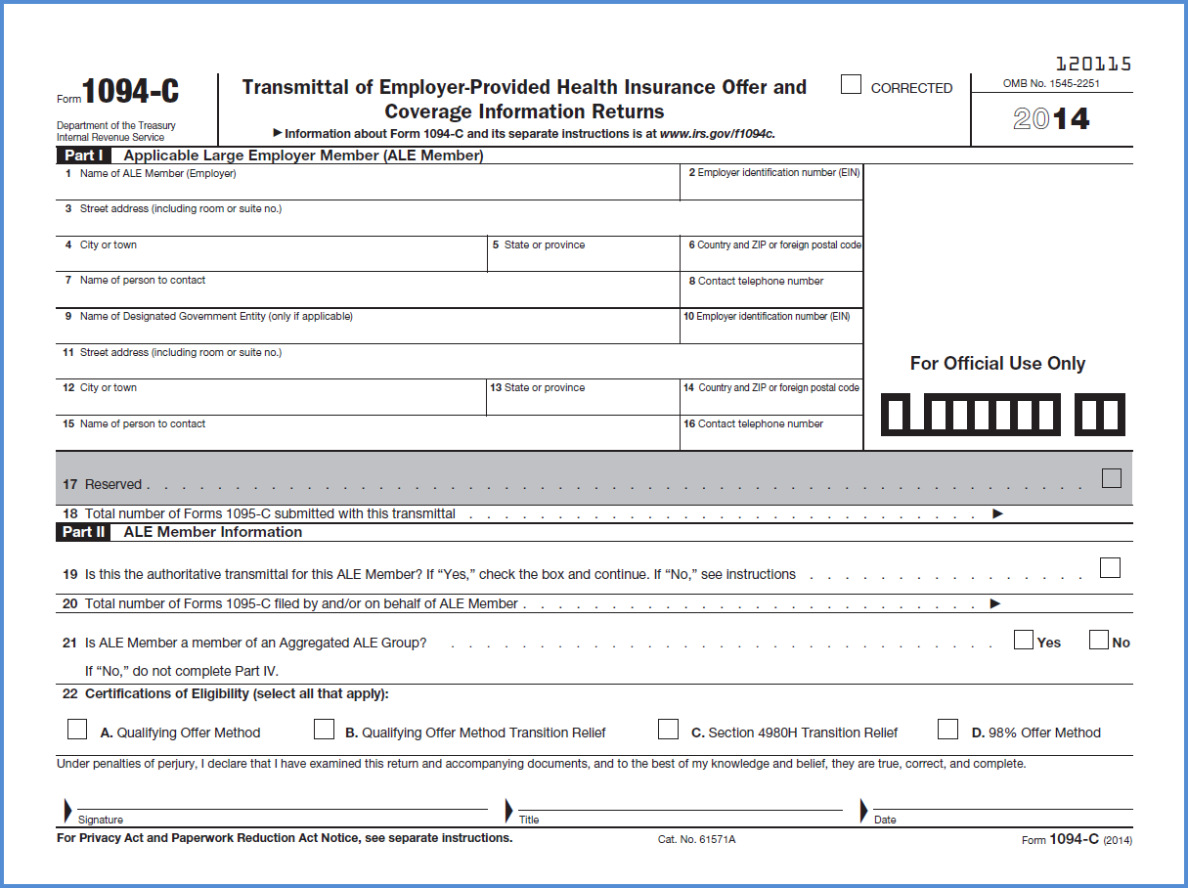
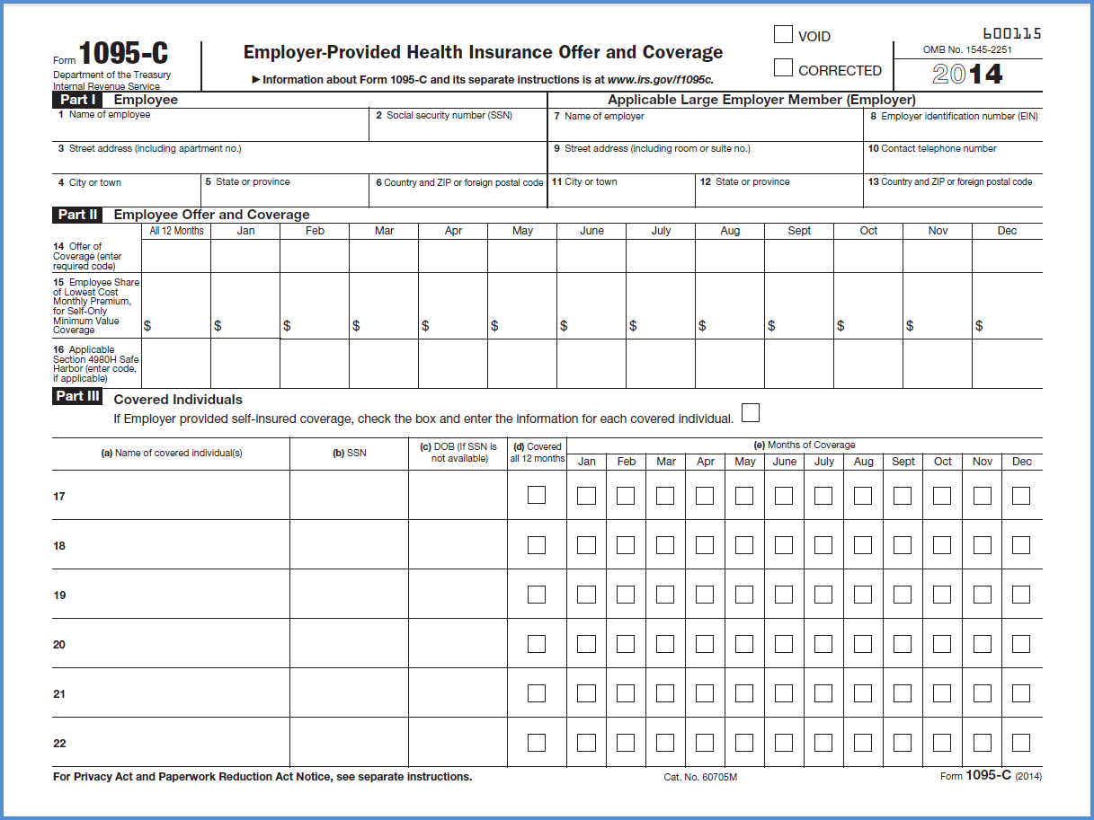
Cheat Sheet: WHICH Form?
Note: One transmittal form will have multiple information forms attached
    Example: ALE with 100 FT employees and no other employees will submit one 1094-C and at least 100 1095-Cs
Notes:
The ACA has created two reporting requirements.
If you haven’t picked up on the lingo yet, there are terms that you will be hearing a lot in the upcoming months.
When you hear the term “6055” this is the reporting requirement that:
Addresses WHO is covered under minimum essential coverage (that is, it will supply the IRS with information regarding who has complied with the individual mandate by having employer-sponsored coverage). This is a broad requirement and includes both employees and nonemployees. It impacts self-insured plans (of all sizes). The requirement includes both a reporting requirement and requirement to provide notice to employees.
When you hear the term “6056” this is the reporting requirement that:
Addresses the employer mandate requirement. Therefore, it applies to employers who are considered large for purposes of the mandate. Large employers include employers with a total of at least 50 full-time and full-time equivalent employees.
It alerts the government as to whether or not the employer is subject to a penalty or whether it has played effectively.
It also alerts employees as to whether or not they were offered coverage that provides minimum value and is affordable.

Slide 18
A look at the forms:
Overview

Slide 19
Individual Mandate - 6055 Reporting:
Big Picture: Some Things Reported to the IRS
Name, address, & EIN of employer plan sponsor
Name, address, & EIN of reporting entity
Name, address, & TIN for each eligible employee enrolled in MEC
Name & TIN of covered spouses and dependents
Months covered

Slide 20
6055 Reporting:
What Is Reported to the IRS – E.g., Form 1095-B
Individual Mandate information

Slide 21
Employer Mandate - 6056 Reporting:
Big Picture: Some Things Reported to the IRS
Name, address and TIN For each full-time employee
Name, address and EIN of ALE
Name and phone of contact
Year of the return
Certification of Offer
Months of availability
Monthly premium for self only lowest cost MEC
Number of FT for each month
Months covered
Indicator codes (i.e. minimum value, spouse coverage, etc.)
Remember, Premium Tax Credit information goes on the same Form as Employer Mandate information.

Slide 22
6056 Reporting by ALEs:
What Is Reported to the IRS – E.g., Form 1094-C
Employer Mandate - FT 95/70% threshold test information goes here

Slide 23
6055 and 6056 Reporting by ALEs:
What Is Reported to the IRS – E.g., Form 1095-C
Affordability, Minimum Value, and Premium Tax Credit Information go here
Fully insured plans skip this Part III. Carrier puts Individual Mandate information on Form 1095-B
Individual Mandate information goes here for self-insured plans

Slide 24

6056 Reporting – Crack the Codes
Offer of Coverage
Line 14
1A - only if using federal poverty level safe harbor OR employee premium is less than $93 per month
Affordability Safe Harbor Line 16
2A – not an employee for the month (new hires)
2C – employee enrolled in coverage offered by employer
1E - if offer employee and dependent minimum value and minimum essential coverage
2D – limited non-assessment period (look back period, waiting period, etc.)
2F – 2H – employee waived but affordable based upon the proper safe-harbor
Here is a partial list of codes that may apply to many of your employees. Do not solely rely on this list. See Tax Form Instructions.

Slide 25

Reporting and Penalties: Strategy Document and Record-Keep
Document
Keep excellent records
Why? This is your defense against the 2K and 3K penalties
If the IRS sends you a notice of penalty, you need to be able to respond, to prove that a penalty does not apply
© 2015 GALLAGHER BENEFIT SERVICES, INC.

Slide 26

Questions You Need Ask Now:
6055/6056 Reporting
Who will be responsible for your reporting obligations? Or you using a vendor?
Do you have accurate or complete information on your employees and dependents or non-employees enrolled in the plan?
Have you tried three times to collect dependent SSNs? Do you have a process making this routine?
Who is going to be responsible for collecting the necessary information?
Who is going to be responsible for retaining the necessary information?

Slide 27
Form 1094-C: the transmittal

Slide 28
Form 1094-C, Parts I and II: 100 or more/entitled to “free” employees

Slide 29
Form 1094-C, Part III: 100 or more/entitled to “free” employees

Slide 30
Form 1094-C, Parts I and II: Entitled to/Relying on 50 to 99 relief

Slide 31
Form 1094-C, Parts I and II: Entitled to/Relying on 50 to 99 relief

Slide 32
6055 and 6056 reporting: examples

Slide 33
Example 1: Calendar Plan Year, Large Employer (100+)
Assumptions
Example 1
  Spa Attendant – Variable Hour Employee
  Date of Hire 8/2/14
FT Eligibility – First day of calendar month coincident with or next following 60 calendar days of employment
Hours tracked and determined to be eligible for coverage
Offer made by October 1
Rate of Pay Safe Harbor
Notes:
The facts are pretty much the same here except that the employer is smaller (falls within the 50 to 99 size range) and we are presuming that the group qualifies for transition relief…..
The employer has a non-calendar year plan and isn’t offering factory employees coverage

Slide 34
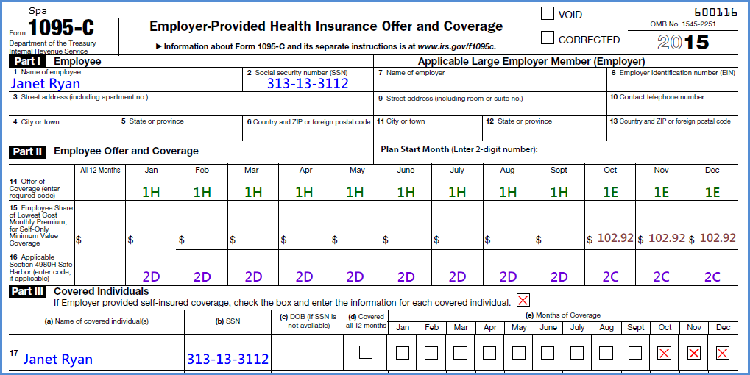
Form 1095-C, Parts I, II & III
Example 1
Self-insured employer completes Part I, II and III. Fully-insured plan does not complete Part III.
Notes:
The employer will indicate in Part I that it did not make an offer of coverage for all “12 Months” on Line 14 and on Line 16 the employer will code this as “2I” (to
indicate this is a non-assessment period)
On the transmittal Form (1094-C), Line 22, the employer should also provide it is entitled to the 50 to 99 transition relief…..

Slide 35
Example 2: Non-Calendar Plan Year, Safe Harbor Used (50 to 99 relief)
Assumptions
Example 2
Employer sponsors a fully-insured plan
Employer has non calendar year plan (June to July)
Employer qualifies for 50 to 99 transition relief
However, its factory employees are not eligible for coverage for the plan year beginning June 1, 2015
Employer amends it plan so that effective June 1, 2016 its full-time factory workers are eligible for affordable, minimum value coverage; spouses and dependents are offered MEC
Notes:
The facts are pretty much the same here except that the employer is smaller (falls within the 50 to 99 size range) and we are presuming that the group qualifies for transition relief…..
The employer has a non-calendar year plan and isn’t offering factory employees coverage

Slide 36
Example 2: Non-Calendar Plan Year, Safe Harbor Used (50 to 99 relief)
Assumptions
Example 2
Employer uses rate of pay safe harbor ($100.00 per month for self-only coverage)
Bob Charles is a factory worker, who has worked full-time for three years
Bob is offered coverage effective June 1, 2016
Bob does not enroll
Notes:
Assuming that the employer qualifies for transition relief and it has a non-calendar year plan year, it needs to comply in 2016. The employer amends its plan and
offers coverage to its factory employees effective June 1, 2016…..
The employer falls within the 50 to 99 group and needs to let the government know why it isn’t offering this full-time employee coverage in 2015 (still need to report)

Slide 37
Form 1095-C, Part I & II
Example 2
Employer completes Part I and II.
Notes:
The employer will indicate in Part I that it did not make an offer of coverage for all “12 Months” on Line 14 and on Line 16 the employer will code this as “2I” (to
indicate this is a non-assessment period)
On the transmittal Form (1094-C), Line 22, the employer should also provide it is entitled to the 50 to 99 transition relief…..

Slide 38
Example 3: Employee Divorces (COBRA) Assumptions
Example 3
Long-term employee, enrolled in plan
Spouse and children also enrolled in plan
Non-calendar plan (rate increase mid-year in July)
Employee divorces on July 3, 2015
Employee enrolled for coverage all 12 months
Former spouse and stepchild (non-employees elect COBRA beginning in August)
Notes:
Assuming that the employer qualifies for transition relief and it has a non-calendar year plan year, it needs to comply in 2016. The employer amends its plan and
offers coverage to its factory employees effective June 1, 2016…..
The employer falls within the 50 to 99 group and needs to let the government know why it isn’t offering this full-time employee coverage in 2015 (still need to report)

Slide 39
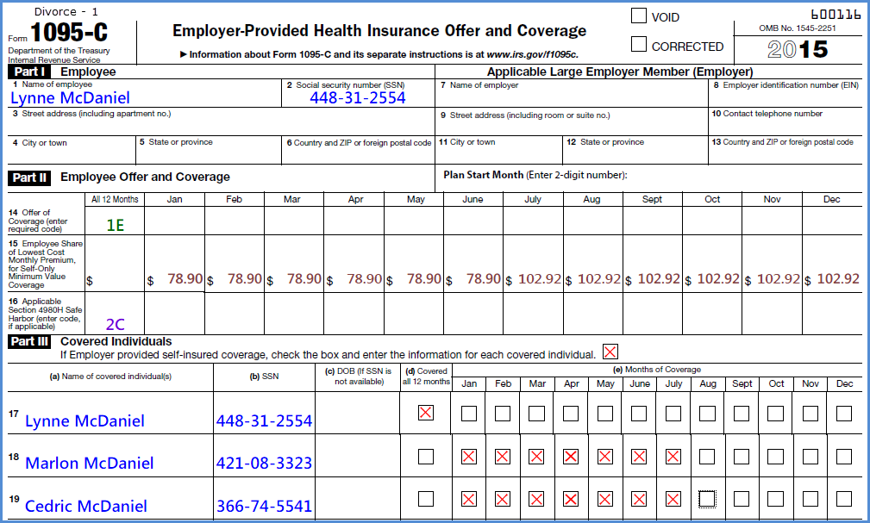
Form 1095-C, COBRA, Part 1
Example 3
Employer completes Part I and II. Fully-insured plan does not complete Part III.
Notes:
The employer will indicate in Part I that it did not make an offer of coverage for all “12 Months” on Line 14 and on Line 16 the employer will code this as “2I” (to
indicate this is a non-assessment period)
On the transmittal Form (1094-C), Line 22, the employer should also provide it is entitled to the 50 to 99 transition relief…..

Slide 40
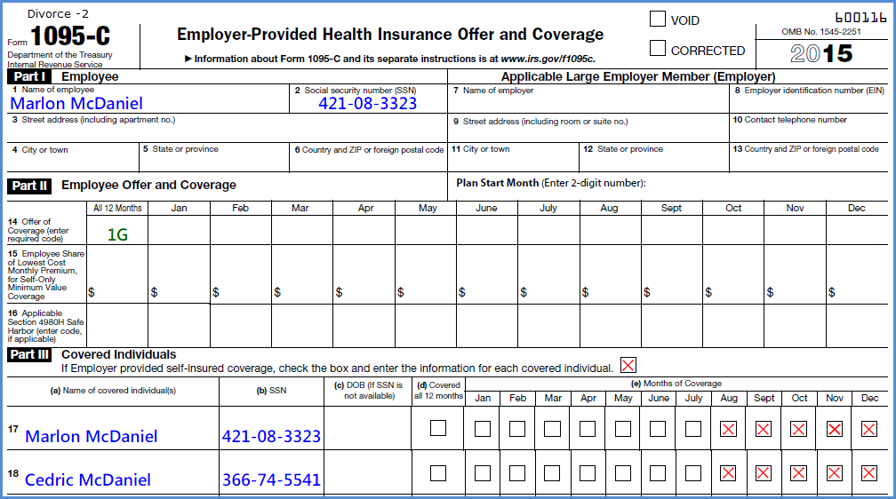
Form 1095-C, COBRA, Part 2: (only for self-insured plans)
Employer completes Part I and II. Fully-insured plan does not complete Part III.
Notes:
The employer will indicate in Part I that it did not make an offer of coverage for all “12 Months” on Line 14 and on Line 16 the employer will code this as “2I” (to
indicate this is a non-assessment period)
On the transmittal Form (1094-C), Line 22, the employer should also provide it is entitled to the 50 to 99 transition relief…..

Slide 41
Example 4: Employee Terminates (No COBRA election )
Assumptions
Example 4
Long-term employee, enrolled in plan
Spouse and children also enrolled in plan
Date of termination (8/4/2015)
No election of COBRA by employee, spouse or dependents
Notes:
Assuming that the employer qualifies for transition relief and it has a non-calendar year plan year, it needs to comply in 2016. The employer amends its plan and
offers coverage to its factory employees effective June 1, 2016…..
The employer falls within the 50 to 99 group and needs to let the government know why it isn’t offering this full-time employee coverage in 2015 (still need to report)

Slide 42
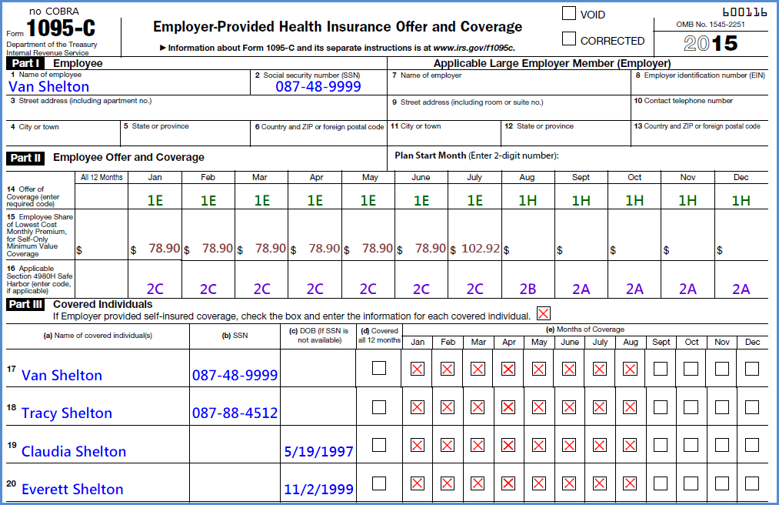
Form 1095-C, NO COBRA
Employer completes Part I and II. Fully-insured plan does not complete Part III.
Notes:
The employer will indicate in Part I that it did not make an offer of coverage for all “12 Months” on Line 14 and on Line 16 the employer will code this as “2I” (to
indicate this is a non-assessment period)
On the transmittal Form (1094-C), Line 22, the employer should also provide it is entitled to the 50 to 99 transition relief…..

Slide 43
Example 5: Employee Terminates (COBRA election )
Assumptions
Example 5
Long-term employee, enrolled in plan
Spouse and children also enrolled in plan
Date of termination (8/4/2015)
COBRA election by employee and spouse only beginning in August
Notes:
Assuming that the employer qualifies for transition relief and it has a non-calendar year plan year, it needs to comply in 2016. The employer amends its plan and
offers coverage to its factory employees effective June 1, 2016…..
The employer falls within the 50 to 99 group and needs to let the government know why it isn’t offering this full-time employee coverage in 2015 (still need to report)

Slide 44
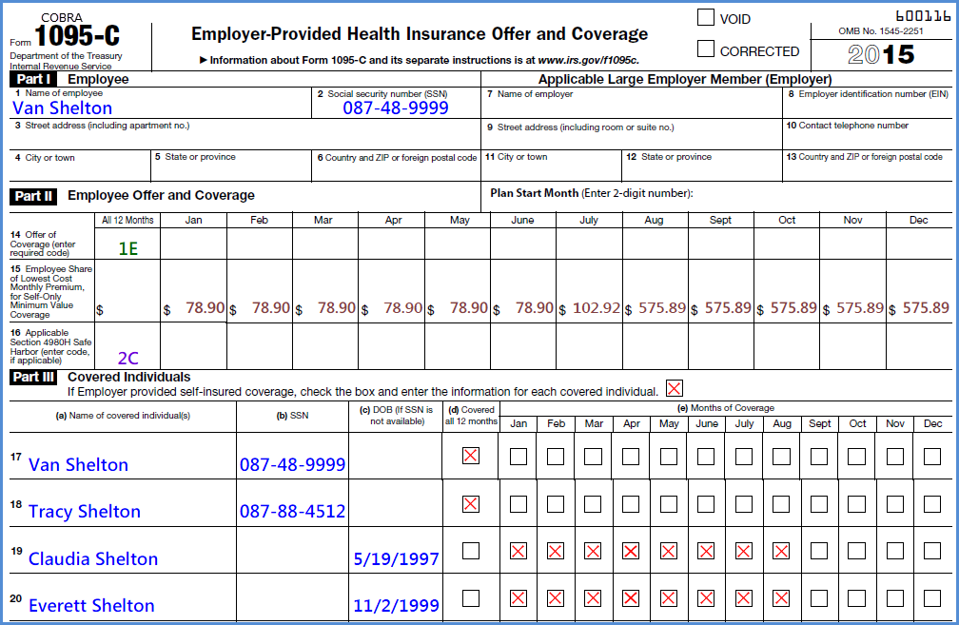
Form 1095-C, COBRA (employee and spouse only)
Employer completes Part I and II. Fully-insured plan does not complete Part III.
Notes:
The employer will indicate in Part I that it did not make an offer of coverage for all “12 Months” on Line 14 and on Line 16 the employer will code this as “2I” (to
indicate this is a non-assessment period)
On the transmittal Form (1094-C), Line 22, the employer should also provide it is entitled to the 50 to 99 transition relief…..

Slide 45
Example 6: Employee Status Change
Assumptions
Example 6
Employee is hired as variable hour employee
Employee has already earned coverage for 2015
However, effective October 7, 2015, employee switches to part-time
Employees drops spouse upon switching to part-time; employee remains enrolled
Notes:
Assuming that the employer qualifies for transition relief and it has a non-calendar year plan year, it needs to comply in 2016. The employer amends its plan and
offers coverage to its factory employees effective June 1, 2016…..
The employer falls within the 50 to 99 group and needs to let the government know why it isn’t offering this full-time employee coverage in 2015 (still need to report)

Slide 46
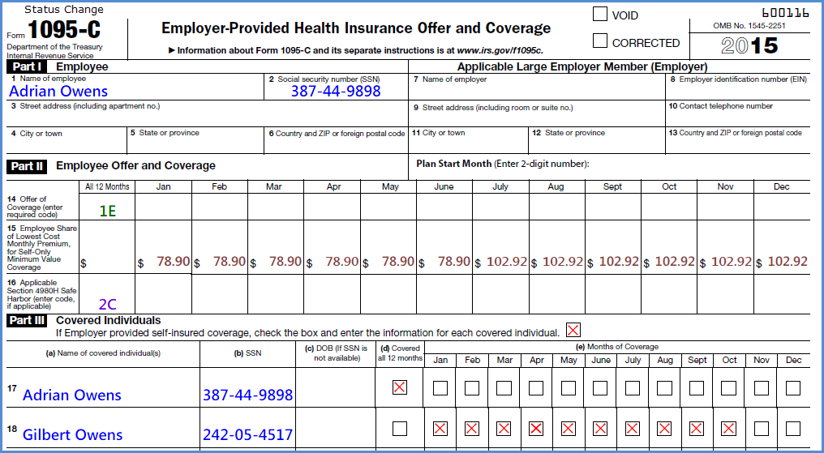
Form 1095-C,Status Change)
Employer completes Part I and II. Fully-insured plan does not complete Part III.
Notes:
The employer will indicate in Part I that it did not make an offer of coverage for all “12 Months” on Line 14 and on Line 16 the employer will code this as “2I” (to
indicate this is a non-assessment period)
On the transmittal Form (1094-C), Line 22, the employer should also provide it is entitled to the 50 to 99 transition relief…..

Slide 47
6055 and 6056 reporting:
Delivery Details and penalties

Slide 48
Method of IRS Reporting
Mailing the forms to the IRS is permitted for employers with fewer than 250 Forms 1095-B or 1095-C in a calendar year.
Can I submit the reports electronically?
  IRS encourages all employers to file their forms electronically.
  Employers that file at least 250 Forms 1095-B or 1095-C in a calendar year are required to file electronically. Other employers may file electronically; but are not required to do so.
Notes:
How do you report? Fewer than 250 forms, can file by mail or file electronically.
If 250 or more, must file electronically and this seems to include the transmittal form.
There are a number of ways to send out statements

Slide 49
Statements to Employees
How should I send out the statements?
  Mail
  Electronically
    If employee has consented to electronic statement
    Can also be made available by posting to a website
      Employee consent still required
      The employer must separately notify the employee of availability
  Employee can also request a paper copy
Can we send out the employee statements with the W-2 forms?
  Yes. Employers may include an employee’s statement with his or her Form W-2 mailing.
Notes:
We are referring to the actual form 1095s that are being filed with the IRS (unless using one of the simplified statements)
Mail to permanent address (or temp)
For electronic distribution, there must be affirmative consent. Consent can be on paper or via email, but if on paper, must still affirm electronically
Cannot simply post on Internet w/o telling employees
Different than the ERISA rules (having computer access alone is not enough)
Can distribute with w-2s

Slide 50
Separate Return and Statement Deadlines
Report/Disclosure | Due date
Section 6055 statement to employees | 1/31 of each year (2/1/16)
Section 6055 report to IRS | 2/28 (or 3/31 if filed electronically*)
Section 6056 statement to employees | 1/31 of each year (2/1/16)
Section 6056 report to IRS | 2/28 (or 3/31 if filed electronically*)
* Must file electronically if provide 250 or more “returns”

Slide 51
Penalties
Failure to timely file complete and accurate returns to the IRS, or failure to timely furnish a correct statement to responsible individuals:
  $250 per return (capped at $3 million)
  Penalties may be reduced if corrective action is taken within 30 days and may even be waived if the failure to file timely or accurately is due to reasonable cause and not due to willful neglect.
Penalty relief for reports filed in 2016 as long as “good faith” efforts to comply are made
Notes:
There are penalties for inaccurate or incomplete filings. However, there is a good faith standard for the first. It is important to be on time….
The fees can really start to add up-----don’t recommend relying upon this argument--- get the forms in and be accurate
Failure to timely file complete and accurate returns to the IRS, or failure to timely furnish a correct statement to responsible individuals:
$100 per return with a maximum of $1,500,000 for a calendar year.
Penalties may be reduced if corrective action is taken within 30 days and may even be waived if the failure to file timely or accurately is due to reasonable cause and not due to willful neglect.
Penalty relief for reports filed in 2016 as long as “good faith” efforts to comply are made
Also triggers 4980 penalties

Slide 52
Questions?
The intent of this presentation is to provide you with general information regarding the status of, and/or potential concerns related to, your organization’s current employee benefits environment. It does not necessarily fully address all of your organization’s specific issues. It should not be construed as, nor is it intended to provide, legal advice. Questions regarding specific issues should be addressed by your organization’s general counsel or an attorney who specializes in this practice area, as appropriate.

