Slide 2
Certificate of Qualification for Employment
(CQE)

Slide 3
What is a CQE?
Created in 2012 by the state legislation
A CQE is a certificate which aids in removing barriers to employment or licensing in the State of Ohio for individuals who are subject to a civil impact (prior criminal conviction).
Relief from criminal-record based job barriers.
Granted by the Common Pleas Court for individuals with a prior criminal conviction
Notes:
It removes two types of barriers 1. the fear employers have of hiring someone with a criminal background 2 preventing justice involved individuals from getting licenses in certain fields of work.

Slide 4
Why is a CQE important in Ohio?
1 in 6 Ohioans (over 16%) have a felony or misdemeanor conviction (Ohio Justice & Policy Center).
Ohio is losing $2 billion GDP annually due to these individuals being excluded.

Slide 5
Who is Eligible to Apply?*
Anyone with a conviction in the State of Ohio
Petitioner does not have to be a current resident of Ohio
Relief from felony conviction:
Petition may be filed one year after release and all periods of supervision
Relief from misdemeanor conviction:
Petition may be filed six months after release and all periods of supervision
If not incarcerated:
Petition may be filed six months from the date of final release from all court sanctions imposed
If incarcerated:
Any time after six months of release from incarceration and all periods of supervision imposed after release from the period of incarceration
Notes:
On-line process, complete petition on line, drccqe.com, DRC will review it for accuracy and forward to the court. Petitioner must print the petition and file it in court, there is a $50 fee unless waived, the Court will review and set a court date, go to court and CQE is reduced to a JE and sent to petitioner and DRC to update website.

Slide 6
Exceptions to Eligibility
Exceptions if incarcerated
Exception if on community control (not Incarcerated)
Completion of High School Diploma or High School Equivalency
Completion of Therapeutic Community
Completion of all 3 phases of IOP program
Completion of Career Tech/ Advanced Job Training college certificate
Completion of the CAE (Certificate Of Achievement & Employability)
Early termination of community control
Letter of Recommendation from County Sheriff
Notes:
There are exeptions

Slide 7
Update:
Effective April 4, 2023: 2953.25 Section A (3) A petition under division (B)(1) or (2) of this section shall be made on a copy of the form prescribed by the division of parole and community services under divisions (J) of this section, shall contain all the information described in division (F) of this section, and, except as provided in division (B)(^) of this section, shall be accompanied by an application fee of not more than fifty dollars, including local court fees.

Slide 8
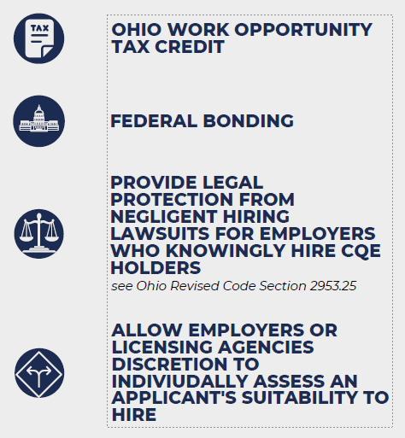
EMPLOYER BENEFITS

Slide 9
CQE
DOES
DOES NOT
Provide an avenue to remove barriers to employment
Guarantee a job
Creates a “rebuttal presumption” when a petitioner applies for professional licensing, certification or employment
Guarantee a license nor certification
Allows employers to individually assess each individual independently
Expunge criminal records
Provider certain benefits to employers
Notes:
No guarantees but opens doors
Remove barriers
Licensing agencies recognize
Individuals are looked at independently
Benefits tax credit bounding protection from prosecution etc

Slide 10
CQE
Application Process

Slide 12
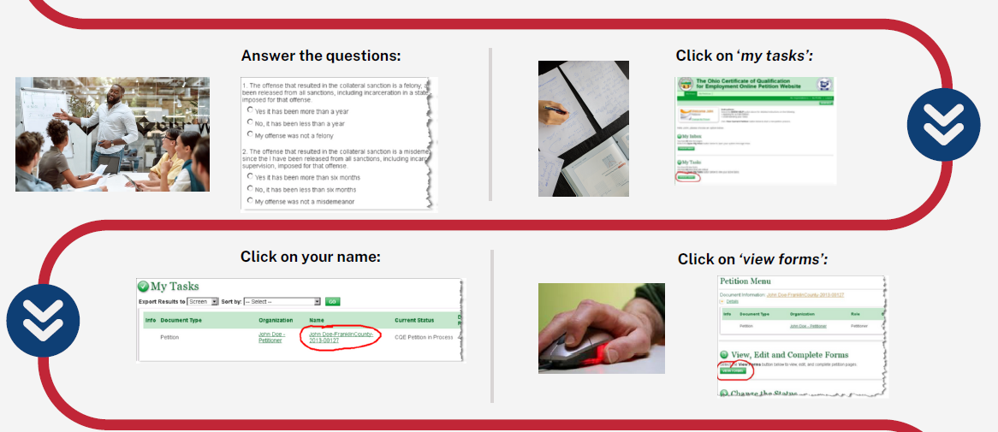

Slide 18
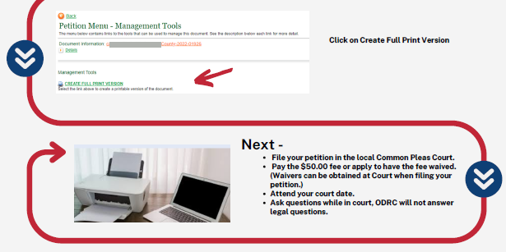

Slide 19
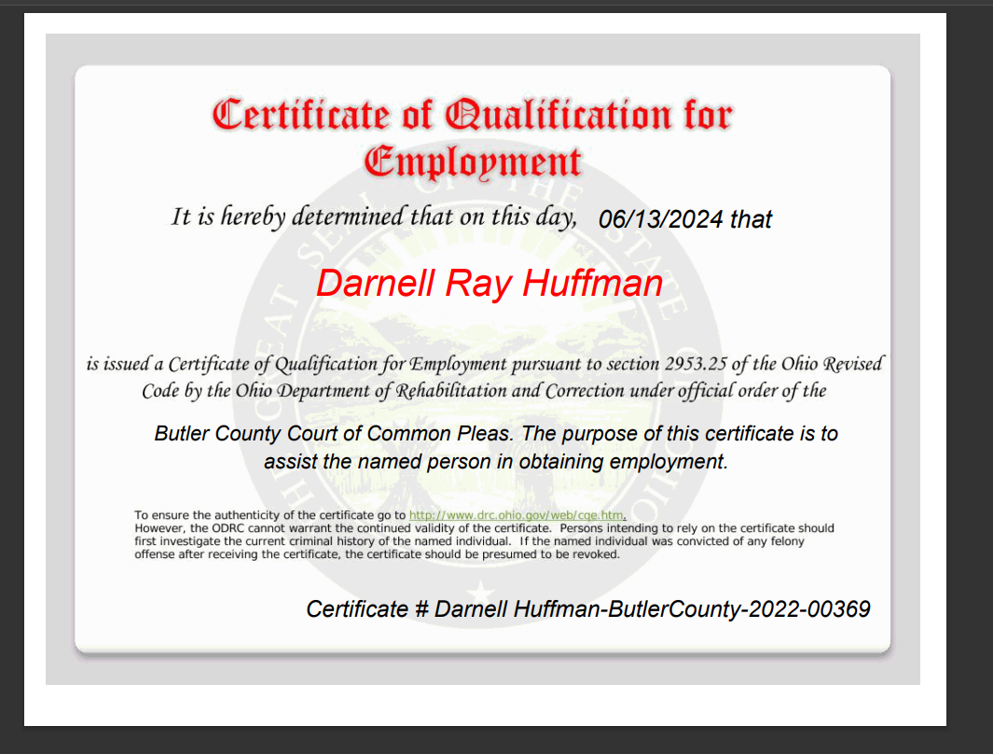
Janie Marie Doe
Janie Doe

Slide 20
Can a CQE revoked?
YES
Conviction of a felony offense committed subsequent to (after) the issuance of the CQE.

Slide 22
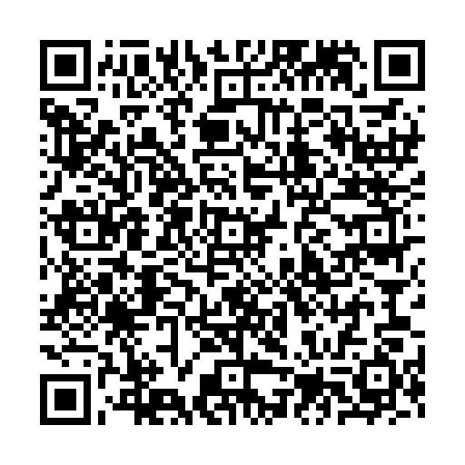
Lanaya R. McDonald, MA, LPC, LCDCIII
Reentry Administrator
Office of Reentry
Ohio Department of Rehabilitation and Correction
Lanaya.mcdonald@drc.ohio.gov
614-971-9178

