Slide 1
Myths of Self-Insurance
I’m too small to be self-insured.
Self-insurance is only for groups with good claims experience.
I can’t budget for the monthly premium as I don’t know what my claims will be each month.
My fully insured carrier pays all the claims.
I have a 12 month guarantee with my fully insured plan so I can’t make a change until my renewal.
If I have a large claim, it could put us out of business.
All self-insured plans are the same.

Slide 2
Fully-Insured
Self-Insured
Under 100 enrolled EE’s there is little to no claims experience
Unused Funds earmarked for paying claims are retained by the carrier
Must follow State and Federal Guidelines
Employer pays full cost of expensive medications
Employee pays cost based on plan design for maintenance medications
Renewal increase factors in all state mandated taxes/penalties
Renewal increase; move carriers, increase contributions and/or plan design, EE disruption
Must use carrier’s own network. No options
Little to no flexibility
Monthly Claims experience for groups from 5 enrolled EE’s and up
Unused Funds are either returned to the employer or used to offset administrative costs
Only need to follow Federal Guidelines
Can source almost 1000 Specialty, Brand and Insulin internationally. Employer average savings 60+%
Employee pays ZERO cost for maintenance medications which can be sourced through our program
Renewal increase does not factor in any state mandated taxes/penalties
Renewal increase, shop the stop loss behind the scenes and not affect employees
Can use carrier’s network, RBP, or dual option
As the plan sponsor you have the ability to override claims essentially letting you make all final decisions

Slide 3
Various Self-Insured Options
Carrier sponsored. The insurance carrier is responsible for the administration if the claims, using their Stop Loss provider, their pharmacy benefit manager (PBM) and their network. Most often, surplus dollars in the clients claim fund are used to offset the following year’s administrative fees. The percentage ranges from 50-100% and the cost for the plan increases alongside the percentage
Third Party Administrator (TPA) who is owned by the insurance company. They will push for the insurance carrier’s network to be used but will often times have the ability to use another carrier network. They will accept other PBM’s, as well as other Stop Loss carriers. They will return 100% of the unused dollars in the clients claim fund.

Slide 4
Various Self-Insured Options
TPA who is independent
They will administer the claims, have options for Stop Loss insurance, give back 100% of the unused dollars in their claim fund. May have more than one insurance carrier option for network access but has few PBM options.
PBM options including a Fiduciary PBM.
Can offer both an insurance carrier option for network access as well as an option for Reference Based Pricing.
Can offer a choice of PBM’s including a Fiduciary PBM as well as ability to source expensive medications Internationally as well as Manufacturers Assistance. Can offer both an insurance carrier option for network access as well as an option for Reference Based Pricing either separately or as a Dual Option
Captive
This is where employers share risk, there is typically a buy-in amount to be part of the Captive.

Slide 5
Items to Consider
Decide in your mind that you will stay in this model for 3 years.
Lasers: If deemed necessary, a laser is placed by the stop loss carrier at the renewal. This is an amount over and above what the employer’s individual stop loss amount is. Instead of the stop loss carrier increasing the rate for all employees they place an additional amount on the person(s) who they feel will exceed the amount of the individual stop loss. Once the claims for that individual reach the laser, any amount above will be covered by the stop loss carrier. One way to eliminate that is to have a No New Laser contract. It will cost more in premium and if you have no lasers, you will still be paying for it. Keep in mind only a small percentage of members with a laser reach the amount. Another creative solution is putting them in a foundation program in which they are provided individual coverage thus coming off the group plan.
Gatekeeper blockades
Education and communication is key as there are more moving parts than fully insured
In the RBP mode, only 2-3% of claims will involve additional work, but the savings outweigh the carrier network
You have more flexibility, you govern overrides, your alignment is always to your own best interests

Slide 6
Demographics
Trend
Plan Design
ACA fees and State Taxes for Fully Insured
Medical Claims Experience
Top 25 Drugs and their Costs

Slide 8
Health Insurance Challenges
Limited competition
Frustration with rising cost
Lack of claims data and analytical reporting
Relatively few new innovative ideas
HR Department is overwhelmed with administration and ACA compliance

Slide 9
Is the current system BROKEN?
No!

Slide 10
It’s working EXACTLY how the Insurance Companies intended!
National spending on healthcare has increased from 5% of gross domestic product in 1960 to a forecasted 20% in 2025.
Employers are likely paying significantly higher reimbursement costs compared to Medicare and other Government programs for the same services.
Facilities costs, which represent the majority of reimbursable healthcare cost, are massively inflated.
Employers should be able to purchase medical services for employees in the same transparent manner that they buy any other product or service.

Slide 11
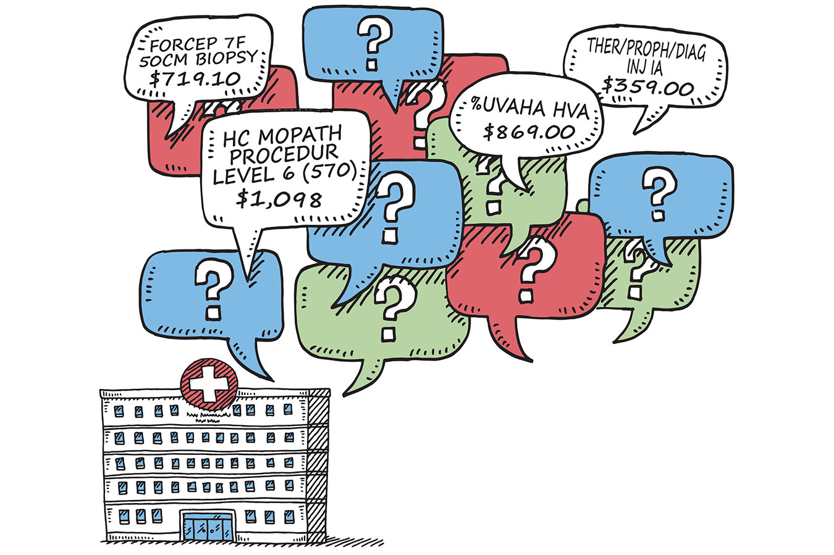
Chargemaster* prices are exorbitant
Chargemaster prices are set to be discounted and not paid. Only 1-3% of patients actually pay them.
They drive up the cost of healthcare for everyone, including the insured.
- George A. Nation III, Lehigh Law and Business Professor, Hospital Chargemaster Insanity: Heeling the Healers, 43 Pepp. L. Rev. 745 (2016).
image via Kaiser Health Network
* Chargemaster: a list detailing the official rate charged by a hospital for individual procedures, services, and goods
Private and Confidential

Slide 12
What if…
You could address the pricing anomalies that are driving cost inflation and save 20% to 30% on
healthcare costs.
The potential savings are enormous
when you consider the average annual health care spend is $15,000 per employee.
That’s $300,000 in potential savings for
every 100 employees.
Private and Confidential

Slide 13
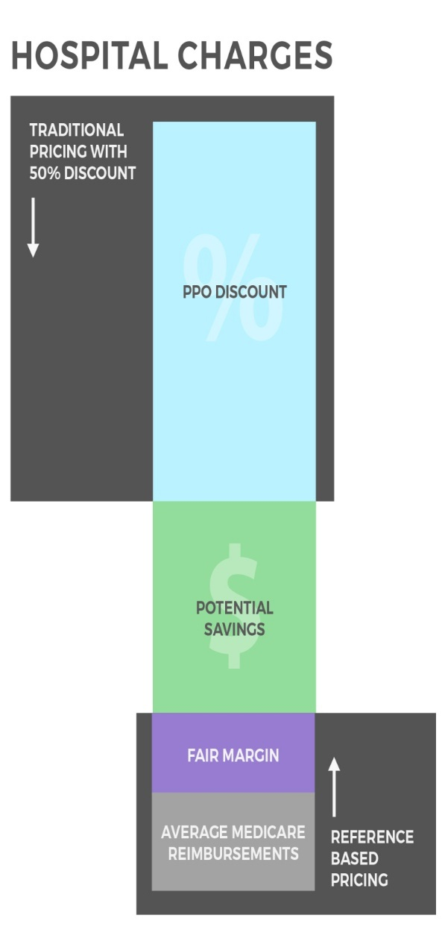
Solution: Reference Based Pricing
Uses available financial statements, actual cost data, and Medicare rates from hospitals and facilities as the basis for reimbursement methodology
Flips the traditional method of paying for health care services from a discount off billed charges to paying actual costs plus a reasonable mark up
Provides a fair, reasonable, consistent, defensible and transparent process
Private and Confidential

Slide 14
Hospital charges = Major cost driver
Hospital System | Charge to Medicare Payment Ratio
Cleveland Clinic | 502%
Miami Valley Hospital | 530%
Summa Health System | 797%
Akron General Medical Center | 495%
Grant Medical Center | 491%
Mount Carmel Health | 470%
Dublin Methodist Hospital | 467%
University of Cincinnati Med Center | 528%
Mercy Hospital Anderson | 549%
Mercy Hospital Hamilton/Fairfield | 606%
Private and Confidential

Slide 15
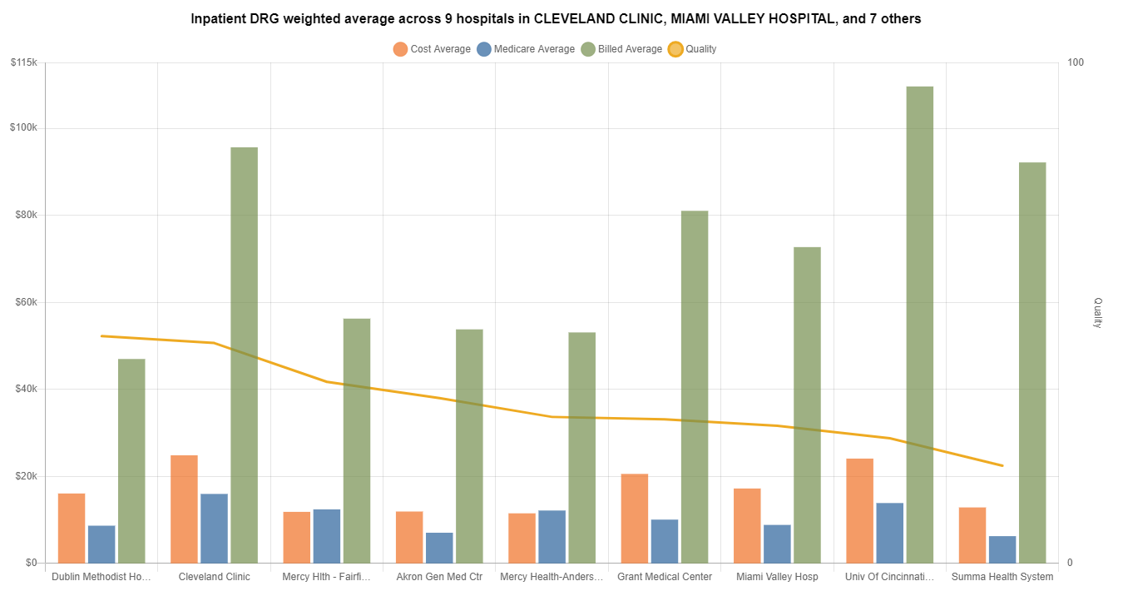

Slide 16
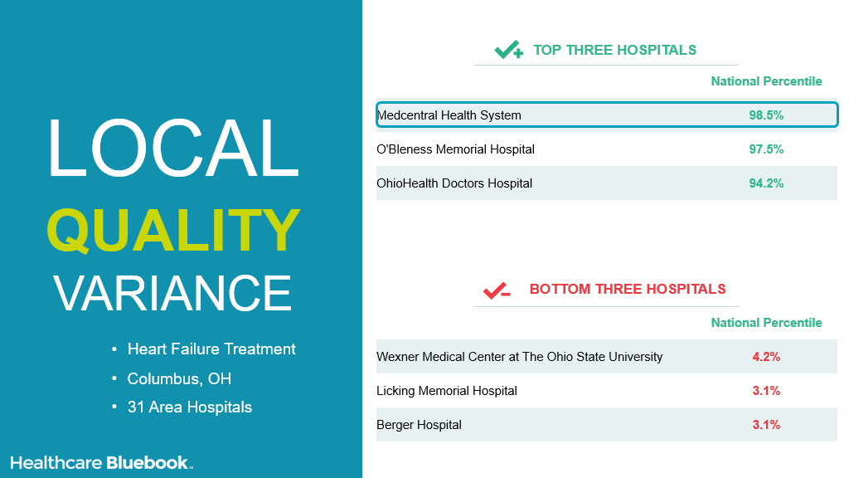

Slide 17
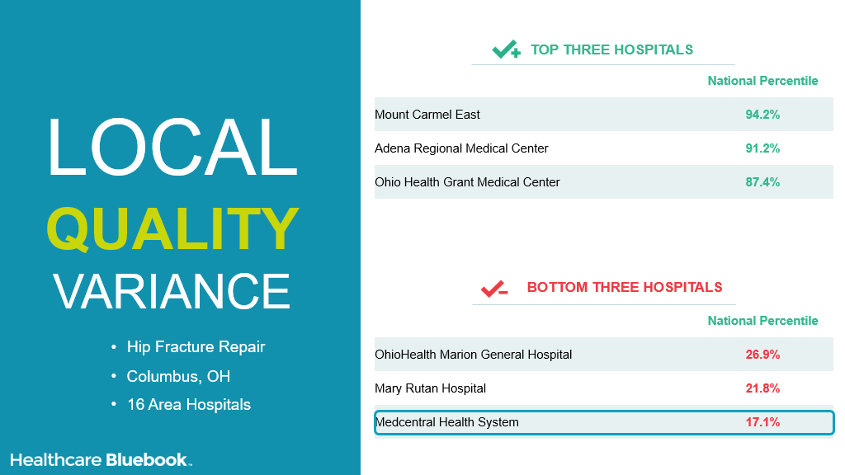

Slide 18
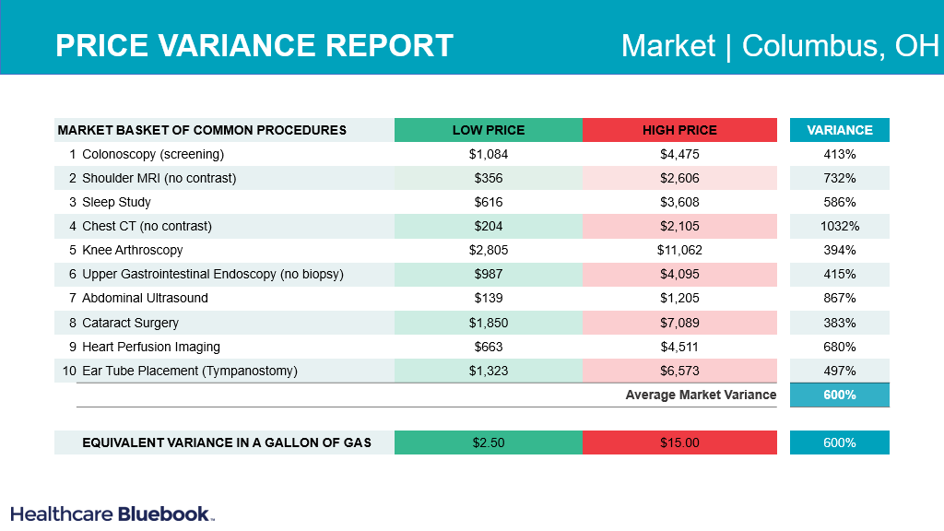

Slide 19
The gap between hospital charges and Medicare reimbursements is widening
National Average - Hospital Charges vs. Medicare Reimbursements
536%
Source: Centers for Medicare & Medicaid Services – Medicare Inpatient Provider Utilization and Payment Data, Fiscal Years 2012 - 2020
Private and Confidential

Slide 20
Considering the widening cost/price gap - what value is a 50% discount from your PPO?
Diagnostic Related Group | Hospital Billed Charge | 50% Discount on Billed Charge [A] | Average Medicare Reimbursement [B] | Excessive Payment [A] – [B]
Bronchitis & Asthma | $50,469 (881% mark-up) | $25,235 (440% mark-up) | $5,732 | $19,503
Hypertension | $41,030 (940% mark-up) | $20,515 (470% mark-up) | $4,364 | $16,151
Diabetes | $47,845 (871% mark-up) | $23,923 (436% mark-up) | $5,492 | $18,431
Source: Centers for Medicare & Medicaid Services – Medicare Inpatient Provider Utilization and Payment Data, Fiscal Year
Private and Confidential

Slide 21
Reference based pricing example Heart Attack
Traditional Pricing
Billed Charges | $ 142,516
Less PPO Discount (50%) | 71,258
PPO Reimbursement | $ 71,258
Referenced Based Pricing
Medicare Reimbursement | $ 16,270
Plus Fair Margin (25%) | 4,068
Referenced Based Reimbursement | $ 20,338
$ 50,920
71% Savings
Source: Centers for Medicare & Medicaid Services – Medicare Inpatient Provider Utilization and Payment Data.
Private and Confidential

Slide 22
Reference Based Pricing = Significant Savings
Provider | ABC Hospital
Billed Charges | $94,212 (14.6 X Medicare Allowable Price)
PPO Discount (66.12%) | $66,295
PPO Reimbursement | $31,917 (4.95 X MAP)
Medicare Allowable Price (MAP) | $6,448
RBP Recommended Reimbursement | $9,027 (140% of MAP)
Pricing Differential | $22,890
Savings vs. PPO | 72%

Slide 23
Referenced Based Pricing and auditing
Unique claims review and audit process that maximizes savings in a transparent, defensible and consistent way
Reimbursement of Medicare plus a fair percentage or a facility’s Cost to Charge ratio plus a fair percentage
Plan document language with clearly stated, rational limits of reimbursement
Line by line auditing, adjudication and payment of all claims
Appeal process that provides a full and fair review
Vigorous defense of the plan and/or member in the event of a balance bill
Private and Confidential

Slide 24
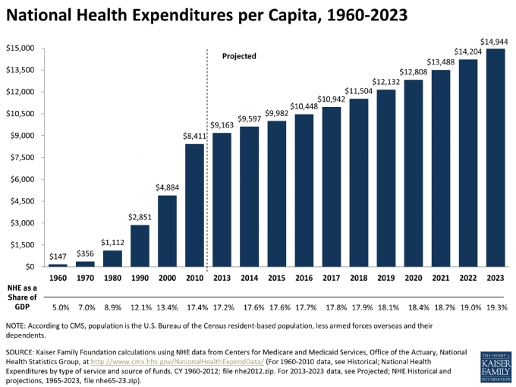
We don’t wait for the Future. We Build the Future with You.

Slide 25
The average employer spends nearly half of its annual medical on hospital/facility costs
Only 8.5 % of the average workforce are utilizing hospital annually

Slide 26
Value of Reference Based Pricing
Immediate hospital/facility claims savings, estimate 20% to 50%
Overall plan savings 15% to 30%
Trend stabilization
Price transparency
Member satisfaction

Slide 27
Pharmacy Benefits Manager

Slide 28
Pharmacy Statistics
More money was spent by the Big Pharma lobbyists than US defense, education, aerospace, oil and gas combined in order to eliminate global competition
80% to 85% of generic meds sold are manufactured in India and China
Generic costs are up over 300% in the last 4-5 years
Brand costs increase 13% per year
Specialty drug usage today is 1% of the total spend. Between 2020-2021, it rose to 50% and continues to rise

Slide 29
Pharmacy Statistics (continued)
Hep C drugs such as Harvoni and Savoldi currently cost approximately $95,000 for a 12 week supply. In other countries the costs range from $1,000 to $3,000 for the same treatment.
70% of household have $1,000 or less in savings and ½ of them have no savings at all. 25% of Prescriptions for chronic conditions for 1st time users are not being filled and 20% of hospitalizations are due to medication non-adherence.

Slide 30
Driving Savings On Non-Specialty Meds
Brand to Brand therapeutics alternatives
Brand to Generic therapeutics alternatives
Generic to Generic therapeutics alternatives
Recommending Rx discontinuation, e.g.,
Discontinue bisphosphonates (like Actonel) after 3-5 years, per package insert
Discontinue Advair except for COPD or severe asthma
Discontinue Restasis after 6 months and test lacrimal duct function

Slide 31
Cost Savings Examples Different formulations, same ingredient
Original Rx | Cost/ 30 Days | Recommended Rx | Cost/ 30 Days
Alphagan 0.1% 10ml (B) | $213.75 | Brimonidine 0.2% 10ml (G) | $4.51
Xolegel Gel 2% 45gm (B) | $503.47 | Ketoconazole 2% Cr 60gm (G) | $28.49
Acuvail Droplette 0.45% (B) | $222.11 | Ketorolac Soln 0.5% 3ml (G) | $4.98
Minocycline ER 45mg #30 (G) | $537.90 | Minocycline 50mg #30 (G) | $8.14
Mupirocin Cream 30gm (G) | $195.98 | Mupirocin Oint 22gm (G) | $6.68

Slide 32
The Castle Edge
We act as an agent for the members
International Pharmacy Management of over 1000 Brand drugs, including:
Abilify, Crestor, Eliquis, Invokana, Janumet, Latuda, Spriva and Jaljanz
Includes many Specialty Drugs and Insulins
Over 60% average savings on the cost of the drugs for our clients
ZERO-dollar copay for the employee which maximizes on adherence to their medication
Over 60% average savings on the cost of the drugs for our clients
Sourced from Tier one countries only: Canada, United Kingdom, New Zealand and Australia.
Factory packaged, sealed and sourced from brick and mortar not a rogue pharmacy.
Meet and exceed US FDA standards
Exclusions: Lifestyle/performance enhancing (Viagra) and those considered a narcotic (Adderall)

Slide 33
Additional Services Worth Considering:
Student Debt – Public Student Loan Forgiveness (PSLF) assistance in making sure all forms are completed properly and sent in a timely manner. They will have their counselor work with them on a one-on-one basis. This comes with a cost of approximately $250 per year.
For those who are not eligible for student loan forgiveness, this same partner will go to various financial institutions to find the best terms. (Free of charge)
Hospital Debt Relief – Covered employees who have huge hospital debt with no way of figuring out how they are going to pay. (Based on financial need)
Medicare - Help individuals through the maze to make more informed decisions and potentially come off the plan thus saving your organization additional revenue
Self-Funded Minimal Essential Coverage Plans (MEC)
Discount Rx card for both retail and mail order through our international program

Slide 34
Contact
Nicholas F. Castellano
President & CEO
Castle Benefits Consulting Group
castlebenefits@aol.com
www.castlebenefitsconsultinggroup.com
610-608-6878
We don’t wait for the Future. We Build the Future with You.

