Slide 1
Managing your workers’ compensation program
Sedgwick MCO – Who are we and what do we do?

Slide 2
MCO & ROLES AND RESPONSIBILITIES
Responsible parties
Five key players in Ohio workers’ compensation.
BWC
Injured Worker
MCO
TPA
Employer

Slide 3
MCO ROLES AND RESPONSIBILITIES
Workers’ compensation process
Employer reports injury to MCO
Claim received by MCO and electronically filed with BWC
Ohio Bureau of Workers’ Compensation
Claim evaluation
Compensability determination
Assignment of claim number
Wage/Compensation calculation & payment
Assignment of customer service team
Provider certification
Identification & auditing of employers
Industrial Commission hearings
Education
90-day exams
Fraud investigation
Approval of lump sum settlement
Managed Care Organization (MCO)
Medical case management
Return to work services
Triage management needs & case assignment
3-point contact by Case Specialist to:
Injured worker
Employer
Provider
Utilization review
Peer review, quality assurance & ADR
Medical bill processing & payment
Outcome measurements & statistical analysis
Dispute resolution regarding treatment requests
Education
Third Party Administrator (TPA)
Claims management
Hearing representation
Claims award & reserve auditing
Manual classification auditing
Payroll report auditing
Experience rating & premium rate verification
Alternative rate analysis
Pursue lump sum settlement
Filing motions, appeals & protests
Handicap reimbursement
Schedule IME’s
Education

Slide 4
MCO ROLES AND RESPONSIBILITIES
Managed Care Organization
MCO = Medical

Slide 5
MCO ROLES AND RESPONSIBILITIES
Primary Functions
ADM4303, FROI-1 or internal accident/illness intake
Medical case management
Payment of bills
Treatment authorization
Return to work coordination
Provider partnerships and education
Education and training
Notes:
ADM 4303, FROI-1 or internal accident/illness intake – often comes from the medical provider. Back in 1997 when the MCO’s took over the Med Mgt/Injury Reporting intake from BWC, the Bureau required BWC Certified Providers to report injuries to the MCO. This reduced the average lag time (injury reporting time) from over 60 days to just 6 days. Give BWC credit since they required this of the Certified Providers.
Medical case Management – If the claim is LT or looks more serious it will be assigned to a Sedgwick MCO Nurse. If MO, then it is assigned to a Case Coordinator. 75-80% of claims are normally Medical Only but it’s still very important to monitor those and successfully medically manage them. One of our primary roles is if the IW is even written off for just a few days, that we follow-up to obtain the Medco-14 and release to RTW so we can avoid the claim going to LT or at lease minimize the number of Lost Days, if possible, by working with the medical provider to obtain restrictions.
Payment of bills – The MCO pays the workers’ compensation medical bills. We reduce the bills down to the BWC fee schedule, which is the primary “savings” for the employer. But we also catch practices that providers often use such as bundling services together or unbundling them, to try to obtain the highest payment possible. We have software that automatically catches this and reprices the bill to the appropriate or lowest amount. This can really make a difference in cost and reduces the charges to your claims, which ultimately can reduce the agencies premium. Nothing taken from the IW. We are following BWC rules and standards.
Treatment Authorization – We have treatment guidelines that we follow called ODG or Official Disability Guidelines that we use to determine whether or not certain treatment is authorized or denied. Often, as in the case of Physical Therapy, a number of treatments are allowed without authorization (I believe it’s 12 PT sessions), but in the case of surgeries, diagnostics such as MRI’s, CT Scans, etc., then the medical providers must request these services. As an MCO, we very much want to ensure that there is not excessive treatment, early in the claim we often want to move quickly with treatment or diagnostics because it is so important to get the IW treatment early to help ensure they recover. This is a case by case basis depending upon the injury, but getting the IW’s back to work safely and timely is our main goal. Compensation is usually the largest cost in the claim so we want to avoid the claim going LT or the IW being out of work for an extended period.
Return to work coordination – The MCO team is very involved with obtaining that Medco-14 and the modified duty restrictions from the medical provider. Obviously, we communicate with you at the employer to notify you about restrictions so that you can hopefully provide transitional work duties/tasks for the injured worker. We also look at other options such as physical therapy, onsite therapy or even voc rehab services on occasion to help assist with the RTW. This is one of the most important roles we play at the MCO.
Provider Partnerships and education – There are several different ways that we educate providers and form partnerships with them. One way is in the day to day contact from the MCO Medical Management teams. They assist with the proper completion of the Medco-14 and forms, as well as explaining the special nature of the state agencies related to TW, OIL, SC, etc. The other way is through our Sedgwick MCO Provider Services Representatives and Account Executives. We regularly schedule meetings with usually the larger employers or institutions and individual occupational health facilities or provider practices, to help solve problems or improve communication. This can often make a difference in helping the providers understand the employers better and to realize how much they “have it together” with safety and their workers compensation programs.
Education and training – This has changed quite a bit with COVID as much of the training is online now, but we regularly do claims staffings and trainings for many employers. Sedgwick MCO also does trainings that are offered to all employers on topics such as viaOne (online access program), Transitional Work Services, etc. Whatever you need and we often partner with the TPA like we are doing today.

Slide 6
MCO ROLES AND RESPONSIBILITIES
Primary Functions
Your MCO will design and customize injury reporting packets that contain the necessary documentation to assist your employees with filing a claim
Accident/Illness form
Medco14
Key contact information at the MCO
MCO identification card to take to the provider
Any special benefit program instructions

Slide 7
Steps to take when a workplace injury occurs
Call 911 immediately in case of serious or life-threatening emergencies
If an incident or injury occurs, we are here to help. Just follow these steps.
Reporting a work-related injury to Sedgwick MCO
Online:
Submit an injury form (FROI)
online at sedgwickmco.com.
Phone:
Contact our customer service team at 888.627.7586 (available 24/7).
Email:
Send encrypted injury/incident reports as soon as possible to:
injury.incident@sedgwickmco.com.
Fax:
Send injury forms to 888.711.9284.
An injured employee, their employer or medical provider may report a work-related injury. Your company has chosen Sedgwick Managed Care Ohio to help you through this process.
Employee instructions
Immediately notify Human Resources
Complete incident reports immediately. Be as specific and detailed as possible.
Seek appropriate medical treatment if needed, and provide the attached ID card at all medical appointments.**
Keep your supervisor informed of your medical status and return all completed claim documentation to Human Resources promptly.
Early documentation and reporting of injuries promotes the best results for everyone.
Employer instructions
Assist in the completion of an injury/incident report, and/or the Employer Info section of the enclosed FROI.
If medical treatment is involved, ensure the incident is reported to Sedgwick MCO using one of the methods described under “Reporting a work-related injury to Sedgwick MCO.”
**Treatment must be by a BWC certified provider. To be eligible for OIL or Salary Continuation benefits, you must treat with a WILMAPC panel provider within 7 calendar days of the original injury date. Approved panel providers can be found by contacting SedgwickMCO or visiting das.ohio.gov/wilmapc. All panel providers are BWC certified.
sedgwickmco.com | 888.627.7586
Detach ID card below and present at all medical appointments
Workers' compensa�on iden�ﬁca�on card
24-hour customer service: 888.627.7586
Employer name: Employer Name
Policy number:

Slide 8
Key contacts and additional information
Employer policy number
10003150-812
Responsibilities
Sedgwick MCO
Initiate new claims with the BWC, collect and submit required information
Return to work and medical case management
Review and approval of medical treatment
Medical bill payment
Medical management of workers’ compensation claims
All associated managed care organization responsibilities
Workers’ compensation coordinator
Name: Email: Phone: Employer:
WC Coordinator Name
WC Coordinator Email Address
Employer Phone
Employer Name
BWC
Medical treatment questions, medical documentation and billing issues Contact Sedgwick Managed Care Ohio:
Claim allowance and compensability determination
Claim number assignment
Compensation award payment(s)
Coordination of Industrial Commission hearings
Phone: Fax: Mail:
888.627.7586
888.627.0074
P.O. Box 1040, Dublin, OH 43017
Medical providers
Prescription questions
Call 800.644.6292 and follow the prompts.
Treating physicians must be BWC certified
Promptly submit all medical documentation to Sedgwick MCO
Clearly indicate work readiness and periods of disability utilizing the MEDCO-14 form
Ohio Bureau of Workers’ Compensation (BWC)
Call 800.644.6292 or visit bwc.ohio.gov.
Medical provider options
Transitional work benefits everyone
A safe and timely return to work is important! Together, we will explore opportunities for modified duty/ transitional work that can accommodate any physical limitations in order to speed your recovery, ease your transition back to work and minimize any hardship as a result of a workplace injury. Employee safety and recovery are the highest priorities. It’s essential – and required – to keep Sedgwick MCO and your employer updated on your recovery status and work restrictions at all times.
Name: Address:
Concentra Urgent Care 4821 Roberts Road
Columbus, OH 43228
614-850-1476
M-F 8am-5pm
Phone: Hours:
Name: Address:
Mount Carmel Occ Health - Hillard 4674 Britton Parkway
Hilliard, OH 43026
614-210-4400
M-F 8:00am-4:30pm
Phone: Hours:
Search other BWC-certified providers at bwc.ohio.gov.
Important BWC forms
First report of injury (FROI)
Initiates workers’ compensation claim; complete and send to Sedgwick MCO
Please provide MEDCO-14 form with any physical restric�ons, as employer may have modiﬁed duty available.
Please send all informa�on within 24 hours of visit.
MEDCO-14
Physician’s statement of workability, recovery status; send to Sedgwick MCO
Injury report and FROI fax: | 888.711.9284
Medical and authoriza�on fax: | 888.627.0074
Customer service: | 888.627.7586
Prescrip�on ques�ons: Send all mail and medical bills to: | 800.644.6292 (follow prompts)
C-9
Physician’s request for treatment approval; addressed by Sedgwick MCO
sedgwickmco.com | 888.627.7586
Sedgwick Managed Care Ohio
PO Box 1040
Dublin, OH 43017
This card is not a guarantee of coverage.
Notes:
Personalized with the WC Coordinator Key Contacts and additional information. MCO phone, fax, address. Prescription questions plus Ohio BWC. We also add two Medical Provider options, almost always either an Occupational Health Facility or an Urgent Care. Suggestions for the IW’s but they can still treat with any BWC Certified Provider, but the occ healths and urgent cares understand the types of injuries your facility sees, know how to complete the paperwork, often more included to provide restrictions for the IW and so on.

Slide 9
MCO ROLES AND RESPONSIBILITIES
Primary Functions
Medical case management
Internal C-9 review process (CM/RTW vs. UM/UR)
Coordinate prescription drug utilization review (DUR) referrals
Monitors quality and outcomes of medical care
Alternative dispute resolution process and options
Contact medical providers for corrections on medical forms
Identifies primary care physicians (WILMAPC) for injured workers

Slide 10
MCO ROLES AND RESPONSIBILITIES
The cost control equation
Medical
Physician consultation & evaluation
Surgery
Diagnostic tests
Physical therapy
Psychological
Chiropractic
Dental

Slide 11
MCO ROLES AND RESPONSIBILITIES
Workplace injuries
If you have a workplace injury
Collect and document the facts
Early reporting and investigation is crucial
Early reporting leads to
Early and effective medical management
Employees returning to work sooner
Lower claims costs

Slide 12
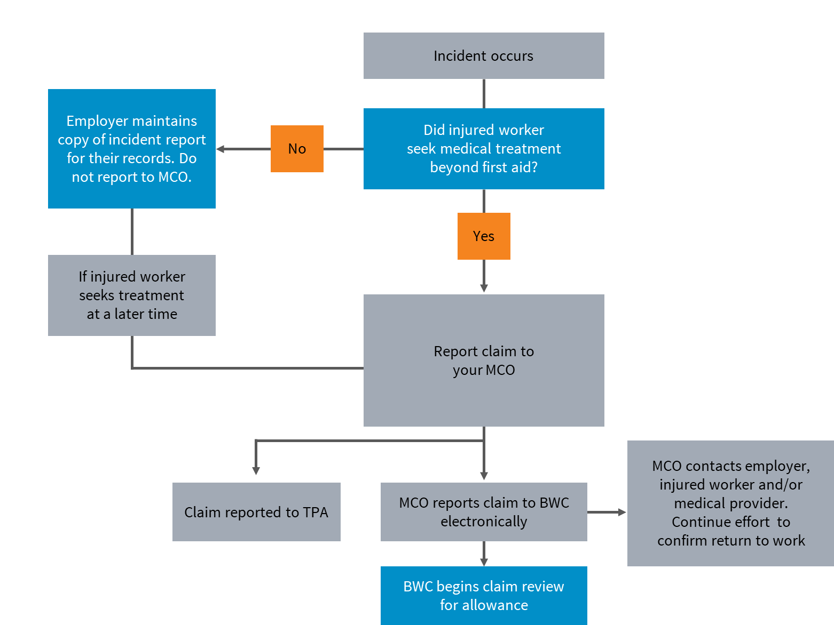
MCO ROLES AND RESPONSIBILITIES
Injury reporting

Slide 13
MCO ROLES AND RESPONSIBILITIES
Referral to a treatment facility
Employers have the right to recommend a treatment facility to an injured worker
Injured employees have the right to select any provider
Identify an initial treating provider
Communicate with initial treating provider
Set expectations
Introduce the provider to your workplace

Slide 14
Mike Stadtmiller
Sedgwick MCO Account Executive
614.679.2668
michael.stadtmiller@sedgwickmco.com

Slide 15
Thank you | Questions

