Slide 1
Office of System Support and Standards
(OSSAS)

Slide 2

Top Citations
Provider Compliance

Slide 3

Purpose
The purpose of compliance reviews is to make sure Ohio has a qualified pool of providers.

Slide 4
Who Conducts Compliance Reviews?
DODD shares responsibility for conducting compliance reviews with county boards and COGs​
All reviewers are trained by DODD
The review process and documents are the same no matter who conducts the review

Slide 5
Agency Reviews
460 Total Agency Reviews
153 with 0 Citations
33%

Slide 6
Agency Reviews with Citations
1-6 citations- 46%
7-15 citations- 18%
16 or more citations- 3%

Slide 7

Most Frequent Agency Citations in 2022
10. UI log with required elements
  Cited 49 times
9. Internal compliance program
  Cited 54 times
8. UI policy/procedure- development & implementation
  Cited 59 times
7. Personal funds- ledger and reconciliation
  Cited 60 times
This Photo by Unknown Author is licensed under CC BY-SA

Slide 8
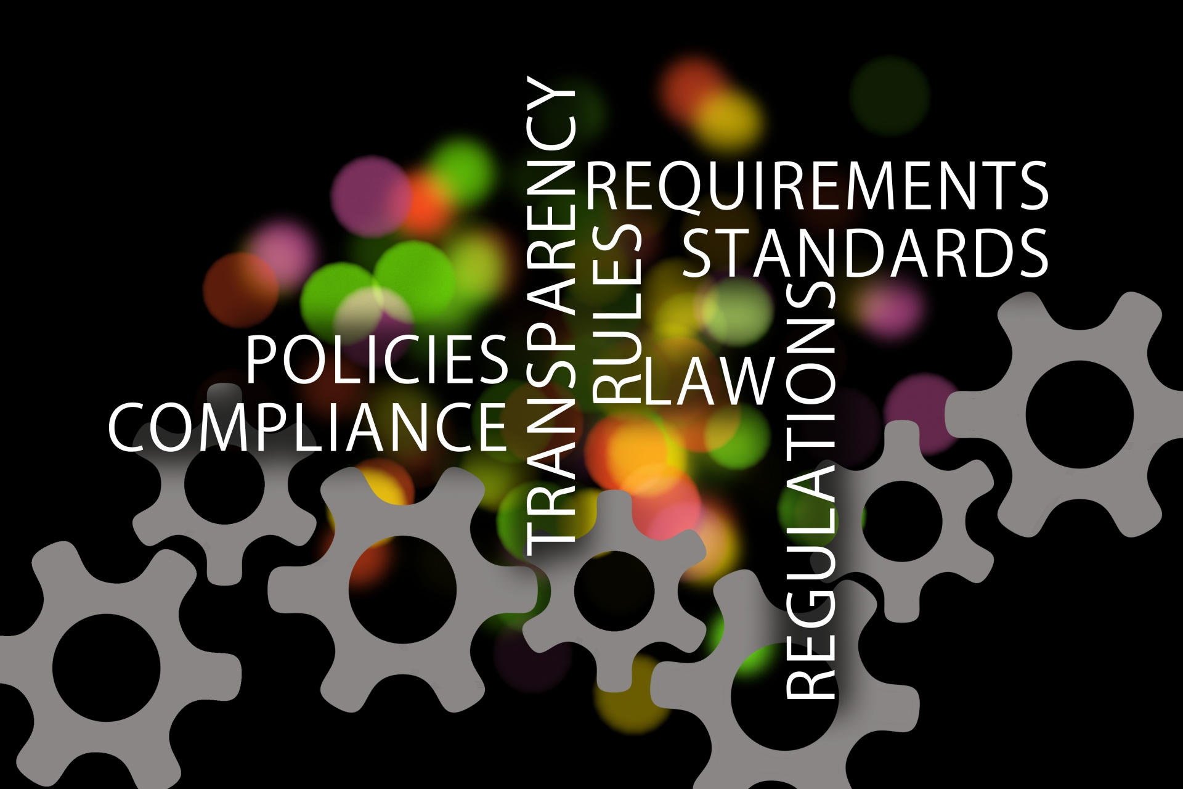
Most Frequent Agency Citations in 2022
6. Documentation elements- ie. date, name, Medicaid #
  Cited 75 times
5. BCII/FBI check prior to employment
  Cited 88 times
4. Service plan implementation
  Cited 90 times

Slide 9

Most Frequent Agency Citations in 2022
3. Pre-employment attestations
  Cited 104 times
2. Rapback enrollment for DSPs
  Cited 130 times
1. Initial database checks for new DSPs
  Cited 143 times
This Photo by Unknown Author is licensed under CC BY-SA

Slide 10
Notable
Top 3 citations are related to onboarding new DSPs
A good internal compliance system should address all citations in the top 10

Slide 11
Independent Reviews
1125 Total Independent Reviews
794 with 0 Citations
71%

Slide 12
Independent Reviews with Citations
1-6 citations- 27%
7-15 citations- 2%
16 or more citations- 0%

Slide 13
Top Independent Provider Citations
10. Monthly review of UIs
  Cited 41 times
9. Transportation documentation- lic plate
  Cited 45 times
8. Service plan implementation
  Cited 50 times
7. UI log containing required elements
  Cited 52 times
6. Service documentation- type of service
  Cited 59 times

Slide 14
Top Independent Provider Citations
5. First Aid/CPR Certification
  Cited 64 times
4. Service documentation- scope
  Cited 80 times
3. MUI trend analysis and annual report
  Cited 91 times
2. Service documentation- basic elements
  Cited 105 times
Annual training during 2021
  Cited 113 times

Slide 15
Notable
4 of the 10 top citations for independent providers were for service documentation elements
3 of the 10 top citations related to MUI/UI requirements

Slide 16
Provider Resources for Compliance
Monthly training offered by OSSAS
Compliance resources on the DODD website- Compliance
OSSAS mailbox - OSSAS@dodd.ohio.gov

