Slide 1



DEMENTIA FRIENDS for Intellectual and Developmental Disabilities
OPRA Presentation Dementia Friends for Intellectual and Developmental Disabilities Thursday, April 16, 2026
This project was supported, in part by grant number 90ADPI0008-01-00, from the U.S. Administration for Community Living, Department of Health and Human Services, Washington, D.C. 20201. Grantees undertaking projects with government sponsorship are encouraged to express freely their findings and conclusions. Points of view or opinions do not, therefore, necessarily represent official ACL policy.
Additional training or a license agreement is required for anyone interested in delivering this presentation to their local providers. Contact Dementia Friends USA for more information at info@dementiafriendsusa.org.
Adapted from Dementia Friends Minnesota and with permission of Dementia Friends, Alzheimer’s Society, London UK. Rev. 07/27/17
Notes:
Taking webinar attendance can be accomplished in a couple ways – attendees type their name and organization (if applicable) into chat at the start of the session;
Champion screen shots the thumbnail view of the audience gallery; Champion takes roll call and records names on paper sign-in form.
It is suggested that you copy and paste the three video links into the chat feature of the webinar before your session begins. This will serve as a back-up in case the link within the powerpoint doesn’t open
Remind attendees that after the Dementia Friends webinar session, Champions will be emailing to each attendee (or ask Marty for assistance in mailing):
Dementia Friends for Living Alone Session Workbook
Dementia Friends Certificate of Completion
Benjamin Rose Care Consultation brochure and referral form

Slide 2
Welcome and Acknowledgments
Welcome and Thank You for participating in this Dementia Friends for Intellectual and Developmental Disabilities session.
This project was supported, in part by grant number 90ADPI0008-01-00, from the U.S. Administration for Community Living, Department of Health and Human Services, Washington, D.C. 20201. Grantees undertaking projects with government sponsorship are encouraged to express freely their findings and conclusions. Points of view or opinions do not, therefore, necessarily represent official ACL policy.
Grant components include Behavioral Intervention training, Benjamin Rose Care Consultation and Dementia Friends.
Notes:
This session will last about 60 minutes. An electronic version of the Dementia Friends for IDD Session Workbook has been/will be emailed to you.
After participating in the session, you will be able to describe dementia and know the most common type of dementia. You will understand the five key messages about dementia and learn how to effectively communicate with a person living with dementia.
Towards the end of the session you will be asked to choose a small action you can take as part of becoming a Dementia Friend today.
The purpose of the evaluation is to examine how Dementia Friends information sessions affect attendees’ knowledge and attitudes about dementia; attendees’ knowledge and attitudes about individuals with dementia and attendees’ intentions to take actions related to dementia.
Dementia Friends is a train-the-trainer program. Participants who are interested in becoming a Dementia Friends Champion should contact Ohio Council for Cognitive Health – Dr. Bonnie Burman, President or Marty Williman, Program Director to schedule a free one-hour Champions training. Slide #54 contains Bonnie and Marty’s contact information.

Slide 3
Acknowledgments
Adaptations to the Dementia Friends for Intellectual and Developmental Disabilities session workbook provided by:
Dr. Philip McCallion, Professor and Director, Temple School of Social Work
Alzheimer’s Disease & Down Syndrome: A Practical Guidebook for Caregivers Copyright © 2018 National Down Syndrome Society
National Task Group on Intellectual Disabilities and Dementia Practice. (2012). ‘My Thinker’s Not Working’: A National Strategy for Enabling Adults with Intellectual Disabilities Affected by Dementia to Remain in Their Community and Receive Quality Supports
Notes:
Acknowledgments of adaptations to workbook

Slide 4
No conflicts of interests or disclosures

Slide 5
Dementia Friends Ohio
Adapted from Dementia Friends Minnesota and with permission of Dementia Friends, Alzheimer’s Society, London UK. Rev. 07/27/17
Additional training or a license agreement is required for anyone interested in delivering this presentation to their local providers. Contact Dementia Friends USA for more information at info@dementiafriendsusa.org

Slide 6
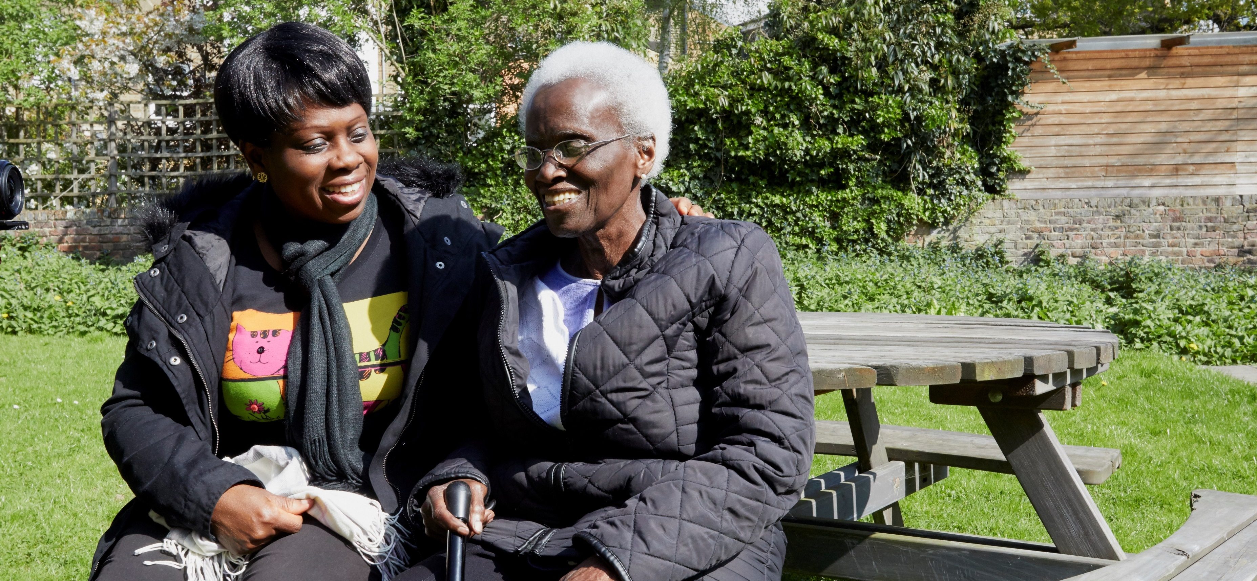
What is Dementia Friends?
Dementia Friends is a social action movement developed by the Alzheimer’s Society in the United Kingdom
The Dementia Friends program focuses on five key messages
To become a Dementia Friend, you need to understand the five key messages and then commit to a dementia-friendly action
Notes:
Dementia Friends is a social action movement changing the way we think, act and talk about dementia. It is about learning more about dementia and the small ways we can all help.

Slide 7
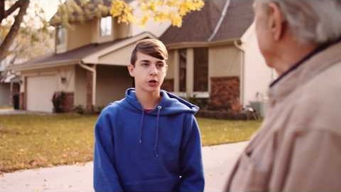
Dementia Friends Trailer
https://youtu.be/x9g0oK2G9x8
Notes:
This 2-minute video demonstrates the need for Dementia Friends in all community sectors and how all of us have an important role to play.
It is suggested that you copy and paste this video link into the chat feature of your webinar before your session begins. This will serve as a back-up in case the link within the powerpoint doesn’t open. https://youtu.be/x9g0oK2G9x8
Be sure to engage the closed caption feature (after starting the video - click on CC icon at right lower part of screen)

Slide 8

Notes:
………………….the global Dementia Friends program

Slide 9

Notes:
Many community doors equal many opportunities! While some “doors’ are easier to open than others, we have found a “key”.……..

Slide 10
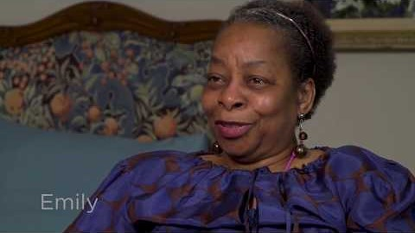
5 Key Messages https://www.youtube.com/watch?v=4oIrRTayLJw&feature=youtu.be
Notes:
It is suggested that you copy and paste this video link into the chat feature of the webinar before your session begins. This will serve as a back-up in case the link within the powerpoint doesn’t openhttps://www.youtube.com/watch?v=4oIrRTayLJw&feature=youtu.be
After opening this link, click on the CC icon in the right lower corner of the video screen to show subtitles/closed caption.
5:48 minutes - actonalz.org/dementia-friends - Dementia Friends Minnesota - May 2018
Individuals living with dementia share their experiences related to the 5 Key Messages:
1. Dementia is not a normal part of aging. Not everyone who grows old will develop dementia.
2. Dementia is caused by diseases of the brain. The most common is Alzheimer’s.
3. Dementia is not just about having memory problems. It can affect thinking, communication and doing everyday tasks.
4. It is possible to have a good quality of life with dementia.
5. There’s more to the person than the dementia. People with dementia are a valuable part of the community.

Slide 11
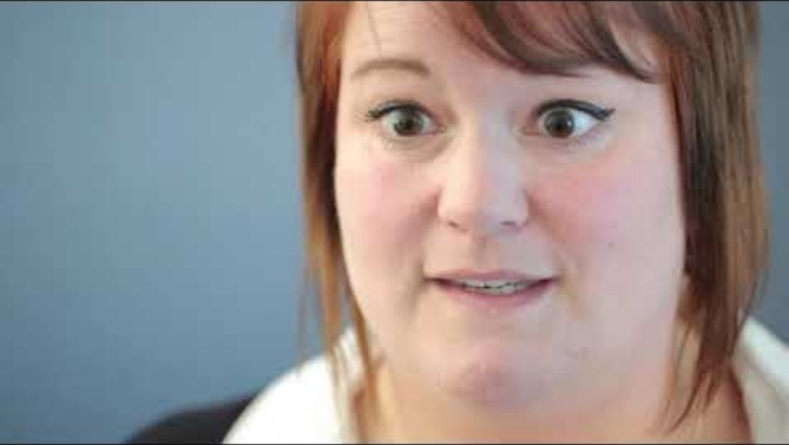
The Bookcase Story
https://www.youtube.com/watch?v=IIlh3Ikp2EQ&list=PPSV
Notes:
After starting the video, click on the CC icon in the right lower corner of the video screen to show subtitles/closed caption.

Slide 12
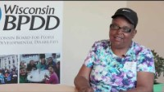
People First Wisconsin https://www.youtube.com/watch?v=UG7tBL0AEsY&feature=youtu.be
Notes:
Presenter: Cindy tells how she noticed changes in her friend who has dementia.
Cindy Bentley is Executive Director of People First Wisconsin
2:55 minutes
https://www.youtube.com/watch?v=UG7tBL0AEsY&feature=youtu.be

Slide 13
Dementia Friends – Staying Connected
Watch for Dementia Friends Ohio updates and get tip sheets on brain health, caregiving, dementia and more from Ohio Council for Cognitive Health’s website: www.ocfch.org
Visit the Dementia Friends / Dementia Friendly America Website. Sign up to receive their updates and newsletter at www.dementiafriendsusa.org
Like and Follow Dementia Friends / Dementia Friendly America on Facebook: www.facebook.com/DementiaFriendlyAmerica
Follow Dementia Friends on Twitter: @dementiafriend
Notes:
Ways for new Dementia Friends to learn more and stay connected, including becoming a Dementia Friends Champion!

Slide 14
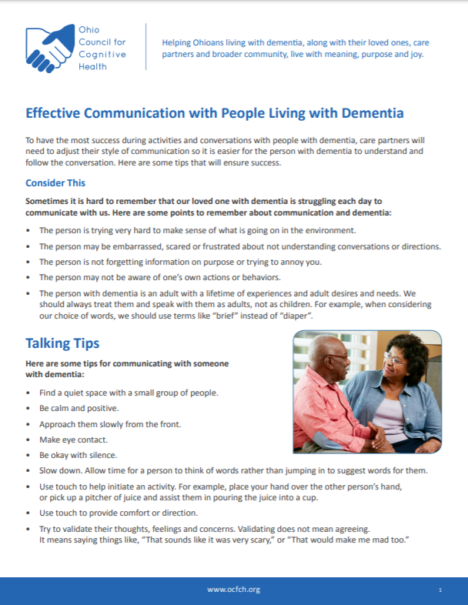
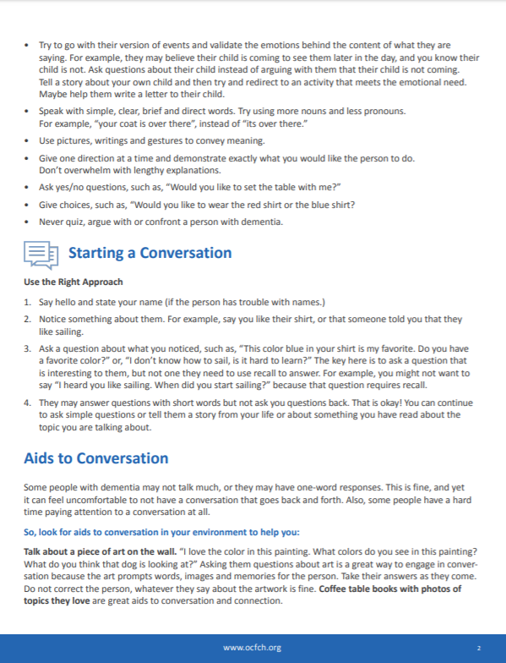
Ohio Council for Cognitive Health: Tip Sheets http://ocfch.org/quick-tips/
Use the link to find Quick Tip Resources such as:
Effective Communication with People Living with Dementia
Understanding Responsive Behaviors Related to Dementia
Walking About
Notes:
Additional resources: Quick Tip Sheets available on Ohio Council for Cognitive Health’s website and can be personalized by adding your organization’s logo

Slide 15






Quick Tip Videos
Visit our website or YouTube channel for all videos
Notes:
Add your own ideas. If feasible, consider removing the toilet seat lid for easier identification or paint and label hot and cold handles on shower and sink faucets.
That’s just one of many 2-minute videos we have on our website – OCFCH.org. shown here (Click on link to show)
Others include:
Declutter: Learn how to decrease clutter in the home while making the least disturbance to the person with dementia. This will help them to maintain focus and find items they need more easily.
Create a Home Memory Center: Learn strategies to support memory function with those living with dementia. Create a memory center in your home to reduce confusion and foster well-being.
Better Communication: Learn to use a style of communication that is easier for the person with dementia to understand and follow conversations.
Memory Books: Learn how to make a memory aid that will improve communication with someone with dementia. Memory Books foster communication, and help people remember their identity.
Dementia Friendly Home: Learn simple changes in the home that can make a big difference for you and the person with dementia.
Self-Care: Learn some simple ways to restore yourself. Regular self-care can make you a better care partner for others.
And, currently in production…………Responsive Behaviors and Walking About
Let’s talk about cueing………………………..

Slide 16
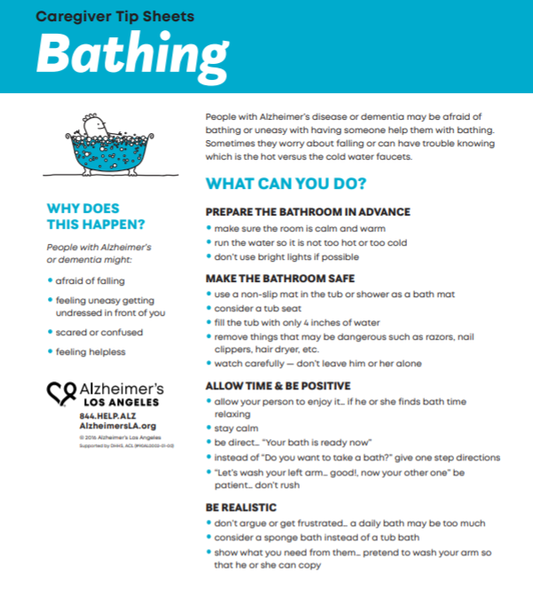
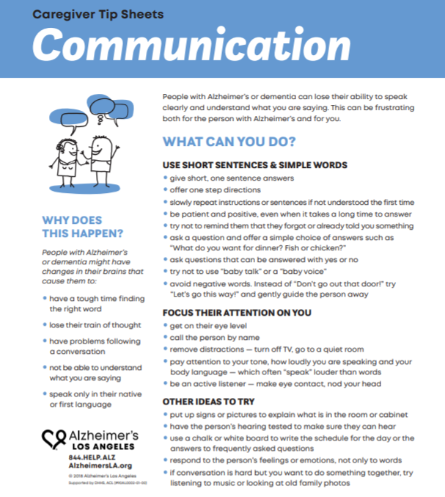
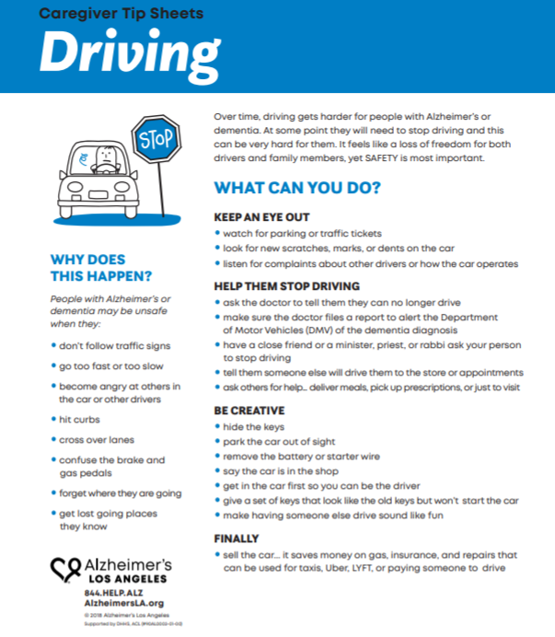
Alzheimer’s Los Angles Caregiver Tip Sheets
Notes:
Additional resources: Alzheimer’s Los Angeles caregiver Tip Sheets available at https://www.alzheimersla.org/caregiver-tip-sheets and can be personalized by adding your organization’s logo

Slide 17
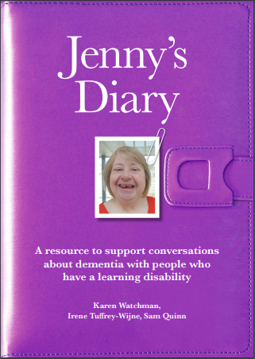
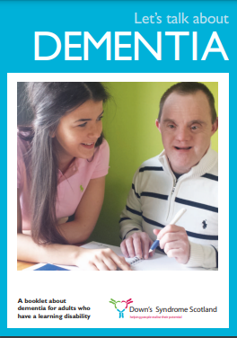

Resources for individuals with IDD - to help talk about dementia
Jenny’s Diary: https://www.learningdisabilityanddementia.org/jennys-diary.html
Let’s Talk about Dementia: https://www.dsscotland.org.uk/wordpress/wp-content/uploads/2016/02/Lets-Talk-About-Dementia-final-version-05.08.15.pdf
Ann Has Dementia: https://booksbeyondwords.co.uk/bookshop/paperbacks/ann-has-dementia
Notes:
Presenter: Resources for individuals with IDD - to help talk about dementia

Slide 18
Additional Resources
Care Transitions Notebook
Caring for Someone with Memory Loss or Dementia After a Hospitalization in Ohio
An adaptation of Alzheimer’s Los Angeles Care Transitions Notebook.
KAER Toolkit for Brain Health
The GSA KAER Toolkit for Brain Health helps primary care teams support brain health and improve cognitive impairment detection.
A Companion to the KAER Toolkit for Brain Health
Addressing Brain Health in Adults With Intellectual Disabilities and Developmental Disabilities by GSAStrategicAlliances - Issuu
Notes:
Lyndi

Slide 19
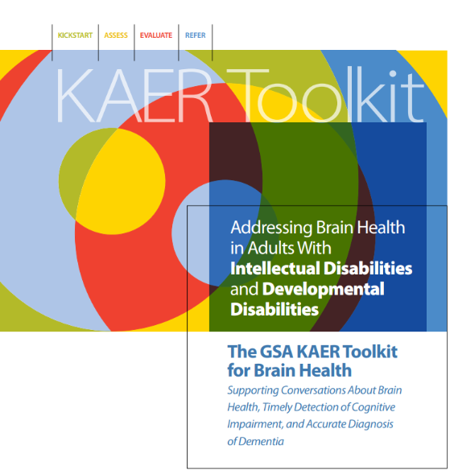
Save the Date – KAER Toolkit for IDD Training
Email: Lyndi Wyrostek if you are interested in attending: Lyndi@memorylanecareservices.org

Slide 20
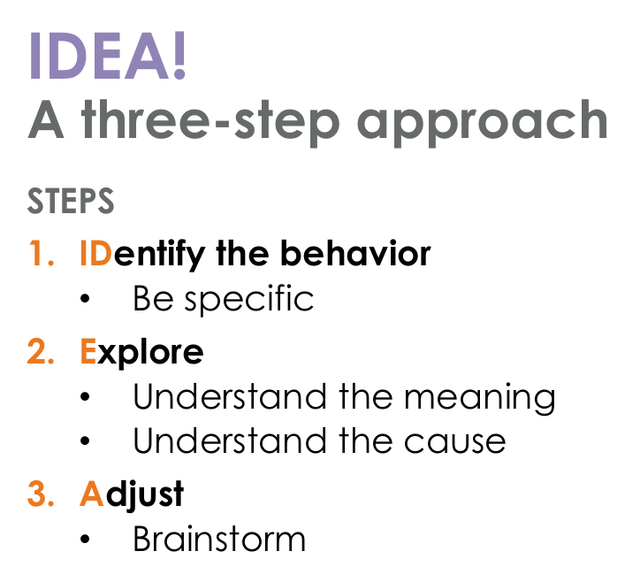
IDEA! Intervention Training
Side by side evidence-informed training
3-step strategy designed to help caregivers understand and manage challenging dementia-related behaviors.
Focuses on identifying the behavior, exploring causes, and finding tailored responses.
The program offers practical, actionable tools for families dealing with behavioral changes

Slide 21
Brain Health and Dementia Trainings Offered in partnership with UsAgainstAlzheimer’s, The Ohio Council for Cognitive Health, Northeast Ohio Medical University, Ohio’s Geriatric Workforce Enhancement Program, and MemoryLane Care Services.
A series of Brain Health and Dementia trainings to empower healthcare and wellness professionals with tools, strategies, and practical knowledge to promote brain health and reduce dementia risk.
Social Isolation, Loneliness and Dementia
Understanding Inequities in Alzheimer's and other Dementia's
Sleep and Dementia
Hearing loss and Dementia
Diabetes and Dementia
Depression and Dementia

Slide 22
Additional Resources
NADRC 2024: Grantee-Implemented Evidence-Based and Evidence-Informed Interventions
Compendium resource that consists of a list of evidence-based and evidence-informed interventions.
Best Programs for Caregiving - Guiding you to Proven Support for Dementia Care
A partnership between Benjamin Rose Institute on Aging and Family Caregiver Alliance.
Notes:
Lyndi

Slide 23

Questions and Additional Information
Ohio Council for Cognitive Health
www.ocfch.org
Salli Bollin, MSW, LSW – President and CEO, Ohio Council for Cognitive Health and MemoryLane Care Services SBollin@ALZCareServices.org
Bonnie Burman, Sc.D. – Director of Strategic Partnerships bburman@ocfch.org
Elizabeth Kinzig, MA, CCC-SLP – Program Coordinator ekinzig@ocfch.org
Marty Williman, BSN, RN – Program Director mwilliman@ocfch.org

