Slide 1
Special Olympics Ohio Health
Amy O’Neal
Senior Director of Health Strategies

Slide 2
Special Olympics Ohio
17,000 athletes
98 programs
4 regions
13 sports

Slide 3
Unique Health Challenges in IDD Population
Vision, hearing, dental issues
Obesity, low bone density, poor flexibility/strength
Substandard or no access to healthcare
Individuals with IDD are twice as likely to die prematurely
Adults with IDD are 14% more likely to be obese
As many as 3 in 5 people with IDD may have a co-occurring mental health condition

Slide 4
Health Findings
On a Special Olympics team of 10 athletes:
4 have untreated tooth decay and 1-2 need urgent dental care
2 have never had an eye exam and 4 need a new prescription for glasses
• 2 would fail a hearing test
2-3 have low bone density even though they may look healthy
6 have problems with flexibility and 5 will have problems with strength, placing them at risk for injury
6 are overweight or obese and at risk for chronic health conditions

Slide 5
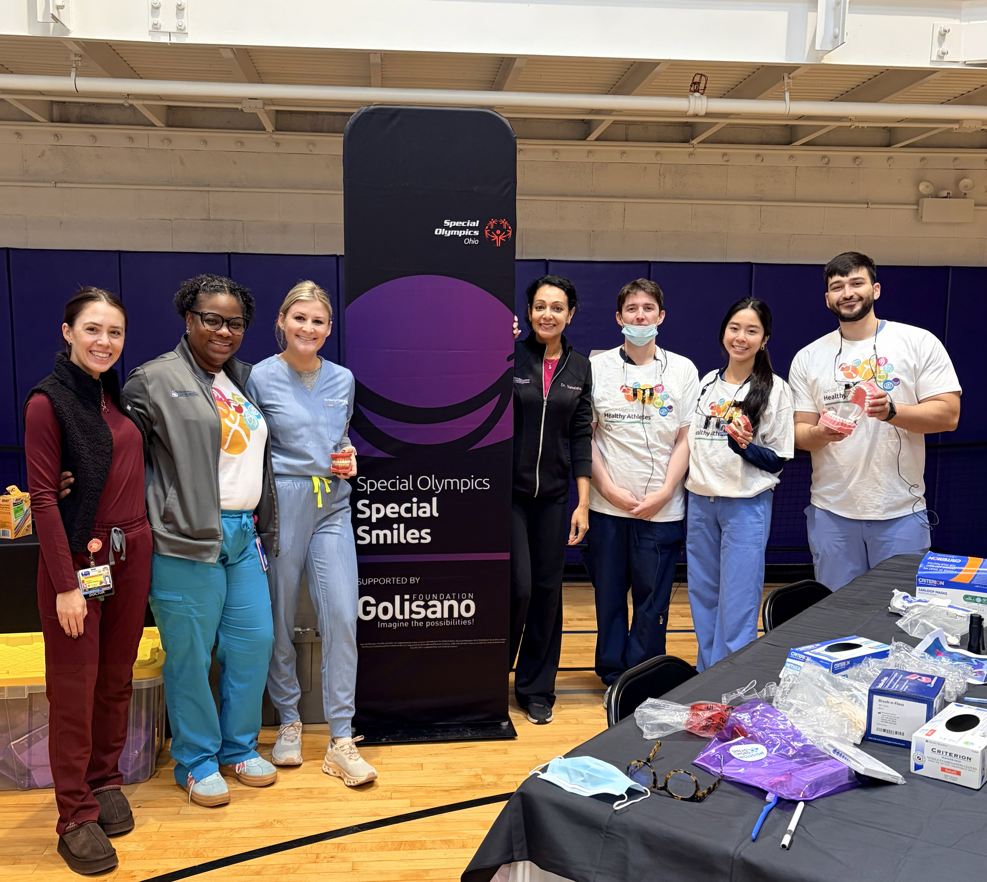
Healthy Athletes
Free health screenings and education to Special Olympics athletes
Began in 1997 – over 2 million screenings have been completed
Over 300,000 health professionals and students have been trained to treat people with IDD

Slide 6


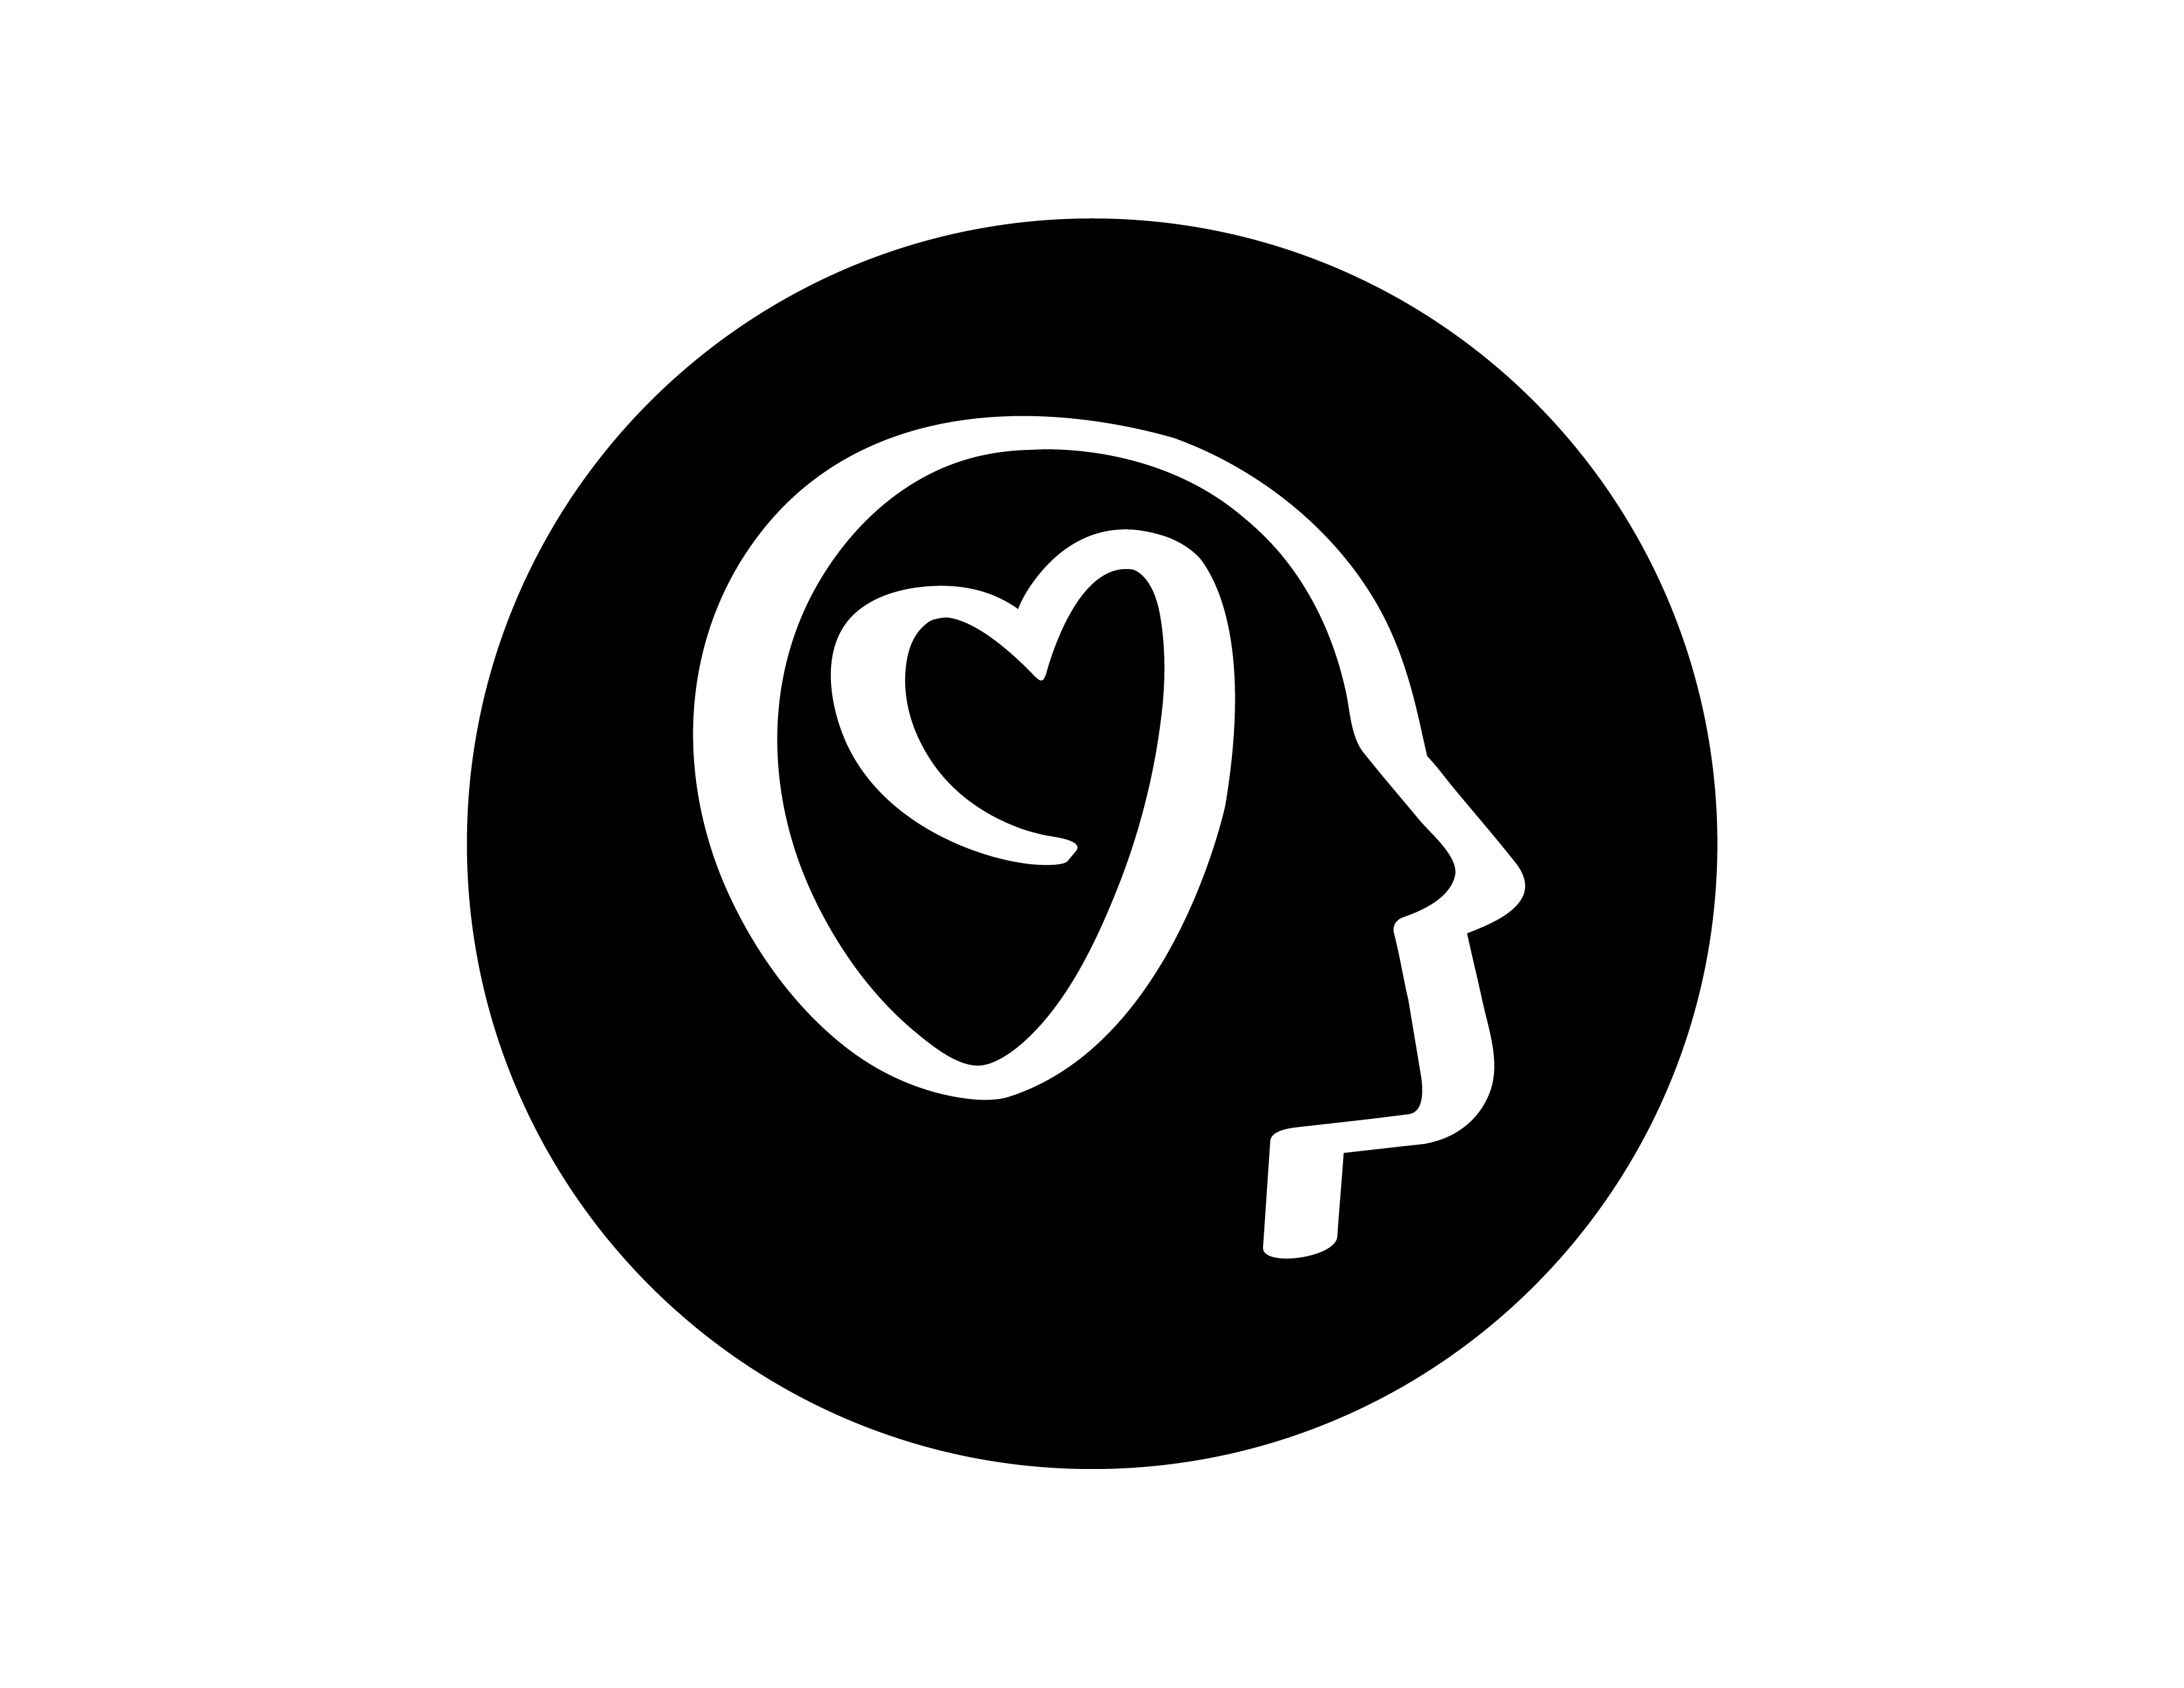
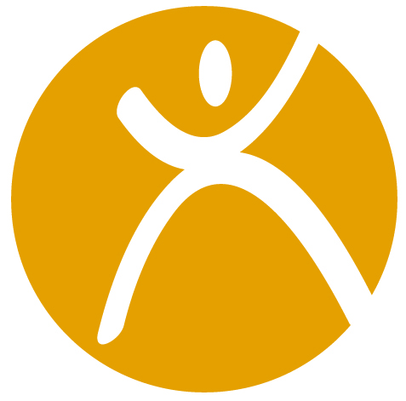

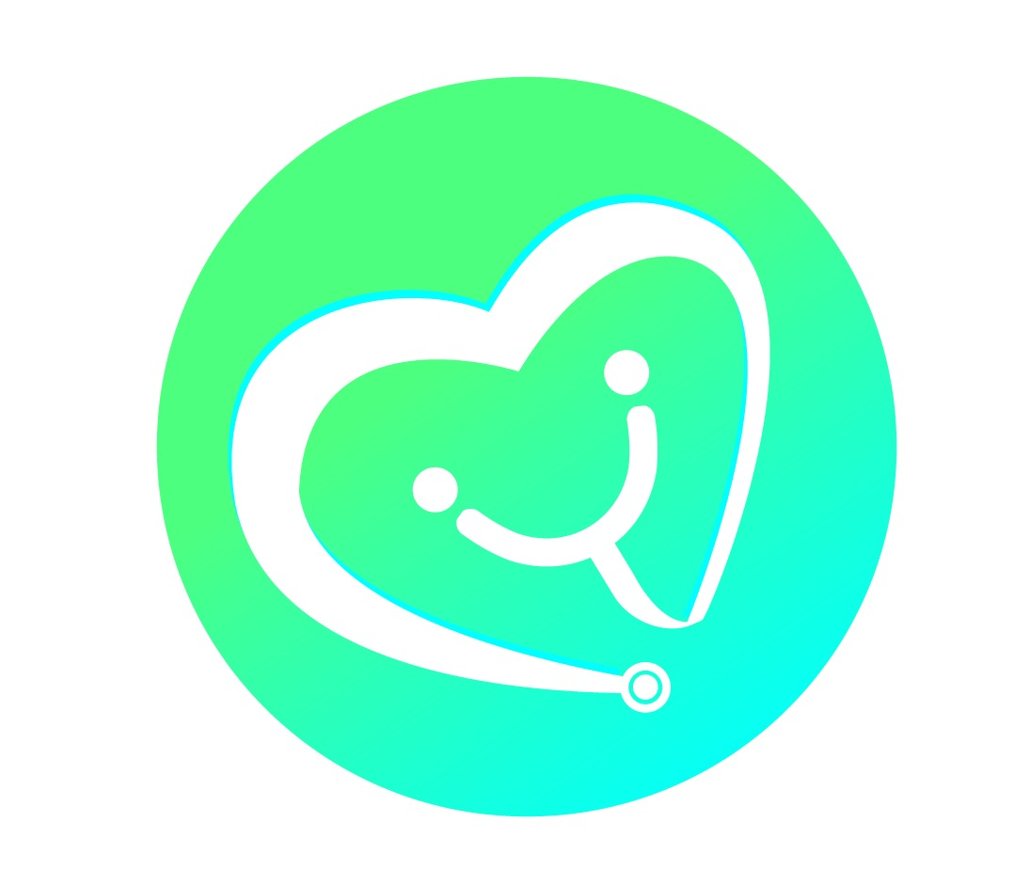



HEALTHY ATHLETE DISCIPLINES
FitFeet- Podiatry
Health Promotion-BMI, Bone
Density
Strong Minds- Emotional Wellbeing
FunFitness-Physical Therapy
Special Smiles-Dentistry
Healthy Young Athletes-
Pediatrics
Healthy Hearing-Audiology
Opening Eyes- Optometry
Medfest-Sport Physicals

Slide 7
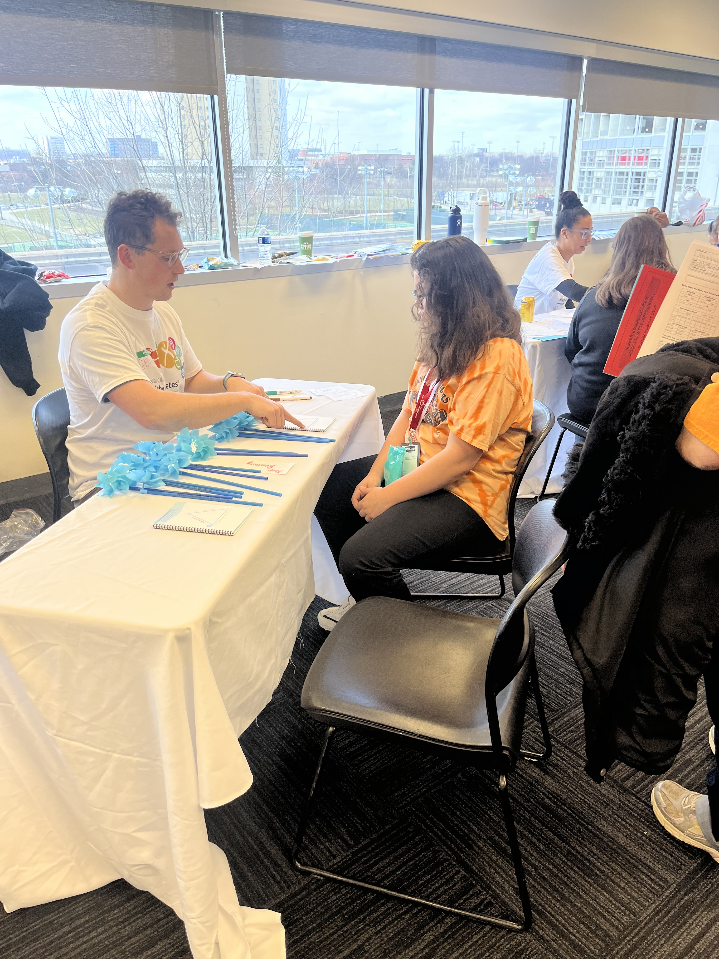
Health in Ohio
In 2025:
Special Olympics Ohio completed over 4,000 health screenings
Worked with 13 colleges and universities on training students to work with ID population
Made over 1,000 referrals to providers for additional care

Slide 8
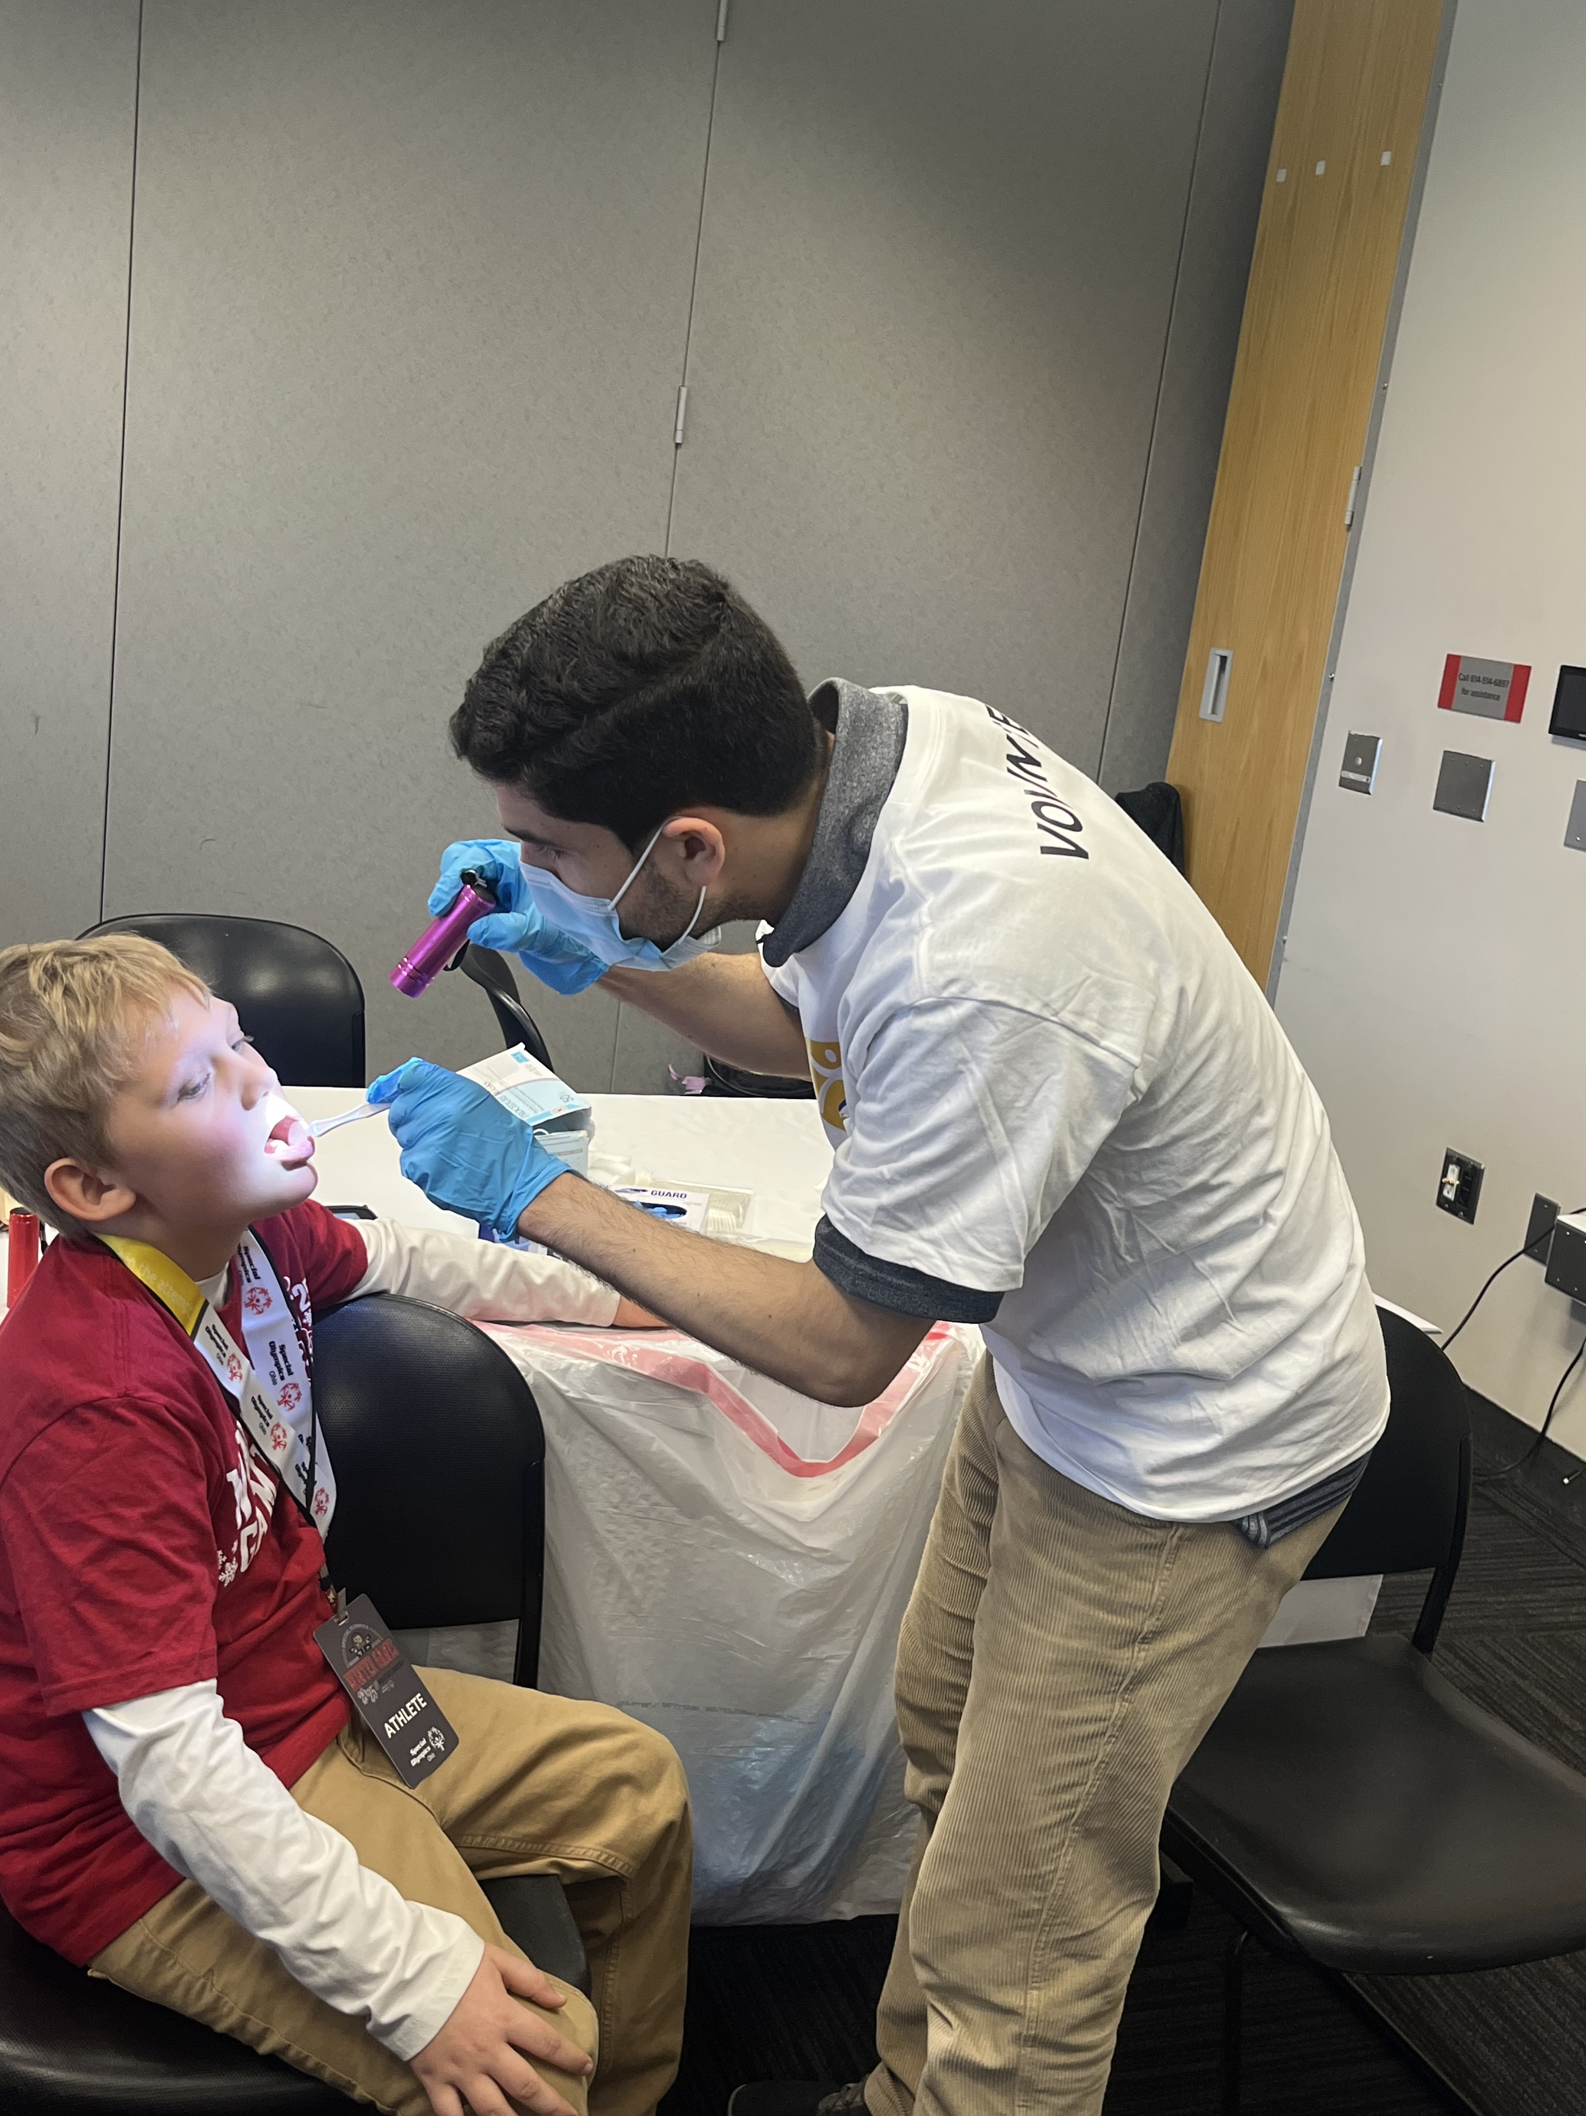
Key Takeaways
Special Olympics Health Initiatives:
Bridge healthcare access gaps for individuals with IDD
Improves health, fitness, and social engagement
Educates students and providers for better care
Special Olympics is the largest provider of health screenings for individuals with IDD

