Slide 1

Substance Use Disorders in Individuals with DD
A.J. Mcconnell, psy.d., nadd
Alvis, Inc.
Michael Mayo, m.s.
Overbrook clinical associates

Slide 2


Introduction

Slide 3
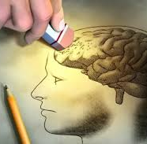
Addiction is a disease
People can become addicted to many things.
It can progressively destroy the brain.
Addiction can be treated.
Without help, a person can potentially die
Addiction becomes a lover and best friend. A person betrays their values, family, job, etc. because of it.
Notes:
Addicted to drugs, gambling, video games, sex, food, you name it.

Slide 4
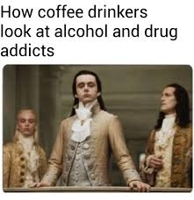
Ohio Statistics (McConnell, 2023; White Light Behavioral Health, 2024)
Over 1.2 million individuals use illicit drugs as of 2020.
In 2023, 35.9 per 100,000 people in Ohio died as a result of drug abuse.
30% of individuals participating in substance abuse treatment report having multiple drug addictions.
20% of adults in Ohio binge drink weekly
In 2022, over 3,000 children in foster care due to parents drug use.

Slide 5
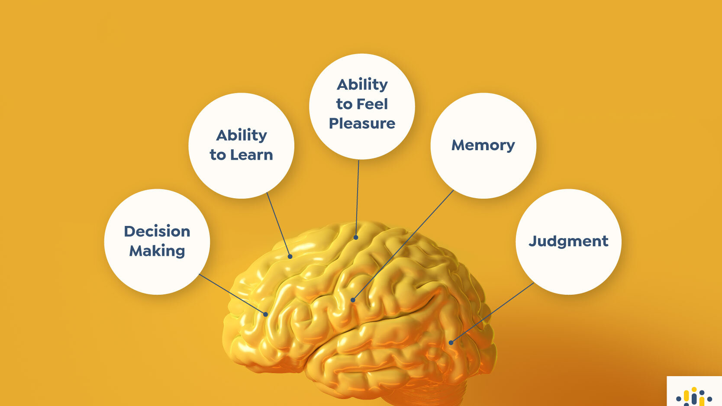

Slide 6
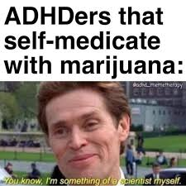
Is Marijuana a harmless drug?

Slide 7
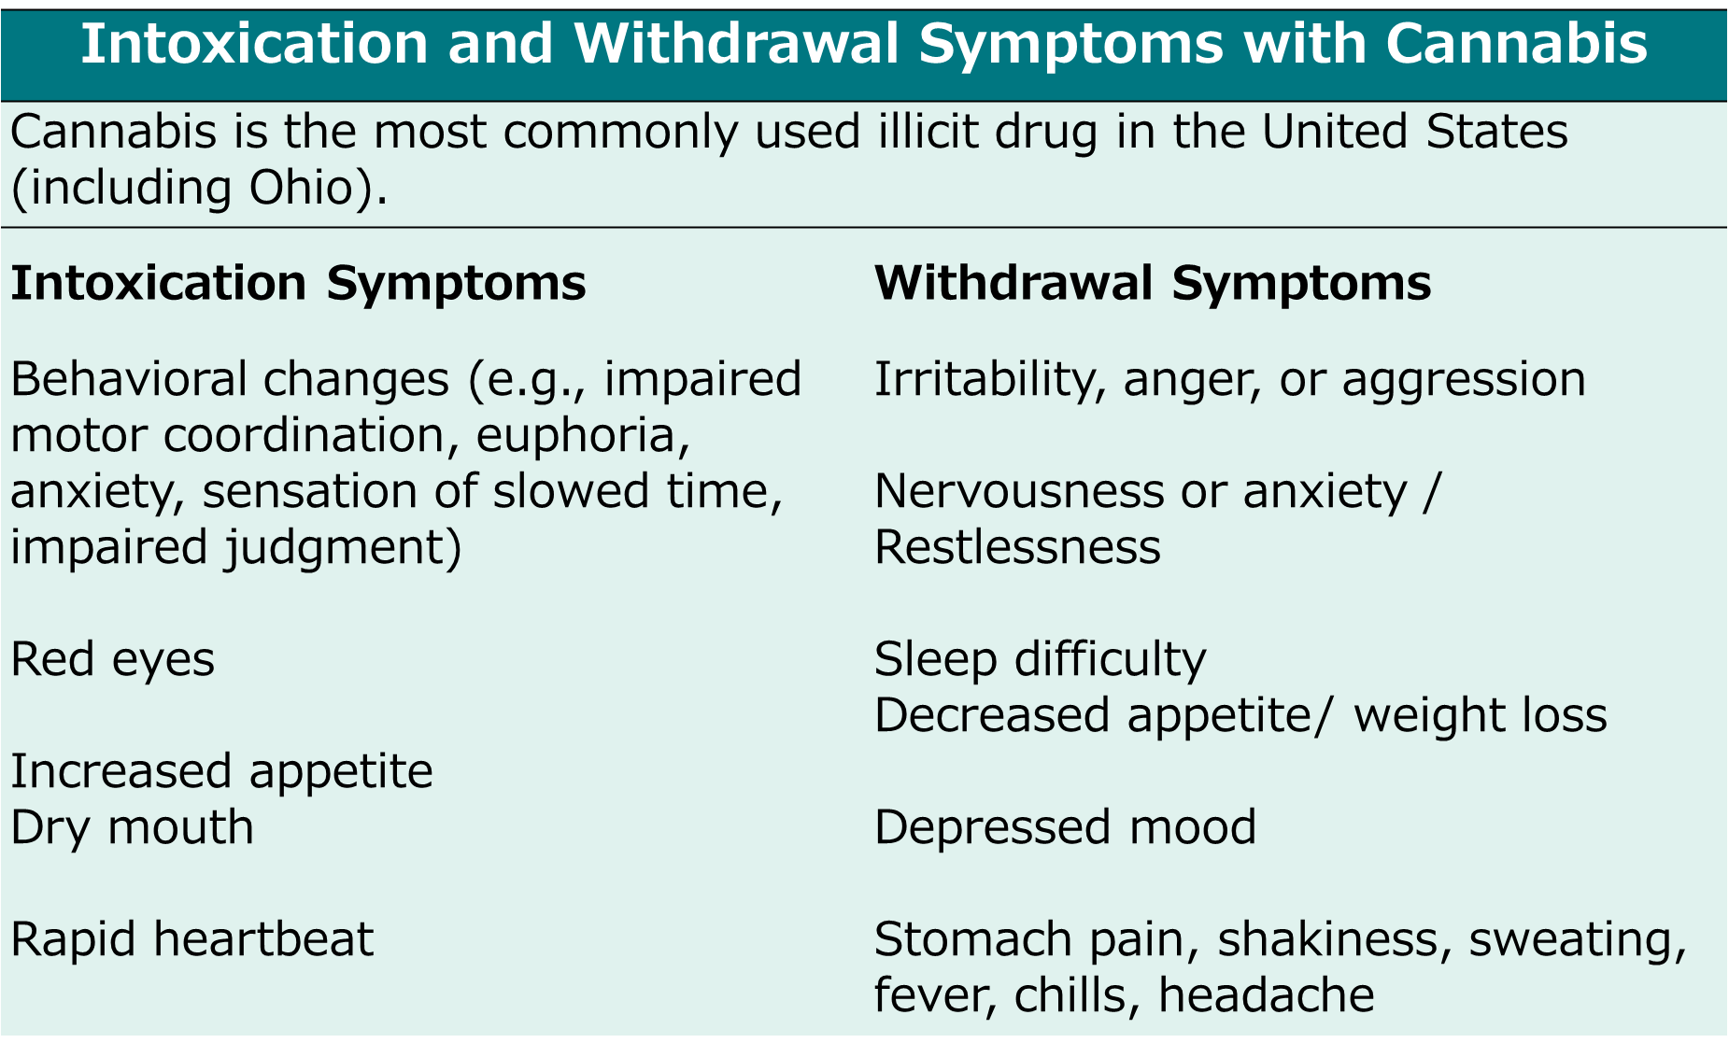
Marijuana use in ohio

Slide 8
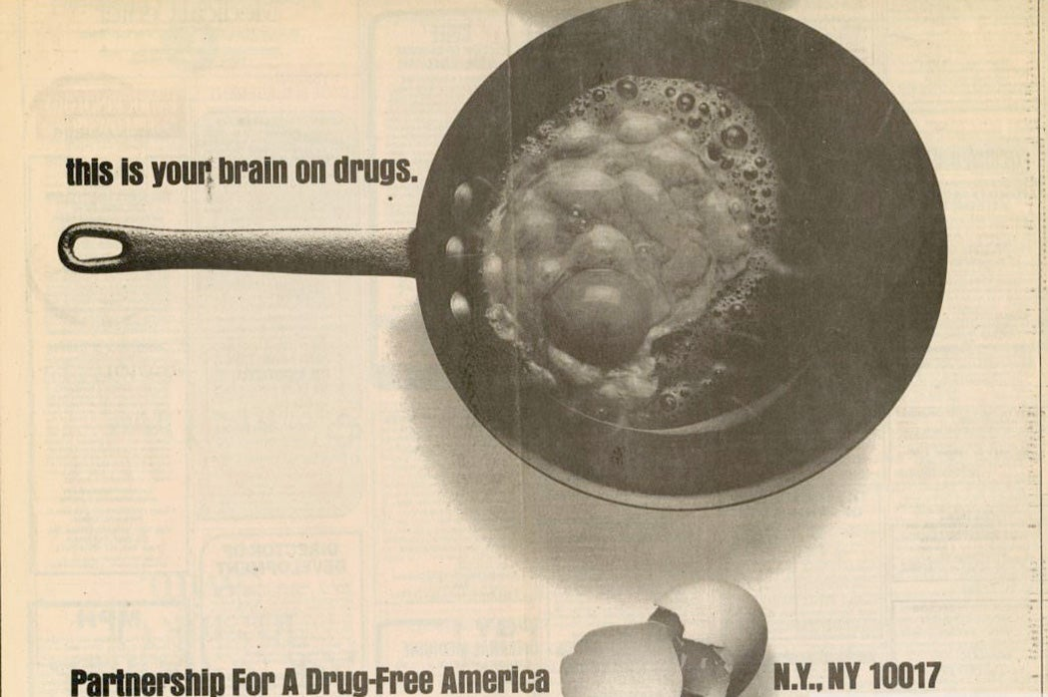
Opioid use in ohio
Ohio has the second highest rate of overdoses in the U.S.
82% of overdoses in Ohio in 2023 were related to Opioids.
Over 8 million Americans admit to misusing prescription Opioid medications in 2023

Slide 9
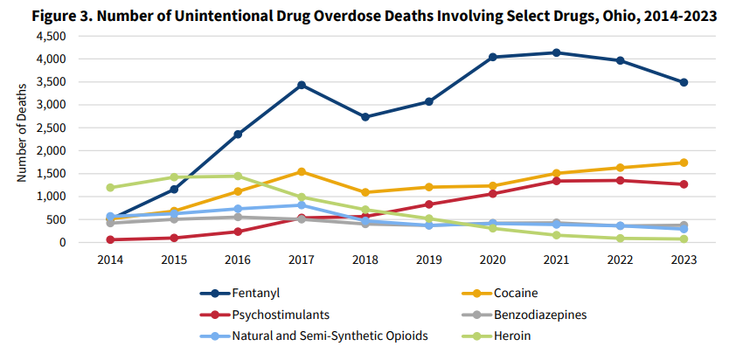

Slide 10
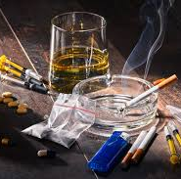
Substance use in individuals with dd

Slide 11
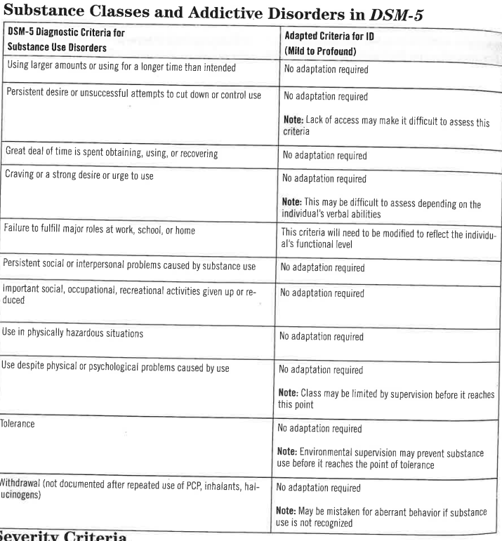
DSM-5 & dmid-2

Slide 12
Research findings on sud in individuals with dd
Overall prevalence of a SUD is difficult to determine (estimated 2-6% of individuals with DD) (DMID-2; Haasbroek & Morojele, 2021)
Most people with SUD start using in early adolescence. It may be later for individuals with DD.
Types of substances used varies.
Professionals often don’t screen for substance use disorders in individuals with DD (Haasbroek & Morojele, 2021).
There are barriers to treatment (Reif & Mitra, 2022; Roux et al., 2022)

Slide 13
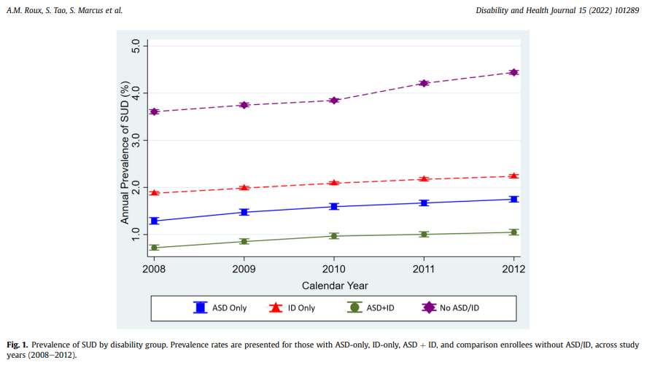

Slide 14
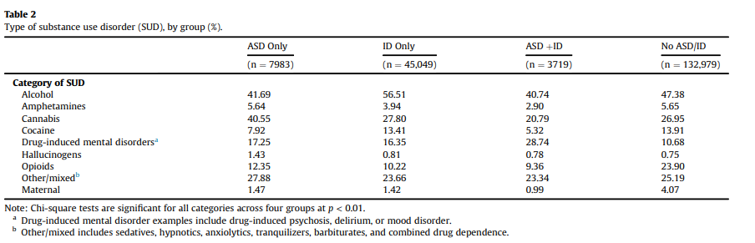

Slide 15
What Places a Person with DD At Risk for SUD? (Chapman & Wu, 2012; Copersino et al., 2022; Haasbroek & Morojele, 2021)
Having a family member with a SUD
Feelings of isolation / Difficulties in Social Skills
Deficits in Executive Functioning
Genetic Heritability
Co-occurring disorders (e.g., anxiety, ADHD, depression)
Early onset of smoking
Family history of child maltreatment
Having an increased level of physical or financial independence
Opportunities to assess illicit substances
Peer Pressure
Poor risk awareness

Slide 16
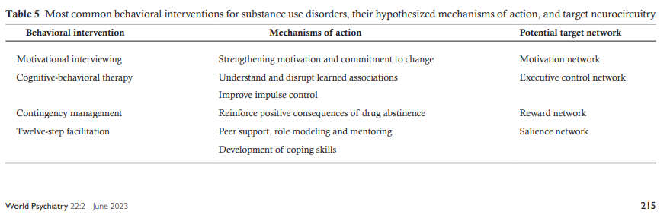
Most Common Behavioral Therapy Models (Volkow & Blanco, 2023)

Slide 17
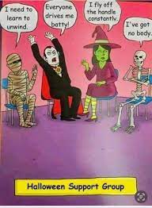
Treatment
People with DD are less likely to receive treatment compared to the general population (Chapman & Wu, 2012).
Group therapy / 12 step programs not likely to be as effective with the DD population (Chapman & Wu, 2012; Haasbroek & Morojele, 2021)
Substance Use Disorders may be underdiagnosed (Haasbroek & Morojele, 2021)

Slide 18
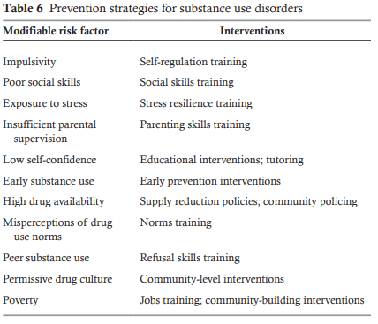
Prevention strategies (Volkow & Blanco, 2023)

Slide 19

Develop a relapse prevention plan
List of support team members & what I need from my support team
Triggers (People, places, and things)
Body responses when Triggered
What can I do to manage body responses to triggers
Safe vs unsafe places
Thinking errors and Replacement Thinking
Positive activities and People

Slide 20
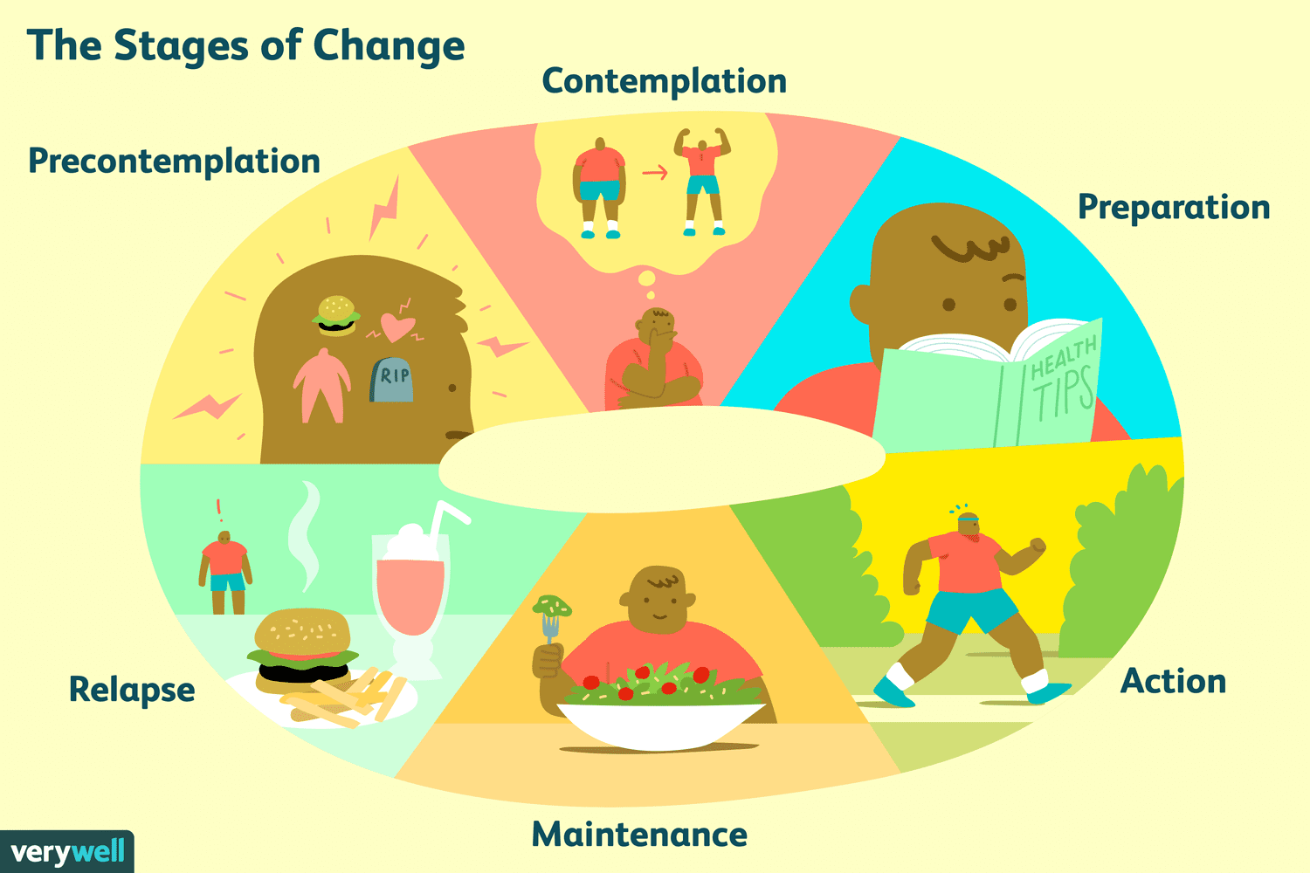

Slide 21

Motivational interviewing
Open-ended questions
Reflective listening
Creating a safe climate
Affirming and supporting the client | Empathy
Responding to resistance in a nonconfrontational manner
Summarizing what the client is saying

Slide 22
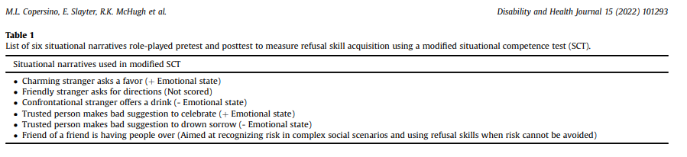
Refusal Skills Training is Supported by Research (Copersino et al., 2022)

Slide 23

Refusal Skills (Copersino et al., 2022)
“No-Go” strategy
Appropriate in all situations
No = make an assertive refusal
Go = remove yourself from the situation
“No-Suggest-Go” strategy
Appropriate to use with individuals you know and trust
No = make an assertive refusal
Suggest = recommend an alternative activity
Go = it is ok to leave the situation

Slide 24

TIPS TO TEACH INDIVIDUALS WITH DD
Visual supports and social stories
Picture-based stories or comic strips to explain concepts
Tools like Boardmaker or Storyboard to help create customized visuals
Interactive Curricula
“Understanding Addiction & Developmental Disabilities” program

Slide 25
More Tips to HELP Individuals with dd
Simplified Language Materials
Role-Playing & Scenario-based learning
Peer Support and Mentorship
Digital Tools and Apps
Caregiver & Support Staff Training

Slide 26
Education Programs
SAMHSA Advisory on Disabilities and SUDS
E-Based Academy: Substance Use Disorders in Individuals with IDD
DisabilityInfo.org Fact Sheet
Disability Resources: Prevention and Treatment
The Recovery Village

Slide 27

Tips for Direct Service Professionals
Develop a relationship that is engaging, nonjudgmental, & full of listening
Confront behavior and not the person
Do not expect immediate change – expect baby steps and a lot of questions
Educate on what drugs do, what people in recovery do.

Slide 28
More Ways to respond
Never give up on a client – they have already given up on self
Strive for 5 positive interactions for every negative one
Do not argue or get into confrontations
Let them know the brain is diseased and needs time to heal
Without breaking confidentiality, give success stories and that things can get better.
Role play scenarios
Frequently review relapse prevention plan

Slide 29

Questions

Slide 30
references
Chapman, S. L. C., & Wu, L. T. (2012). Substance abuse among individuals with intellectual disabilities. Research in developmental disabilities, 33(4), 1147-1156.
Copersino, M. L., Slayter, E., McHugh, R. K., Shedlack, K. J., Lukas, S. E., & Weiss, R. D. (2022). Clinical utility of a hybrid secondary and relapse prevention program in adults with mild intellectual disability in community residential and day habilitation settings. Disability and Health Journal, 15(2), 101293.
Haasbroek, H., & Morojele, N. (2022). A systematic literature review on the relationship between autism spectrum disorder and substance use among adults and adolescents. Review Journal of Autism and Developmental Disorders, 9(1), 1-20.
McConnell, A.D. (2023). The impact of the opioid crisis and the Covid-19 pandemic on children in Ohio. The Ohio Psychologist.
Reif, S., & Mitra, M. (2022). The complexities of substance use disorder and people with disabilities: current perspectives. Disability and health journal, 15(2), 101285.
Roux, A. M., Tao, S., Marcus, S., Lushin, V., & Shea, L. L. (2022). A national profile of substance use disorder among Medicaid enrollees on the autism spectrum or with intellectual disability. Disability and health journal, 15(2), 101289.
Volkow, N. D., & Blanco, C. (2023). Substance use disorders: a comprehensive update of classification, epidemiology, neurobiology, clinical aspects, treatment and prevention. World Psychiatry, 22(2), 203-229.

Slide 31
Contact information
A.J. McConnell, Psy.D., NADD-CC
Allen.mcconnell@alvis180.org | (614) 205-8152
Michael Mayo, M.S.
M.Mayo@overbrookclinic.com | (614) 256-4242

