Slide 1
OPRA Health Care Committee
April 2024

Slide 2
Agenda
Welcome and Introductions
Guest Speakers: Ohio’s Next Gen Medicaid Managed Care
Major Unusual Incident Rule
EVV Update
Hot Topics
Surveys/QA Reviews
Tarrytown Expocare IDD/BH Symposium- Tuesday June 11th, 2024

Slide 3
Ohio’s Next Gen Managed Care Overview
April 18, 2024

Slide 4
Thank you for inviting us to join you!
Corazon Eaton, MPH, Director of Health Equity
Buckeye Health Plan
Ericka King-Betts, PhD, Director of Health Equity
Humana Healthy Horizons of Ohio
Kate Tullio, MPH, MS, Associate Vice President, Health Equity
CareSource

Slide 5
Ohio’s Medicaid Managed Care Plans

Slide 6
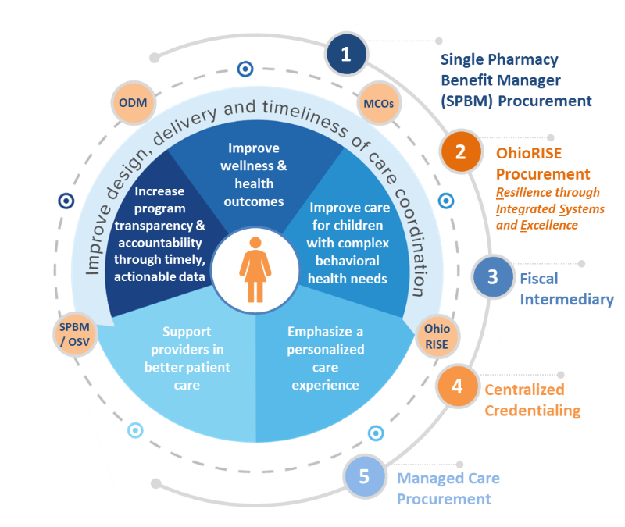
Ohio’s Next Generation Medicaid Managed Care Program
Ohio phased in the next generation of managed care beginning in July 2022. This effort combined several strategies including:
Medicaid Managed Care
OhioRISE
Single Pharmacy Benefit Manager
Fiscal Intermediary
Centralized Credentialing/Provider Network Management
The new program is focused on the individual with collaboration and coordination among all plans, state agencies, community partners and providers.

Slide 7
MyCare Ohio
In addition to the Medicaid Managed Care Program, Ohio launched the MyCare Ohio demonstration program in 2014.
MyCare Ohio provides coordinated benefits to individuals enrolled in both Medicaid and Medicare.
Historically, there has been little to no coordination between state Medicaid programs and the federal Medicare program
The dual-eligible population commonly has complex health care needs that require high-cost services.
The program is ‘live’ in seven geographical regions composed of 29 Ohio counties.
Ohio was among the first states to adopt a managed care approach to care for this population.
Pursuant to a recent legislative mandate, Ohio’s MyCare program will be going statewide by 2026.

Slide 8
Who is Enrolled in Managed Care?
Over 3.2 million Ohioans are covered by Ohio’s Medicaid program
Nearly 90% of those Ohioans are enrolled in managed care plan either through the Medicaid Managed Care program or MyCare Ohio
Most individuals are required to enroll in a plan. Individuals enrolled in a DODD-administered HCBS waiver may voluntarily enroll.
Individuals excluded from enrollment are those who:
Reside in ICF–IID Facility;
Are enrolled in PACE;
Reside in a nursing facility except when enrolled in MyCare Ohio;
Receive HCBS waiver services when not enrolled in MyCare Ohio;
Are dually eligible for both Medicaid and Medicare when they do not reside in a MyCare Ohio Demonstration County.
All individuals with Group 8 (Expansion) eligibility are required to enroll in a plan even when residing in a nursing facility or on an ODM-administered HCBS waiver.

Slide 9
Medicaid Managed Care Covered Benefits
Managed Care plans must cover all services that are included as under the state’s FFS program.
Inpatient hospital services
Outpatient hospital services
Physician services
Lab and X-ray services
Screening, diagnosis, and treatment services for children under 21 years (Healthchek/EPSDT)
Immunizations
Family planning services and supplies
Home health and private duty nursing
Podiatry
Chiropractic Services
Physical, occupational, development and speech therapy services
Nurse midwife, certified family nurse practitioner, and certified practitioner services
Prescription drugs
Ambulance and ambulette services
Dental services
Durable medical equipment and medical supplies
Vision care services
Nursing facility services
Hospice care
Behavioral health services
Respite services for eligible children receiving Supplemental Security Income (SSI)

Slide 10
Medicaid Managed Care plans may also provide enhanced services that are not available under the standard Fee-for-Service program. Enhanced services include:
Additional Transportation Benefits
Health & Wellness Programs
Access to a toll-free 24/7 nurse hotline for medical advice
On-line searchable provider directory
Disease Management and Health Education Programs
Enhanced Dental and Vision Programs
Preventive care reminders & Incentives
Extended Provider Office Hours

Slide 11
More Details on the Transportation Benefit
MCOs cannot require more than 48 hours of advance notice for transportation needs and must provide exceptions for advance notice requirements for urgent member needs (e.g., for same or next day urgent appointments) and hospital discharges;
MCOs cannot restrict the number of transports in a single day; and
MCOs are responsible for arranging transportation in cases where transportation of families, caregivers, and siblings (other minor residents of the home) is needed to facilitate the treatment needs of the member and their family.
MCOs must provide additional transportation benefits for members under the age of 21. This medically necessary service cannot be a value-added service or have annual limitations.
MCOs must ensure specialized transportation for members who have cognitive or behavioral challenges that require different transportation providers or supports than available from counties or standard Medicaid provider network.

Slide 12
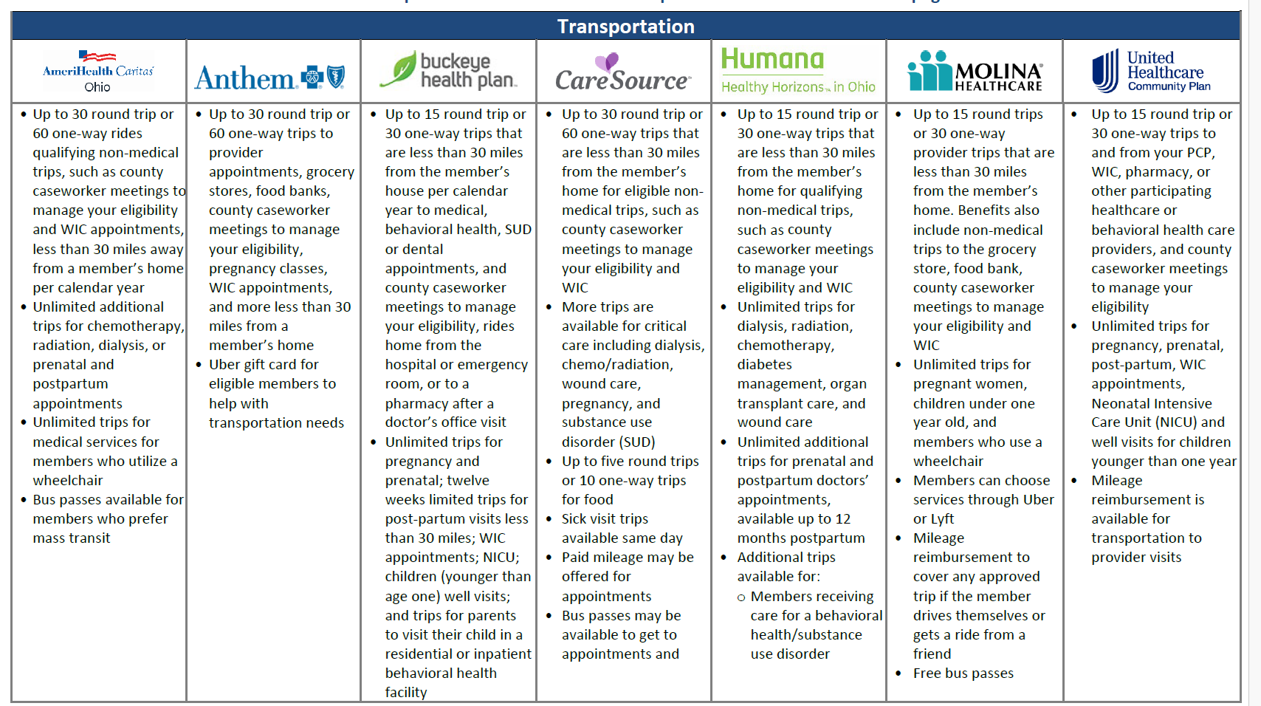

Slide 13
With Next Gen’s focus on health equity, there are a host of enhanced benefits aimed at social drivers of health in order to improve overall health outcomes:

Slide 14
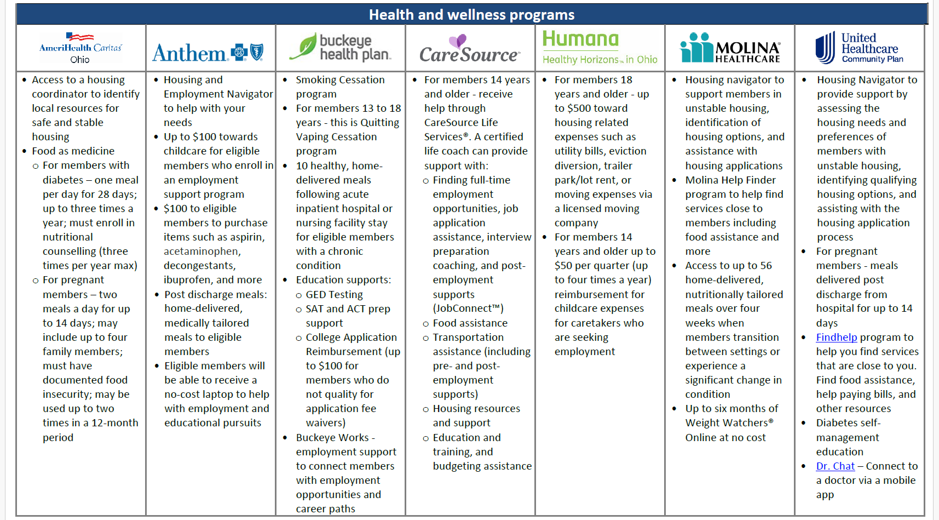

Slide 15
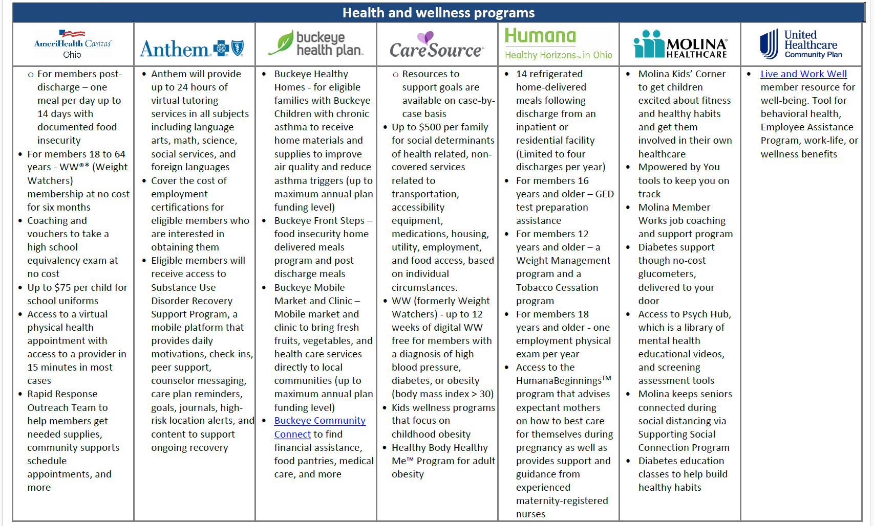

Slide 16
Care Management
All Medicaid managed care plans must implement a care management program through a model of care that broadly defines the way services will be delivered to meet population needs.
High quality care coordination results in better quality of life for the member, fewer unmet needs, lower avoidable health care utilization (such as emergency department visits and inpatient admissions), reduced duplication of services, and improved satisfaction with the experience of health care for the member and their support system.
The MCOs must assess new members using a standardized health risk assessment within 90 days of enrollment for the purpose of risk stratification and to identify potential needs for care management.
The MCP must develop and implement systems, and processes that detect, prevent, and mitigate harm and/or risk factors that could impact an individual’s health, welfare, and safety. When the MCP identifies or becomes aware of risk factors, it must put in place services and supports to mitigate and address the identified issues as expeditiously as the situation warrants.

Slide 17
Care Management
Care coordinators focus on the individual by:
Assessing a member’s needs and identifying any unmet needs and barriers to care.
Developing an individualized care plan with the member and their support system.
Educating the member and their support system on resources available.
Facilitating communication among multi-disciplinary providers on the care team.
Ensuring access to care.
Monitoring the member for changes that impact the individualized care plan.
Care coordinators educate and support members to take charge of their own health, assisting them to develop and understand their individualized care plan and the importance of compliance.
Care coordinators also guide members and their families to community resources and additional supports to address social determinants of health, as well as consumer and advocacy groups that can provide or facilitate access to other services that address health and other needs.

Slide 18
Questions?
Here are a few conversation starters:
How does a client/provider know if the client is enrolled in managed care and which plan they have?
How does a client know if they qualify for care management services?
How does a client access the enhanced benefits?
THANK YOU for you time today!

Slide 19
MUI Rule
Rachel Hayes
Group of stakeholders working on changes to the MUI rule
One area of concern is the changes to current understanding of unscheduled hospitalizations
If you have suggestions for language changes, please reach out to Rachel- Rhayes@opra.org

Slide 20
EVV Update
Changes anticipated in July
Split current rule into 4 rules
Inclusion of residential respite services and nursing delegation
Removal of GPS requirement
Beneficiaries must “opt-in” to the use of GPS with written consent if they want GPS used
State-provided system will no longer be sent to beneficiaries- providers must request the system
See more information - https://dam.assets.ohio.gov/image/upload/medicaid.ohio.gov/Providers/EVV/Presentation/EVV%20Stakeholder%20Engagement%20Jan%2019.2024.pdf

Slide 21
Hot Topics
Tarrytown Symposium
QA reviews
Surveys

