Slide 1
OPRA Healthcare Committee
October 19, 2023

Slide 2
Marlene Anielski, Director
Nick Siniff, Supervising Attorney
Tracy Williams-Johnson, Licensure Manager
Jack Brubaker, Legislative Liaison

Slide 3
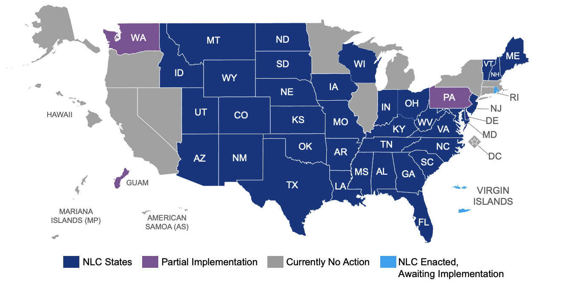
The Nurse Licensure Compact (NLC)
41 participating states in the NLC with several other states working towards NLC implementation.
Ohio became the 39th state to implement the NLC on Jan 3, 2023.
If a nurse’s primary state of residence (PSOR) is a compact state and they meet the qualifications, they can choose to convert to a multistate license.

Slide 5
Multistate Licensure (MSL) 101
RNs and LPNs are eligible to convert to an MSL.
An MSL permits a nurse to practice in both their home state and other compact states.*
* Unless the nurse is under discipline or has a restriction.

Slide 6
The NLC (and NURSYS)…
Increases information sharing between states.
Reduces the time and expense of multiple single state licenses.
Eases the burden of maintaining continuing education requirements from different states.

Slide 7
Eligibility and Requirements
•NLC's uniform licensure requirements.
•A nurses' PSOR must be a part of the NLC.
•11 other eligibility requirements.

Slide 8
Prepare for a Multistate License

Slide 9
MSLs by the Numbers*
More than 23,740 MSL Conversion Requests submitted.
Approximately 20,874 MSLs issued.
*As of October 16 , 2023.

Slide 10
COST SAVINGS FOR EMPLOYERS
Removes cost barriers for employers.
•Shares the cost of multiple Iicenses.

Slide 11
Reporting

Slide 12
VERIFICATION
Do it all on Nursys.com

Slide 13
Nursys eNotify provides:
•Automated license status updates.
•License expiration
and disciplinary status updates.

Slide 14
Registration and Reporting
What's included in a Nursys.com registration?

Slide 15
E-Notify Enrollment Process
Jason A. Schwartz, Director of Outreach

Slide 16
How do institutions sign up?
2. Click on “Access e-Notify.”
3. Select “Create an institution account.”
1. Go to nursys.com

Slide 17
Flexible Enrollment Options
“Enroll a Nurse”
NCSBN web interface
Manual entry of licenses
One license at a time
Designed for up to 100 licenses but supports any number
Typical user: Medical office or small clinic
Spreadsheet
NCSBN web interface
Supports upload of MS Excel
Multiple licenses at a time
Designed for up to 20,000 licenses but supports any
number
Typical user: Hospital
API
Automated solution
Designed for more than 1000 licenses but supports any number
Technical setup required
Typical user: Large hospital or hospital network

Slide 18
Need Assistance?
General support
Getting started?
Which enrollment option is right for you?
General questions:
Jason A. Schwartz Director of Outreach Email: jschwartz@ncsbn.org
Technical support
Contact the NCSBN technical team
Email: NursysENotify@ncsbn.org

Slide 19
2023 RN / APRN Renewal
Register with eNotify by October 31, 2023, to receive license updates for RN and APRN renewal.

Slide 20
MSL Reporting
Board approved an amendment to Revised Code 4723.114 to clarify who the employers are that are required to report the numbers of nurses holding an out of state MSL to the Ohio Board of Nursing.
Requirement will be met when health care providers upload their workforce numbers into Nursys eNotify.

Slide 21
Out of State MSLs
License Type | Non-Ohio Issued Multistate License Holders
RN | 1,373
LPN | 97
Total* | 1,470
* As of October 16, 2023.

Slide 22
Ohio Nursing Laws and Rules
The Ohio Nurse Practice Act is codified in Chapter 4723 of the Ohio Revised Code (ORC) (4723, ORC) and in Rules issued by the Board in Chapter 4723 of the Ohio Administrative Code (OAC) (4723, OAC).
FAQs: Nursing.Ohio.gov/MSLToolkit

Slide 23
Prepare Your Workforce
What happens if nurses do something that is legal in another state, but not in Ohio?
The nurses home state will be responsible for conducting any investigations and assigning
disciplinary actions. However, employers and contractors are required by Section 4723.34(A),
Ohio Revised Code, to report the name of a current or former employee or person providing
nursing services under a contract to the Ohio Board of Nursing (OBN), when the employer or
contractor knows or has reason to believe there is conduct in Ohio that would be grounds for
disciplinary action by OBN, under the law.

Slide 24
Prepare Your Workforce
When will OBN investigate?
If a complaint is submitted about the practice or behavior of an MSL nurse,
Section 4723.28(H), Ohio Revised Code requires OBN to investigate evidence that appears
to show that a person has violated any provision of law or rules regulating the practice of nursing.

Slide 25
Prepare Your Workforce
What are my duties as an employer?
A. Adhere to all reporting requirements as mandated by the Ohio legislature;
B. Provide each nurse holding a multistate license (MSL) a copy of board-developed information concerning laws and rules specific to the practice of nursing in Ohio. The OBN shall develop information concerning laws and rules specific to the practice of nursing in Ohio and make that information available on its internet website; and
C. Nurses with an MSL from another Compact State will not be registered or licensed by the OBN, it is the
employers’ responsibility to ensure that the nurses’ multistate licenses are current and unencumbered.

Slide 26
Prepare Your Workforce
How can I keep track of my nursing staff?
eNotify

Slide 27
Resources

Slide 28
Resources
National Council of State Boards of Nursing (Nurse Licensure Compact)
Visit www.NCBSN.org
The Ohio Board of Nursing
Visit www.Nursing.Ohio.gov

Slide 29
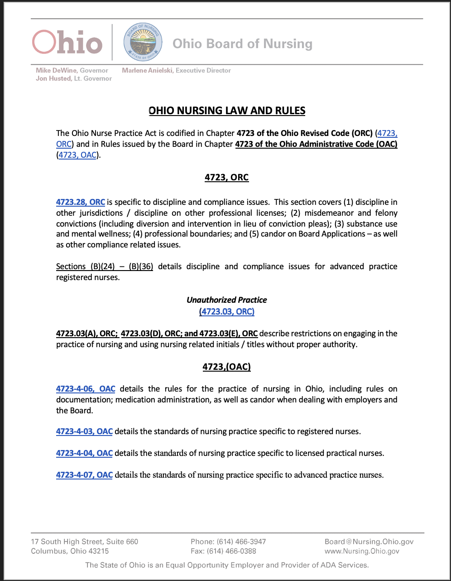
Resources
Pamphlet for employers to provide to out of state MSL holders and employees.
Additional Questions?
Customer Service– 614.466.3947

Slide 30
Resources for Educators
National Council of State Boards of Nursing (NCSBN) is presenting on the next-generation of NCLEX Examinations on November 1, 2023.
Please join us for our Education Workshop on November 2, 2023. The latest Education Workshop is available via our YouTube channel.

Slide 31
Questions?

Slide 32
THANK YOU!
CONTACT INFO:
MAnielski@Nursing.Ohio.Gov
NSiniff@Nursing.Ohio.Gov
JBrubaker@Nursing.Ohio.Gov

