Slide 1


Slide 2
DNR Orders
Robin P. Amicon, JD, BSN, RN
614.464.5466 | rpamicon@vorys.com
Vorys, Sater, Seymour and Pease LLP

Slide 3
Do Not Resuscitate (DNR) Orders
Do-not-resuscitate order or “DNR order” means a directive issued by an authorized health care provider, that identifies a person and specifies that CPR should not be administered to the person so identified.
The do-not-resuscitate-order shall be implemented in accordance with the “do-not-resuscitate protocol”
  standardized method of procedure for the withholding of CPR by physicians, APRNs, PAs, EMS personnel, and health care facilities (including ICFs)
Notes:
Authorized health care provided defined in next slide

Slide 4
Do Not Resuscitate (DNR) Orders
Chapter 3701-62 of the Ohio Admin. Code
  Purpose of law to help individuals communicate their wishes about resuscitation and to protect emergency squads and other health care providers from liability if they follow the DNR orders
A physician, advanced practice registered nurse (APRN), or physician assistant (PA) may issue a DNR order
  APRN = certified nurse practitioner, certified nurse midwife, clinical nurse specialist, certified registered nurse anesthetist

Slide 5
Do Not Resuscitate (DNR) Orders
Forms of DNR Identification:
  DNR Order (Appendix A)
  Hospital-type bracelet with insert (Appendix B)
  Necklace or bracelet with logo (Appendix C) and name
  Wallet card with logo (Appendix D)
  Printed form of living will declaration if specifies on form declarant wishes to use it as DNR identification
Notes:
These are in the appendixes of OAC 3701-62-04. Still need to obtain copy of DNR order from physician, CNP, CNS, or health care facility if using other types of identification (wallet card, bracelet, necklace).

Slide 6
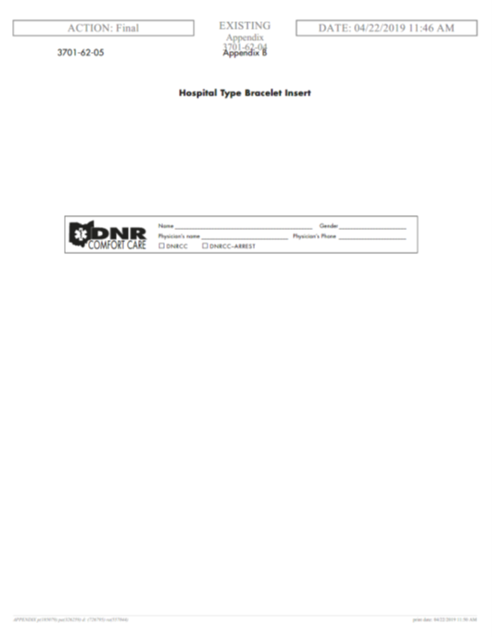
Do Not Resuscitate (DNR) Orders
Notes:
These are in the appendixes of OAC 3701-62-04.

Slide 7
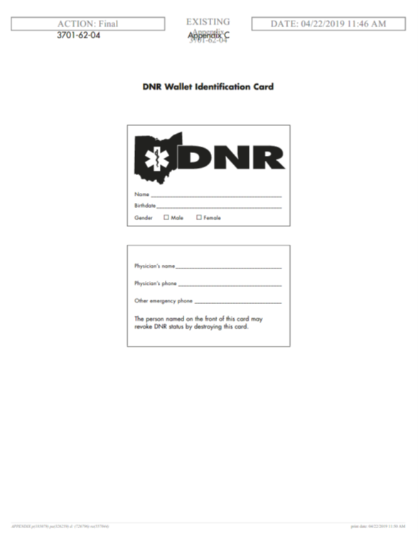

Do Not Resuscitate (DNR) Orders
Notes:
These are in the appendixes of OAC 3701-62-04.

Slide 8
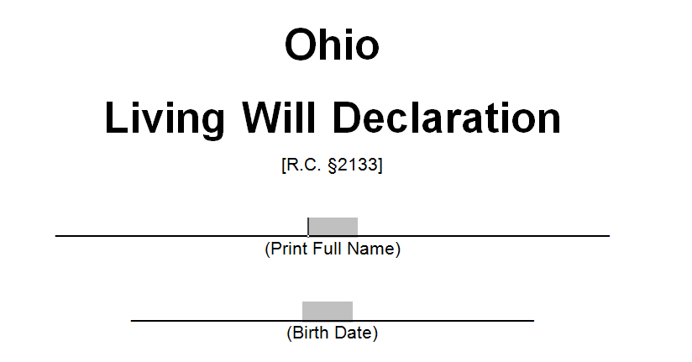
Do Not Resuscitate (DNR) Orders
Notes:
EXAMPLE OF FORMS. Different than a DNR or Last Will and Testament. Sets forth your desire that artificial life-sustaining treatment be withheld or withdrawn ONLY if you are in a permanently unconscious state or terminal condition AND unable to express your desire for treatment

Slide 9
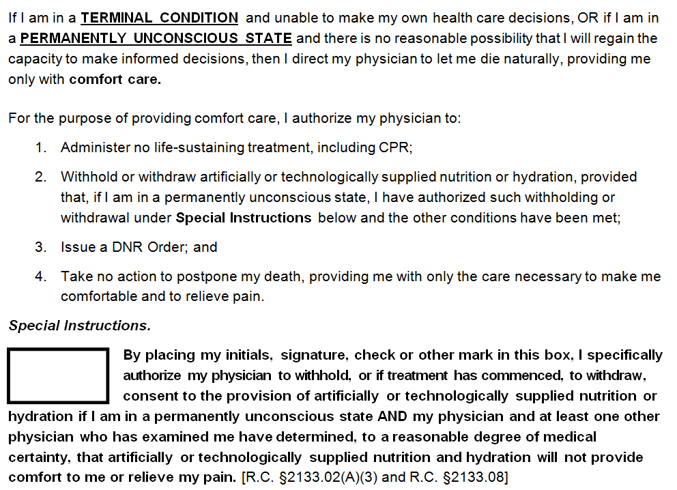
Do Not Resuscitate (DNR) Orders

Slide 10
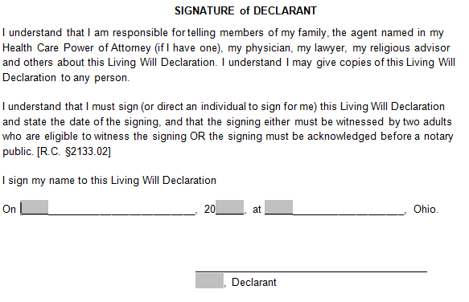
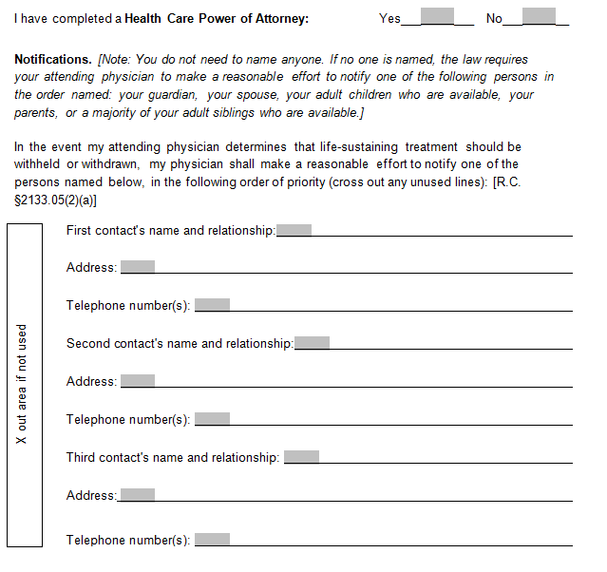
Do Not Resuscitate (DNR) Orders

Slide 11
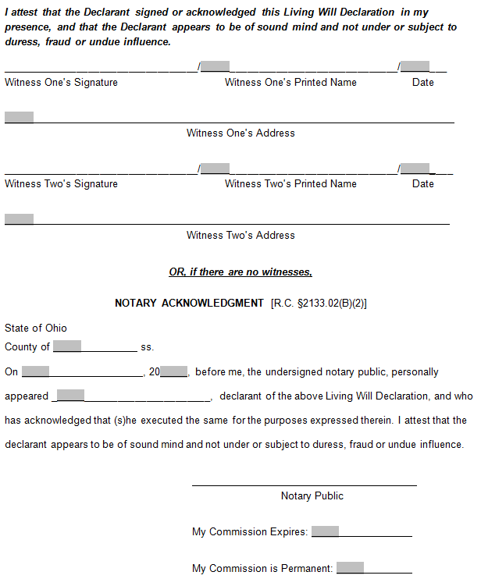
Do Not Resuscitate (DNR) Orders

Slide 12
Do Not Resuscitate (DNR) Orders
DNR Protocols
  DNR Comfort Care
    Activated when DNR order issued or when living will (that includes a directive that the declarant not receive CPR) becomes effective.
  DNR Comfort Care – Arrest
    Activated when individual experiences cardiac arrest (absence of palpable pulse) or respiratory arrest (absence of spontaneous respirations or presence of agonal breathing).
      Permits use of life-saving measures before person’s heart or breathing stops. After, only comfort care may be provided.
Notes:
Located in Appendix to OAC 3701-62-05. Patients can be either DNR Comfort Care patients or DNR Comfort Care – Arrest patients. The
difference is that for a DNR Comfort Care patient, the State of Ohio DNR Protocol is activated
immediately when a DNR order is issued or when a living will requesting no CPR becomes
effective, but for a DNR Comfort Care – Arrest patient, the protocol is activated only when the
patient experiences a cardiac arrest or a respiratory arrest. Be careful to check the patient’s DNR
order or DNR identification to determine which applies.
Agonal respiration, gasping respiration or agonal breathing is an abnormal pattern of breathing and brainstem reflex characterized by gasping, labored breathing, accompanied by strange vocalizations and myoclonus. Possible causes include cerebral ischemia, extreme hypoxia or even anoxia.

Slide 13
Do Not Resuscitate (DNR) Orders
DNR Comfort Care Protocol
  Allows:
    Suction the airway
    Administer oxygen
    Position for comfort
    Splint or immobilize
    Control bleeding
    Provide pain medication
    Provide emotional support
    Contact other appropriate health care providers, such as hospice, home health, attending physicians/APRN/PA
Notes:
Located in Appendix to OAC 3701-62-05.

Slide 14
Do Not Resuscitate (DNR) Orders
DNR Comfort Care Protocol
  Does Not Allow:
    Administer chest compressions
    Insert artificial airway
    Administer resuscitative drugs
    Defibrillate or cardiovert
    Provide respiratory assistance (other than listed on previous slide)
    Initiate resuscitative IV
    Initiate cardiac monitoring
Notes:
Located in Appendix to OAC 3701-62-05.

Slide 15
Do Not Resuscitate (DNR) Orders
Immunity from Liability
  Workers in health care facilities are not subject to any of the following arising out of or relating to the withholding or withdrawal of CPR from a person after DNR identification:
    Criminal prosecution
    Liability in damages for injury, death, or loss of personal property
    Professional disciplinary action
  Also not subject to above liability if after DNR identification, the person makes an oral or written request to receive CPR and person provides CPR pursuant to that request
    Health care facility = hospital, hospice, nursing homes, assisted living facilities, home health agencies, and ICFs/IID
Notes:
Nothing in law that addresses DNR responsibilities for any entities outside of those settings. According to ODH, no requirement for a provider outside of the above definitions to follow the DNR law in Ohio, as law is primarily meant to provide immunity from criminal prosecution, liability etc. to health care providers that follow DNR orders and do not initiate resuscitation measures. So, basically for a licensed residential facility/non ICF, non-licensed group home, and day habilitation setting – the decision regarding advance directives and following DNR protocol is left entirely up to that entity.

Slide 16
Do Not Resuscitate (DNR) Orders
Protocol states “[i]f family or bystanders request or demand resuscitation for person for whom the DNR Comfort Care Protocol has been activated, do not proceed with resuscitation. Provide comfort measures . . . and try to help the family members understand the dying process and the patient’s choice to not be resuscitated.”
  Wheelock v. Doers (Tenn. Ct. App. Sept. 14, 2010): Patient instructed did not want resuscitated and DNR order in chart. Went into cardiac arrest during surgery. Physician instructed medical staff not to administer CPR. Patient’s son shouted “Give him CPR now!” Physician did not revise his DNR order, CPR not administered, and patient died. Wrongful death lawsuit brought by family. Ultimately, court held physician immune from liability for compliance with valid DNR order.

Slide 17
Do Not Resuscitate (DNR) Orders
A person may revoke his/her DNR identification or DNR by oral or written request by:
  Destroying the DNR form or wallet card
  Permanently removing the bracelet or necklace
  Revoking the living will declaration
Notes:
The authorized health care provider of a person with a DNR order may revoke the DNR order by issuing an order discontinuing the DNR order.

Slide 18
Do Not Resuscitate (DNR) Orders
If a person possesses DNR identification and the attending health care provider or facility is unwilling or unable to comply with the DNR protocol for the person, they should not delay or attempt to delay the transfer of the person to a different facility or health care provider where the protocol will be followed
  When a person is transferring from one facility to another, the transferring facility should notify the receiving facility and the persons transporting the person of the existence of the DNR identification or DNR order

Slide 19
Do Not Resuscitate (DNR) Orders
Health care facilities must ensure that one of the following accompany the person to the receiving facility:
  An original or paper copy of the person's written state of Ohio DNR order form signed by an authorized health care provider; or
  DNR identification authorized in rule 3701-62-04 of the Administrative Code (bracelet or necklace, wallet card, copy of living will declaration)
  Person’s DNR identification shall remain in effect until it is revoked

Slide 20
Do Not Resuscitate (DNR) Orders
The death of a person resulting from withholding or withdrawal of CPR based on the DNR order does not constitute suicide, aggravated murder, murder, or homicide
Nothing in the rules condones, authorizes, or approves of mercy killing, assisted suicide, or euthanasia
ODH DNR Resources and Forms: https://odh.ohio.gov/know-our-programs/do-not-resuscitate-comfort-care/resources

Slide 21
QUESTIONS?

Slide 22

Robin P. Amicon, JD, BSN, RN
614.464.5466 | rpamicon@vorys.com

