Slide 1
State of the State in Ohio IDD
November 6, 2013

Slide 2
Environmental Scan
Congress is struggling with multiple life-changing reforms such as health reform, immigration, environmental disasters, and wars
Uncertain political climate – move to social extremes
Health Reform - Medicaid Reform - Managed Care, Exchanges, Expansion, Duals
How DD is funded
FMAP changes
Provider tax elimination, reduction, or expansion

Slide 3
Environmental Scan
States, providers and local government absorbed tremendous cuts
Election, fiscal cliff, deficit reduction, ACA
Companionship exemption, definition of community, Medicaid funding for IDD services
Now some states have projected surpluses
Tax cuts and/or invest in human services, infrastructure, education
Local government/county financial challenges
Long waiting lists – demand management

Slide 4
Environmental Scan
Direct support professional
Turnover (47.2%, up 4.4%)
Salaries at poverty level ($9.54, down $.17 since ‘11)
Staff on public assistance
How system resources are utilized is shifting
Regulatory heavy environment
Role of managed care organizations and systems based on managed care principles
Uncertainty from US DOJ action
Access to health care, technology and information for individuals with IDD
Unsustainable course

Slide 5
State Fiscal Conditions

Slide 6
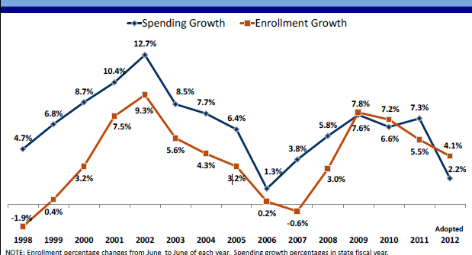
Medicaid Spending & Enrollment

Slide 7
5% Drive 55% of Medicaid Expenditures

Slide 8
Long-Term Care Expenditures Dominate Top 5%

Slide 9
Implications for Our Profession
Quality
Shift focus from inputs to outcomes
Customer defined outcomes
Fundamental system changes through financing reforms that drive policy changes
Risk shared with provider
Funder predictability and accountability
Taxpayer and societal value

Slide 10
Additional Implications
We need to fundamentally change how services are designed and delivered
Importance of focusing on quality in time of diminishing resources
Systems based on person-centered planning and managed care principles
Reinvest efficiency dividends
Direct care wages, benefits, training and supervision
Waiting list
State/county fiscal relief

Slide 11
Questions and Comments
Mark Davis
Ohio Provider Resource Association
1152 Goodale Boulevard
Columbus, Ohio 43212
614-224-6772

