Slide 1
OPRA ICF/MR Committee
February 10th, 2011

Slide 2
Environmental Scan
State of Ohio
$8 Billion budget shortfall
Medicaid Considerations: Loss of EFMAP
Office of Health Transformation
Direction from New Administration

Slide 3
Environmental Scan
Federal Issues
DOJ Initiative
How Ohio Stacks Up:
Private ICF Beds 7-15 (Ohio ranks 4th)
Private ICF Beds 16+ (Ohio ranks 2nd)
Developmental Center (Ohio ranks 7th)

Slide 4
DODD Downsizing Initiative
In Anticipation of DOJ:
Continue DC Downsizing
Challenges: rate structure in ICF’s and HCBS
Committee to Develop Recommendations
Proposal for Budget

Slide 5
Work to Date
ICF Subcommittee process/funding challenges
Rollback vs. Other: Need to Manage
Moving Forward:
Depreciation Recapture
12th Payment
Max Bed Tax @ 6%
IAF Modernization
Modify Reimbursement System??

Slide 6
What Our Members Told Us
Rollback is unsustainable: As an unknown it can’t be managed. It penalizes efficiency.
Inequities within the system need to be addressed.
“Known's” within the system would be preferable, even with cuts. Providers could then manage their resources to a measurable outcome.
More stability/predictability desired.

Slide 7
System Issues Under Consideration
Ohio has high number of ICF beds when compared to the national average.
DOJ initiative.
Downsizing not incentivized in current system: Capital, depreciation recapture.
$8 billion budget hole – no new money.
Administration looking for ideas.
System rebalancing to incentivize efficiency and downsizing.

Slide 8
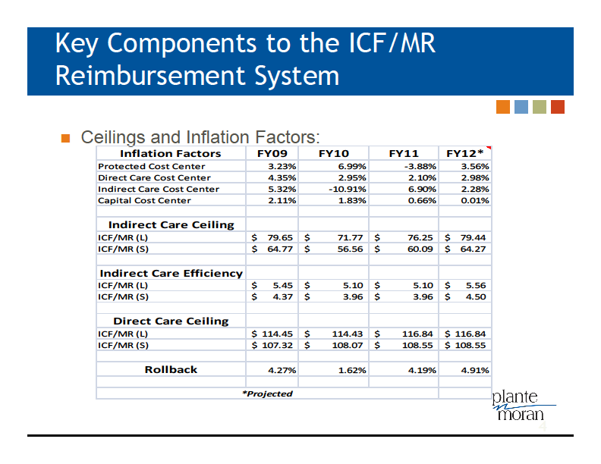

Slide 9
System Funding Issues
FMAP changes
Enhanced FMAP – 69.94%
FMAP – 63.69%
6.25% change is a $31.1 million issue
Increases rollback by 5.76% if funding is lost

Slide 10
Franchise Permit Fee
“Bed Tax” expected increase from 5.5% to 6.0%
Decreased from $14.75 to $13.55 because of anticipated 11 payments in FY2011
.5% increase allows for a $1.40 increase in bed tax or $16.15
Assuming money stays in the system
Generates approximately $2.8 million in GRF
No net gain for FY2012 because providers received an increase in the rate for FY2011.

Slide 11
Analysis of FY 2011 Inflation/Incentives/Rollback

Slide 12
Analysis of Covered Cost (Large vs. Small)

Slide 13
Modified Formulary/2 Year Phase In Assumptions

Slide 14
Current vs. Modified Ceiling & Incentive Comparisons

Slide 15
Impact Statistics

Slide 16
Current vs. Modified Comparisons

Slide 17
Analysis of FY 2011 using Full Modified Formulary

