Slide 1
Ohio Provider Resource Association Environmental Scan & Ohio Health Care Trends September 27, 2017
Maureen M. Corcoran MSN, MBA
Vorys Health Care Advisors, LLC

Slide 2
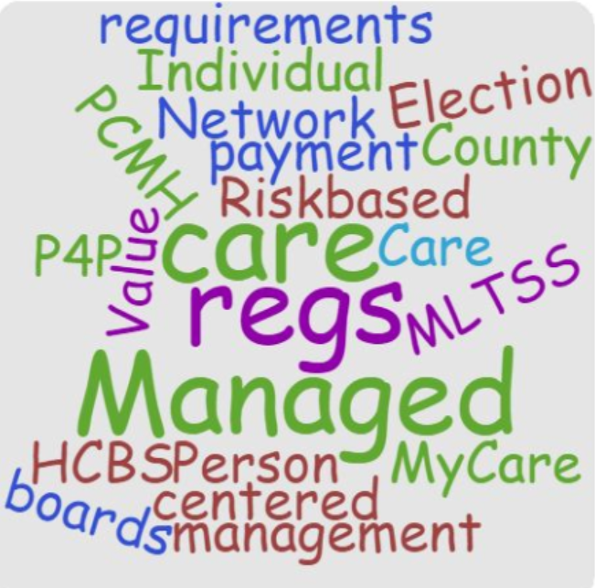

Slide 3
Agenda
Environmental scan
Value based purchasing
Managed care
Provider Considerations: Regulatory Changes & Reframing
Provider Network
Care management & Ohio’s delegation arrangements
Business pressure
Managed Care Quality

Slide 4
Environmental Scan
Federal: Election, tax reform, repeal of Obamacare
Entitlement reform: sooner or later
State of Ohio
Overall ranking of 35 in U.S. News 2017 Ranking of Best States

Slide 5
U.S. News 2017 Ranking of Best States
Overall Rank | 35
Health care | 29 | Access, affordability, quality, health outcomes
Education | 38 | How well educate at different levels
Crime & Corrections | 34 | Public safety, quality & fairness of prison systems, inc. racial bias
Infrastructure | 40 | quality of states' bridges, public transportation, power grids, broadband
Opportunity | 18 | poverty, housing affordability and equality for women, minorities and people with disabilities
Economy | 31 | unemployment rates, GDP growth, migration into the state, patents, new businesses
Government | 12 | transparency, integrity, FISCAL STABILITY and their use of digital technology in serving residents
 |  | FISCAL STABILITY #42 Government budget balancing #20 Government credit rating #16 Pension fund liability#48

Slide 6
State GRF expenditures: Adjusted for inflation, Ohio just now caught up to the budget the first year of recession

Slide 7
Is Ohio state spending wildly out of control?

Slide 8
Environmental Scan
State continued: Gubernatorial election
Local government/county financial challenges
Loss of MCO tax
CMS HCBS regulations on definition of community and person-centered planning
Also implementation of managed care regulations, MHPAEA
Long waiting lists. Chaning needs of an aging group of individuals with IDD
Direct support professional turnover, salaries, benefits
Minimum wage initiatives

Slide 9
Notes:
Where has the income growth been?

Slide 10
Value based purchasing: managed care is the vehicle

Slide 11
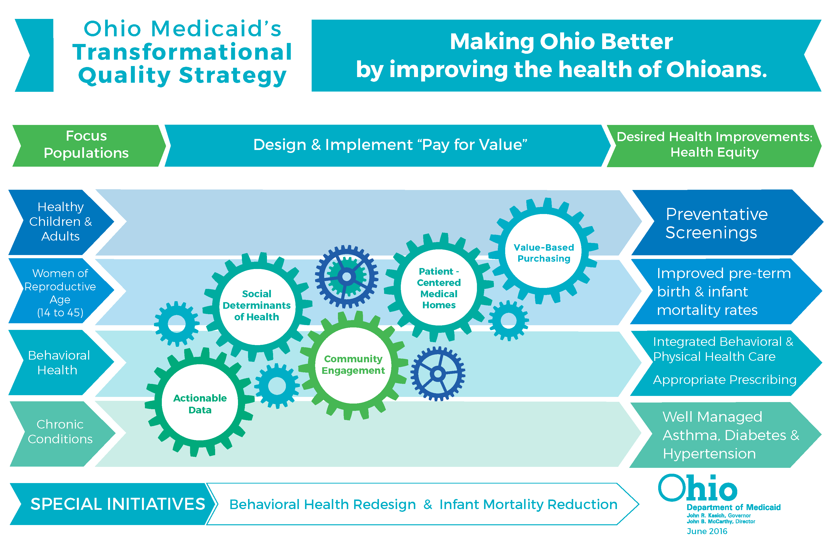
Ohio Medicaid’s Quality Strategy

Slide 12
From Fee-for Service to Value Based Payment
Ohio’s
Value-Based Alternatives to Fee-for Service
Transforming Payment for a Healthier Ohio, July 2016

Slide 13
Medicaid FFS MyCare Beh Health MLTSS
Medicaid MANAGED CARE includes
86% of members
60% of service expenditures
Medicaid MyCare
All Medicaid services are mandatory, Medicare is voluntary
Community BH services carved in for MyCare counties/recipients
Medicaid CARVE-IN BH services into Managed Care
July 1, 2018 scheduled
MLTSS
Plan to carve LTSS into MCOs for Non-MyCare counties, inc. Medicare (Non-IDD, adult dual eligible individuals)- July 2018
On hold-subject to veto override discussions

Slide 14
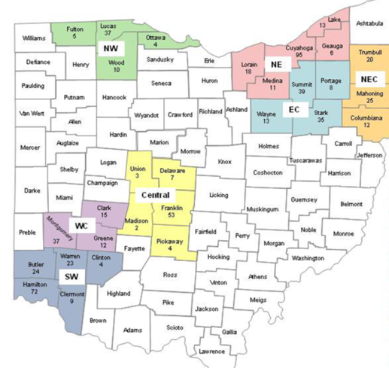
Ohio Medicaid Managed Care Plans (MCPs)
Medicaid MCP STATEWIDE
Medicaid | MyCare
Buckeye | Buckeye
CareSource | CareSource
Molina | Molina
UHC | UHC
Paramount | Aetna
MyCare MCP REGIONAL

Slide 15
MyCare Basics Individuals eligible for M’are & M’aid
Launched in May 2014
Vehicle is 1915(b)/(c) waivers.
Three-way contract with Medicare, Medicaid & ICDS plans
Cap rates include HCBS waiver and behavioral health services
April 2017 enrollment MyCare 107,000
Individuals receiving Waiver service ~22,000
15

Slide 16
Individuals with IDD
Ohio
Total # Dual eligibles Ohio 248,000
107,000 in MyCare
7% of the enrollment & 30% of the cost
Nationally
40% of dual eligible individuals: current Medicare status is “disabled”
41% are under 65 yrs. age
This is why the work that OPRA has done re: analytics & health status is so important!

Slide 17
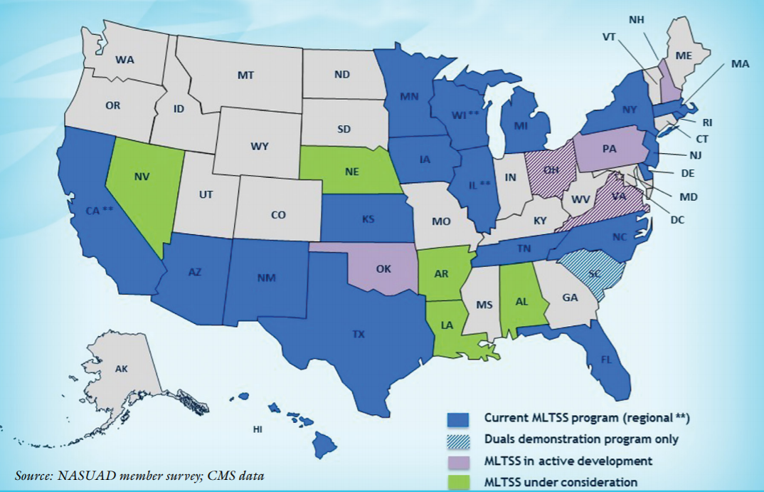
MLTSS Programs 2017

Slide 18
New York State Health Home Model & HARP
MCO
With HARP Benefit
Lead
Health
Home
or
Health Home
Administrative Services, Network Management, HIT data support/data exchange
Down- stream Care Manager Partners
Health Home Care Coordination:
6 HH services
Care Manager
Access to Services:
Primary, Community & Specialty Services Providers

Slide 19
NYS Health Home Model for Individuals with Intellectual and/or Developmental Disabilities – Population Transitioned to Managed Care
Attachment C
Specialized IDD / Managed Care Organizations (MCOs)
(when HH benefit moves into Plan)
Care Coordination Organization/ Health Home (CCO/HH)
Administrative Services, Network Management, HIT Support/Data Exchange
Health Home Core Services
Comprehensive Care Management
Care Coordination and Health Promotion
Comprehensive Transitional Care
Individual and Family Support
Referral to Community and Social Support Services
Use of HIT for Care Plan and to Link Services
HIT EHR/Life Plan
HIT EHR/Life Plan
Network Requirements CCO/HH
Care Managers
Former Medicaid Service Coordinators (MSCs) and other qualified care managers
Access to Needed Primary, Community and Specialty Services**
OPWDD Developmental Disabilities Regional Offices (DDROs), medical care providers (e.g. primary care, ambulatory care, preventive and wellness care, FQHCs, clinics, specialists including hospitals, rehabilitation/skilled nursing facilities, pharmacies/medication management services, home health services, chronic disease self-management and enrollee education services, etc.); developmental disability service providers; long term supports and service providers; dentists; behavioral health care providers (e.g. acute and outpatient mental health, substance abuse services and rehabilitation providers, etc.); regional START teams, and community-based organizations, and social services providers (e.g. public assistance support services, housing services, etc.)
(**Coordinated with Managed Care Plan when population moves to Managed Care)

Slide 20
Remember: it’s all the care, not just LTC/HCBS
Medical care
HCBS
Housing/ Recovery-LTC Supports
Behavioral Health
Home Care
Better Value for $
Prevention & Early Intervention
Population health management
Notes:
May 2016 expect data/benchmarking for costs re IDD population related to 14 TYPES OF EPISODES, INC. Glaucoma, COPD, CHF, DEPRESSION, HTN, CAD, OSTEOARTHRITIS, ASTHMA, GERD AND 5 OR 6 OTHERS

Slide 21
Regulatory changes & Reframing: Provider impact

Slide 22
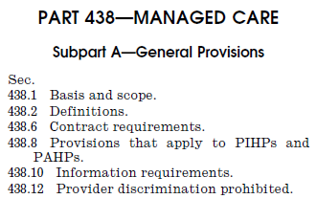
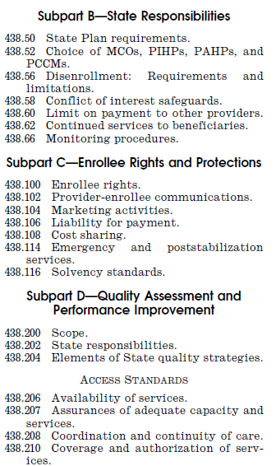
Medicaid Managed Care (MMC) Final Rule
Key provisions
Modernize Medicaid & CHIP MC
Improve Quality of Care for Medicaid Beneficiaries
Strengthen Consumer Experience
Enhance States’ Delivery System Reform Efforts
Increase Accountability, Integrity & Transparency
Strengthen MC Long Term Services & Support
Strengthen CHIP Managed Care
Align with Medicare & Private Plans
States can ask to delay 2018 provisions
SOURCE: Medicaid Managed Care Regulations (42 CFR part 438)

Slide 23
HCBS Regulations
Person-centered planning
Definition of HCBS settings and “Community” standard
Conflict-free case management
Provider owned or controlled
Impacts day and housing/residential services
Divestment of services by county boards
Heightened scrutiny and Presumed not to be
Notes:
206 pages

Slide 24
Medicaid Managed Care
Changing Regulatory Focus
FEDERAL
USC 1931(a) 42 CFR 438
STATE PLAN – FED APPROVE
State Plan Amendment¹ / Waiver
From
Regulation
STATE
ORC 5167
OAC 5160-26
STATE – MCP CONTRACT
MC Provider Agreement²
To
Contract
MCP – PROVIDER CONTRACT
Provider Contract &
Medicaid Addendum³
1. State Plan Amendment, 2. 2017 – 18 MC Care Provider Agreement, 3. Model Medicaid Addenda

Slide 25
Business & Clinical Transformation Model VHCA
1. Describe services, clients’ needs to identify programs
2. Align clients, units & revenue by each program
3.Map program units to new service codes based on Redesign rules
4. Model program options to determine the best clinical model
5. Fulfill action steps to transform business clinical model
Iterative
Interactive
an ongoing process…
COPYRIGHT 2017 VHCA LLC

Slide 26
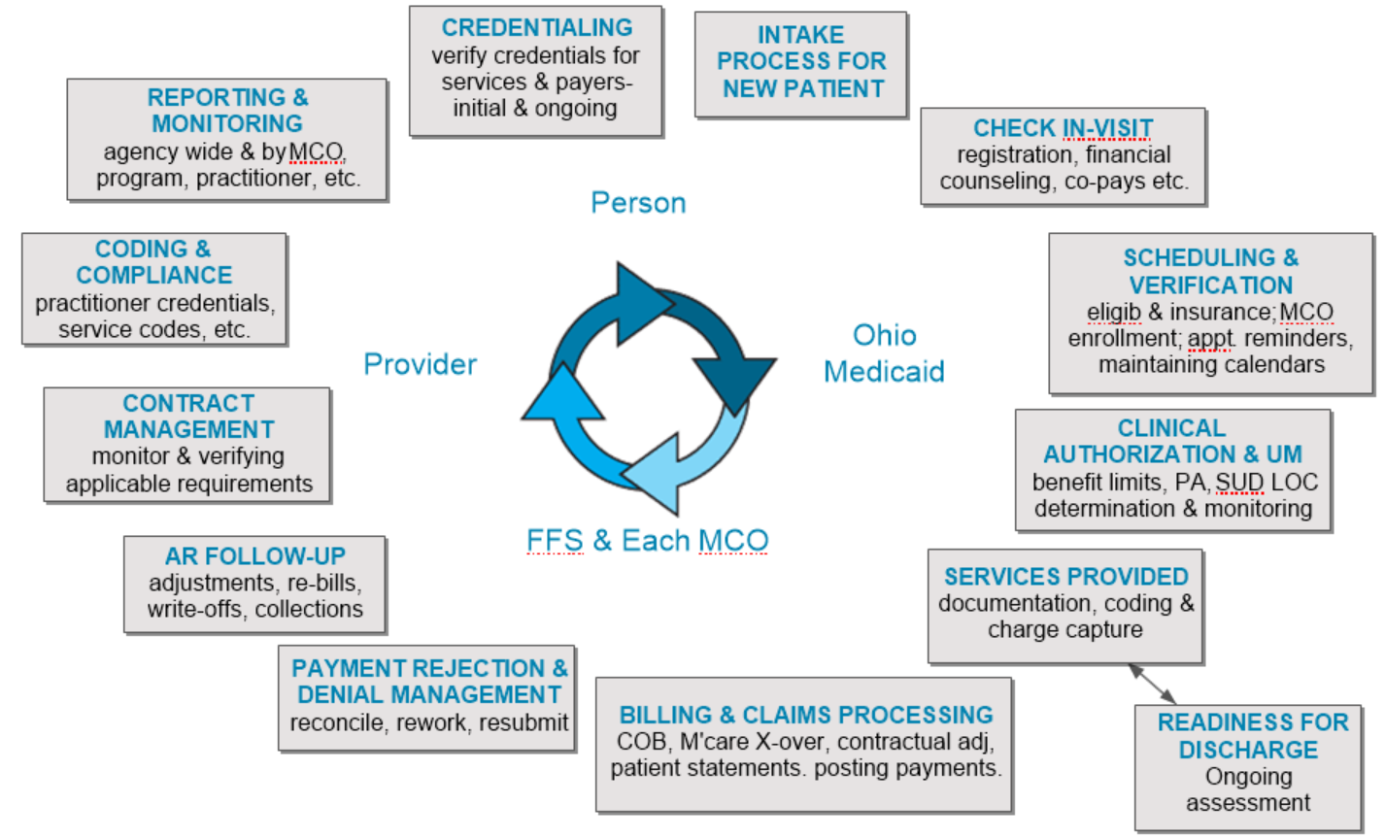
Business & Clinical Transformation: Revenue Cycle Management

Slide 27
Pressure to Collaborate or Consolidate
Each provider will be dealing with several Medicaid payers. Each MCO and FFS has its own requirements
Behavioral Health: as many as 7 different Medicaid payers plus Medicare, commercial and others
It’s easier to deal with fewer entities with a larger geographic footprint, rather than a large number of niche providers.
Pressure to integrate physical and behavioral healthcare
Reimbursement models are changing, incl. accountable systems and practitioners, with responsibility for the ‘whole person’
Value based purchasing and Pay-for-Performance puts pressure on the MCO or hospital/system to control the entire spectrum of services, for both quality and cost reasons…Full Service Providers
Infrastructure costs of information technology, business capabilities and risk sharing require larger, well capitalized organizations; e.g. economies of scale.

Slide 28
Pressure to Collaborate or Consolidate
Capitalization for whole spectrum of business decisions
Survival/cash flow…investment in best practice/workforce to be competitive…growth
Risk: P4P and value based purchasing is all about risk
Business and actuarial risk
It is going to be increasingly difficult to operate independently, except for the very largest providers
OPTIONS
Collaborate: preserve independence but strategically collaborate with other providers to pursue value based arrangements. Examples: PPSs, ACOs, IPAs
Corporate Transaction: pursue a strategic affiliation, such as management agreement, merger, joint venture, corporate substitution. Gives scale by combining operations.

Slide 29
Provider Network Panel

Slide 30
Provider Network
§ 438.68 Network adequacy standards
State must develop & enforce network adequacy standards
Time & distance standards for providers in all geographic areas
(i) Anticipated Medicaid enrollment,
(ii) Expected utilization of services
(iii) Characteristics & HC care needs of covered populations
(iv) Numbers & types of network providers
(v) Numbers of providers - not accepting new Medicaid patients
(vi) Geography of providers & enrollees (distance, time & transportation)
(vii) Communicate with limited English proficiency in preferred language
(viii) Physical access, reasonable accommodation, cultural competence for enrollees with disabilities
(ix) Telemedicine, e-visits & evolving & innovative technological solutions

Slide 31
Provider Panel Specifications
Needs & Capacity
Identify enrollee needs
Determine provider capacity
Access Standards
Max time & distance
Monitoring Adequacy
Define access goals & metrics
Enforcing requirements
Special Populations
Align & project capacity
Timely appointment
Provider: enrollee ratio
Language, culture, physical access
Care models, telehealth & contingency
Reporting
MLTSS
Pediatric
BHC providers -
States must develop standards for BH (includes MH & SUD) providers separately for adult & child BH providers (§438.68(b)(1)(iii) & §457.1218 ) ? MLTSS

Slide 32
Ohio BH Provider Panel Specification Appendix H. Example
NE REGION | CUYAHOGA
PRACTITIONERS
Dentists |  | 187
Gastroenterology |  | 2
- OB/GYN |  | 24
Orthopedists |  | 12
Otolaryngologist |  | 3
Pediatricians |  | 66
- Phy Med Reh |  | 2
Podiatry |  | 4
Psychiatry |  | 5
Urology |  | 2
Vision |  | 32
NE REGION | CUYAHOGA
HOSPITALS
- General Hospital | 1
- Hospital System | 1
County | CMHC | AOD
CUYAHOGA | 28 | 29

Slide 33
Network Standards
Time / distance standards
Maximum travel distance
Provider-to-Enrollee ratios
Wait time to receive service
Facility-based standards

Slide 34
Network Standard Measures State Examples (FL, GA, TN)
Provider to enrollee (FL)
Board certified adult psychiatrists 1:375
Board certified child psychiatrists 1:3500
Travel time or distance to a psychiatrist
Geographic designations (Large metro, Metro, Micro & Rural)
Maximums – Metro 45 minutes & 30 miles
Maximum travel distance (TN)
Outpatient MH, non physician < 30 miles for 100% members
Wait time until receipt of service
Psycho Social Rehab (TN) < 10 business days
O/P SUD (TN) <24 hrs. for detox.
MH providers (GA) < 14 days
MH Case Management (TN) < 7 calendar days
Facility based standard (FL)
SUD Inpatient Detox 1 bed/1000 enrollees
Psych hospital / crisis stabilization 1 bed/2000 children

Slide 35
Ohio Changing Landscape
HCBS
FEDERAL REGULATIONS
Managed Care
BH July 1, 2018
Value-Based Payment 2020
50% of MCP pmts. must be Value-Based
MyCare
PCMH
BH & PH Integration
Episode-Based Payment
Continuing discussions re MLTSS
FEDERAL REGULATIONS
Many Ohio changes
Managed Care
86% of Medicaid members
60% of service expenditures
~ 100% Medicaid members covered by Managed Care

Slide 36
care management

Slide 37
A. MCP Care Management Activities
Assessment
Create an Individualized Care Plan
Plan for Care Transitions
CROSS CULTURAL
Men Are from Mars, Women Are from Venus
Per ODM 7/1/17 Provider Agreement Appendix K (1)(b)

Slide 38
A. MCP Care Management
Each Care Management strategy must include Risk stratification levels.
Framework comprised of five levels (i.e., from lowest to highest: monitoring, low, medium, high and intensive),
MCP will determine the appropriate risk stratification level based on assessed needs.
acuity of chronic conditions, substance use and/or mental health disorders, maternal risk (e.g., prior preterm birth), inpatient or emergency department utilization, and social and/or safety risk factors.
Per ODM 7/1/17 Provider Agreement Appendix K (1)(a)(i)
Notes:
All members <21 years start at high or intensive until assessed

Slide 39
A. MCP Care Management Levels
High & Intensive Risk Management
Each member assigned to the intensive and high risk levels must have an assigned care manager
MCP must use a multi-disciplinary care team when the member’s conditions would benefit
Risk Stratification Level | Required Penetration | Staffing Ratio
Intensive | > 1% | 1:25-1:50
High | > 1% | 1:51-1:100
Per ODM 7/1/17 Provider Agreement Appendix K (1)(b)(v) & (1)(e)

Slide 40
B. Comprehensive Primary Care & Delegation of Care Management

Slide 41
B. Delegation of Care Management
ODM seeks to improve the health of the Ohio Medicaid population by identifying and monitoring individual patients within specified groups
MCP must ensure that each member is in a care management arrangement where the MCP, delegate or a Comprehensive Primary Care (CPC) practice is the designated primary care management entity
Ongoing shift in responsibility for population health (care mgt) from the payor to the provider when willing and capable. The payor, or MCP, must support this provider arrangement
Per ODM 7/1/17 Provider Agreement Appendix K (1)

Slide 42
B. Delegation: My Care Care Management/Service Coordination
Plan care manager = MCO
Waiver service coordinator = Area Agency Aging
The individual will be assigned both a plan care manager and a waiver service coordinator
The care manager will lead and coordinate the individual's trans-disciplinary team and ensure overall coordination between acute care and waiver services
The waiver service coordinator is the waiver service expert who will ensure that all functions under the waiver occur and that health and welfare checks are made as needed
Depending on the structure of the plan’s care management program, the roles of the waiver service coordinator and the care manager may be filled by the same person.
42

Slide 43
B. Delegation: MLTSS Care Management/Service Coordination
Require MCOs to contract with the AAA’s for waiver service coordination with the option of full care coordination
ODM will standardize a comprehensive waiver assessment to be applied across the full spectrum of venues of LTSS programming
Permissive language will allow creativity between the MCP’s and providers of care coordination. It will include the option for incentivized PMPM arrangements
43

Slide 44
B. Delegation: Community BH provider or Network
Referred to as “Model 2”
Include the full array of community behavioral health Medicaid services into MCO contracts
Requires MCO to delegate care coordination to community BH provider or network of providers, in accordance with standards developed by the state
MCO will assess readiness and oversee delegated functions in accordance with state & NCQA requirements
See OHT: Stakeholder Input for Managed Behavioral Health Care Implementation Executive Summary

Slide 45
Payment Reform Marisa

Slide 46
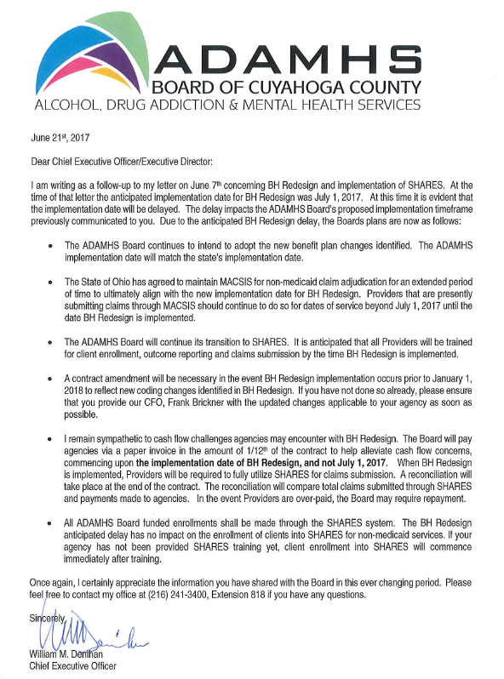
Roles of Ohio’s Community Partners: Non Medicaid Individuals & Services
WHO:
Area Agencies on Aging
Public Children Services Agencies
ADAMH Boards
County Boards of DD
STATE HOSPITAL & STATE DEV CENTER ADMISSIONS
Inc. Coordination with MCOs
Particular areas of Service Overlap/Interplay
Housing & other community supports
OpERATIONAL CONSIDERATIONS

Slide 47
OHIO Managed Care Quality

Slide 48
Ohio MCP Quality Measures
Measures | Descriptions
HEDIS OH MMC Aggregate Report, 2016 | Access, clinical quality, consumer experience trends compared to national benchmarks by population: (1) Healthy Children, (2) Healthy Adults, (3) Women of Reproductive Age, (4) BH & Chronic Conditions
External Quality Review Report, 2015 | External evaluation – MCPN submission, Network & Call Center Access, Complaints & Grievances, Clinical Quality Measures (P4P incentive) , per 42 CFR 438.364
Adult Medicaid Quality Measures, 2014 | CMS Medicaid clinical quality measures for adults
CAHPS MCP Full Report, 2016 | Consumer Assessment of Healthcare Provider Systems annual independent survey of member experience for MMCP & MyCare
Quality of Life Survey OH MMC, 2014 | QOL survey yielding MCP & statewide results

Slide 49
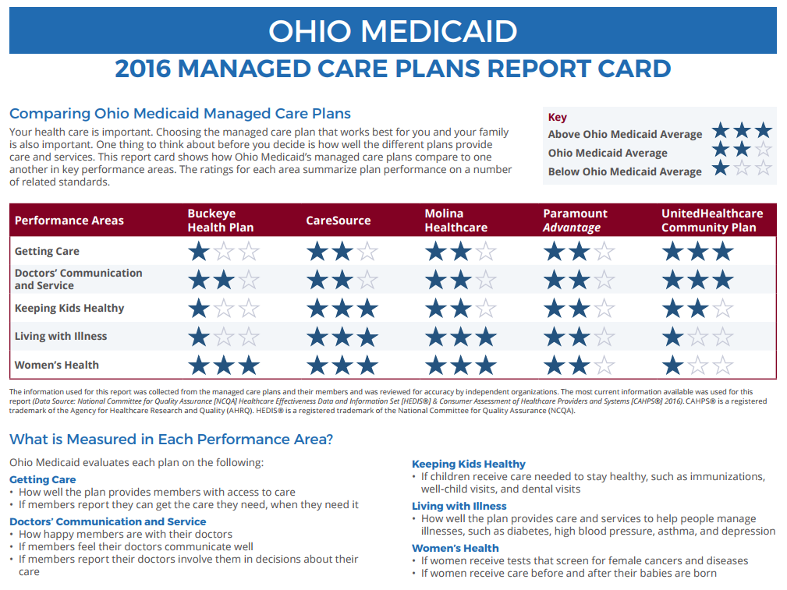
ODM MCP Report Card

Slide 50
MCP Pay for Performance Statewide MCP Self-Reported Audited HEDIS Metrics
100
 | Timeless of Prenatal Care
 | Postpartum Care
 | Follow Up After Hospitalization for MI
 | Controlling High Blood Pressure
 | Appropriate Treatment for Children with URI
 | Diabetes: HbA1c Control (<8.0%)
 | Adolescent Wellcare
MCP self-reported audited HEDIS
P4P 25th to 75th percentile
After 75th MCP awarded 1.25% of premium & delivery payment
25%
5%
2014 HEDIS 2014 national Medicaid percentiles

Slide 51
MCP Pay for Performance
MCP’s Earned $49 M (34%) of $142 M
100

Slide 52
State Experience with MLTSS
Iowa
Arizona

Slide 53
Conclusion
Questions?
Discussion?
Thanks for listening
53

