Slide 1
OPRA Rules Focus Group

Slide 2
OPRA Rules Focus Group
Purpose of this Focus Group/Projected Outcomes
To promote the effective and efficient facilitation of and delivery of service in Ohio’s Developmental Disability System
To identify barriers in existing administrative rules to the effective and efficient delivery of service in Ohio’s Developmental Disabilities System
To propose improvements to administrative rules that increase efficiency and effectiveness
To review proposed administrative rules and advocate for improvements that increase efficiency and effectiveness

Slide 3
OPRA Rules Focus Group
MUI/ UI Rule
Why does this rule exist – what is the underlying purpose/regulatory objective?
The MUI system is set up for the purpose of identifying the cause or contributing factors leading up to the incident and developing prevention plans to reduce the likelihood of the incident occurring again. MUIs are always filed on the victim. The residential provider is also flagged for incidents involving individuals whom they serve. This assists the provider in looking at trends and working with the county board to address them.
This rule established the requirements for addressing major unusual incidents and implements a continuous quality improvement process in order to prevent or reduce the risk of harm to individuals.

Slide 4
OPRA Rules Focus Group
MUI/UI Rule
What issues exist with the current MUI/UI rule and process?

Slide 5
OPRA Rules Focus Group
MUI/ UI Rule
What does the rule really say?

Slide 6
OPRA Rules Focus Group
MUI/UI Rule
Review of other materials related to this rule (FAQs, Memos, Notices, etc.)

Slide 7
OPRA Rules Focus Group
MUI/UI Rule
Alternate approach/language resolution:
Rule recommendations/change in language
Training
Provider Training and Policies/Procedures
County Board Role-Investigative Agents – policies, trainings, approach to DSP, etc.

Slide 8
OPRA Rules Focus Group
Simplification – Efficiencies
Letter sent to Director from OPRA and OACB to address the need for simplification and efficiencies in rules/regulations that are presenting barriers for effective service delivery ---response received from the Director (this committee can have direct impact on what rules/regulations are being addressed.)
Here is a copy of the actual letter:

Slide 9
OPRA Rules Focus Group

Slide 10
OPRA Rules Focus Group
Simplification – Efficiencies
Survey --- Priorities for efficient service delivery (identify top areas to address)

Slide 11
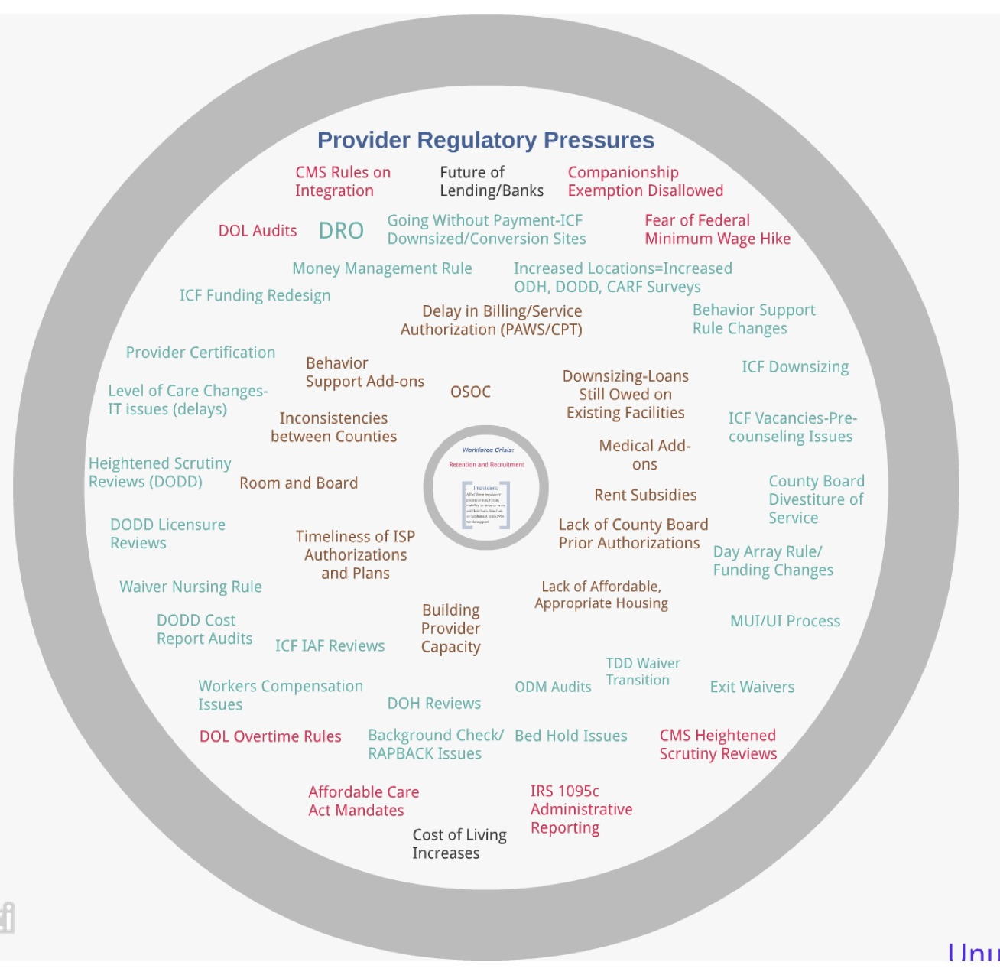
OPRA Rules Focus Group

Slide 12
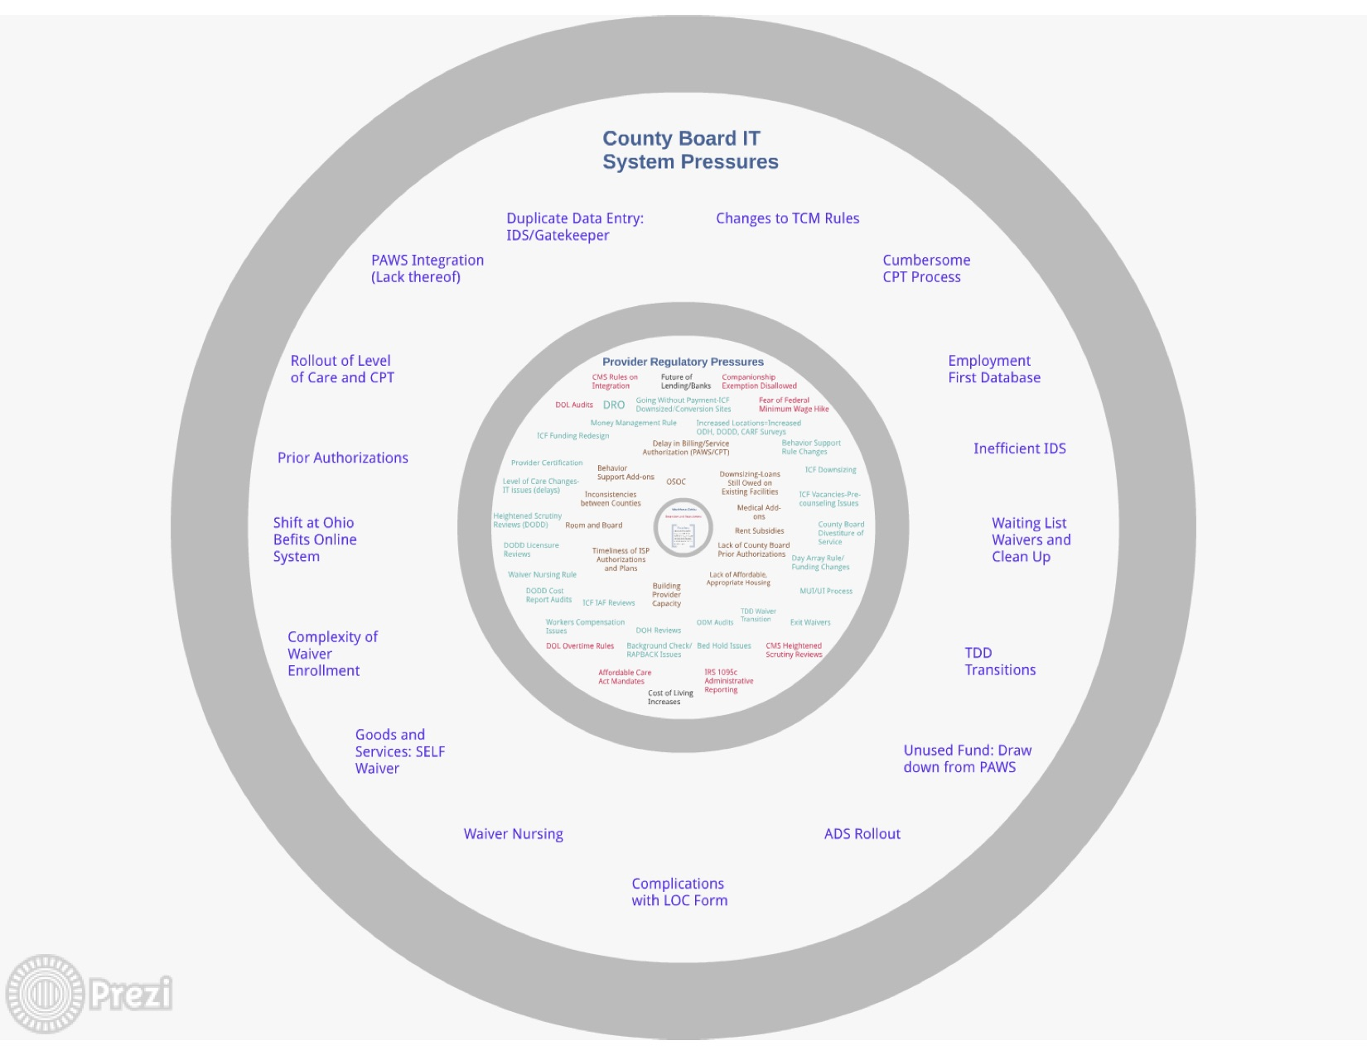
OPRA Rules Focus Group

Slide 13
OPRA Rules Focus Group
Next Meeting: Focus, objectives, outcomes,
who should attend?

Slide 14
OPRA Rules Focus Group

