Slide 1

Leading the Change
OPRA’s Next Six Months

Slide 2

What We Heard
You want:
  Simplification
  Predictability
  Fairness/accountability
  Structural change
  OPRA to lead

Slide 3
Aligning Budget Asks & Modernization Plan
Since modernization plan developed:
Property tax instability
Medicaid budget hole
County board instability
interRAI
FWA narrative
Ongoing growth in demand and acuity
The system is about to be restructured, intentionally or reactively.

Slide 4
Fraud, Waste, and Abuse: A Symptom
Fraud, waste, and abuse are not the root problem, they are a symptom
They result from:
A system too complex to work reliably
A system that pays for activity, not value
A fragmented and duplicative structure
A system that cannot manage access or capacity

Slide 5
Two Goals: Laser Focus
Shape the next administration
Land modernization in the state budget

Slide 6

Shape the Next Administration

Slide 7
Strategy #1
Strategy | Tactics
Be indispensable as a trusted partner in transition planning | Build relationships with both gubernatorial transition teams early and consistently Deliver a concise “First 100 Days” transition brief (OPRA modernization priorities) Offer OPRA as an ongoing advisory partner during transition Align messaging with coalition partners (Budget Coalition, others)

Slide 8
Strategy #2
Strategy | Tactics
Influence leadership selection and agency structure | Identify and vet Director candidates aligned with modernization Build Board consensus around leadership profile and priorities Coordinate quiet coalition support for aligned candidates Engage key decision-makers privately (Governor’s office, senior advisors) Reinforce the importance of maintaining Ohio Department of Developmental Disabilities as a standalone cabinet agency

Slide 9
Strategy #3
Strategy | Tactics
Align political capital to outcomes | Make targeted PAC investments tied to influence priorities Participate in strategic campaign events (both sides) Equip Board and members with consistent transition messaging Activate key providers as local validators with transition teams

Slide 10
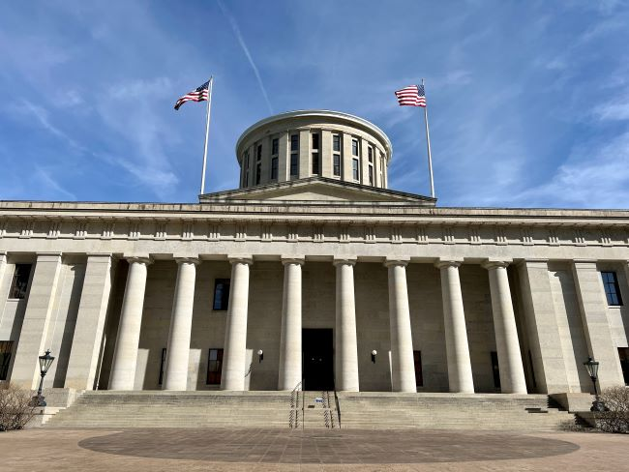
Land Modernization in the State Budget

Slide 11
Strategy #1
Strategy | Tactics
Define a budget-ready policy framework | Translate modernization into specific, fundable proposals: Predictable rate framework (with defined methodology) Enhanced rates for quality & specialized services (waiver and ICF) Structural reforms (assessment, provider enrollment, risk-based monitoring) Develop draft budget language and fiscal framing Ensure proposals are administratively feasible (not conceptual)

Slide 12
Strategy #2
Strategy | Tactics
Build legislative champions early | Identify and engage key legislators (House, Senate, Finance Committees) Conduct targeted briefings (not broad education—focused influence) Equip champions with talking points and district-level impact Align messaging with broader Medicaid and workforce priorities

Slide 13
Strategy #3
Strategy | Tactics
Center the voices of people and families | Develop a tight narrative: What’s not working today (access, instability, inconsistency) What better looks like (predictability, quality, outcomes) Elevate voices strategically (not broadly): Include individuals/families in key legislative conversations Curate a small number of high-impact stories tied directly to policy asks Integrate quotes/testimonials into budget materials Create structured input opportunities: Focused listening sessions tied to specific proposals Feedback loops on modernization concepts Partner with advocacy organizations where aligned Ensure every policy answer connects to: “How does this improve the experience of people and families?”

Slide 14
Strategy #4
Strategy | Tactics
Align stakeholders around a shared problem and solution | Frame modernization around 2–3 core system problems: Misaligned incentives (volume over value) Unpredictable and inequitable funding Administrative fragmentation/inefficiency Build alignment with: Providers County Boards (where possible) Partner associations Use consistent, solution-oriented language across all groups Minimize public fragmentation or conflicting policy signals

Slide 15
Strategy #5
Strategy | Tactics
Prepare for execution, not just passage | Engage Ohio Department of Medicaid and Ohio Department of Developmental Disabilities early on feasibility Identify what requires: Budget language Waiver authority Rule changes Develop an implementation “Phase 1” roadmap to show readiness Anticipate opposition and prepare counters (cost, disruption, etc.)

