Slide 1

Funding Overview
Clay Weidner
Department of Developmental Disabilities
Division of Fiscal Administration

Slide 2
State Revenue Sources

Slide 5
State Expenditures

Slide 7
$40.62 billion

Slide 8
State Medicaid Expenditures

Slide 9
CAGR = 5.73%

Slide 12
Ohio DD Expenditures

Slide 15
Funding Source | People Served | Average Cost | Providers | State Funding | Federal Funding | Local Funding
Locally-Funded Programs | 60,100 | $17K | N/A | $90M | $225M | $753M
Home and Community-Based Waivers | 44,000 | $84K | 13,600 | $757M | $2,382M | $552M
Intermediate Care Facilities | 4,300 | $184K | 420 | $281M | $509M | $0
State-Operated Intermediate Care Facilities | 600 | $395K | 8 | $117M | $120M | $0
Totals | 109,000 | $53K | 14,028 | $1,245M | $3,236M | $1,305M
Notes:
Local funding is from 2024 CBCP actuals (state revenue, federal revenue, & levy/misc/other local less waiver match

Slide 18
How Does Ohio Compare Nationally?

Slide 22
Local DD Funding

Slide 23
CY24 CB Cost Report Program Expenses* |  |  |  | CY24 CB Expenses (5-year cost projection)
Waiver Match | 36% | $620M |  | Personnel Expenses | 42% | $718M
SSA | 15% | $262M |  | Waiver Match | 33% | $555M
Non-Federal Reimbursable | 9% | $158M |  | Locally-Funded Services | 14% | $239M
Children 0-2 | 9% | $148M |  | Other Expenses | 11% | $175M
Community Residential | 8% | $137M
Children 6-21 | 7% | $115M
MAC | 6% | $97M
Adult Program | 4% | $70M
Children 3-5 | 4% | $60M
ICF | 2% | $31M
Family Resources | 2% | $25M
Total Expenses-$1.7 Billion |  |  |  | Total Expenses-$1.7 Billion
Notes:
*As submitted as of 8/8/25

Slide 27
Financial Risks to the System

Slide 28
Changes to Medicaid funding at the Federal level
Block grants, per capita limits, provider tax limitations, etc.
Economic downturn
Reduction in state revenue
Previously bailed out by increased FMAP..…would that happen again?
Growth in Medicaid spending as a percentage of state revenue
Total Medicaid spending outpaces state revenue growth
Growing focus on local property taxes
Virtual bipartisan agreement that change is needed
Will levy passage rates suffer?
Demographic trends
Economic impact of population trends
Increasing demand for services

Slide 29
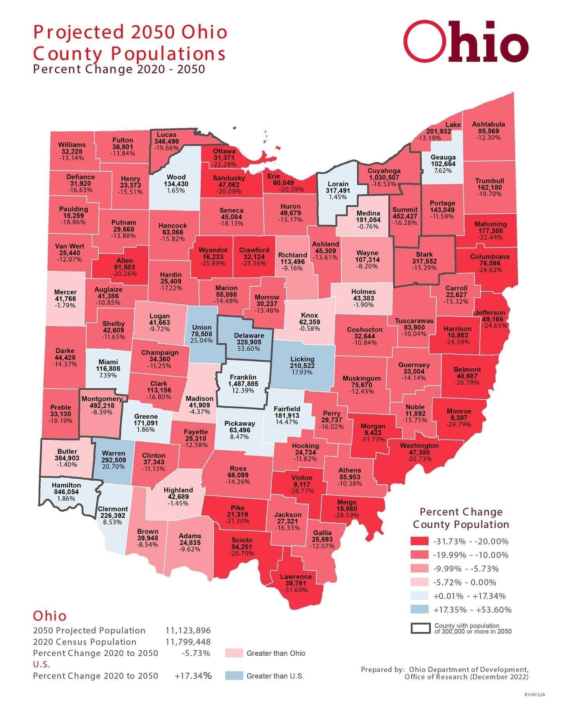

Slide 30
Age Group | End of June 2018 | End of June 2025 | Annual Growth Rate | Unmet Need for Waiver Services <1 Year | Unmet Need for Waiver Services within 30 days
< 18 | 39,238 | 49,434 | 3.35% | 617 | 23
18 - 21 | 7,581 | 8,459 | 1.58% | 557 | 36
>22 | 46,517 | 51,102 | 1.35% | 806 | 67
Totals | 93,336 | 108,995 | 2.24% | 1,980 | 126

Slide 31
Questions?

