Slide 1
Guiding Principles and Strategic Plan-2024 Annual Report

Slide 3
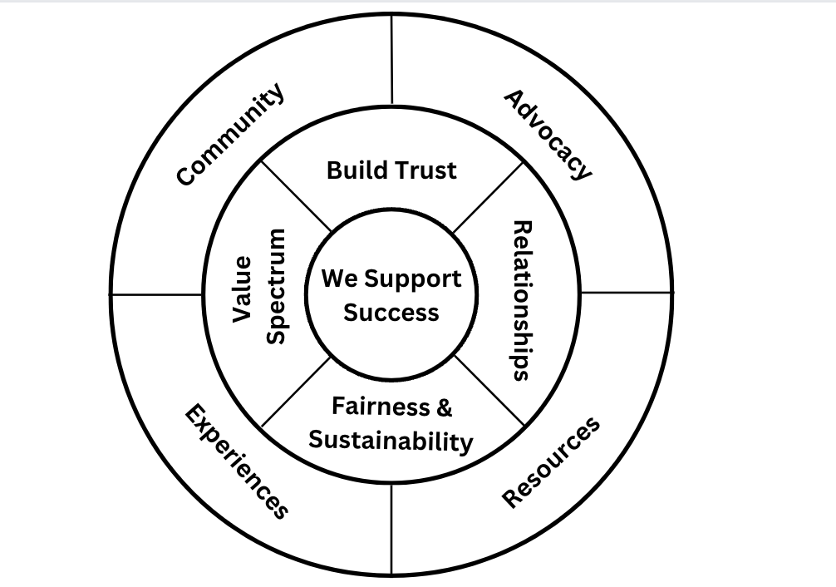

Slide 4
The Why
OPRA and its members are focused on supporting the success of Ohioans with intellectual and developmental disabilities.

Slide 5
Principle #1
We believe the primary focus of our work is the positive and supportive relationship between front-line professionals and the people they support.

Slide 6
Principle #2
We believe providers should be supported and trusted to support people with developmental disabilities and operate effective and successful organizations.

Slide 7
Principle #3
We believe providers must be sufficiently compensated to deliver essential services to meet the needs of the people they support in an ever-evolving society and system.

Slide 8
Principle #4
We believe all services currently provided across the spectrum of services should be recognized as crucial to each and every person we serve.

Slide 9
Core C.a.r.e Activities
Community
Friday Calls
District Meetings
Scream Rooms
ListServs
In-person visits, trainings and board meetings.
Advocacy
Budget
Rules
Legislation
Workgroups
Federal
Resources
Friday 5 Newsletter
Committee Meetings
Town Hall Tuesdays
Technical Assistance
Communication Guides
Experiences
Regular Conferences
PAC Outings
Online Training Offerings
Advocacy Opportunities

Slide 10
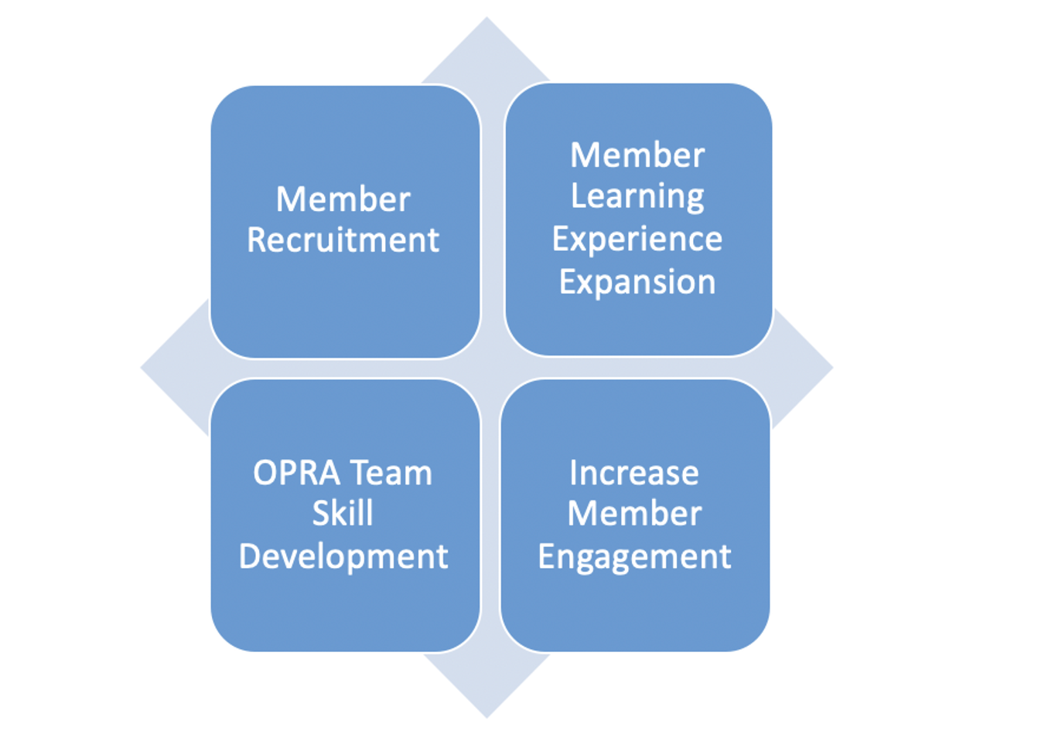

Slide 11
New C.a.r.e Activities
Community
Professional Networks (CEO, CFO, PD, Qs)
Restructured Policy Core Committee
Bi-monthly Newsletter
Family Organizations
Regular meeting w/OADSP
Quality Pilot Workgroup
Advocacy
Legislative
Lauren’s Law
HB 427-14c
Never Alone Act
Federal
DOL/Overtime
CMS Rules
SOC Code Bill
3 Advocacy Events in DC
Resources
ADS Pilot Support and Workgroup
Issue 2 Resources
New Compensation & Benefits Survey
New Vendor Partners; Reidy and Giv
Works 4 Me SME and Family Engagement
ES Coach and ICI
Experiences
Spring Business Retreat 2024
CEO/DOO Training
Just Culture Learning Collaborative
Advocacy Army
Increased Member Trainings
New PAC Events-CAVS
Rules
MUI
BEST/PRE-Voc
NMT to CIE
OOD Fee Schedule
Compliance Survey
Disability ‘Signage’
Budget Investment Data Collection

