Slide 1
Agency Quarterly Workforce Impact Survey 2023 Quarter 4
Wednesday, February 21, 2024

Slide 2
154
Total Responses
Date Created: Wednesday, January 17, 2024
Complete Responses: 154

Slide 3
Q4: From the period of October 1, 2023-December 31, 2023, were you able to take on new referrals?
Answered: 128 Skipped: 26

Slide 4
Q4: From the period of October 1, 2023-December 31, 2023, were you able to take on new referrals?
Answered: 128 Skipped: 26
ANSWER CHOICES | RESPONSES
Yes | 72.66% | 93
No | 27.34% | 35
TOTAL |  | 128

Slide 5
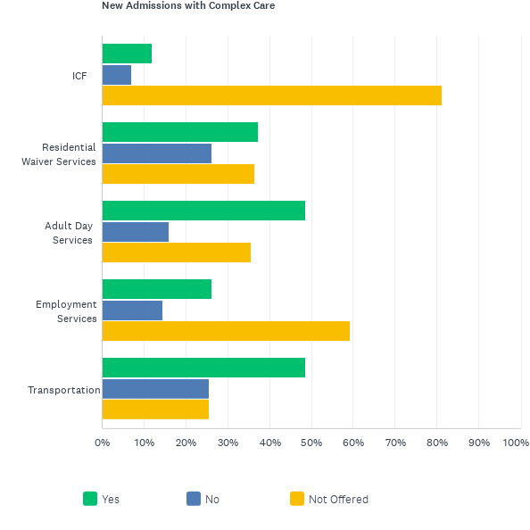
Q5: From the period of October 1, 2023-December 31, 2023, please select all of the statements that apply to your ability to take on new referrals in each service line. If your agency does not provide a given service, please select "Not Offered."
Answered: 122 Skipped: 32

Slide 6
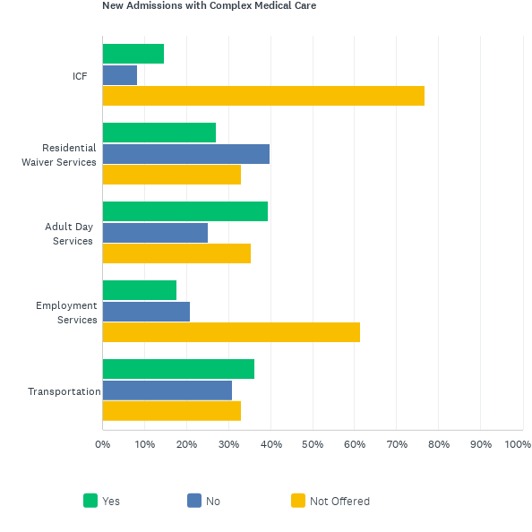
Q5: From the period of October 1, 2023-December 31, 2023, please select all of the statements that apply to your ability to take on new referrals in each service line. If your agency does not provide a given service, please select "Not Offered."
Answered: 122 Skipped: 32

Slide 7
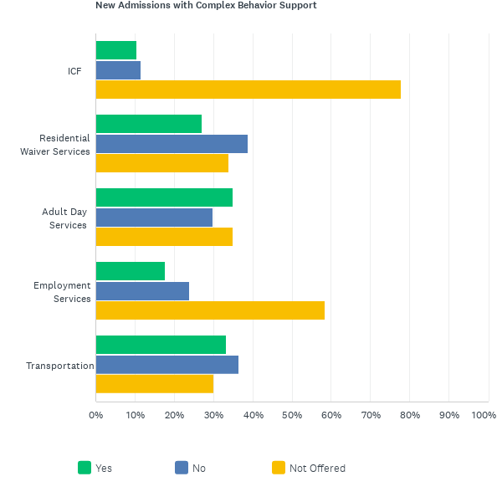
Q5: From the period of October 1, 2023-December 31, 2023, please select all of the statements that apply to your ability to take on new referrals in each service line. If your agency does not provide a given service, please select "Not Offered."
Answered: 122 Skipped: 32

Slide 8
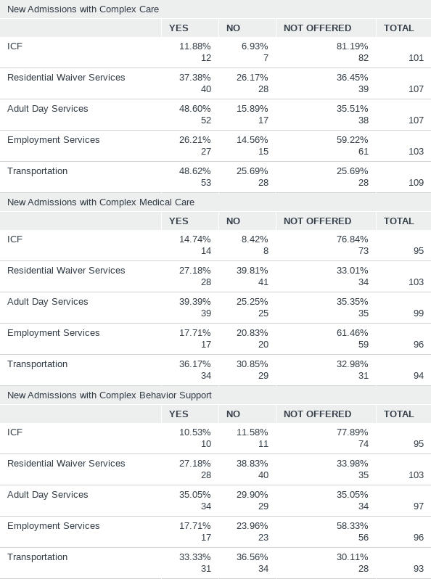
Q5: From the period of October 1, 2023-December 31, 2023, please select all of the statements that apply to your ability to take on new referrals in each service line. If your agency does not provide a given service, please select "Not Offered."
Answered: 122 Skipped: 32

Slide 9
Q6: From the period of October 1, 2023-December 31, 2023, did you serve notice/discharge people you serve primarily as a result of staffing shortages?
Answered: 122 Skipped: 32

Slide 10
Q6: From the period of October 1, 2023-December 31, 2023, did you serve notice/discharge people you serve primarily as a result of staffing shortages?
Answered: 122 Skipped: 32
ANSWER CHOICES | RESPONSES
Yes | 18.03% | 22
No | 81.97% | 100
TOTAL |  | 122

Slide 11
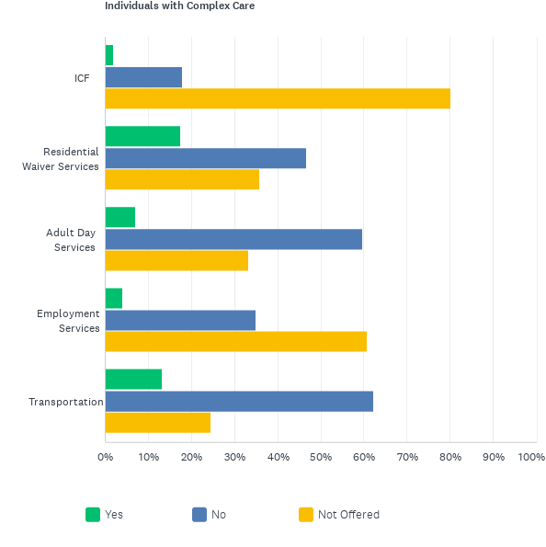
Q7: From the period of October 1, 2023-December 31, 2023, did you serve notice/discharge people you serve primarily as a result of staffing shortages? If your agency does not provide a given service, please select with "Not Offered."
Answered: 110 Skipped: 44

Slide 12
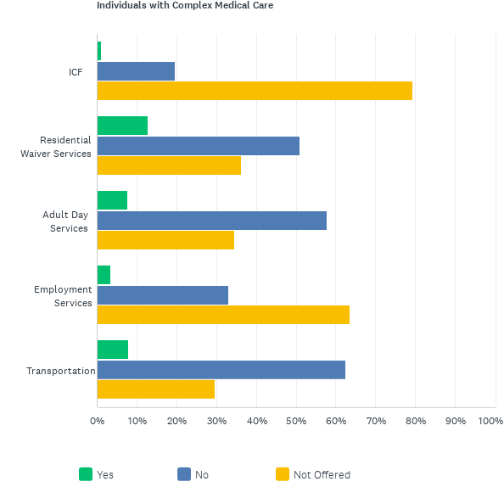
Q7: From the period of October 1, 2023-December 31, 2023, did you serve notice/discharge people you serve primarily as a result of staffing shortages? If your agency does not provide a given service, please select with "Not Offered."
Answered: 110 Skipped: 44

Slide 13
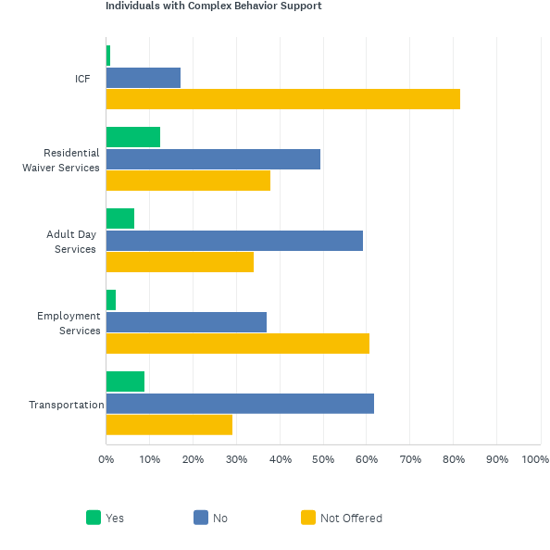
Q7: From the period of October 1, 2023-December 31, 2023, did you serve notice/discharge people you serve primarily as a result of staffing shortages? If your agency does not provide a given service, please select with "Not Offered."
Answered: 110 Skipped: 44

Slide 14
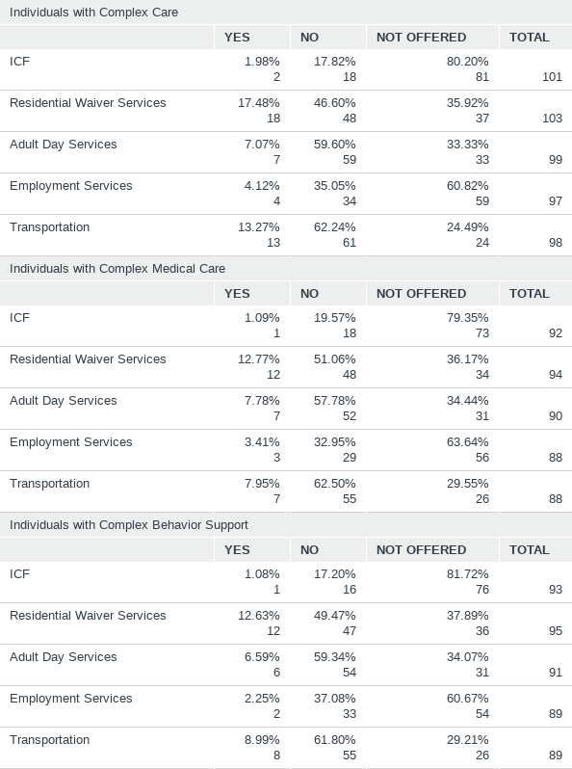
Q7: From the period of October 1, 2023-December 31, 2023, did you serve notice/discharge people you serve primarily as a result of staffing shortages? If your agency does not provide a given service, please select with "Not Offered."
Answered: 110 Skipped: 44

Slide 15
Q8: From the period of October 1, 2023-December 31, 2023, about how many people did you serve notice to or discharge as a result of staffing shortage? If your agency does not provide a given service, please select "Service Not Offered."
Answered: 118 Skipped: 36

Slide 16
Q8: From the period of October 1, 2023-December 31, 2023, about how many people did you serve notice to or discharge as a result of staffing shortage? If your agency does not provide a given service, please select "Service Not Offered."
Answered: 118 Skipped: 36
 | SERVICE NOT OFFERED | 0 | 1-5 | 6-10 | 10-25 | 26-50 | 50+ | TOTAL | WEIGHTED AVERAGE
ICF | 79.82% 87 | 19.27% 21 | 0.92% 1 | 0% 0 | 0% 0 | 0% 0 | 0% 0 | 109 | 1
Residential Waiver Services | 32.74% 37 | 49.56% 56 | 14.16% 16 | 1.77% 2 | 0.88% 1 | 0.88% 1 | 0% 0 | 113 | 1
Adult Day Services | 31.86% 36 | 58.41% 66 | 7.08% 8 | 0% 0 | 2.65% 3 | 0% 0 | 0% 0 | 113 | 1
Employment Services | 59.26% 64 | 37.04% 40 | 1.85% 2 | 1.85% 2 | 0% 0 | 0% 0 | 0% 0 | 108 | 1
Transportation | 20.18% 22 | 66.06% 72 | 10.09% 11 | 1.83% 2 | 0.92% 1 | 0.92% 1 | 0% 0 | 109 | 1

Slide 17
Q9: From the period of October 1, 2023-December 31, 2023, please select the statement that best matches your staffing capacity in each service. If your agency does not provide a given service, please select "Service Not Offered."
Answered: 118 Skipped: 36

Slide 18
Q9: From the period of October 1, 2023-December 31, 2023, please select the statement that best matches your staffing capacity in each service. If your agency does not provide a given service, please select "Service Not Offered."
Answered: 118 Skipped: 36
 | SERVICE NOT OFFERED | STAFFING CAPACITY HAS GREATLY DECREASED | STAFFING CAPACITY HAS SLIGHTLY DECREASED | STAFFING CAPACITY HAS STAYED THE SAME | STAFFING CAPACITY SLIGHTLY INCREASED | STAFFING CAPACITY GREATLY INCREASED | TOTAL | WEIGHTED AVERAGE
ICF | 81.82% 90 | 4.55% 5 | 1.82% 2 | 2.73% 3 | 6.36% 7 | 2.73% 3 | 110 | 1
Residential Waiver Services | 31.30% 36 | 15.65% 18 | 19.13% 22 | 24.35% 28 | 8.70% 10 | 0.87% 1 | 115 | 1
Adult Day Services | 32.14% 36 | 13.39% 15 | 9.82% 11 | 36.61% 41 | 6.25% 7 | 1.79% 2 | 112 | 1
Employment Services | 59.63% 65 | 6.42% 7 | 1.83% 2 | 26.61% 29 | 4.59% 5 | 0.92% 1 | 109 | 1
Transportation | 21.43% 24 | 13.39% 15 | 16.07% 18 | 39.29% 44 | 8.93% 10 | 0.89% 1 | 112 | 1

Slide 19
Q10: From October 1, 2023 to December 31, 2023, how do you feel your agency's overall ability to provide quality in all of your agency's DD services was impacted?
Answered: 114 Skipped: 40

Slide 20
Q10: From October 1, 2023 to December 31, 2023, how do you feel your agency's overall ability to provide quality in all of your agency's DD services was impacted?
Answered: 114 Skipped: 40
ANSWER CHOICES | RESPONSES
Our ability to provide quality services has greatly decreased. | 5.26% | 6
Our ability to provide quality services has slightly decreased. | 19.30% | 22
Our ability to provide quality services has stayed the same. | 44.74% | 51
Our ability to provide quality services has slightly increased. | 20.18% | 23
Our ability to provide quality services has greatly increased. | 7.02% | 8
Other (please specify) | 3.51% | 4
TOTAL |  | 114

