Slide 1
Guiding Principles and Strategic Plan-2023 and Beyond

Slide 3
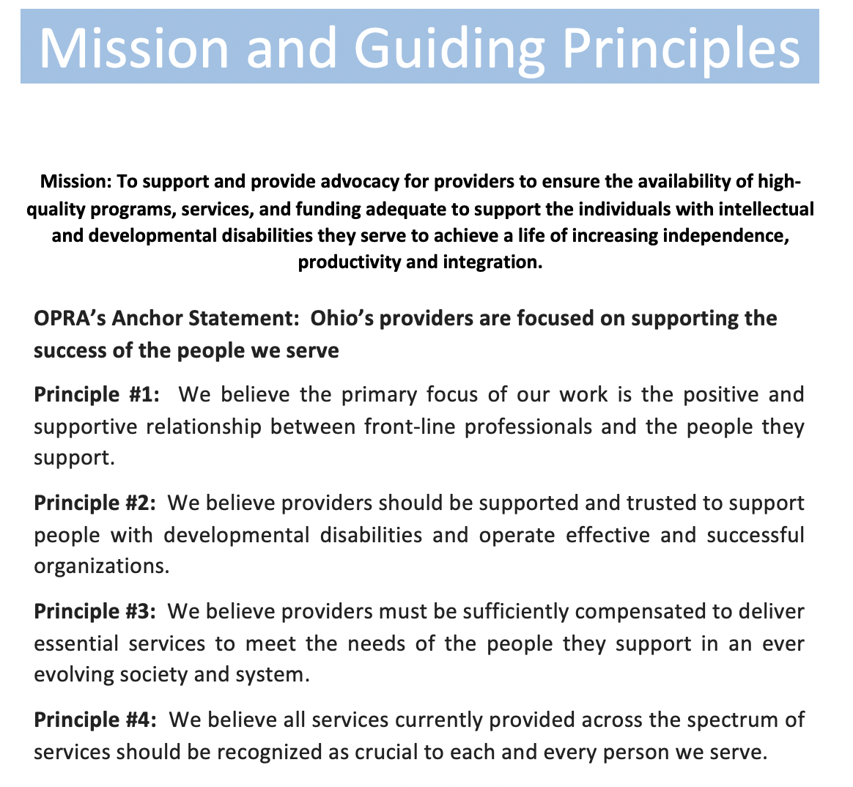

Slide 4
The Why
OPRA and its members are focused on supporting the success of Ohioans with intellectual and developmental disabilities.

Slide 5
Core C.a.r.e Activities
Community
  Friday Calls
  District Meetings
  Scream Rooms
  ListServs
  In-person visits, trainings and board meetings.
Advocacy
  Budget
  Rules
  Workgroups
  Federal
Resources
  Friday 5 Newsletter
  Committee Meetings
  Town Hall Tuesdays
  Technical Assistance
  Communication Guides
Experiences
  Regular Conferences
  PAC Outings
  Online Training Offerings
  Advocacy Opportunities

Slide 6
Principle #1
  We believe the primary focus of our work is the positive and supportive relationship between front-line professionals and the people they support.

Slide 7
Budget advocacy approach centered on including people with disabilities, families, providers and community members to share their stories and make the case for state investment in services. Approach was intended to enhance advocacy relationships and effectiveness, as well as to fight for supports that enhance service relationship.
Advocated and collaborated with system partners to operationalize the ‘Retention Bonus’ program, providing an opportunity and resource to support staff through quarterly bonuses while continuing to advocate for rate increases through state operating budget.
Development of approach to Waiver Redesign work, focused on Guiding Principles and addressing system ‘pain points’ in delivering waiver services. Began contract with Chris Whistler to help lead this work.
Continued advocacy for 16/17 year old and GED for DSP or DSA positions through Budget coalition regulatory reform workgroup. Waiver implemented in 2021 and renewed again this September.
Advocated in partnership and in support of our national partners at ANCOR on a bill to create a Standard Occupational Code for DSPs, creating a new data and analytical tool to be able to assess and determine appropriate wage levels for DSPs in an ‘apples to apples’ way. Senate bill 1332, the "DSP SOC bill", recently advanced by unanimously passing through the HSGAC (Homeland Security and Governmental Affairs Committee)

Slide 8
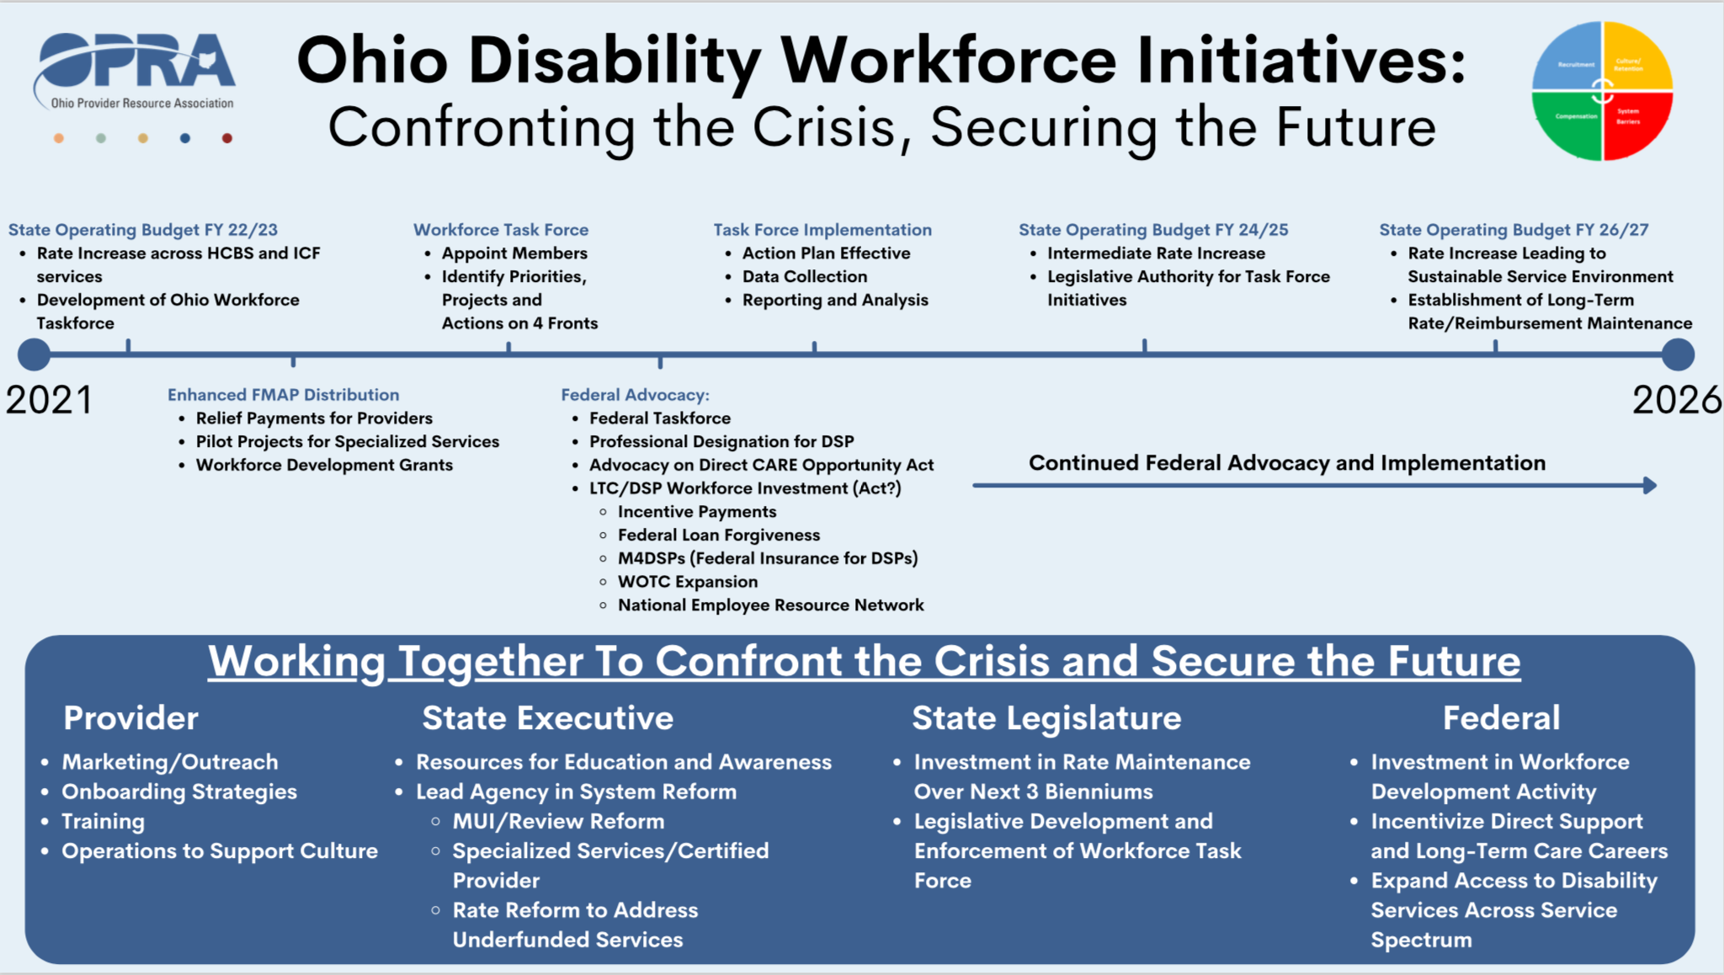

Slide 9
Principle #2
  We believe providers should be supported and trusted to support people with developmental disabilities and operate effective and successful organizations.

Slide 10
Advocated and collaborated with DODD and system partners to rework Blueprint ‘Quality Proposals’ for ADS and Voc Hab services to develop 2 new pilot projects, set to begin in late 2023 and early 2024 in ADS and Employment services.
Advocacy on Federal “HCBS Access Rule” and it’s 80/20 requirement, which proposed to require providers to utilize at least 80% of their revenue towards direct support wages.
Led provider sub-group to explore administrative and indirect costs associated with ADS and Voc services for Blueprint.
As relevant rules opened this year, used opportunity to advance distinction of ‘quality’ providers in good standing in relevant compliance/review rules.
Outreach and ongoing communication with new OSSAS Director, Lisa Burt. Ongoing advocacy and discussion with Director Hauck on oversight reform and inclusion in coalition regulatory reform proposal.
Intentional focus of national work, to connect with and understand other state quality, oversight to establish best and promising practices.
Development and sharing of resources to help providers navigate and communicate rate increases.

Slide 11
Advocacy on several rules that would impact provider autonomy including;
  ODM PHE Unwinding
  Compliance Reviews-Licensed and HCBS
  Non-Medical Transportation
  Several ICF rules
  Home-delivered Meals
  Employment First
  Suitability of Settings

Slide 12
Principle #3
  We believe providers must be sufficiently compensated to deliver essential services to meet the needs of the people they support in an ever-evolving society and system.

Slide 13
Led budget effort resulting in historic funding of DD system. Worked with stakeholder coalition to organize effective advocacy approach, legislative outreach, data collection, witness testimony, departmental and executive outreach and gratitude campaign.
Successfully advocated against DODD/Milliman Blueprint proposal, which would have resulted in a significant cut in funding for the most commonly-accessed ADS supports.
Advocated in support of OOD budget investments and corresponding development of provider-led workgroup to apply investment to fee schedule services. Additionally, worked with OOD on administration of Works 4 Me grant project, bringing $13M in funding for VR services.
Continued expansion of legislative meetings and activity, including more in-district meetings and legislative outreach.
Developed and disseminated ‘Budget Guide’ to help members understand and better advocate for resource and funding needs.
Offered leadership training and expanded catalog of OPRA training workshops, looking for real expansion into ‘OPRA GPS’ model.

Slide 14
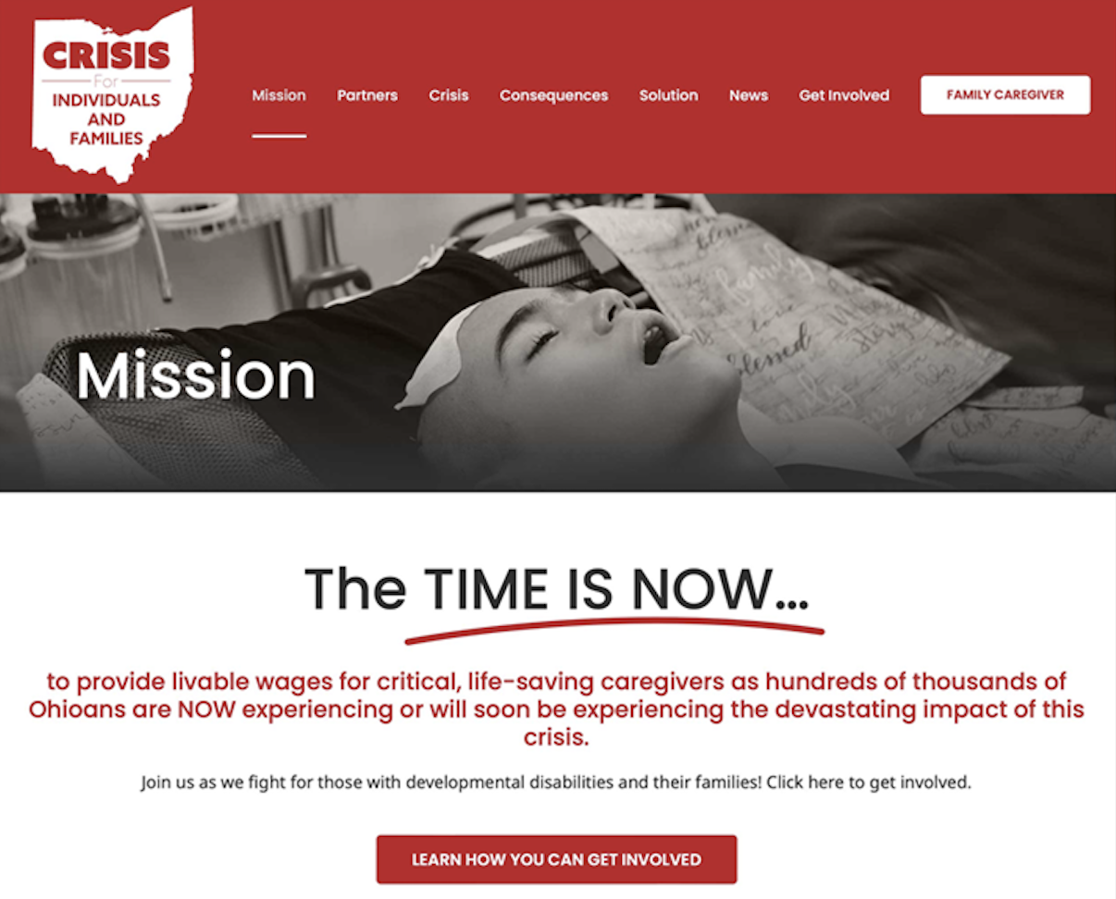
Remember This?

Slide 15
Principle #4
  We believe all services currently provided across the spectrum of services should be recognized as crucial to each and every person we serve.

Slide 16
Supported ICF members and Legislative Committee Members on the Protection and Advocacy Joint Legislative Committee to review DRO activity especially regarding ICF and Vocational services.
Legislative outreach and activity to remove age limit from Medicaid Buy-in For Workers with Disabilities program, which led to effective collaboration with Ohio Chamber of Commerce.
Advocacy to include Day Array services in DSP retention program.
Advocated to ensure budget investments/increases were aligned across service spectrum areas, especially following Governor DeWine’s executive budget.
Worked to educate legislative and system partners and find resources to support Competitive Integrated Employment as efforts to eliminate the certificate have appeared on both the Ohio and National level.
Supported ‘Workforce Reinvestment Act’, which would allow employment service providers to reinvest certain sales taxes.
Successfully advocated for service rate increases to align employment service rates with OOD Vocational rehabilitation rate.

Slide 17
