Slide 1
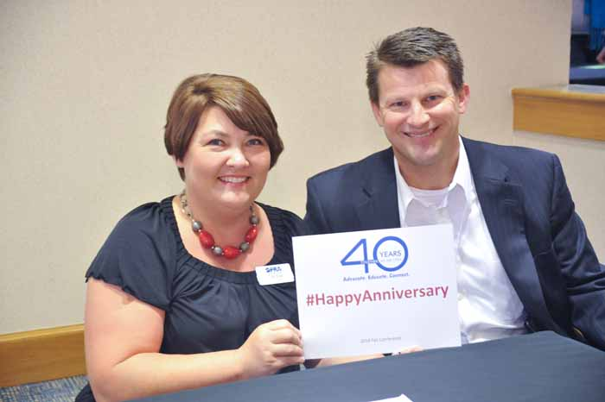
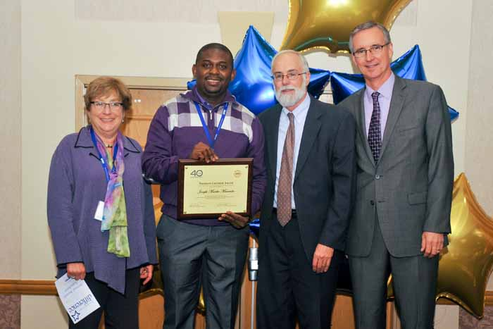
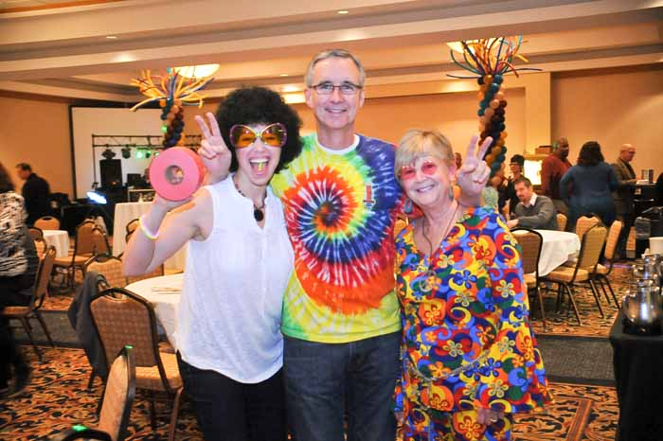
OPRA 2014 Board Retreat Columbus, Ohio - December 11 & 12, 2014
Together
We Are OPRA!

Slide 2
2014 Strategic Plan

Slide 3
Efficiencies and Simplification
Push to align the SSA and Program Management functions to clarify who does what and to pursue program specialist as a distinct, separate waiver service.
Proposed Program Management for ICF Transitions
Champion the reduction of duplication of surveys, including ODH/Licensure and nursing quality assurance, and pursue deeming for CARF and other national accreditation.
ODH/Licensure
Pursue corrective action for a regularly-updated, prioritized list of member concerns.
Member Relations Data, Roundup, and Alerts
Nursing QA
Background Checks – Rapback
Certification, Licensure and County Board Accreditation/National Accreditation
Person-Centered Training
SSA Rule

Slide 4
Reimbursement Transformation for Workforce Sustainability and Quality
Advocate for re-investment of County Boards of DD/DODD budget savings accrued from waiver budgets or efficiencies in County Boards and State systems in DSP wages, benefits, training and supervision, and waiting list.
Waiver Pilot
Advocate for annual adjustments to ICF and waiver reimbursement tied to inflationary index and unfunded mandates for provider viability.
ICF Reimbursement Work Groups
Using data provided by OPRA, advocate for implementation of data-informed reimbursement policies/systems that provide positive incentives for achieving desired outcomes / policies
OPRA BI Tool
AOF Direct Care Workforce Coalition
US DOL Threshold for Exempt Status
CCS Study
IDD- Specific Health Home Initiative
Center for Health Care Analytics for People with IDD

Slide 5
Future Opportunities and Unmet Needs
Develop an OPRA strategy that identifies willing County Boards of DD and provides assistance to continue the trend of County Board divestment of direct services.
Collaboration with Provider Support Group
Support the realization of the Employment First Initiative
Participation in Employment First Funding Redesign Workgroup
Persistently and consistently pursue service planning reform with our system partners.
2016-2017 Budget, AOF Direct Car Workforce, Trauma Informed Care, C3PO, Building System Capacity for Individuals Intense Challenges, Adult Foster Care, OOD Score Card, DRO, & Funding System Redesign
Provided Assistance to 8 County Boards Interested in Privatizing Services or Expansion of Private Providers Market Share
CMS Transition Plan
CMS Transition Plan Committee

Slide 6
Membership and Member Services
Implement the Communications Plan with tangible achievement by March 2014 and full implementation by March 2015.
Timeline Designed and Ready for Implementation
Recruit 40 new members by December 2014.
26 Active Members and 13 Associate Members Joined
Retain membership at 90% level.
87% of 2013 Active Members were Retained
Plan for 2015 (Redesigning Marketing Materials, New Member Care Packets, Holiday Open House, Vendor at 5 Conferences, Business Intelligence Tool, Social Media, Bi-Annual Magazine & Roundup)
Plan for 2015 (Website and Member Service Site, Biannual New Member Orientation, Video Conferencing, Member Relations Data Base, Business Intelligence Tool, Roundup, Other Publications, Social Media, Bi-Annual Magazine)
3-Year High for Active (126) and Total Membership (159)

