Slide 1
OPRA Board Meeting
July 2022

Slide 2
The Budget Process

Slide 3
Understanding the State Budget Process
The Budget is essentially one really long bill
Mostly follows the legislative process as other bills
There are a few differences with the Main Operating Budget
Instead of a legislator developing the bill, the initial budget bill language is developed by the Governor and his executive branch
OBM will provide directions to cabinet directors on drafting their budget proposals
The bill language is typically introduced by mid-February but no later than March 15^{th*} and must be passed by July 1st
There are limitations on the main operating budget per Ohio’s Constitution and Ohio law
The bill always starts hearings in the House of Representatives
There is always a conference committee
Notes:
The Governor and the leaders of his departments, commissions, and boards and staff from the Office of Budget and Management will start putting together the Governor’s proposed budget in the summer before the budget must be enacted. So for us, DODD and the Governor’s team will start to develop their request this summer.
The March 15th date is only applicable if the governor is new
The most impactful budget limitations:
balanced budget: the state can not spend more money than it has coming in as revenue
The overall main operating budget can’t grow by a certain percentage each year

Slide 4
Understanding the Budget Process
https://www.legislature.ohio.gov/publications/the-legislative-process
Legislators determine how they want to change the Governor’s budget through committee hearings, direct outreach from constituents, and general caucus priorities
Notes:
We are going to go back through the process and point out some of the differences

Slide 5
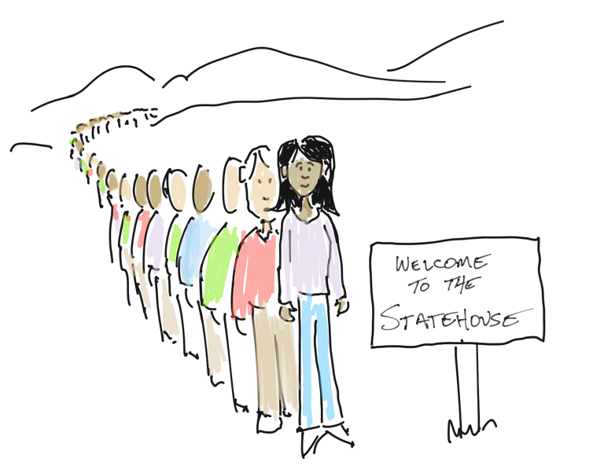

Slide 6
The Budget Ask

Slide 7
Budget Priorities
The Coalition
Historic Asks
Start with the Governor’s proposal
Hired assistance to manage, plan, and market (the Impact Group)

Slide 8
We will be
Organizing groups of OPRA Members to work on specific issues

Slide 10
3 phases
Phase 1
Stabilize
Phase 2
Sustain
Phase 3
Succeed

Slide 11
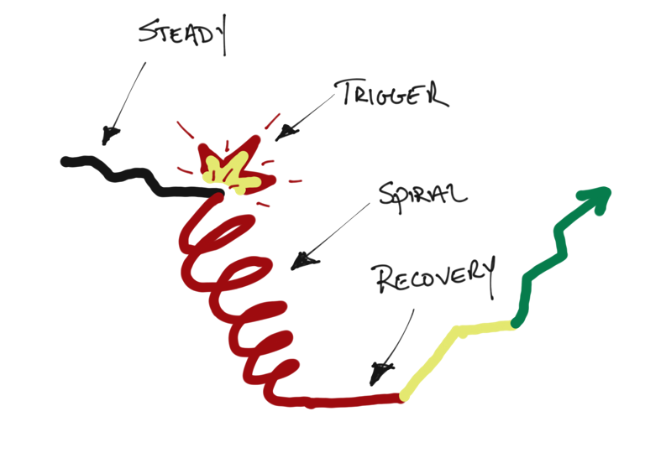

Slide 12
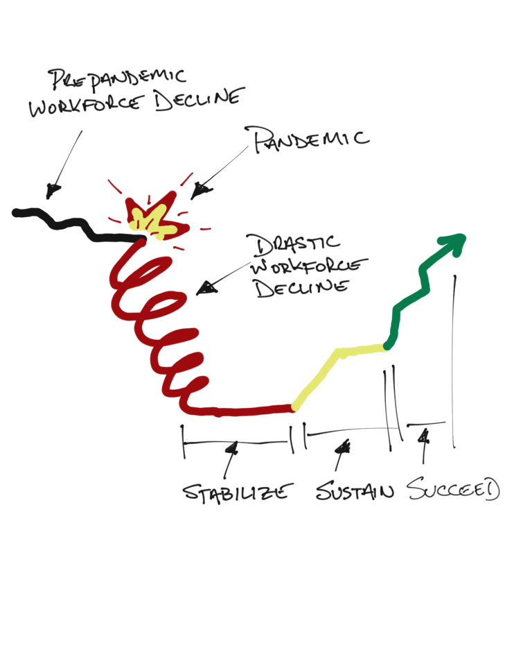

Slide 13
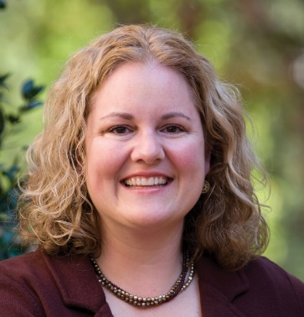
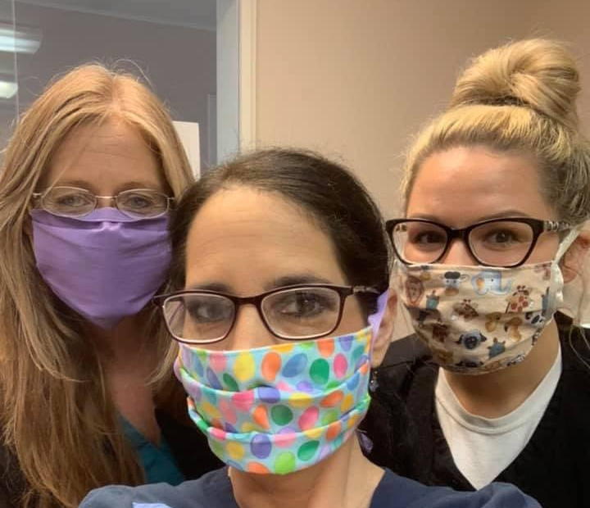
Funding
Capacity
Process Improvement/Efficiency

Slide 14
Possible areas to address:
Percentage Increase
$100s of millions
Staff wages
COLA
Maximize CB Funding
Funding
Capacity
Process Improvement/Efficiency
Possible areas to address:
Must-have proposal for contractor
Stratify HPC
Compliance reform
ICF Modernization
Remote technology
Possible areas to address:
Licensed beds
Setting flexibility
Nursing capacity
Provider certification reform
MSY/add-on reform

Slide 15
The Challenge: Leveling the Playing Field in Our System
ICF
Run the formula
Specialized Services
Day
Rates Supporting the Array
“The blueprint will take care of it.”
Residential Waiver
Increase Pay
Reconcile what services should be provided

Slide 16
ICF
Indirect
Direct
Protected
Capital
The Nuance of the Ask

Slide 17
What does 50% really mean?
Means something different with every service type
Prepare to answer questions about the ask
Present state of our system (closing providers, giving notice, no new workforce, etc.)
Why so much???? Why now???
Good processes
Who does it benefit?
What about future sustainability???

Slide 18
Next Steps
Presentation of reform ideas to DODD (kick off to more discussions, who to have in the room)
Follow-up with the Governor when we formalize and are able to justify our ask
Provider/Legislative visits…preparing them for what we need to succeed
Develop “the campaign”
Organize our internal communications with you, asking for your participation, getting your feedback, helping you organize your story and who to share it with.

