Slide 1
OPRA Board Meeting
3-24-21

Slide 2
Membership Dues Update

Slide 3
Provider Members
Provider Members – 190 (if all renew)
13 New Members in 2021
Still waiting for 49 provider members to renew
This time last year (2020), we had 177 members with 56 members yet to renew.
We are actively contacting those on our roster that have not renewed yet

Slide 4
Dues Breakdown
Total 2021 membership dues invoiced as of today = $1,402,843
  providers - $1,362,273
  public entities - $27,000
  associates - $13,570
Total 2021 payments made so far = $1,036,858
Total membership dues invoiced this time last year = $1,505,123
  providers - $1,486,518
  associates - $18,500
Total membership payments made this time last year = $981,509

Slide 5
Recruitment and Welcome New Members
In process of preparing materials to recruit new members.
  Recruitment prospects from -
    Lapsed OPRA members
    Attendees from conferences and trainings
    DODD billing database
OPRA swag has been ordered and welcome materials are in development to send to new members.
  Coffee mugs
  Pen/highlighter
  Magnet clips
  Post-it notes
  “Proud to be an OPRA Member” window clings

Slide 6
Workforce Focus Areas

Slide 7
OPRA's Guiding Principles
Guiding Principle #1
We believe the primary focus of our work is the positive and supportive relationship between front-line professionals and the people they support.
Guiding Principle #2
We believe providers should be supported and trusted to support people with developmental disabilities and operate effective and successful organizations.
Guiding Principle #3
We believe providers must be sufficiently compensated to deliver essential services to meet the needs of the people they support in an ever evolving society and system
Guiding Principle #4
We believe all services currently provided across the spectrum of services should be recognized as crucial

Slide 8
Recruitment
How do we attract quality employees?
Culture/ Retention
Do our employees feel safe and supported?
System
Barriers
What obstacles hinder attracting and keeping quality employees?
Compensation
Are providers appropriately compensated for their services?

Slide 9
Workforce Focus Areas
Direction of our Service System (System Barrier)
Onboarding Staff (System Barrier)
Agency Waivers to enable the hiring necessary staff (System Barrier)
Establish the base qualifications, skills and job requirements for a DSP (What does Medicaid require) (System Barrier)
What training approach works best for DSPs? (System Barrier and Retention)
Rates related to DSP job requirements (Compensation)
Set outcome limits proportionate to individual funding (System Barrier and Compensation)
Strategies to support providers based on performance (System Barrier)
The MUI Culture (System Barrier and Retention)

Slide 10
A Few Thoughts
All of the focus areas are important and will be addressed.
We would like to establish both short-term and long term priorities

Slide 11
Workforce Priorties
 | Direction | Onboarding | Waiver | Base DSP | DSP Training | DSP Rates | Outcome limits | Support vs. Comp. | MUI
Rating (4/5) | 37/19 | 26/33 | 5/32 | 27/64 | 16/0 | 23/64 | 14/0 | 25/35 | 40/30
Total | 56 | 59 | 37 | 92 | 16 | 87 | 14 | 60 | 70
Rank | 6 | 5 | 7 | 1 | 8 | 2 | 9 | 4 | 3

Slide 12
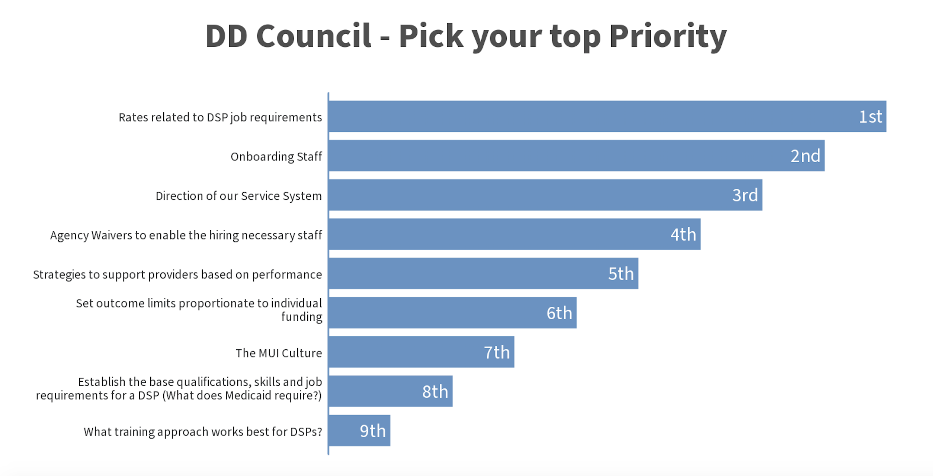

Slide 13
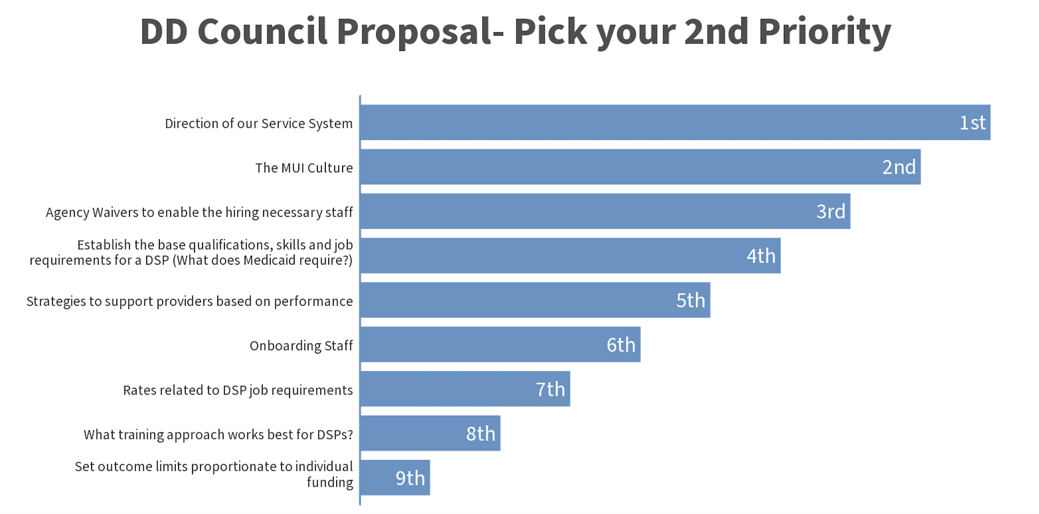

Slide 14
Top Priorities
Combine DSP base requirements and rates and DSP job requirements
MUI Culture
Onboarding staff
Direction of Service System

Slide 15
Everything is a priority…
We also have to address
The oversight relationship between DODD/County Boards and Providers
Your ability to hire who you need
Ensuring that the expectations on the provider made by the ISP are clear, reasonable and appropriate to the level of funding/rates provided to deliver the service
Trusting providers to prepare/train DSPs to do the job they are required to do

