Slide 1
OPRA Evaluation of President
Monday, October 05, 2020

Slide 2
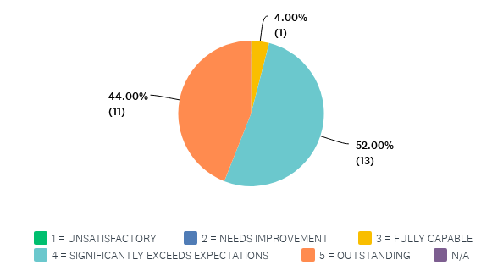
Q1: PLANNING – Develops short and long range plans and goals to meet OPRA Strategic Plan objectives consistent with established priorities; sets appropriate priorities of needs and resulting services to be provided; anticipates and prepares for future requirements and devises contingencies; devises realistic plans.

Slide 3
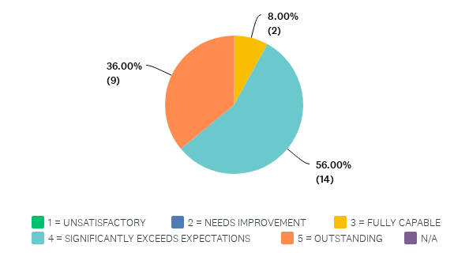
Q2: BUDGETING AND ECONOMIC MANAGEMENT – Prepares an appropriate budget and subsequently adheres to it; utilizes finances, budgets, facilities, equipment, materials and products to minimize costs; actively practices cost containment.

Slide 4
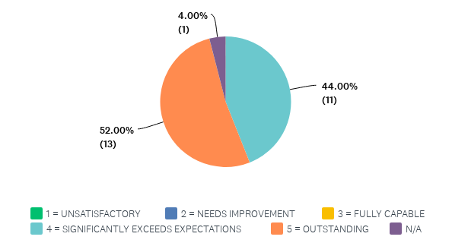
Q3: ORGANIZATION OF WORK – Structures work in order to avoid crisis, promotes productivity, attains cost effectiveness. Involved in this process are the tasks of allocating work, delineating responsibilities, scheduling activities, and adequately preparing for meetings and presentations.

Slide 5
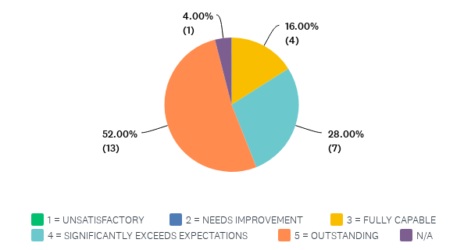
Q4: COMPLIANCE – Complies with established policies, procedures and directives; conducts functions in accordance with applicable laws, statutes, and regulations.

Slide 6
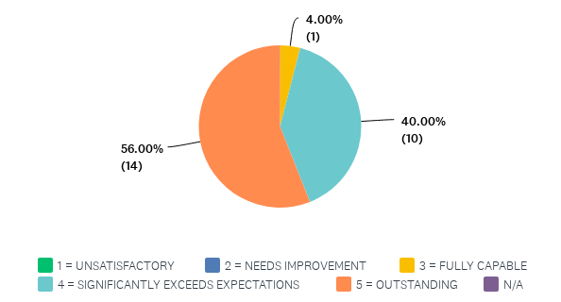
Q5: PROBLEM SOLVING AND DECISION-MAKING – Identifies problems and acts to rectify them by employing analytical thinking and sound judgment.

Slide 7
Q6: EVALUATION AND CONTROL – Practices regular and systematic review of OPRA operations to evaluate progress toward established goals; evaluates strategies being deployed to achieve those goals; implements remedial measures when necessary.

Slide 8
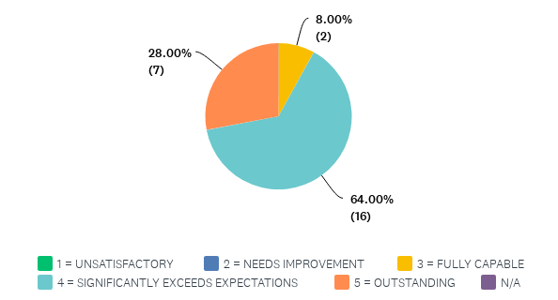
Q7: RISK (LIABILITY) MANAGEMENT - Ensures that liability risk exposures are identified and treated when proposing new advocacy initiatives and member services; evaluates and monitors established advocacy initiatives and member services to identify areas which need revision due to changes in operation, legislation, policies and procedures; implements changes where needed to facilitate favorable loss experience.

Slide 9
Comments for the Category Administration

Slide 10
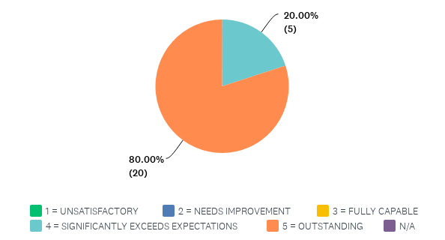
Q9: RELATIONSHIP BUILDING – Treats individuals fairly and with dignity and respect. Works well with other OPRA staff. Interacts appropriately with general membership, board members, vendors, ANCOR and governmental agency representatives. Works well with people representing a wide range of backgrounds and styles.

Slide 11
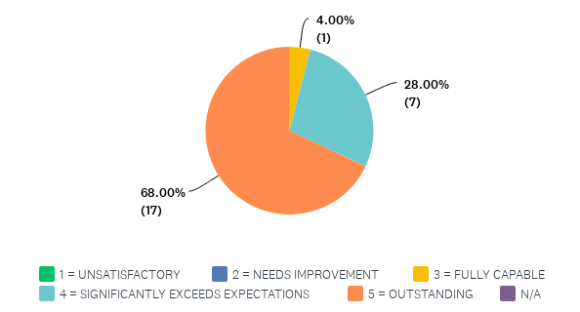
Q10: ORAL COMMUNICATION – Effectively communicates orally with individuals and groups, including public presentations; presents ideas in an organized, clear and concise manner, employs tact and discretion; listens well; offers appropriate feedback.

Slide 12
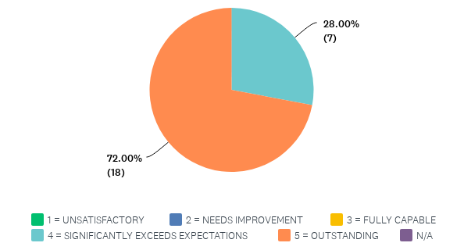
Q11: COORDINATION/COLLABORATION – Works well with others at various levels; keeps information flowing to the appropriate parties vertically (down as well as up) and horizontally; facilitates communication and problem solving among parties when necessary. Works with governmental stakeholders to maintain high esteem and integrity for OPRA.

Slide 13
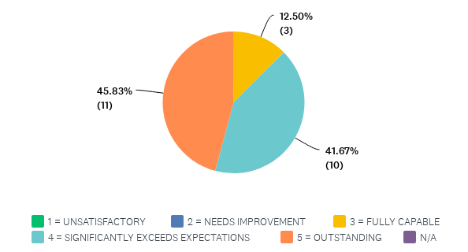
Q12: WRITTEN COMMUNICATION – Prepares organized, clear, concise, accurate and informative letters, memos, reports and other documents which effectively fulfill content and timeliness requirements.

Slide 14
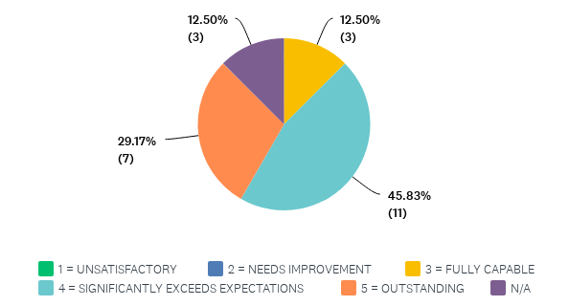
Q13: SUPERVISORY CONTROL – Effectively hires, assigns, directs, controls, evaluates performance, counsels and disciplines all other functions necessary or incidental to supervision; practices compliance with employment law guidelines and mandates.

Slide 15
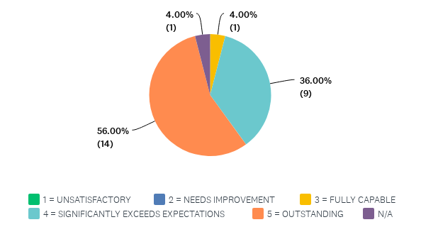
Q14: LEADERSHIP – Promotes cooperation and team work among staff; establishes high standards of conduct and job performance for staff; maintains open communication channels; delegates work; leads by example.

Slide 16
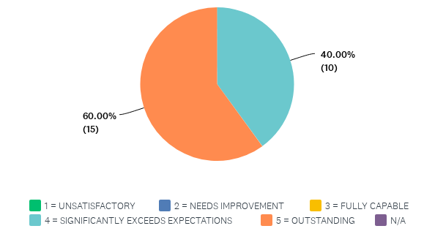
Q16: EFFORT AND INITIATIVE – Requires little work direction; exhibits persistence and initiative; puts forth consistent, energetic effort; assumes full and complete responsibility for accomplishment of OPRA’s functions.

Slide 17
Comments for Category Interpersonal

Slide 18
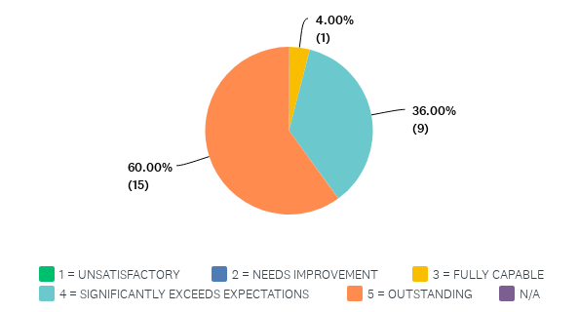
Q17: INNOVATION – Displays original and novel though in creative efforts to improve on the status quo. Generates creative solutions to work problems and responsibilities, takes appropriate risk-taking actions to introduce and encourage innovative approaches.

Slide 19
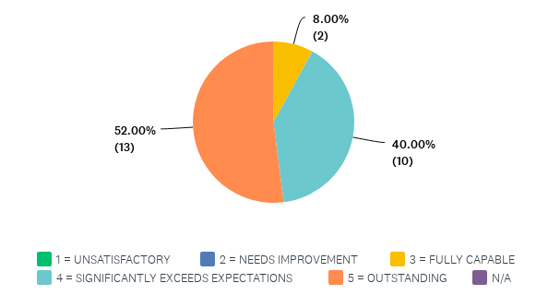
Q18: OBJECTIVITY – Assesses issues, problems and decision situations based on the merits of the case presented; personal loyalties and biases do not unduly influence decisions; human resource decisions made on the basis of equal opportunity and objective job-related criteria

Slide 20
Q19: CREDIBILITY – Through successful performance, instills the feeling of trust and dependability.

Slide 21
Q20: FLEXIBILITY – Adapts well to change, both internally and externally. Is open to change and adjusts well to new requirements of the job and changes in external environment, staff, and the organization. Maintains patience, confidence, and composure under pressure. Is open to different ideas, styles and approaches to job duties.

Slide 22
Comments for the Category Individual

Slide 23
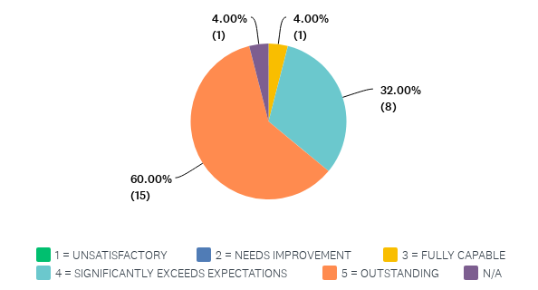
Q22: COACHING – Communicates a positive attitude; serves as a catalyst for action and encourages staff to try new things and to take calculated risks; provides honest feedback; minimizes tension and defensiveness; creates an environment for success; teaches and guides staff.

Slide 24
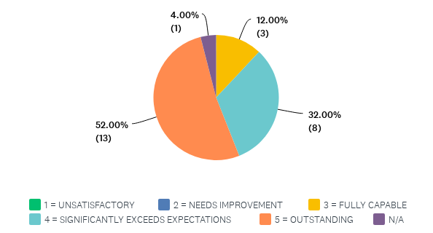
Q23: EMPOWERING – Creates an awareness in others of the powers and self worth; involves others and shares powers in planning and decision-making; fosters leadership in others; challenges others to assume leadership roles and provides support by allowing them to risk, fail and learn; creates an environment in which others feel ownership for results and feel comfortable to take action to achieve desired results.

Slide 25
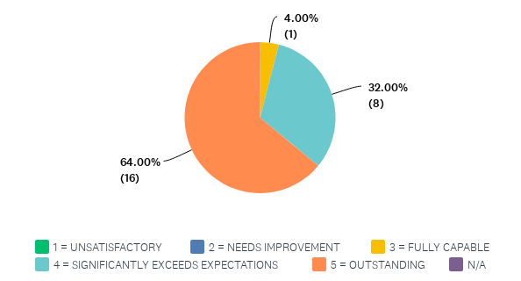
Q24: MODELING – Believes in public service; treats all with respect and dignity and creates an atmosphere of mutual respect and trust. Serves as a catalyst for action and is a team player; believes in oneself and looks at problems as opportunities; uses powers in a positive way; accepts responsibility for mistakes; insists on excellence (not perfection); adapts to changes as conditions and situations warrant.

Slide 26
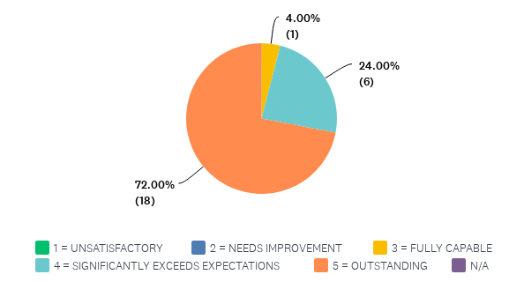
Q25: TEAM BUILDING – Builds group cohesiveness and pride; encourages cooperation; fosters and practices good communication; recognizes and rewards individuals and team accomplishments and contributions; shares success and rewards; manages conflict; fosters and atmosphere of cooperation among OPRA staff. Is open to different ideas, styles, and approaches to job duties, development and implementation. Practices the team concept through active participation as a team member. Willing to assist others.

Slide 27
Q26: VISIONING – Establishes and articulates a vision of what could be; looks to and plans for the future; accepts new challenges; keeps an open mind.

Slide 28
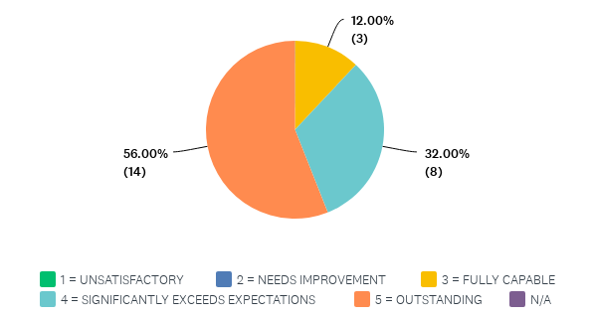
Q27: SELF-DEVELOPMENT – Is not static; prepares for the future; has the courage to identify and address shortcomings; is committed to self-improvement; manages personal stress in positive ways.

Slide 29
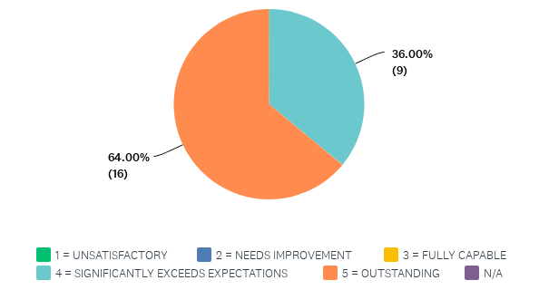
Q28: SYSTEM LEADERSHIP – Participates in local, state and federal groups external to OPRA in order to advance the OPRA mission.

Slide 30
Comments for the Category Leadership

Slide 31
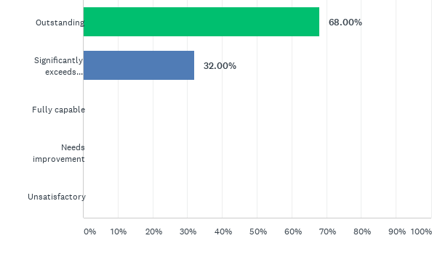
Q30: Overall Evaluation Please Check One
Answered: 25 Skipped: 0

Slide 32
What were the President’s Performance Highlights in the Past Year?

Slide 33
What were the President’s Performance Highlights in the Past Year?

Slide 34
What were the President’s Performance Highlights in the Past Year?

Slide 35
What were the President’s Performance Highlights in the Past Year?

Slide 36
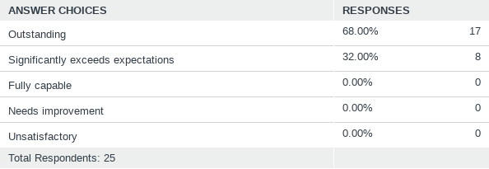
Q30: Overall Evaluation Please Check One
Answered: 25 Skipped: 0

Slide 37
What Should the President’s Performance Goals be for Next Year?

Slide 38
What Should the President’s Performance Goals be for Next Year?

Slide 39
What Should the President’s Performance Goals be for Next Year?

