Slide 1
OPRA Spring Conference
John L. Martin, Director
Ohio Department of Developmental Disabilities
April 9, 2014

Slide 2
What follows is a draft of a presentation I am preparing on Ohio’s legacy programs for the Strategic Planning Group
Early Intervention
Schools
Day Services
Residential Supports

Slide 3
Strategic Planning Update
OACBDD/OSCBDD | Steve Oster
 | Alice Pavey
 | Willie Jones
 | Dee Zeffiro-Krenisky
Arc of Ohio | Gary Tonks
 | Judy Murray
People First | Sadie Hunter
 | Tami Grogg
The Ohio League | Neil Castilow
OSDA | Dana Charlton
 | Diana Mairose
Autism Association | Pat Cloppert
Down Syndrome Assoc | Marge Barnheiser
APSI | Karla Rinto
DD Council | Carolyn Knight
SIBS | Barb Sapharas
Ohio Waiver Network | Kathy Phillips
OPRA | Mark Davis
 | Jorji Milliken
OHCA | Pete Van Runkle
 | Marilyn Weber
Values and Faith Alliance | Vicki Obee-Hilty
 | Deb Lyle
Ohio Department of Medicaid | Icilda Dickerson
DODD | Patrick Stephan
 | Kate Haller
 | Monty Kerr
 | Zach Haughawout
 | Ann Rengert
 | Ginnie Whisman
 | Toni Wallace
Facilitator | Jo Krippenstapel

Slide 4
Strategic Planning Leadership Group
February 11
SLG Meeting
Aging/
Wait List
Benchmarking
March 11
Open Forum
FULL DAY
CMS Rule
April 1
Open Forum
FULL DAY
CREATING WORK
OPPORTUNITIES
April 29
12:30-3:30
SLG Meeting
Legacy
Programs Benchmarking
May 6
Open Fourm
FULL DAY
CREATING OPPORTUNITIES
FOR COMMUNITY LIVING
May 20
SLG Meeting
12:30-3:30
Legacy Program
Benchmarking
June 11
Open Forum
FULL DAY
Listening to People &
Family Supports
July 15
12:30-3:30
SLG Meeting
Changing Systems &
Collaboration; Outcome-based Planning
Aug. 12
12:30-3:30
SLG Meeting
Workforce
Development
Sep. 9
12:30-3:30
SLG Meeting
Benchmarks & Biennium
Recommenda-tions
Oct. 7
12:30-3:30
SLG Meeting
Benchmarks &
Biennium
Recommenda-tions
Nov. 4
12:30-3:30
SLG Meeting
Benchmarks
& Biennium
Recommenda-tions
June 25
12:30-3:30
SLG Meeting
Listening to People/Family Support
Benchmarking
Blue = Strategic Leadership Group (SLG) Meetings.
Red = Open Forums hosted by the Strategic Leadership Group (SLG), open to all (as long as space is available). Flyers will be prepared for each Open Forum.

Slide 5
Early Intervention
Setting the Tone For Community Integration
The first community we are a part of is our family.
With self-directed/family oriented services, competent and confident parents are essential components to making the family a successful community.
If facility based, rather then community based, EI services are the first services the parent experiences, they will expect, facility based services the rest of their child’s life.

Slide 6
The Plan
Every year Ohio serves between 10,000 – 11,000 kids 0-2 in Early Intervention. To be successful, these services need to be parent focused and provided in integrated environments (usually the home).
Currently over 70% of the state is practicing parent focused EI services, with many other areas of the state interested in the new approach.

Slide 7
The Plan
The Department and DD Council have provided funding for trainings to assist providers in community based rather than facility based services.
These competent and confident parents who see themselves as partners, are essential in the new environment our system is evolving toward.

Slide 8
Benchmarks
By 2016 90% of the providers will be practicing parent focused EI services in integrated environments
By 2016 80% of Ohio families will have access to an EI specialist trained to teach parents in ways to work with their son or daughter with Autism in daily interactions in the home environment
Other Benchmarks identified by Strategic Planning Group

Slide 9
Where Do We Learn – School Services
The second community we are a part of is where we are educated as we become a part of two communities – home and school
From preschool to graduation diversity is important in the classroom
Individual with disabilities and their nondisabled peers need to experience daily interaction to learn from each other and about each other. Segregation stigmatizes people and if we can not grow up and learn together, we will not live together and work together as adults
Historically, virtually every county board ran a school, today 39 county boards run schools. In recent years, there has been an increase in privately run segregated schools
We need to develop ways to support schools and parents so segregated schools are not necessary

Slide 10
Consideration for Strategic Planning Group
How can we reduce the reliance on segregated schools both in the public sector and the private sector?
What ways can we support families and schools so full integration becomes a reality?
Benchmarks
Two Years
Ten Years

Slide 11
Adulthood – Living, Working and Socializing Together “Working in the Community”
We grow up expecting to work, with the hope of a meaningful job to be independent and self supporting
Goal: Everyone including persons with disabilities have this expectation set early in EI, school and our families
This is the third community we enter, and like the first two, it should not be segregated
What is the status of this third community, where individuals with disabilities spend their day.

Slide 16
Looking to the Future and Current Initiatives
Building on the strength of being the 8th state out of 50 states in the number of individuals per capita in integrated employment, these current initiatives are under way

Slide 17
Current Initiatives
Joined SELN
Governor Kasich signed and supports Employment First Initiative
Established a taskforce of representatives from 6 state agencies and an enthusiastic efficient stakeholder advisory group (cb’s, providers, advocates)
DODD receives $3 million annually for Employment First, with part of the money transferred to OOD to leverage federal draw down. In return:
OOD hires counselors exclusively for individuals with DD. County board initiates referrals, and career planning. The VR counselors provide the person-centered training. The counselors will have a smaller than average caseload, allowing them to provide in-depth person-centered career planning
A dual certification process was created so waiver providers can provide VR services and VR providers can provide waiver services. This ensures a seamless service delivery system from the individual/family and employer perspective when shifting from time limited to long term supports
Competency-based supported employment training required for all providers and counselors. Currently more than 1,000 trained
Goal: 1500 individuals in year one and 1,500 individuals each successive year will have the opportunity to be employed that are currently in sheltered workshops. The slots are distributed to counties based on the number of individuals in sheltered workshops.

Slide 18
Current Initiatives (con’t)
Data collection system to track outcomes is in pilot testing phase
Local leaders grants awarded in 7 counties
Workshop to Employment Transformation grants awarded to 6 counties and 3 private providers
Entered into a contract to establish on-line benefits calculators so person/families can understand how working will not impact benefits
Awarded a contract to support families/jobseekers to understand the initiative
Awarded a contract to redesign our reimbursement system to incentivize employment leading to competitive employment
Awarded a contract to support providers to understand career planning, discover and assistive technology
Awarded a contract to build community first and employer engagement teams at the local level
Transition framework – training for educators and professionals about evidence-based transition planning process

Slide 19
Benchmarks – to be Established by Strategic Planning Group
-Two Years
-Ten Years

Slide 20
Adulthood – Living, Working and Socializing Together “Living in the Community”
Just as we need to learn and work as a diverse community, we also need to live in diverse communities. Segregation of any group is demeaning and deprives the community from experiencing and learning from each other
This was not always society’s view, and early efforts at residential services was large residential facilities. States like Ohio that identified this need early expanded this service platform dramatically from 1960 to 1980. Business grew up around the model and families liked it
Ohio is engaged in an effort to move away from this model and the following slides describe our current system and initiatives to move to a more integrated community based services

Slide 21
Non State Operated Residential Options

Slide 26
ICF to Community Initiatives
Moved the ICF program from the Ohio Department of Medicaid to DODD so the money, reimbursement system, and licensure resided at DODD.
Created the ability for an ICF provider to convert an ICF bed to a waiver bed. With both budget allocations (ICF and waivers) in DODD this became easy, rather then a huge obstacle.
Issued a White Paper providing clarity to the field on DODD’s direction with ICF’s along with frequent presentations to anyone who would listen. Established stakeholder work group.
DODD started to align the reimbursement system to support the White Paper.

Slide 27
DODD negotiated an agreement with the private providers associations to either downsize or convert 1,200 ICF beds over the next five years. Included are reimbursement changes to facilitate this movement. We are engaged in frequent meetings with individual providers and their boards to problem solve and facilitate this work. All providers operating large facilities have to submit a downsizing plan by June 1, 2014 to be eligible for full efficiency incentives.
CMS approved a community integration add on ($2.00 hour) for one year for people converting from ICF to waiver and requested we study the impact.
Capital Assistance is available.
This is hard work with many barriers, but we are grateful for an understanding and supportive provider community.

Slide 28
Additional Benchmarks and Initiatives Identified by the Strategic Planning Group
Two Years
Ten Years

Slide 29
State Operated Facilities Current Status and Initiatives
Current goal is downsizing our DC’s census by 90 persons per year

Slide 31
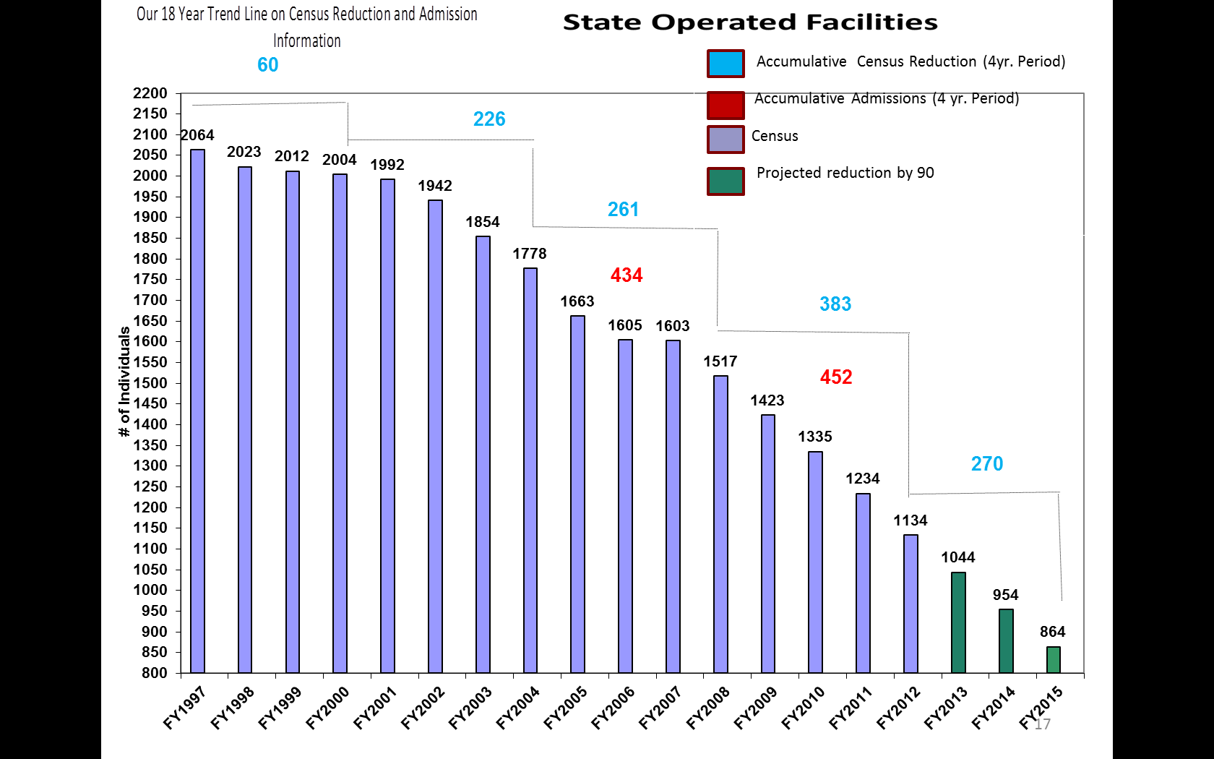

Slide 32
Methods
Created a DC stakeholder group for ongoing input
Offered state funded waivers to every single resident of a DC
If a county needs an emergency placement, they pay the match and take a current resident out.
Offering families attractive alternatives:
19 6-person ICF’s
Privates operate but state controls admission/discharge
Hired resource coordinators to provide intensive follow along services/interventions to individuals from the DC to the community and prevent readmissions.
CMS approved a $2.00 an hour community add on for 1 year for persons going from a DC to a waiver. They have requested we study the impact.
Communicating that DC’s are not long term placements
One year free readmission
Provide access to community capital for individuals leaving a DC
Money follows the person dollars are available for start up
The support of families/advocates/county boards/providers has been critical as we have moved 1,032 individuals from our DC’s into the community since 2007.

Slide 33
Additional Benchmarks and Initiatives Identified by the Strategic Planning Group
Two Years
Ten Years

Slide 34
Other Updates
and
Questions?

