Slide 1
ADS Rule Revisions
July 2026 Changes and Guidance

Slide 2
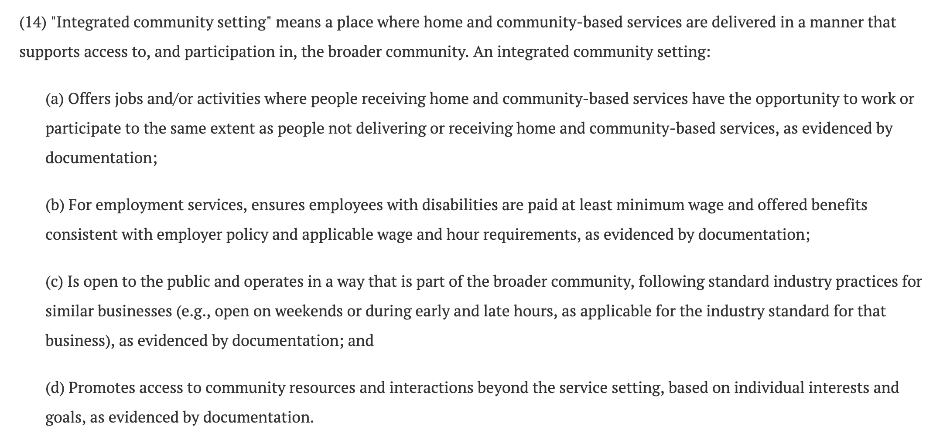

Slide 3
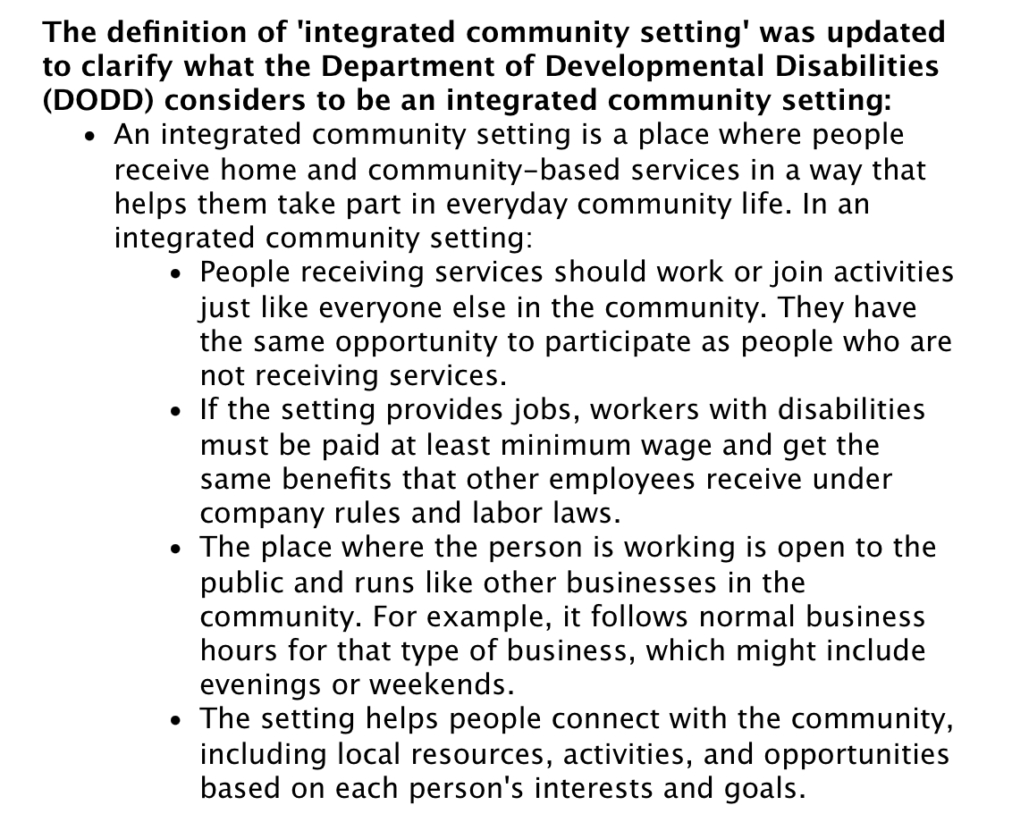

Slide 4


Slide 5



Slide 6
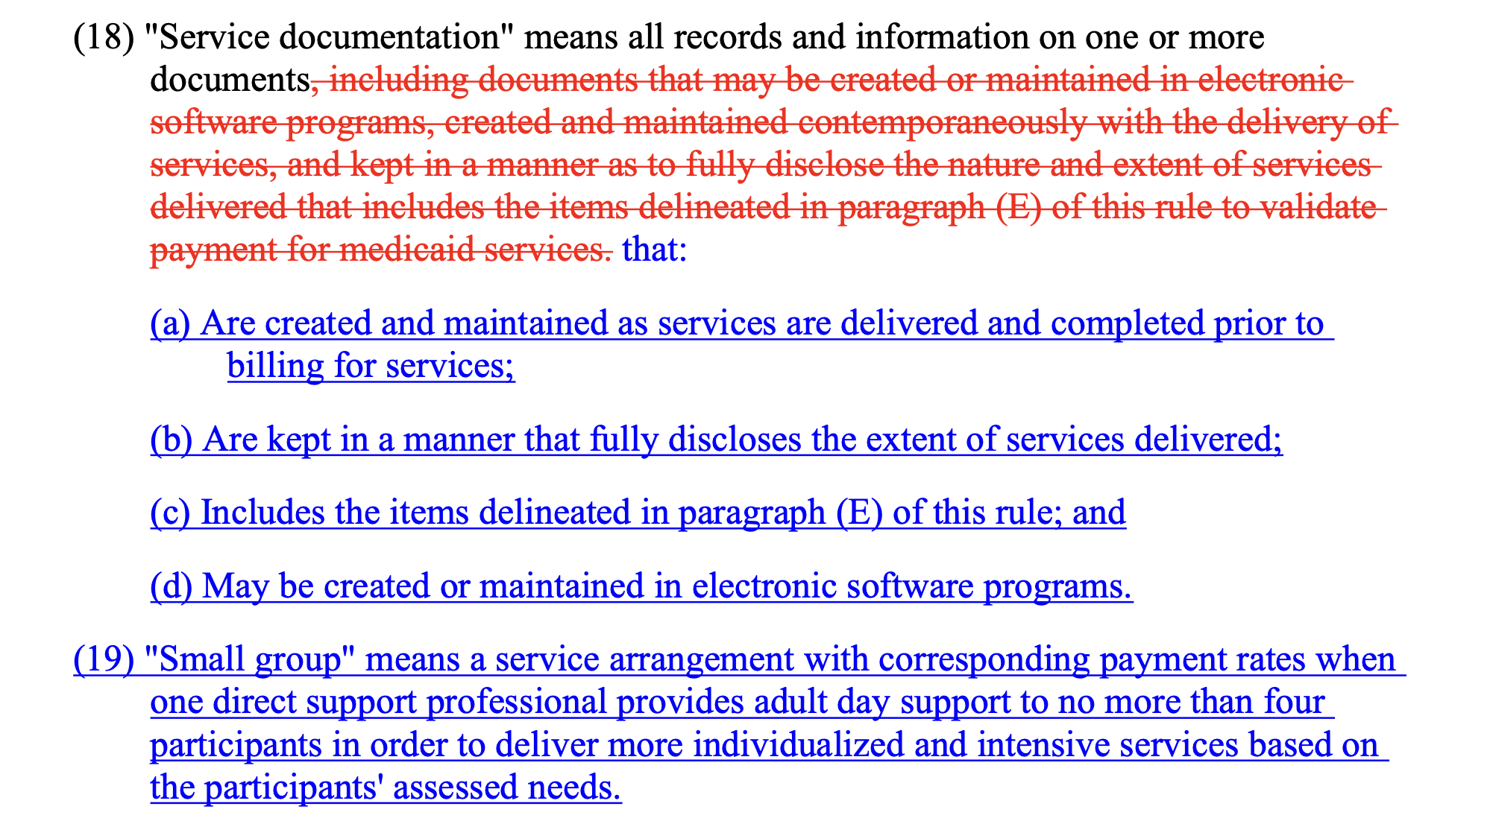

Slide 7
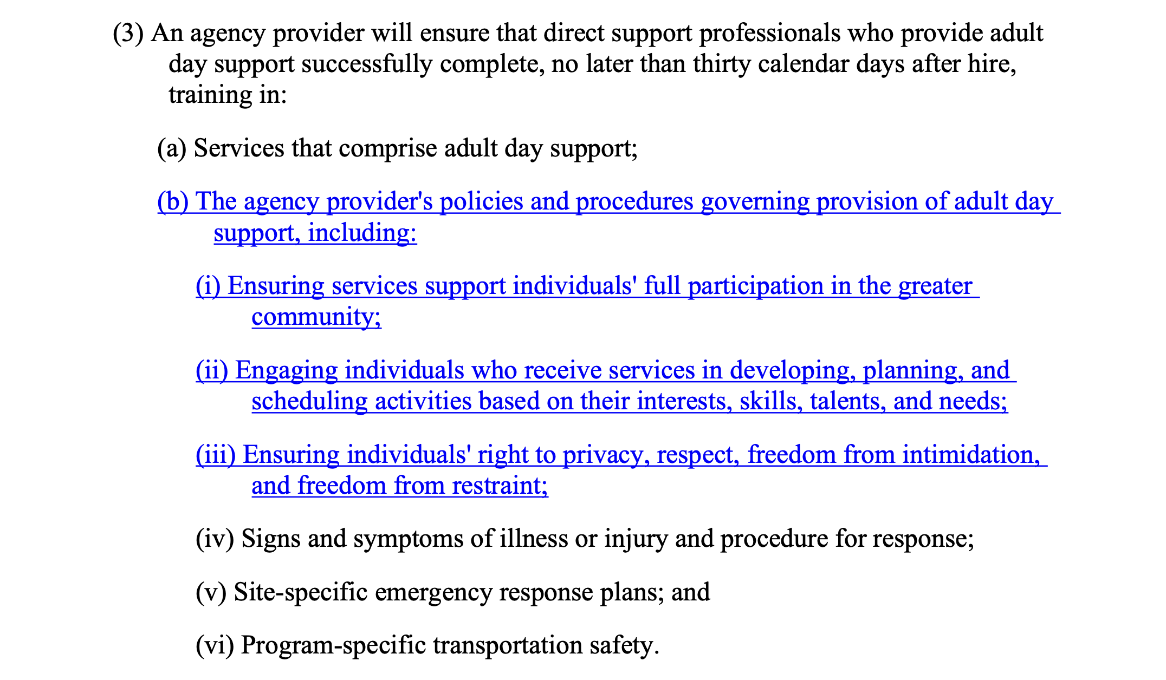

Slide 8
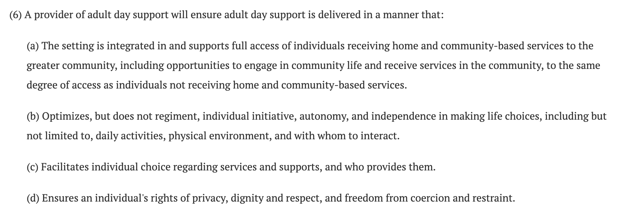

Slide 9
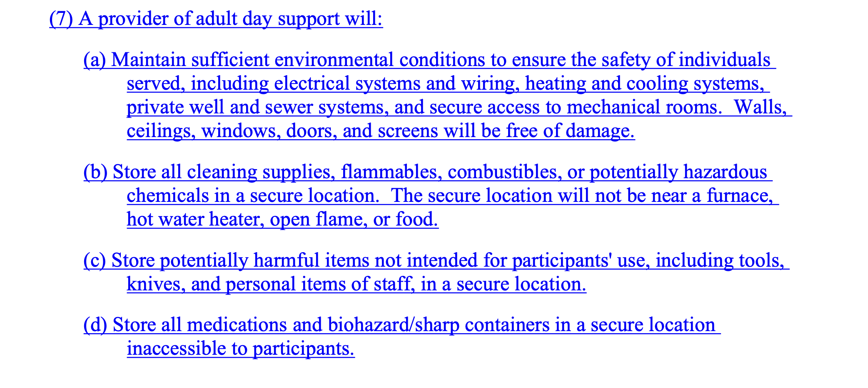

Slide 10
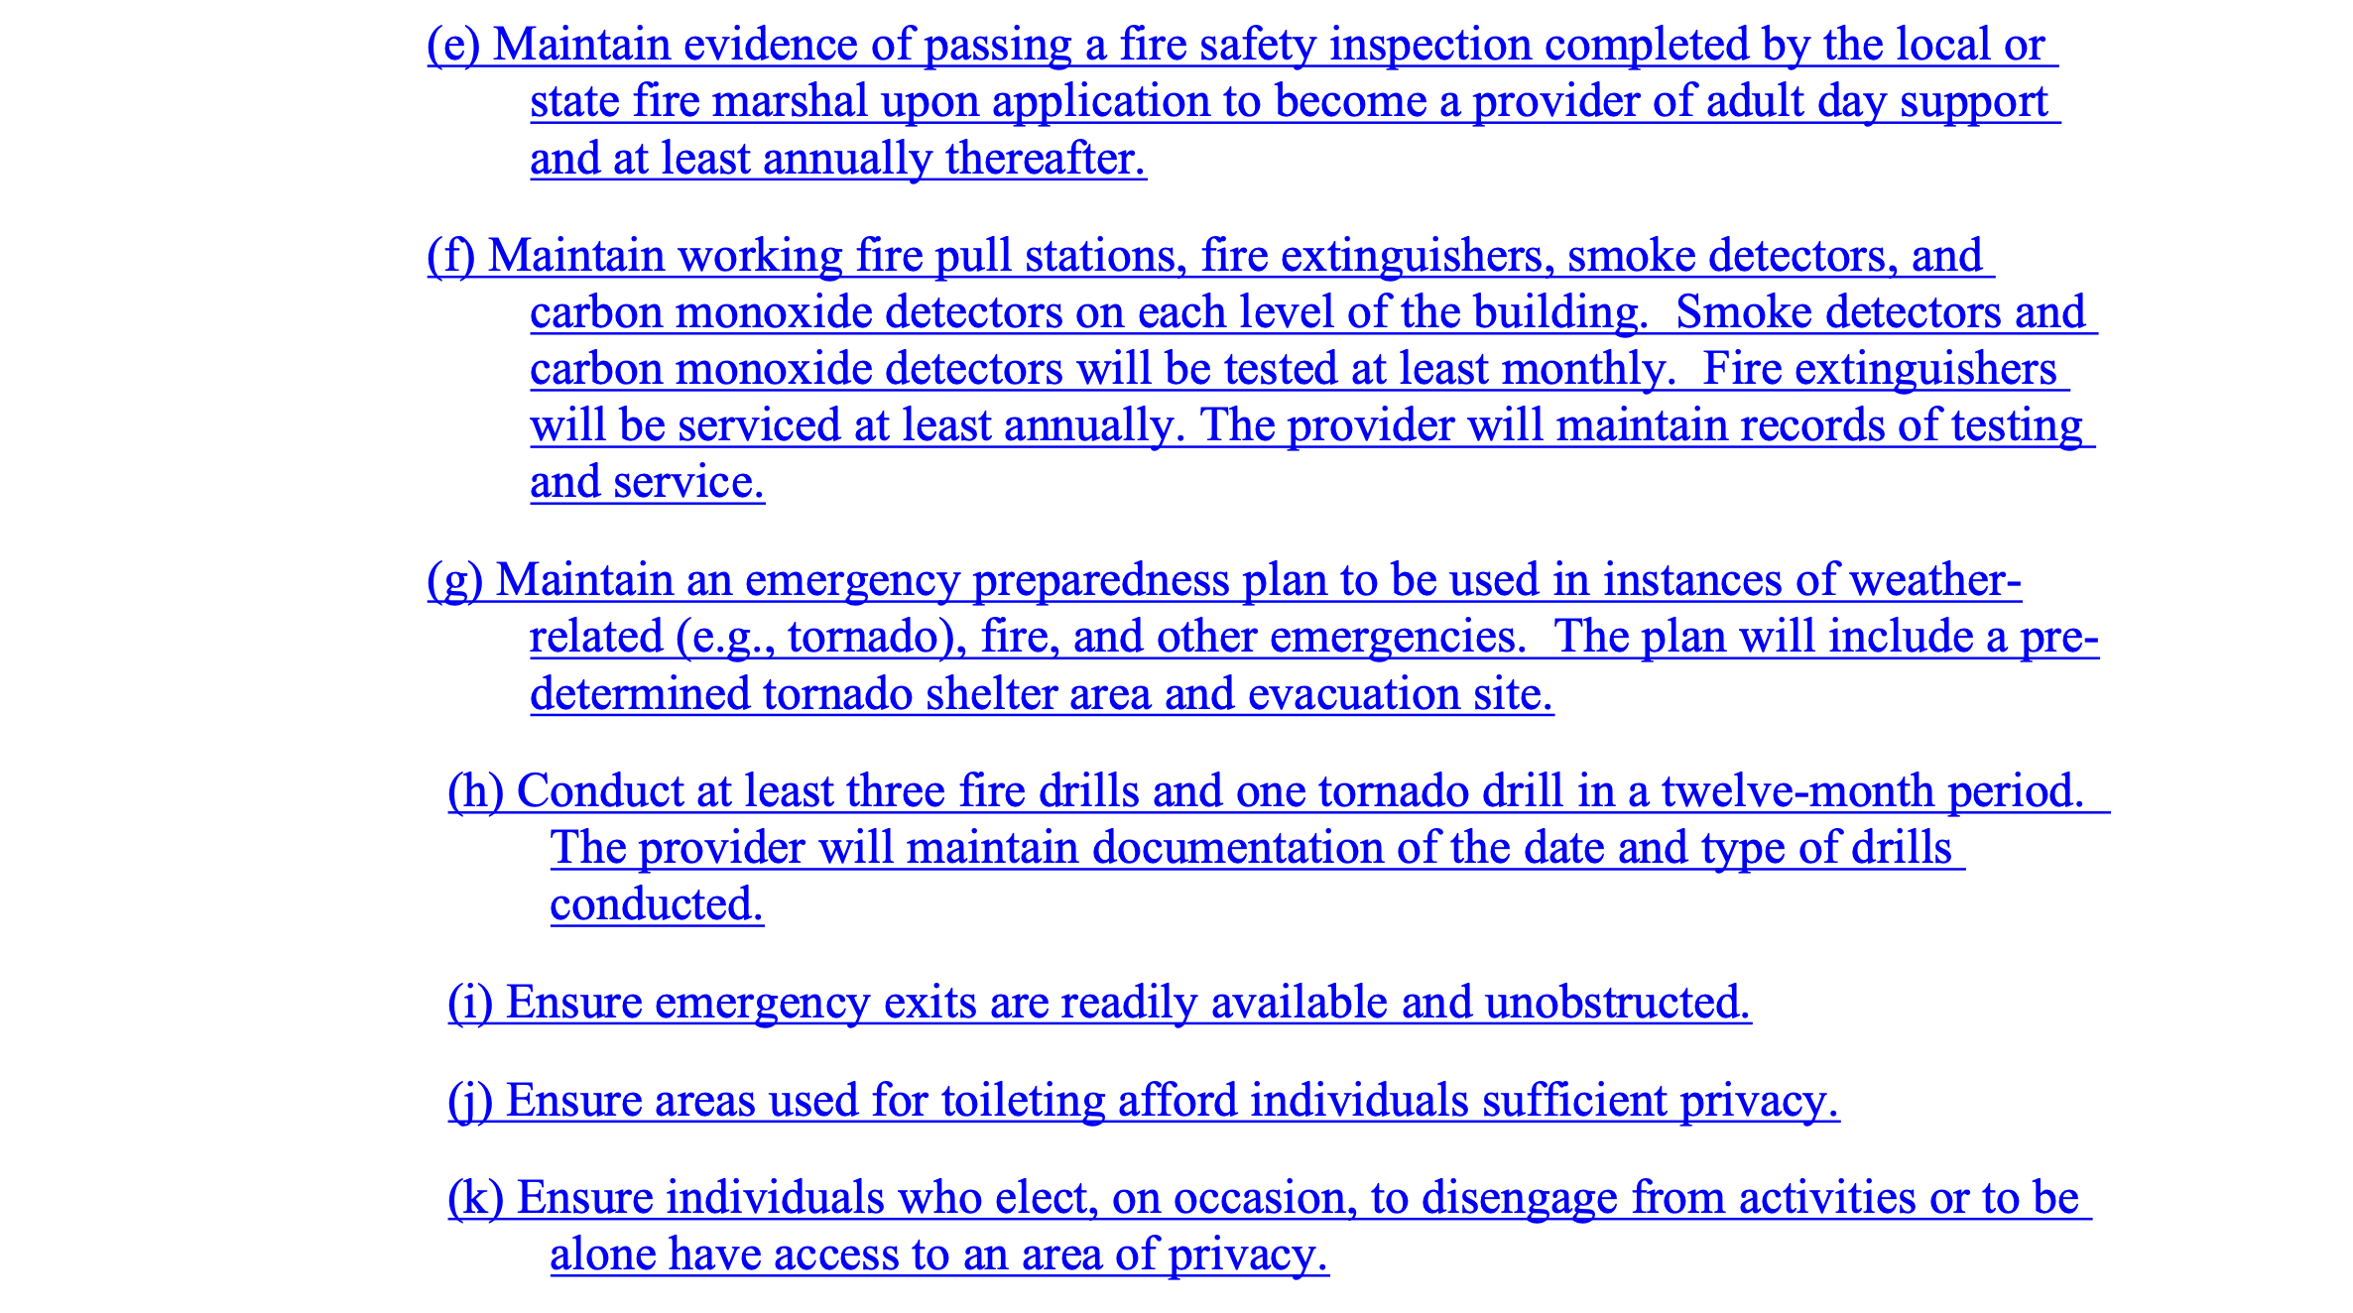

Slide 11
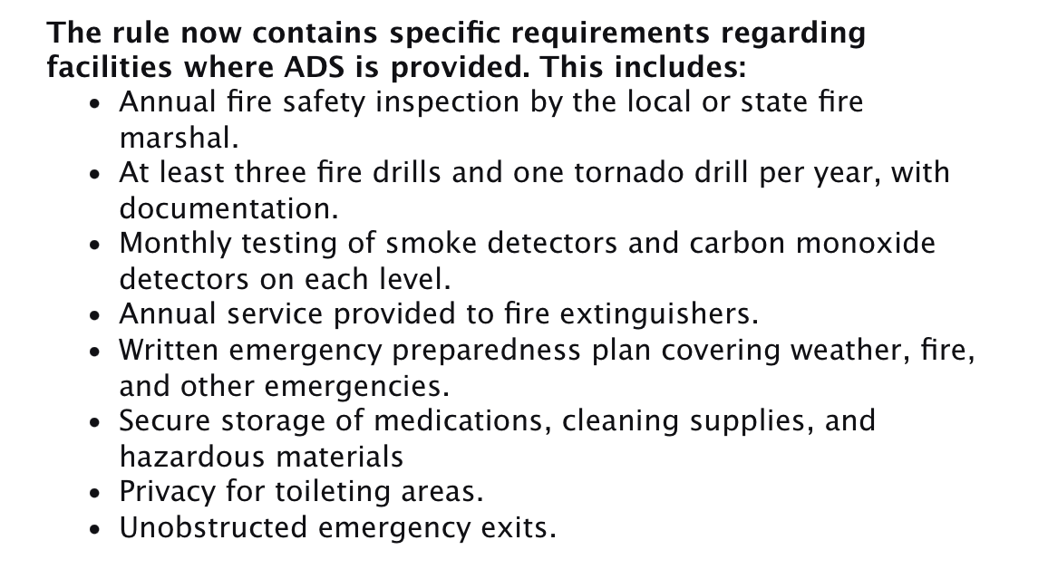

Slide 12

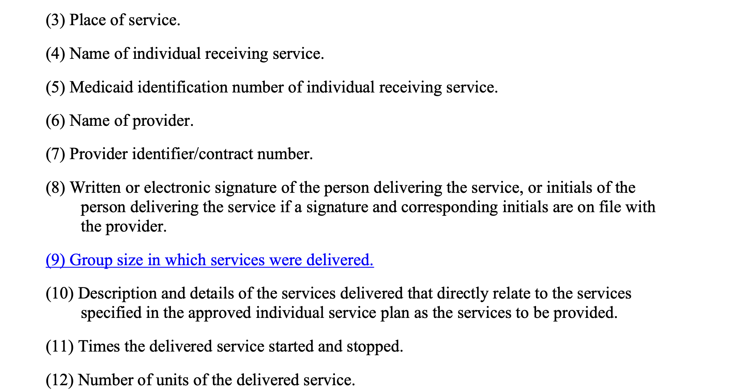

Slide 13
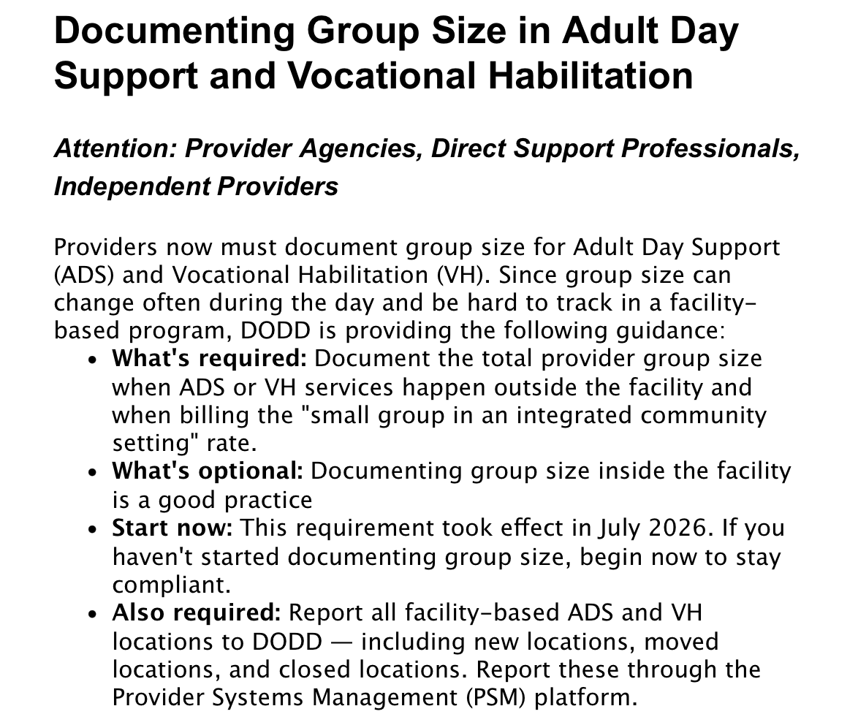

Slide 15
DODD will be providing Doc sheet templates (not required) that demonstrate expectation.
Reminder: There are no required group sizes except when billing the Integrated Community Rate. No group can be larger than 16.
Employees are not listed in group size, only people served.
Memo follow-up clarifies group size required for all services outside of the main facility.

Slide 16
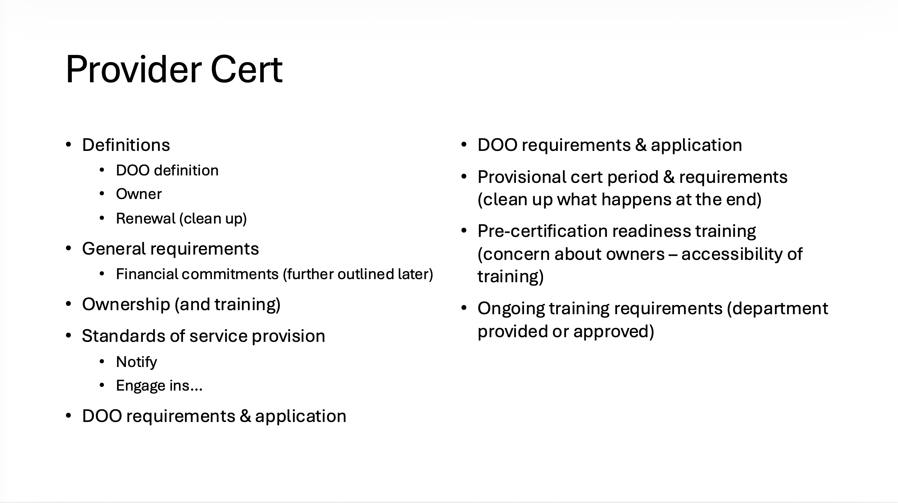

Slide 17


Slide 18
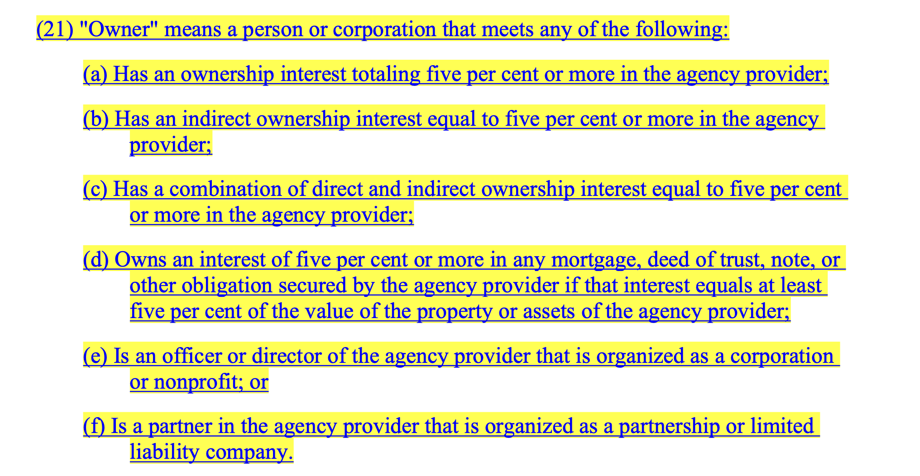

Slide 19


Slide 20
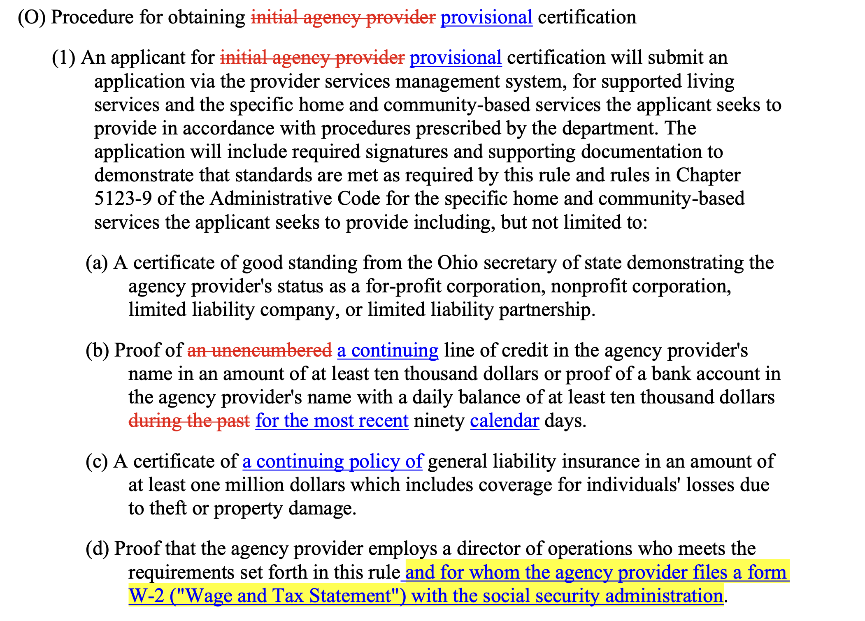

Slide 21

Recertification

Slide 22

New DOO and Owners

Slide 23



