Slide 1
BEST, GES, Career Exploration
Day & Employment Committee July 2025

Slide 2
BEST 5123-9-42
‘Integrated Community’ Definition removed from rule.
Integrated Community Rate also removed/not carried over from Voc Hab
Regular Voc Hab Rate transitions to BEST
Voc Hab will remain in effect for 1 year after BEST to allow for transition

Slide 3
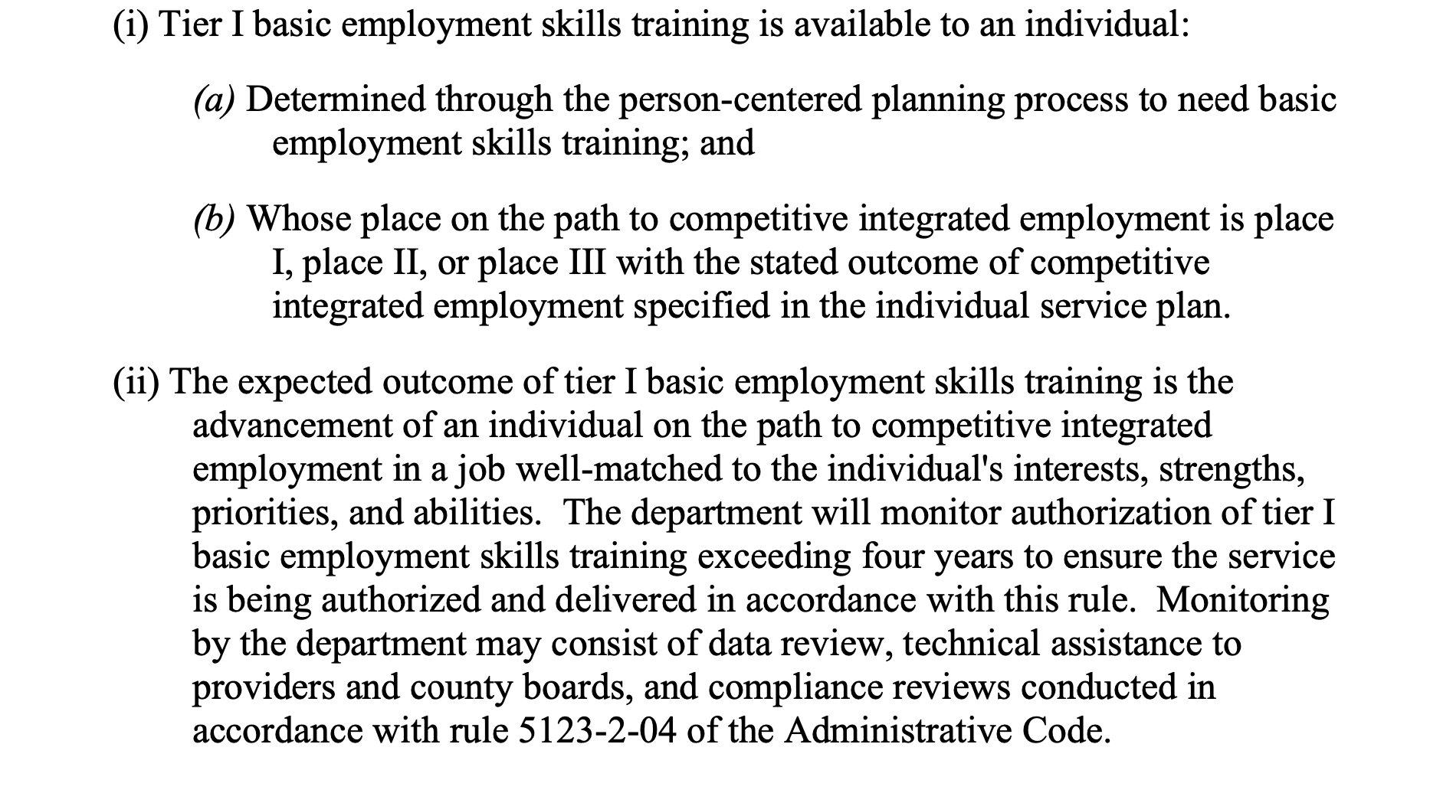

Slide 4
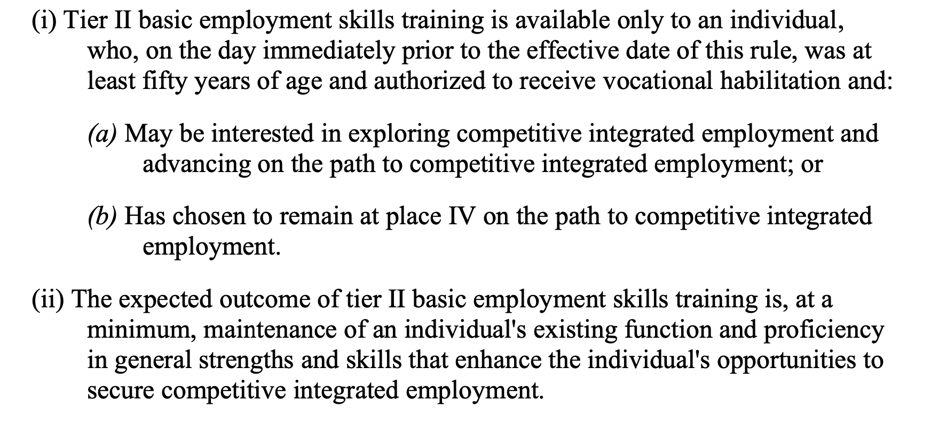

Slide 5
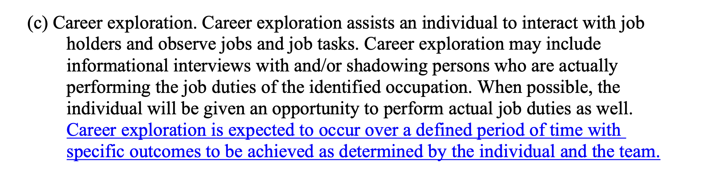
Group Career Exploration- Career Planning 5123-9-13

Slide 6
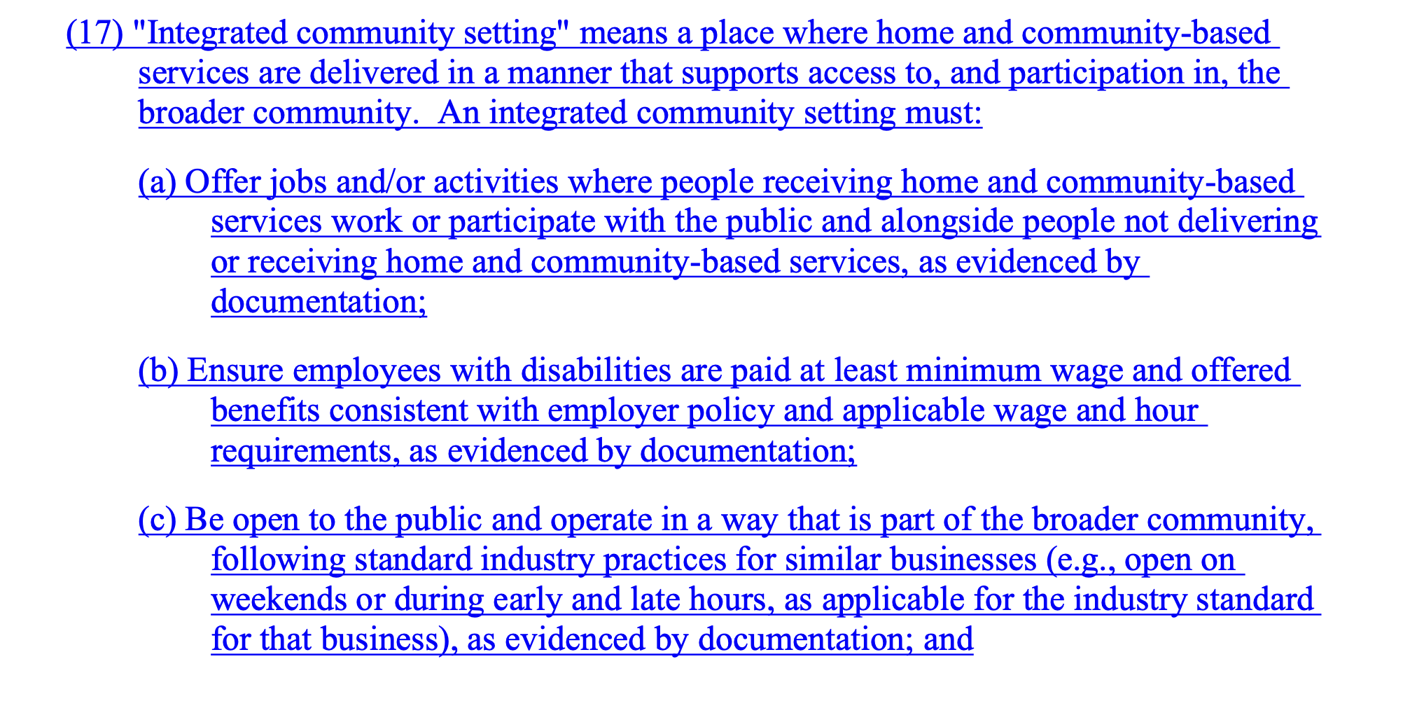
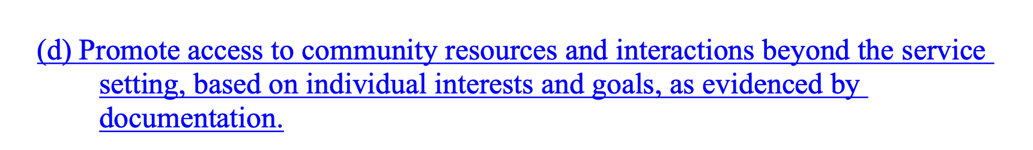

Slide 7
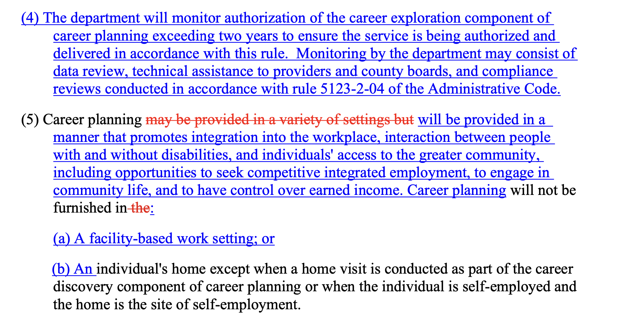

Slide 8
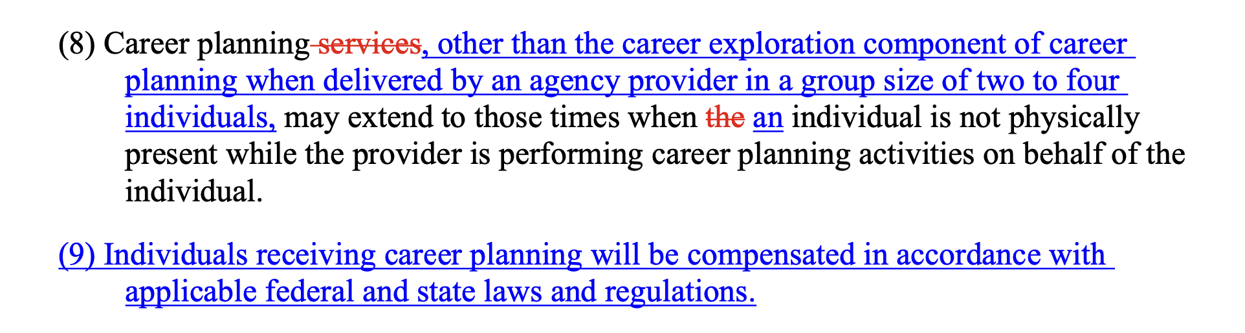

Slide 9
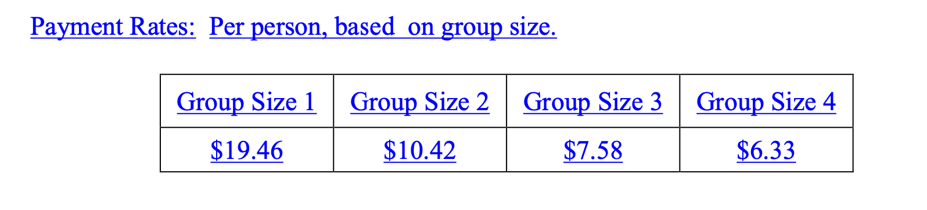
Rates: 15 min UOS

Slide 10
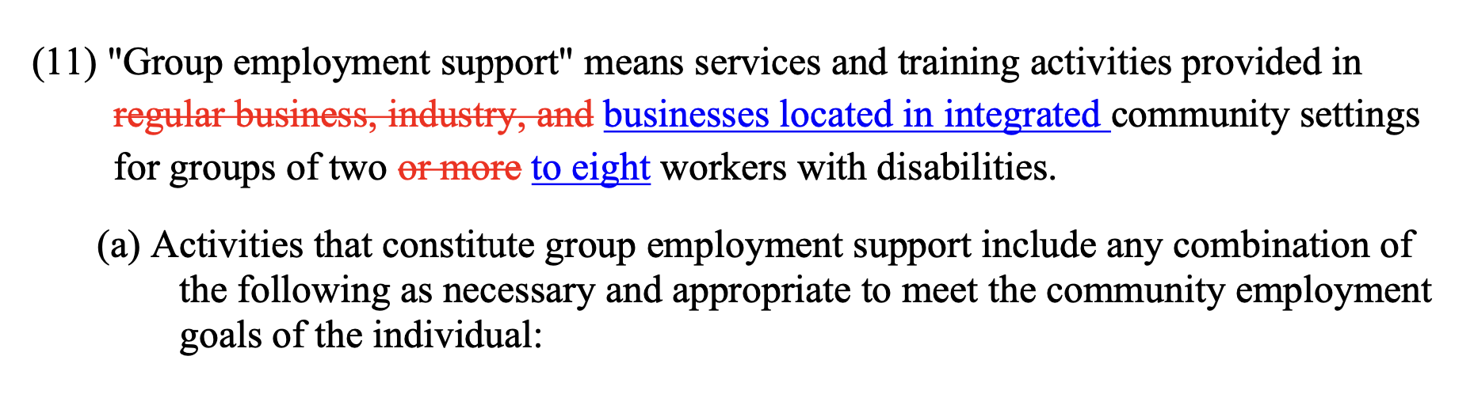
Group Employment Support (GES) - 5123-9-16

Slide 11
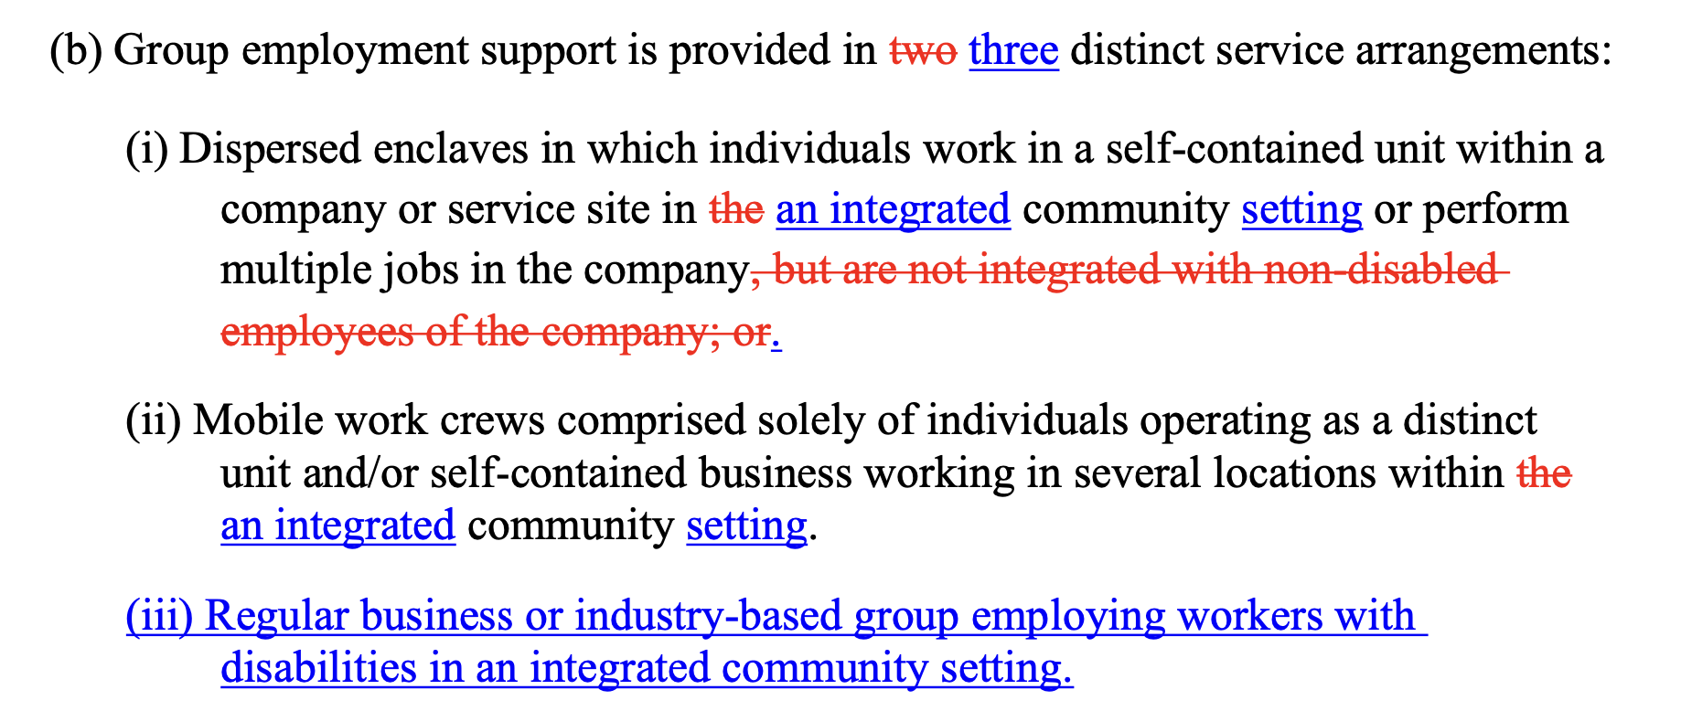

Slide 12
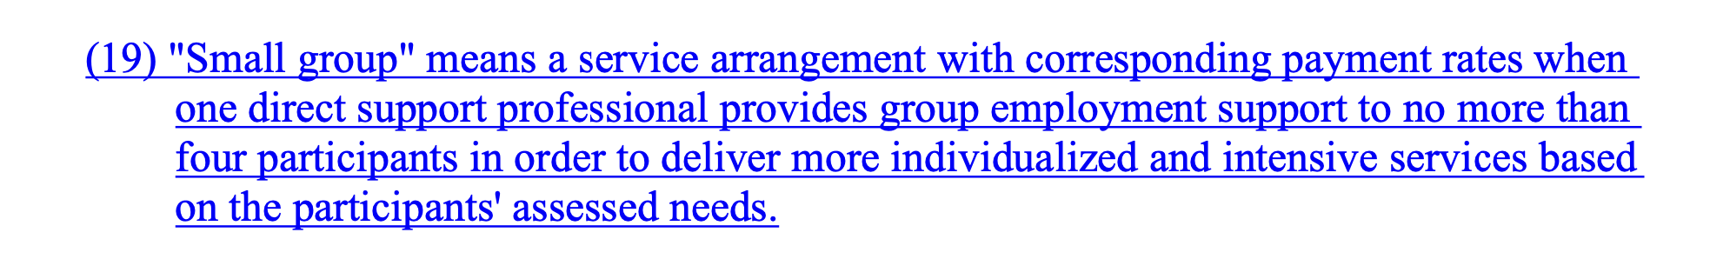

Slide 13
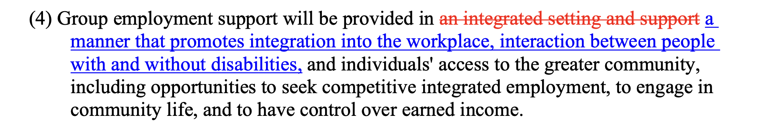
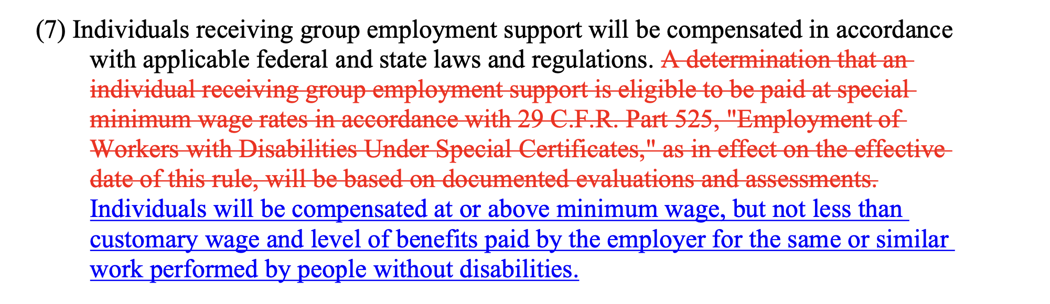

Slide 14
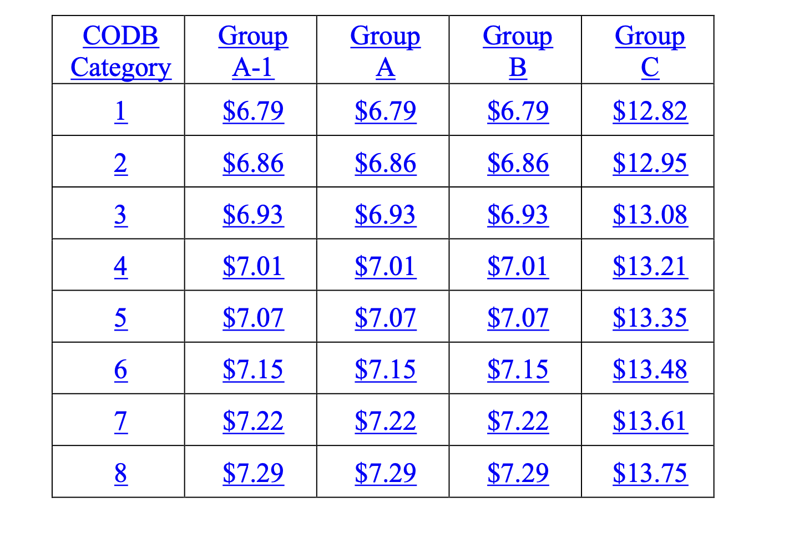
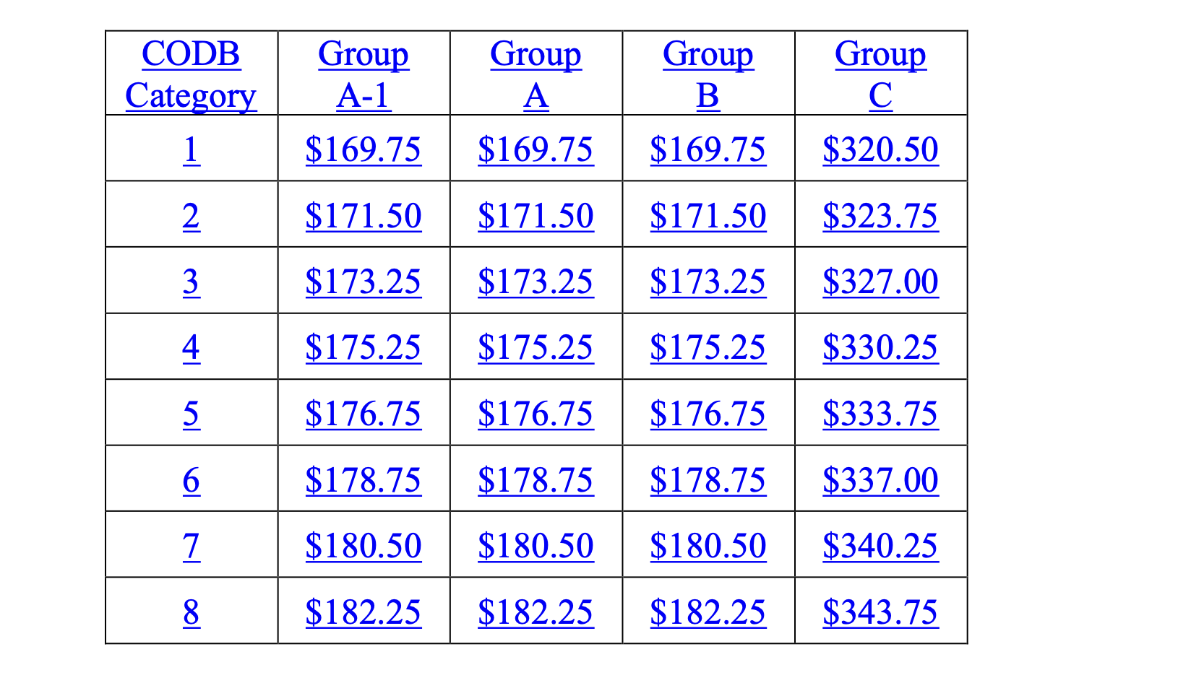
Rate: Small Group

Slide 15
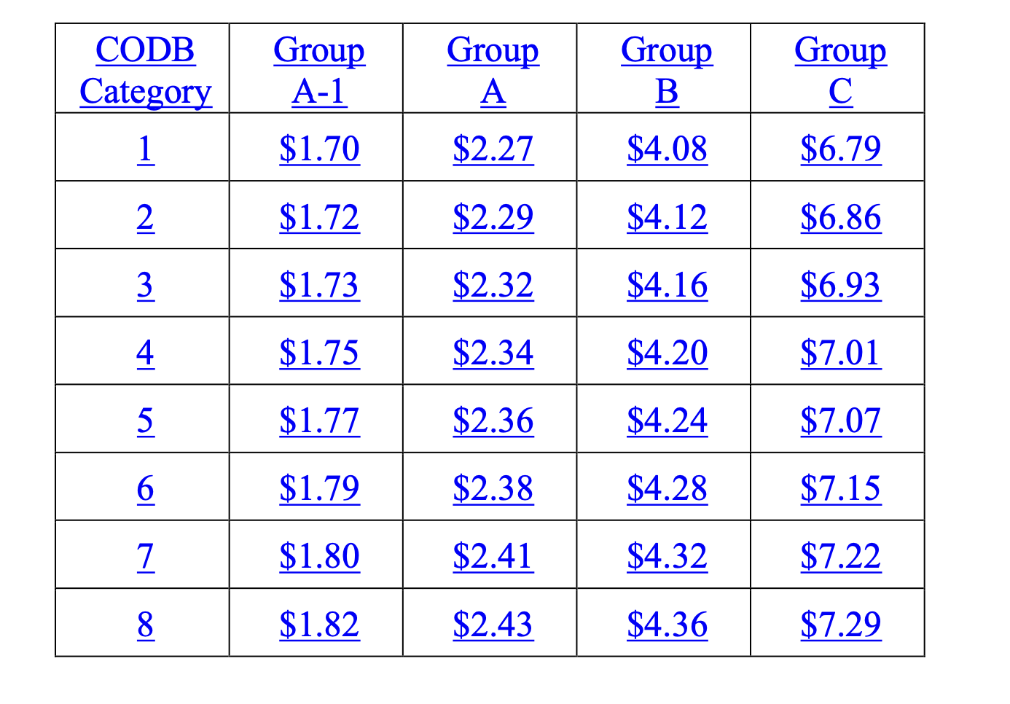
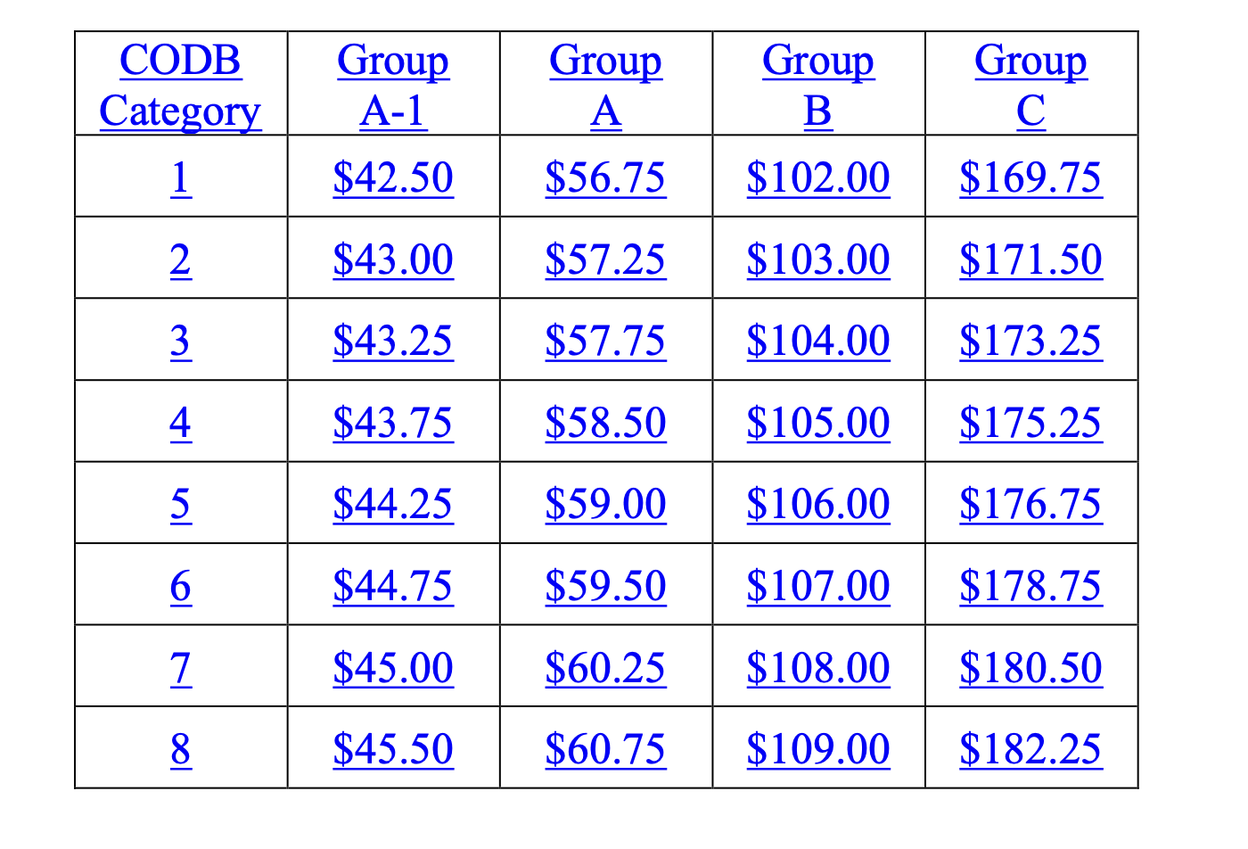
Rates: Not Small Group (5-8)

Slide 16
Are We Okay With This?
What would this mean for Integrated Community Voc Hab???
Those in paid services will likely transition to GES.
Those in unpaid services will have to transition to Integrated Community ADS or the new Group Career Exploration, depending on planning/service needs and outcomes.
Voc Hab will stay in effect for 1 year after BEST to allow for transition to new service at new span year.

Slide 17
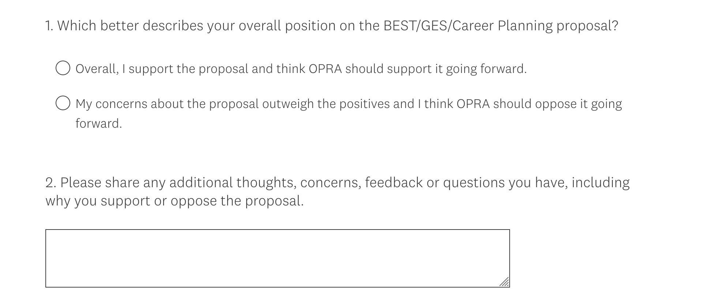
https://www.surveymonkey.com/r/BQ99MH2

